Slide 1
Lecture 03
Digital I/O and Interrupts
CE346 – Microprocessor System Design
Branden Ghena – Spring 2025
Some slides borrowed from:
Josiah Hester (Northwestern), Prabal Dutta (UC Berkeley)

Slide 2
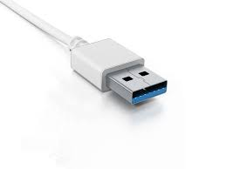
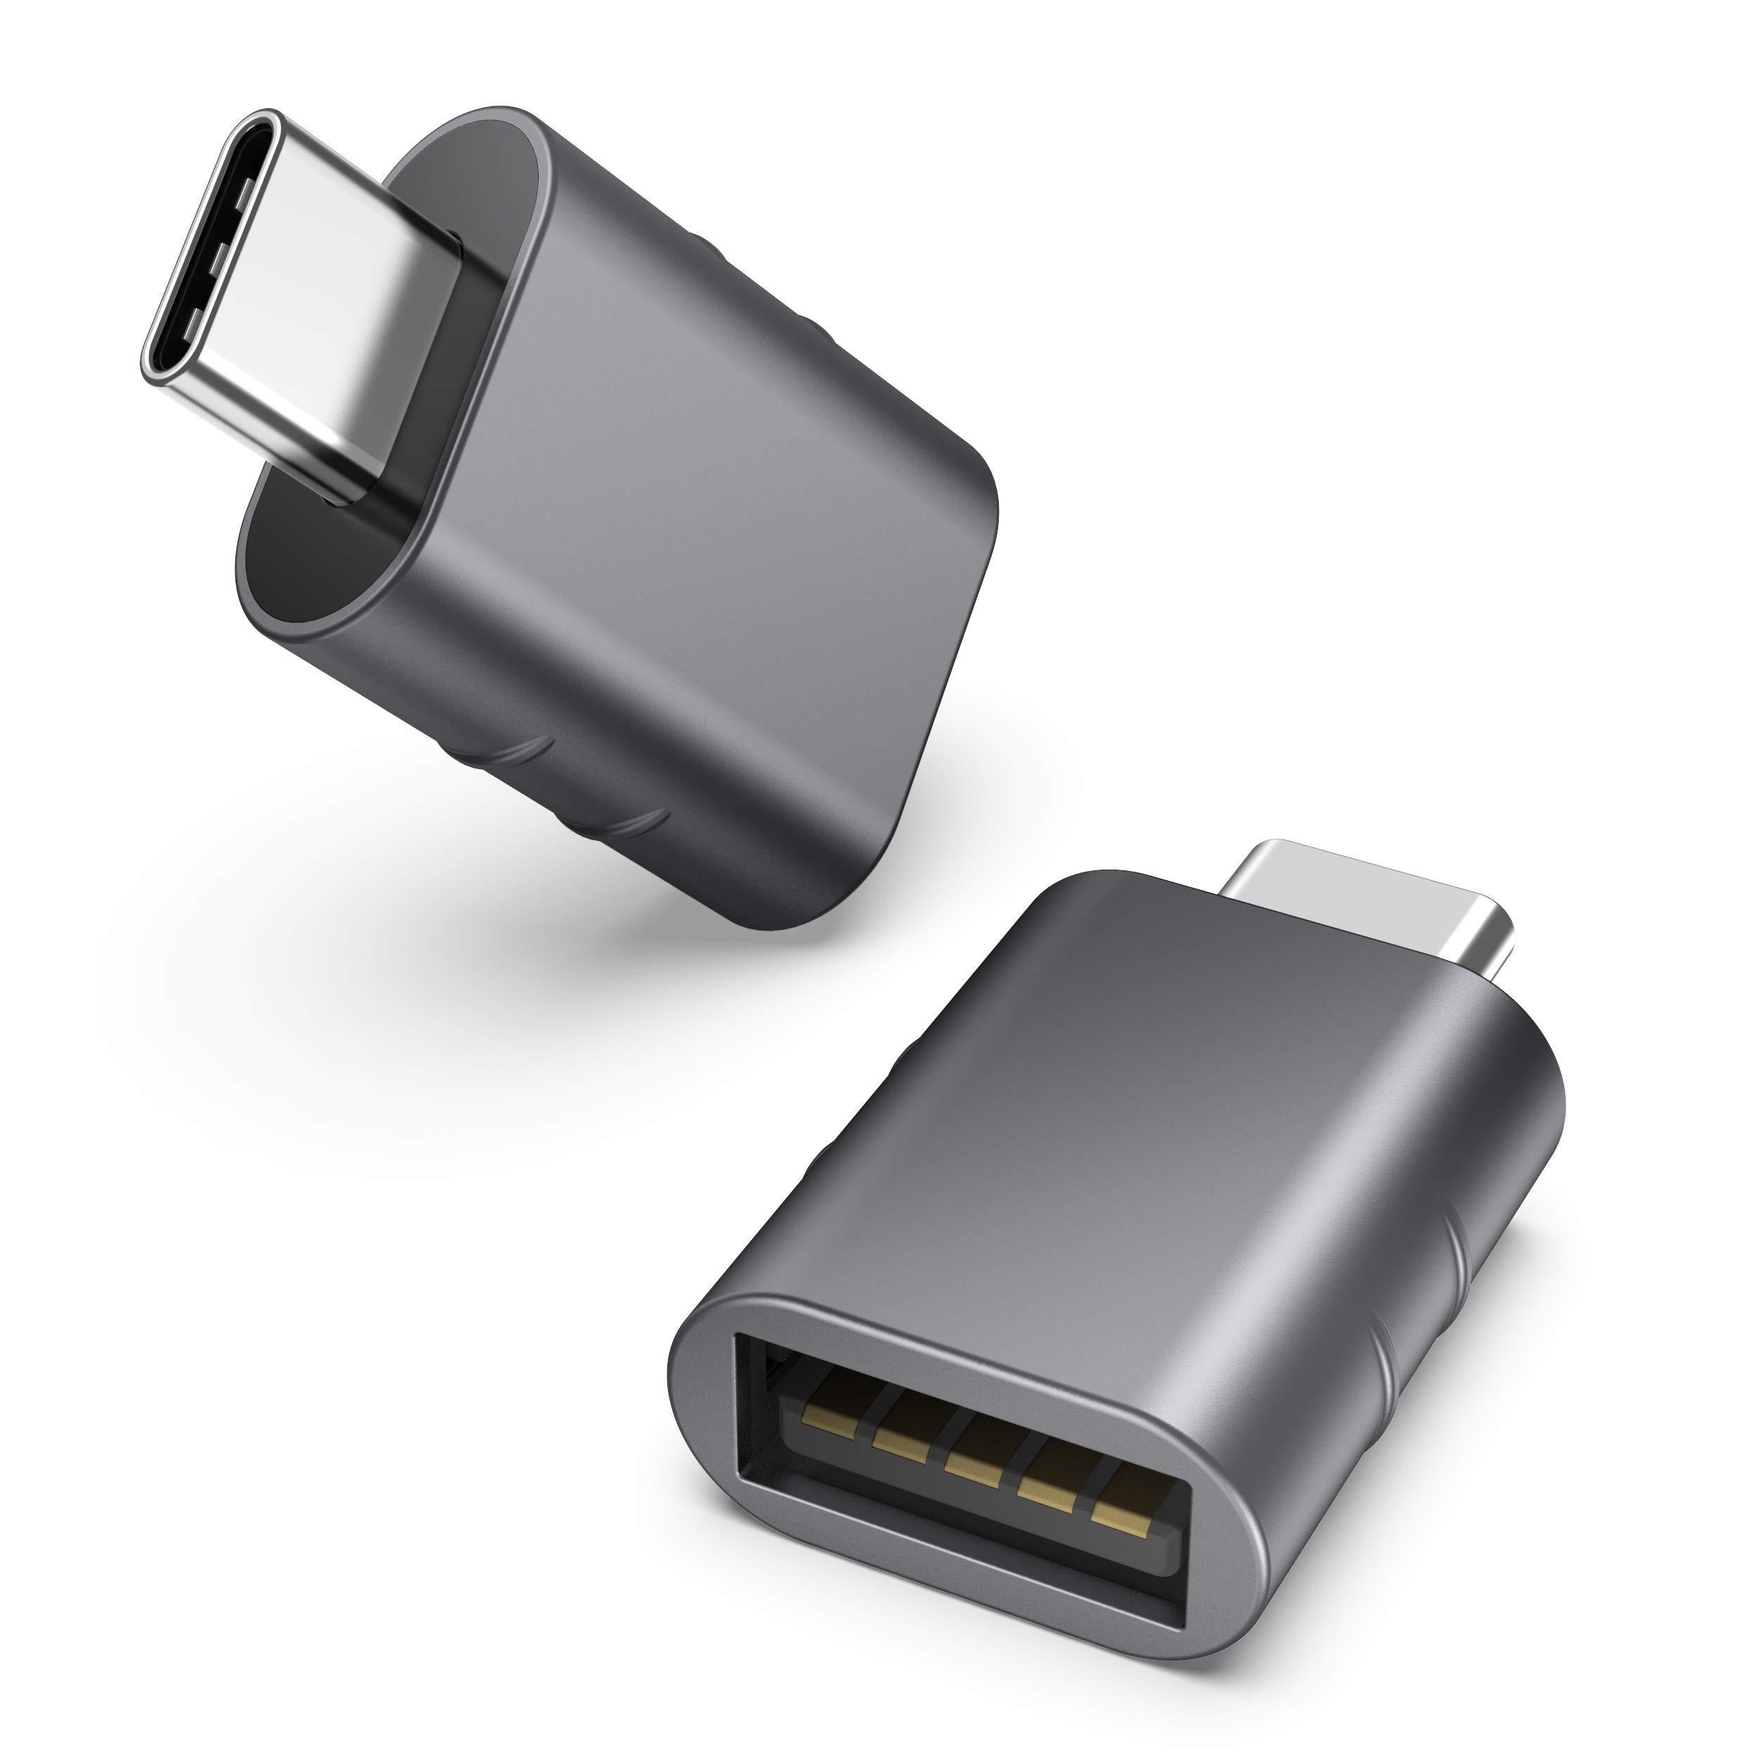
Administrivia
Lab on Friday!
  Frances Searle room 2370
  See you all there!!
  Show up on-time. We are going to get started right away
    None of this 5-10 minutes late nonsense
Bring a USB-C adapter if you need one
Remember that you need to attend the section you registered for in CAESAR
  If you need to switch for a day, ask me for permission in advance on Piazza

Slide 3
Quiz coming soon
First quiz is next week Tuesday! (April 15)
  15-minute quiz, taken in-class on paper
  Last fifteen minutes of class
  Bring a pencil
  No notes, no calculator
Covers material from the last two weeks, including today
Goals:
  The quiz is not meant to be difficult. It’s meant to keep you involved
  Do review class material and make sure you actually understand it

Slide 4
Today’s Goals
Two major parts today:
1. How does a microcontroller interact with peripherals?
  Already discussed Memory-Mapped I/O
  Interrupt and DMA mechanisms today
2. How do we interact with digital inputs and outputs?
  GPIO peripheral for Digital I/O
  GPIOTE peripheral for interrupts

Slide 5
Outline
I/O Motivation
Pins
Controlling digital signals: GIPO peripheral
Interrupts
Digital Input Interrupts: GPIOTE peripheral
DMA (Direct Memory Access)

Slide 6
Devices are the point of computers
Traditional systems need to
receive input from users and
output responses
  Keyboard/mouse
  Disk
  Network
  Graphics
  Audio
  Various USB devices
Embedded systems have the same requirement, just more types of IO
Computer
Processor
Memory
Devices
Control
Input
Datapath
Output

Slide 7
Devices are core to useful general-purpose computing
Input
Output
Mouse
Monitor
Computer
Keyboard
Headphones
Ethernet
Ethernet
Bluetooth
Bluetooth

Slide 8
Devices are essential to cyber-physical systems too
Input
Output
Lidar
Throttle Control
Computer
Inertial Measurement Unit
Brake Control
Camera
Wheel Rotation
CAN
CAN

Slide 9
Device access rates vary by many orders of magnitude
Rates in bit/sec
System must be able to handle each of these
  Sometimes needs low overhead
  Sometimes needs to not wait around
Device | Behavior | Partner | Data Rate (Kb/s)
Keyboard | Input | Human | 0.2
Mouse | Input | Human | 0.4
Microphone | Output | Human | 700.0
Bluetooth | Input or Output | Machine | 20,000.0
Hard disk drive | Storage | Machine | 100,000.0
Wireless network | Input or Output | Machine | 300,000.0
Solid state drive | Storage | Machine | 500,000.0
Wired LAN network | Input or Output | Machine | 1,000,000.0
Graphics display | Output | Human | 3,000,000.0

Slide 10
Outline
I/O Motivation
Pins
Controlling digital signals: GIPO peripheral
Interrupts
Digital Input Interrupts: GPIOTE peripheral
DMA (Direct Memory Access)

Slide 11
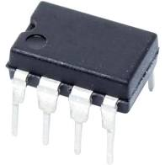
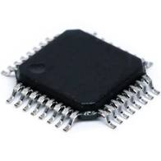
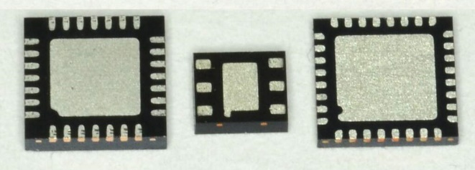
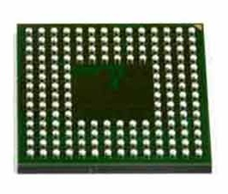
Pins
Peripherals need to electrically connect to outside world
  Attach to pins on the exterior of the chip
More pins allow for more connections
  At increased cost and size
Under-chip pins can add more pins for cheaper
  But make soldering and debugging difficult

Slide 12
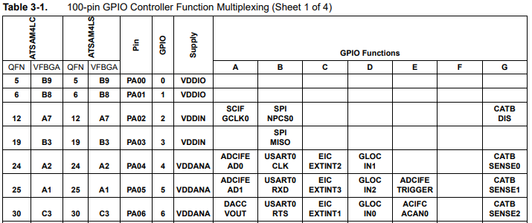
Internal connections to pins
Peripherals need to connect to external pins
  Can any peripheral connect to any pin, or are there limited mappings?
  Modern microcontrollers allow any-to-any connections
Older MCUs
had mapping
tables and
pin selection
was more
challenging

Slide 13
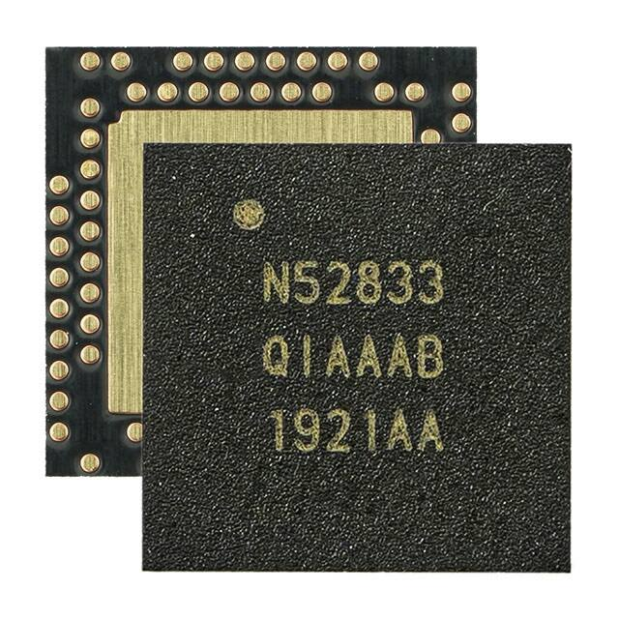
Pins on the nRF52833
Pins
73 individual pins
  Plus a big ground pad
Some are used for special purposes
  Power (16)
  External Oscillator (2)
  Debugging (2)
  RF Antenna (1)
  USB (2)
  Not connected at all (8)
Remaining 42 pins can be used as General Purpose I/O (GPIO)
  Digital I/O
  Or connected to other peripherals

Slide 14
Accessing nRF52833 pins in software
Pins are collected into “Ports”
  Each Port has 32 pins
42 total GPIO pins
  Port 0 – pins 0-31
  Port 1 – pins 0-9
Referred to as P[port].[pin]
  For example: P0.20, P1.08, P0.00

Slide 15
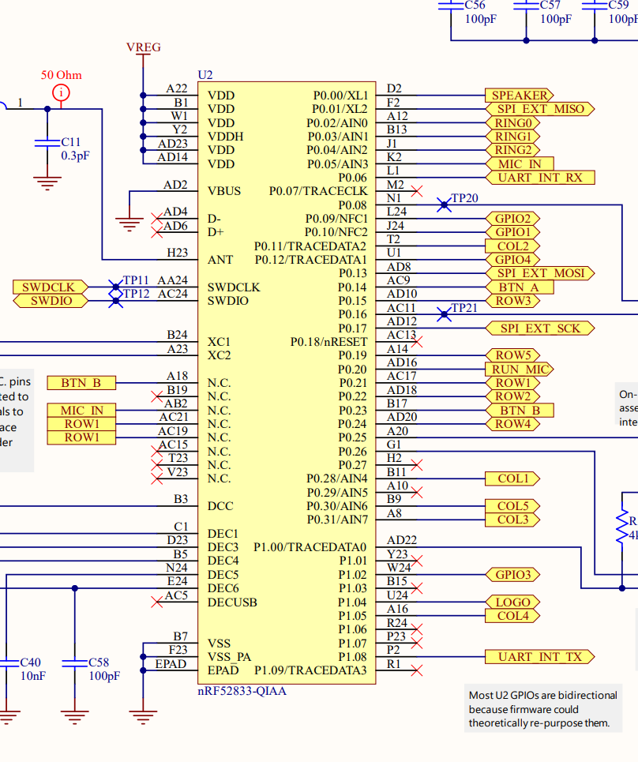
Pins on the Microbit
The Microbit uses the nRF52833, and then connects individual pins from the Microcontroller to certain parts of the board
  Every board does this
  The only way to know this connections is to look at the documentation
For example:
  BTN_A connects to P0.14
  BTN_B connects to P0.23

Slide 16
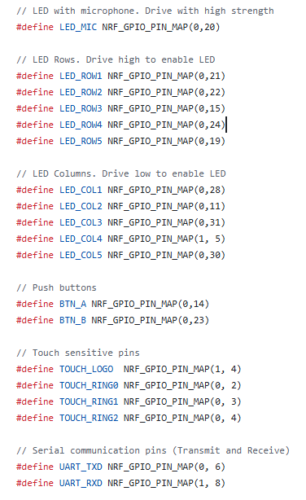
In our software library
Header file gives names to each pin based on how the Microbit uses it
  https://github.com/nu-ce346/nu-microbit-base/blob/main/software/boards/microbit_v2/microbit_v2.h
You can use these names directly in your code where you need the pin number

Slide 17
Outline
I/O Motivation
Pins
Controlling digital signals: GIPO peripheral
Interrupts
Digital Input Interrupts: GPIOTE peripheral
DMA (Direct Memory Access)

Slide 18
Digital signals
Simplest form of I/O
Exist in two states:
  High (a.k.a. Set, a.k.a. 1)
  Low (a.k.a. Clear, a.k.a. 0)
Simpler to interact with
  Constrained to two voltages
  With quick transitions between the two
  No math for voltage level
    Either high or low

Slide 19
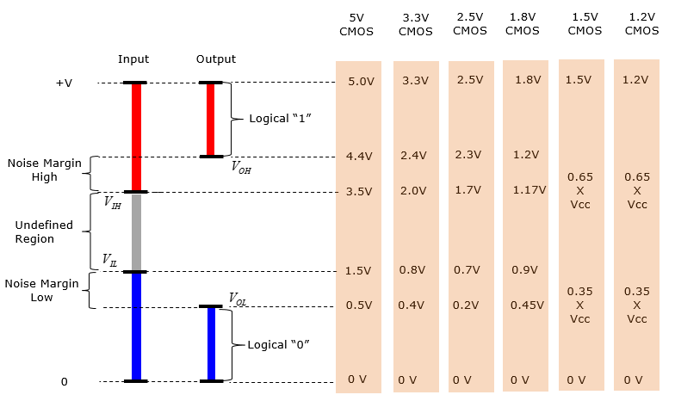
Digital signals map to voltage ranges
Upper range is high signal
  ~0.7*VDD
Bottom range is low signal
  ~0.3*VDD
Middle is undefined
  Only exists during transitions
http://www.sharetechnote.com/html/Electronics_CMOS.html

Slide 20
Digital Input/Output
Read/write from/to external pins on the microcontroller
  Two possible values: high (1) or low (0)
Basic unit of operation for microcontrollers
  Allows them to interact with buttons and LEDs
  Every microcontroller has Digital I/O

Slide 21
Some terminology
Pins can be inputs or outputs
Output pins can be:
  High or Set or 1
  Low or Cleared or 0
Input pins can read an externally connected value
  Which is translated into either High or Low
  Middle remains undefined. It’ll be High or Low though

Slide 22
Controlling Digital I/O
Outputs
  Configure pin as an output
  Set or Clear it
Inputs
  Configure pin as an input
  Read it
That’s about it. Digital I/O peripherals all look something like this
  Every Digital I/O peripheral also has some “special features” of some kind or another, which vary with the Microcontroller

Slide 23
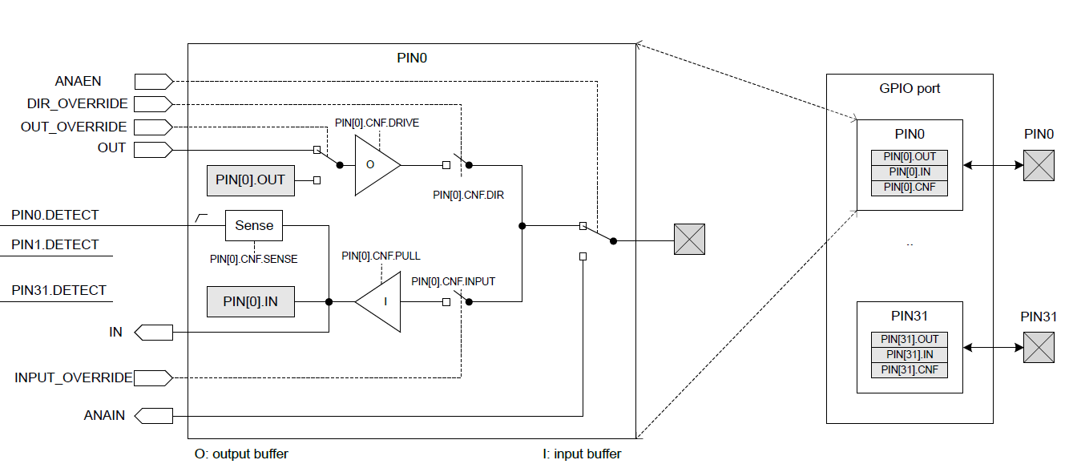
nRF52833 GPIO Peripheral

Slide 24
nRF52 GPIO Output
Outputs a high or low signal
Output configurations
  High drive output (either for high, low, or both)
    Sources or sinks additional current
      For powering external devices
    Normal drive: ~2 mA
    High drive: ~10 mA
  Disconnect (a.k.a. High Impedance or High-Z)
    Wired-OR or Wired-AND scenarios (we’ll talk about these later in class)

Slide 25
nRF52 GPIO Input
Reads in a signal as either high or low
Input Configurations
  Input buffer connect/disconnect
    Allows the pin to be disabled if not being read from
  Pull
    Disabled, Pulldown, Pullup (we’ll discuss in a future lecture)
    Connects an internal pull up/down resistor (~13 kΩ)
    Sets default value of input

Slide 26
Electrical specifications
High voltage range: 0.7*VDD to VDD (~2.3 volts)
Low voltage range: Ground to 0.3*VDD (~1 volt)
GPIO are extremely fast
  Transition time is <25 ns
  Connected directly to memory bus for faster interactions
  This allows complicated signal patterns to be replicated in software
    If they aren’t implemented as a hardware peripheral
    Known as “bit-banging”

Slide 27
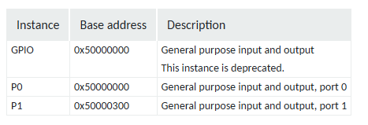
GPIO Instances
The nRF52833 has two GPIO peripheral “instances”
  Several peripherals have multiple instances. For example, multiple timers
  Each instance functions independently
  Each instance has its own copy of MMIO registers
For the GPIO, each instance controls one Port
  Port 0 with 32 pins
  Port 1 with 10 pins

Slide 28
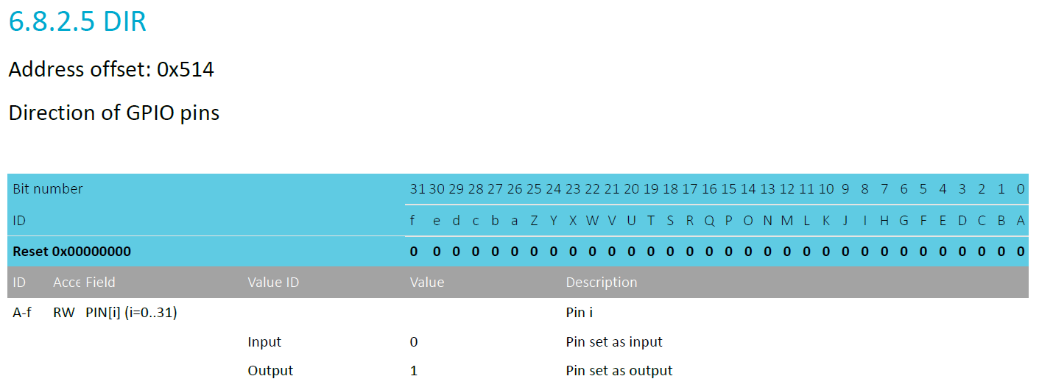
Pin configuration
DIR register controls direction (input or output) for each pin
  Each bit 0-31 corresponds to pin 0-31
  Reset value: 0x00000000 -> all pins are inputs by default

Slide 29
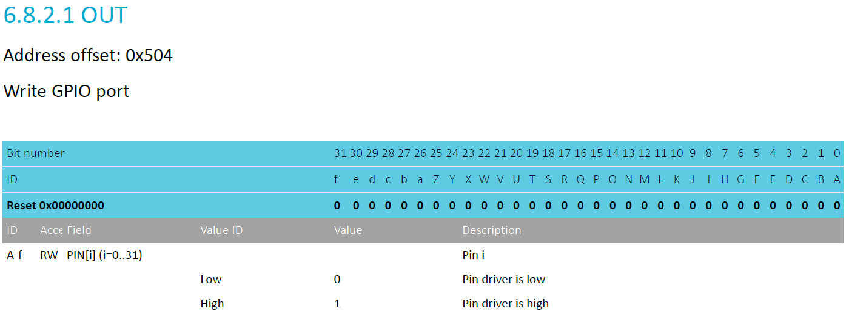
Controlling output level
OUT register controls whether each pin is high or low
  Only meaningful if the pin is configured as an Output
  Again, each bit is a single pin and reset is 0x00000000 (all pins low)

Slide 30
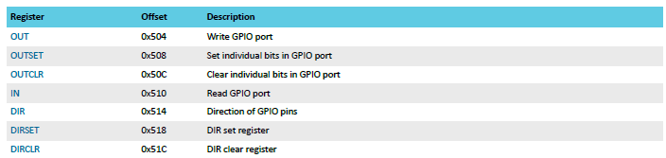
*Set/*Clear registers
OUT works traditionally: write a 1 for high, 0 for low
OUTSET write a 1 to set that pin (high) zero has no effect
OUTCLR write a 1 to clear that pin (low) zero has no effect
  Lets you modify a pin without modifying the others (or reading first)

Slide 31
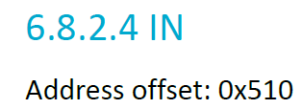
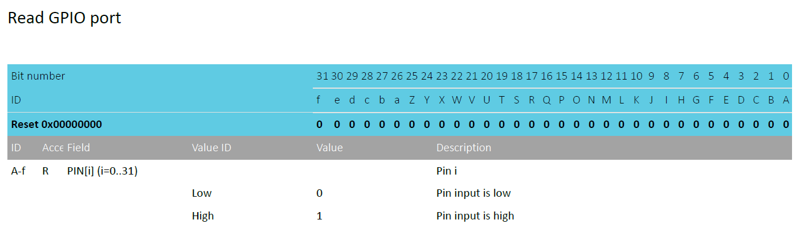
Reading input levels
IN register allows you to read the value for an input pin
  Each bit 0-31 corresponds to pin 0-31
  Read-only register. Writing has no effect
  For Port1, pins >= 10 are undefined (data sheet doesn’t mention it)

Slide 32
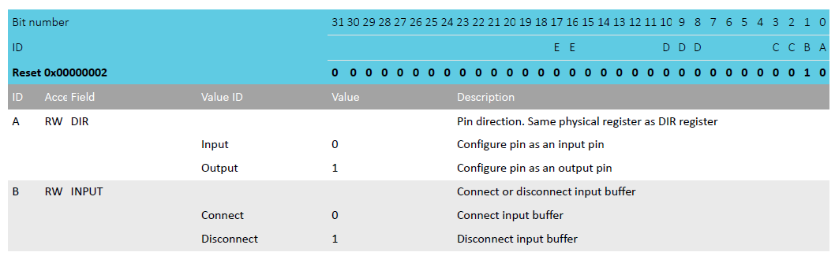
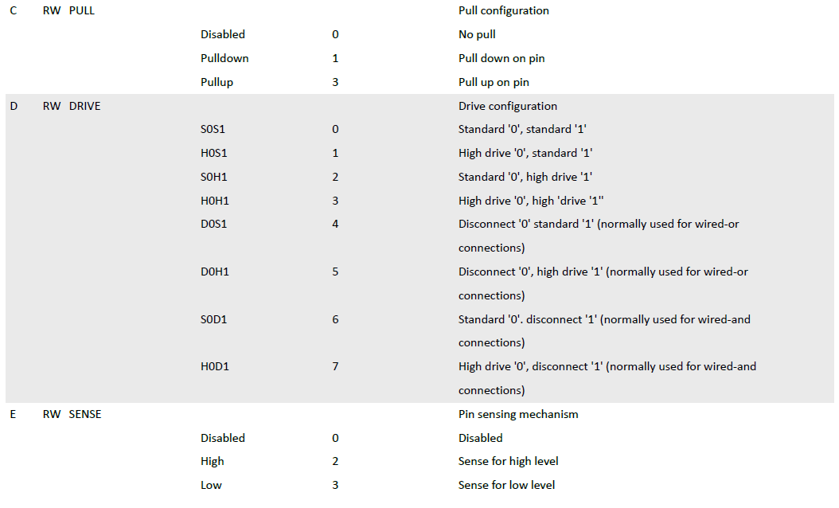
Complex configuration
If you want to change other pin configurations, you do so per pin with the PIN_CNF[n] registers
  There are 32 of them, one per pin
Various fields correspond to different groups of bits
  Direction, Input buffer, Pullup/down, Drive strength, Sensing mechanism
Bits not part of a field should be ignored
  Do not modify them

Slide 33
Break + Question
Reset value is 0x2
What are the default configurations here?

Slide 34
Break + Question
Reset value is 0x2
What are the default configurations here?
  DIR: Input
  INPUT: Disconnected
  PULL: Disabled
  DRIVE: Standard 0/1
  SENSE: Disabled

Slide 35
Outline
I/O Motivation
Pins
Controlling digital signals: GIPO peripheral
Interrupts
Digital Input Interrupts: GPIOTE peripheral
DMA (Direct Memory Access)

Slide 36
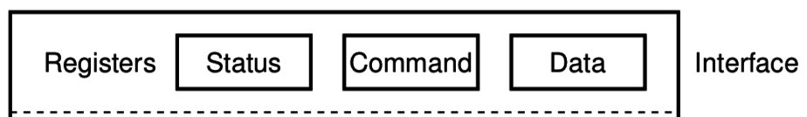
What do interactions with devices look like?
    while STATUS==BUSY; Wait
      (Need to make sure device is ready for a command)
    Write value(s) to DATA
    Write command(s) to COMMAND
    while STATUS==BUSY; Wait
      (Need to make sure device has completed the request)
    Read value(s) from Data
This is the “polling” model of I/O.
“Poll” the peripheral in software repeatedly to see if it’s ready yet.

Slide 37
Waiting can be a waste of CPU time
    while STATUS==BUSY; Wait
      (Need to make sure device is ready for a command)
    Write value(s) to DATA
    Write command(s) to COMMAND
    while STATUS==BUSY; Wait
      (Need to make sure device has completed the request)
    Read value(s) from Data
Problem: imagine a keyboard device
  CPU could be waiting for minutes before data arrives
  Need a way to notify CPU when an event occurs
    Interrupts!

Slide 38
Interrupts
What is an interrupt?
  Some event which causes the processor to stop normal execution
  The processor instead jumps to a software “handler” for that event
    Then returns back to what it was doing afterwards
What causes interrupts?
  Hardware exceptions
    Divide by zero, Undefined Instruction, Memory bus error
  Software
    Syscall, Software Interrupt (SWI)
  External hardware
    Input pin, Timer, various “Data Ready”

Slide 39
Interrupts, visually
Some code
that’s executing

Slide 40
Interrupts, visually
Some code
that’s executing
Interrupt triggers!
Interrupt handler
code

Slide 41
Interrupts, visually
Some code
that’s executing
Interrupt triggers!
Interrupt handler
code
Continue
original code

Slide 42
ARM Nested Vectored Interrupt Controller (NVIC)
Handles interrupt entry and exit
Stacking
Unstacking
Priorities
Interrupts can preempt other interrupts!
Jump directly to the interrupt handler
Manages interrupt requests (IRQ)
  Stores all caller-saved registers on the stack
    So the handler code doesn’t overwrite them
  Moves execution to proper handler, a.k.a. Interrupt Service Routine (ISR)
  Restores registers after handler returns and moves execution back

Slide 43
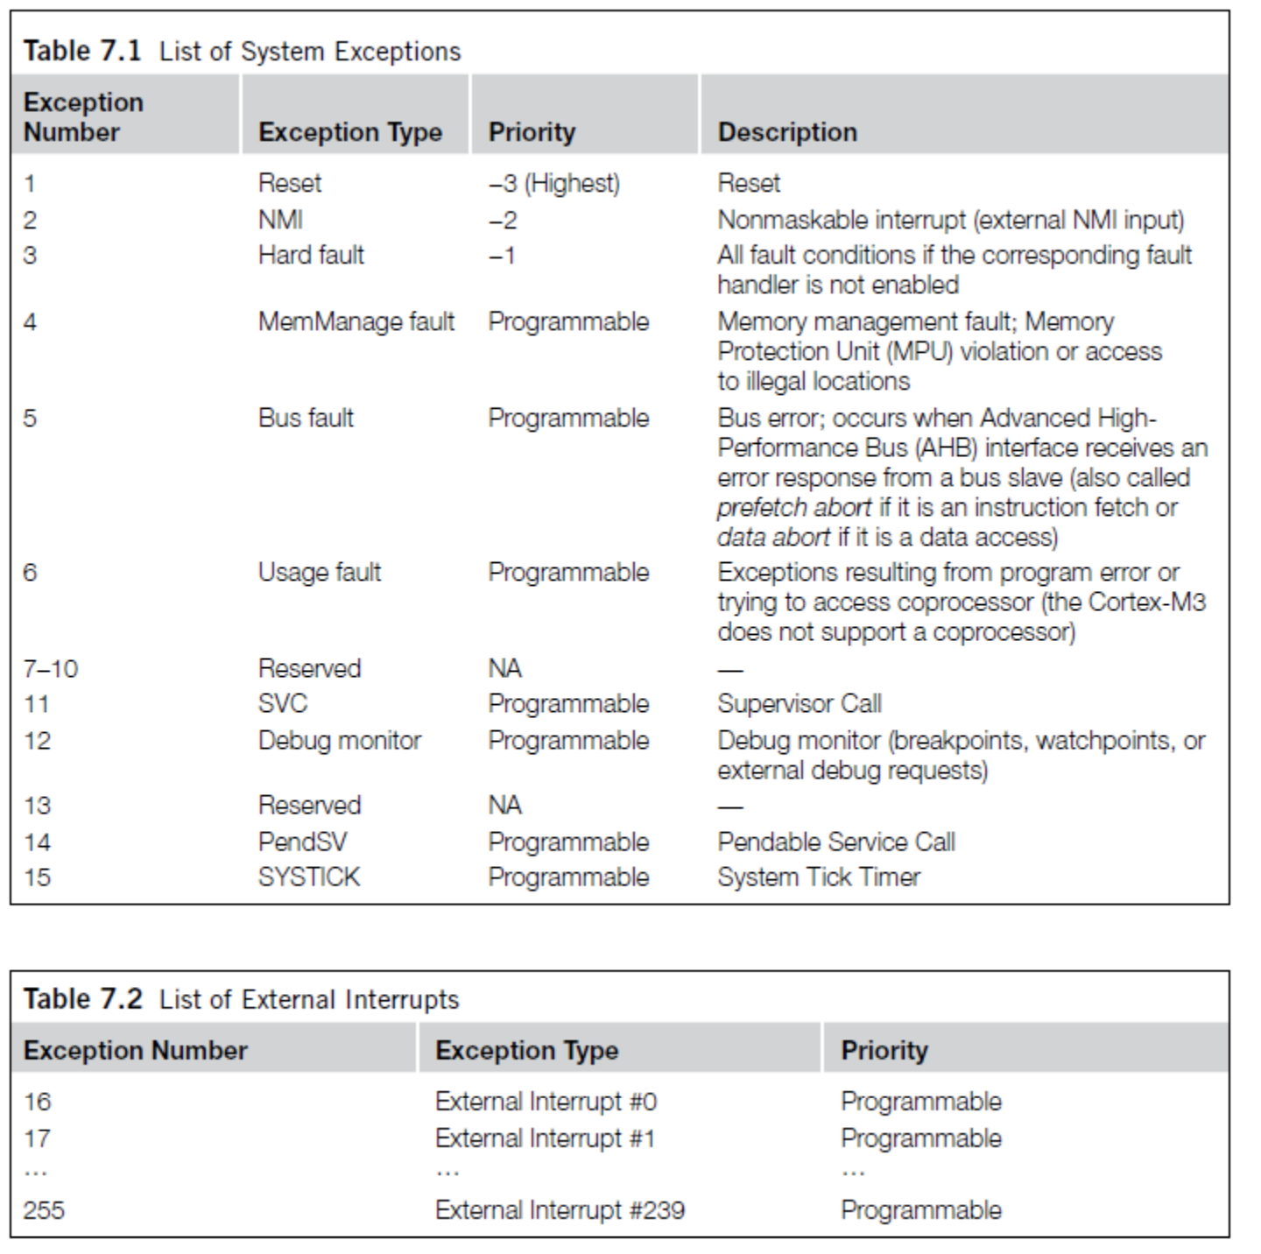
ARM Vector table
List of function pointers to handler for each interrupt/exception
First 15 are architecture-specific exceptions
After that are microcontroller interrupt signals

Slide 44
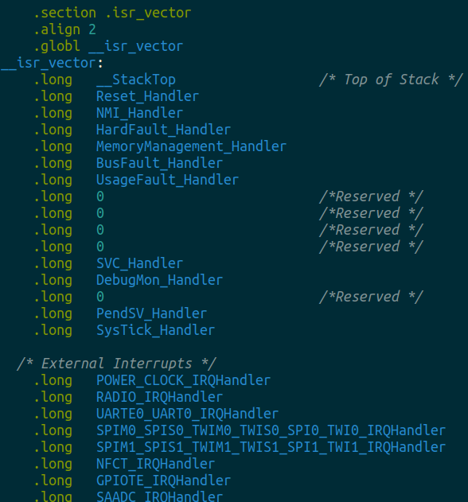
Vector table in software
Placed in its own section
  LD file puts it first in Flash
Reset_Handler determines where software starts executing
After that are all exception and interrupt handlers
  All function pointers to some C code somewhere

Slide 45
Generating interrupts on the nRF52
Peripherals can generate “events”
  1-bit signal that get set when action occurs
  There are Event registers that store the value
Peripherals can enable interrupts
  Which connects the Event to the NVIC
  STILL has to be enabled in the NVIC to actually get an Interrupt
Advanced feature: Events can chain directly into Tasks
  Tasks are 1-bit actions that a peripheral can take
  Something occurring can automatically trigger something else to happen
    PPI is the peripheral that makes these connections
    (this is advanced stuff though, we’ll rarely use it if ever)

Slide 46
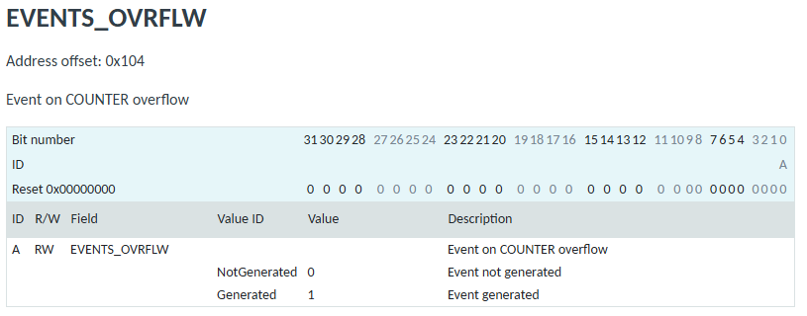
Example “EVENT” register
nRF-specific concept
  Event registers record if some action has occurred
  They are always 1-bit, with a 1 meaning “the action has occurred”
  Up to the software to clear this register back to 0

Slide 47
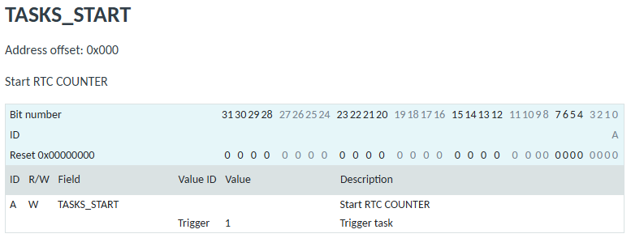
Example “TASK” register
nRF-specific concept
  Task registers start some action
  They are always 1-bit, with a 1 meaning “start the task”

Slide 48
ARM NVIC functionality
NVIC functions
  NVIC_EnableIRQ(number)
  NVIC_DisableIRQ(number)
  NVIC_SetPriority(number, priority)
    Technically 256 priorities
    Only 8 are implemented
Must enable interrupts in two places!
  Enabling event in the peripheral will generate the signal
  Enabling interrupt in the NVIC will cause signal to jump to handler
Priority determines which interrupt goes first
  And determines how interrupts are nested

Slide 49
Nested interrupts, visually
Some code
that’s executing
Interrupt triggers!
Interrupt handler
Higher priority
Interrupt triggers!
Interrupt handler
continues
Continue
original code

Slide 50
Break + Open Question
When should a system use polling versus interrupts?

Slide 51
Break + Open Question
When should a system use polling versus interrupts?
Polling
  Great if the device is going to respond immediately (like 1 cycle)
  Important if we need to respond very quick (less than a microsecond)
Interrupts
  Great if we’ll need to wait a long time for status to change
  Still responds pretty quickly, but not immediately
    Needs to context switch from running code to interrupt handler

Slide 52
Outline
I/O Motivation
Pins
Controlling digital signals: GIPO peripheral
Interrupts
Digital Input Interrupts: GPIOTE peripheral
DMA (Direct Memory Access)

Slide 53
Handling interrupts from GPIO
Separate peripheral, GPIOTE (GPIO Task/Event)
  Manages up to 8 individual pins (8 “channels”)
    Can read input pins and trigger Events
    Also has Tasks for setting/clearing outputs pins
Unclear to me why this is a separate peripheral
  Presumably too complicated/expensive to have 42 of them

Slide 54
Configuring individual input interrupts
Pick an available GPIOTE channel (0-7)
Configure it
  Port and Pin number
  Task (output), Event (input), or Disabled
  Polarity for input events
    Low-to-high
    High-to-low
    Toggle (both directions)
Enable interrupts for channel in GPIOTE (and in NVIC!)
Clear event in interrupt handler
  Doesn’t happen automatically!

Slide 55
What if you need more than 8 interrupt sources?
Can trigger interrupts for a “Port event” as well
  Any pin in the Port can trigger the interrupt
  Software checks which pin(s) caused the event to occur
Very low power operation (works with system clocks off)
  Whereas normal GPIOTE operations are not low power

Slide 56
Sensing port events
A Port event is a coordination between GPIO and GPIOTE peripherals
  GPIO can configure pins with a SENSE option
      Disabled
      Trigger on High level
      Trigger on Low level
  GPIOTE port event will occur if one or more pins matches their SENSE configuration
    Software will get an interrupt (if the NVIC is configured)
    Software checks each pin to determine which one caused the event

Slide 57
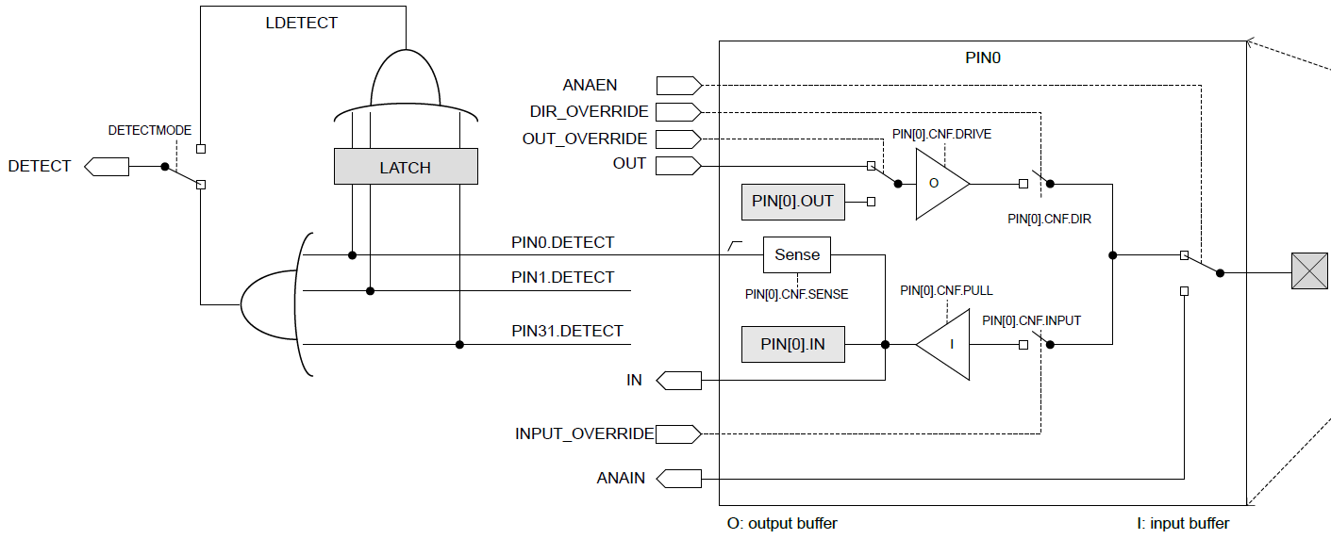
Port events can also be “latched”
Latching saves the value unless cleared

Slide 58
Outline
I/O Motivation
Pins
Controlling digital signals: GIPO peripheral
Interrupts
Digital Input Interrupts: GPIOTE peripheral
DMA (Direct Memory Access)

Slide 59
Direct Memory Access (DMA)
Even with interrupts, providing data to the peripheral is time consuming for transferring lots of data
  Need to be interrupted every byte, to copy the next byte over
DMA is an alternative method that uses hardware to do the memory transfers for the processor
  Software writes address of the data and the size to the peripheral
  Peripheral reads data directly from memory
  Processor can go do other things while read/write is occurring

Slide 60
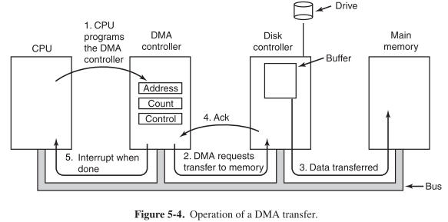
General-purpose DMA

Slide 61
Full peripheral interaction pattern
Configure the peripheral
Enable peripheral interrupts
Set up peripheral DMA transfer
Start peripheral
Continue on to other code
Interrupt occurs, signaling DMA transfer complete
Set up next DMA transfer
Continue on to other code, and repeat

Slide 62
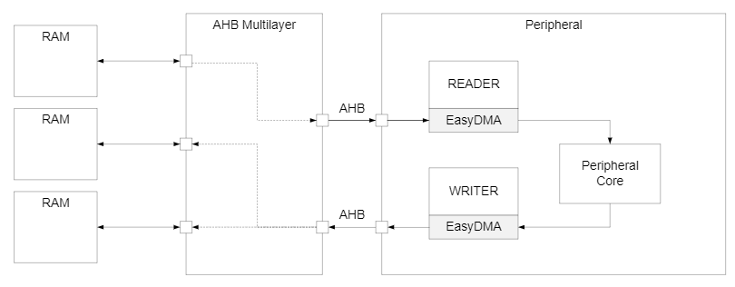
Special-purpose DMA
nRF52 uses “EasyDMA”, which is built into individual peripherals
  Only capable of transferring data in/out of that peripheral
  Easier to set up and use in practice
  Only available on some peripherals though (no DMA for TEMP or GPIO)
Warning: addresses for DMA buffer MUST be in RAM!

Slide 63
What kinds of peripherals/devices should you use the DMA for?
Anything where there is a lot of data coming in over a period of time
  Either a big buffer of lots of data, like a radio message
  Or a bunch of individual samples, coming in quickly
Devices
  Messages to/from other devices (radios, wired busses)
  Sensor readings (if read quickly/continuously)
  Canonical example from general computing: disks (HDD/SSD)

Slide 64
Outline
I/O Motivation
Pins
Controlling digital signals: GIPO peripheral
Interrupts
Digital Input Interrupts: GPIOTE peripheral
DMA (Direct Memory Access)

