Slide 1
Lecture 01
Introduction
CE346 – Microcontroller System Design
Branden Ghena – Spring 2025
Some slides borrowed from:
Josiah Hester (Northwestern), Prabal Dutta (UC Berkeley)

Slide 2
Welcome to CE346/CS346!
Focus on hardware/software systems and their design
  Hardware/Software co-design
    How do you write software that interacts with hardware?
    How do you choose hardware to support software needs?
  Sensors and Sensing
    What can sensors do and how do they work?
    How do you write applications that sense the world?

Slide 3
Asking questions, four ways
You can always ask questions during lecture!
  I’ll let you know if I need to move on for now and answer you after class
We’ll take breaks during lecture
  I’ll pause after each break to see if any questions came up
I will hang out after class for questions
  Plenty of time to answer everyone
You can always ask questions on Piazza too
  The class message board app

Slide 4
Today’s Goals
What are the goals of this course?
Why do I think embedded systems are so important?
How is the course going to operate?
Discuss hardware used for the course and some project ideas.

Slide 5
Outline
Who and Why
Embedded Systems
  Microcontrollers
Course Overview
Class Hardware
Project Ideas

Slide 6
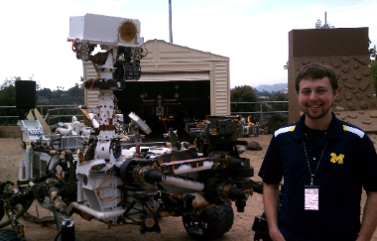
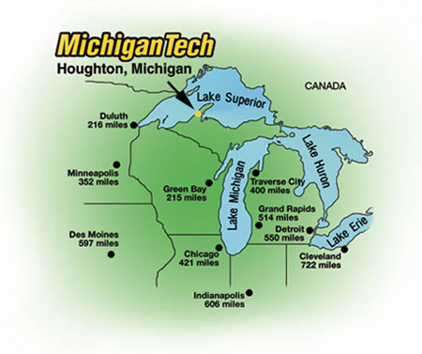
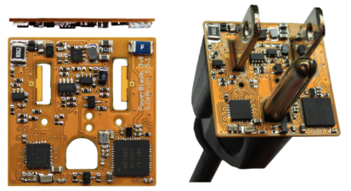

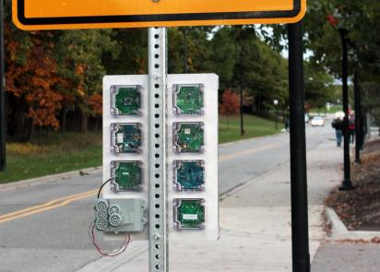




Branden Ghena (he/him)
Assistant Faculty of Instruction
Education
  Undergrad: Michigan Tech
  Master’s: University of Michigan
  PhD: University of California, Berkeley
Research
  Resource-constrained sensing systems
  Low-energy wireless networks
  Embedded operating systems
Teaching
  Computer Systems
    CS211: Fundamentals of Programming II
    CS213: Intro to Computer Systems
    CS343: Operating Systems
    CE346: Microprocessor System Design
    CS433: Wireless Protocols for the IoT
Things I love

Slide 7

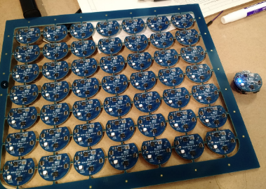
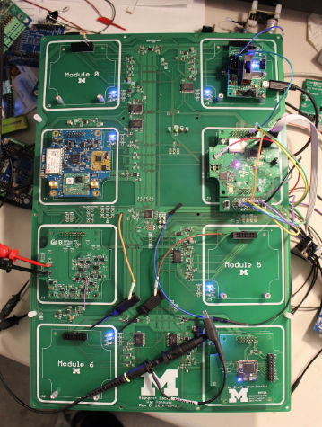
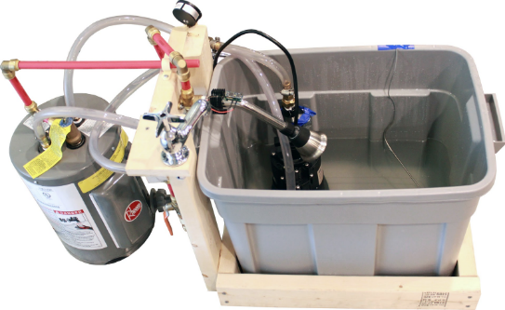
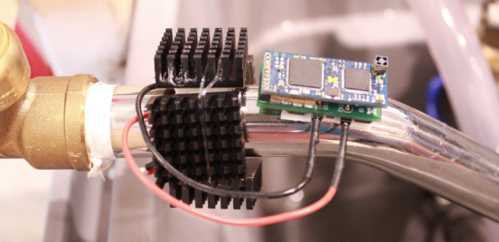
Research area: resource-constrained embedded systems
Most interesting to me: the interfaces
  Hardware and software
  Applications and OS
  Communication

Slide 8
Faculty: now I can choose what to teach!
Goal: provide classes that teach more advanced embedded systems topics
  Hopefully, generally useful to other nearby domains of CS and ECE too!
Result: this course!
  Course goal: introduce students to hardware-software interactions
    Practical hands-on experience with microcontrollers and sensors
    Open-ended project where students can choose their specific focus

Slide 9
Outline
Who and Why
Embedded Systems
  Microcontrollers
Course Overview
Class Hardware
Project Ideas

Slide 10
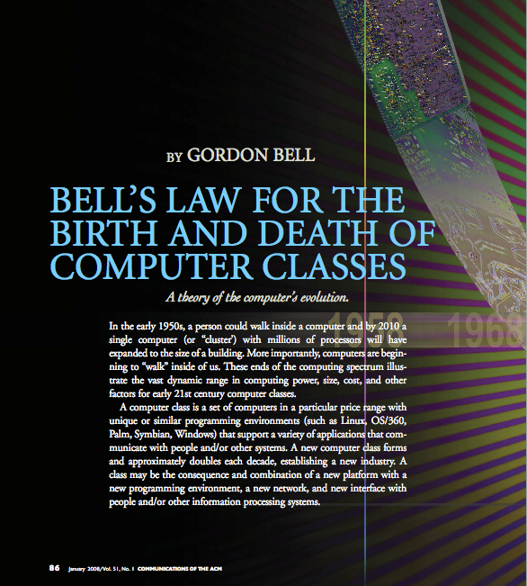
Bell’s Law: A new computer class every decade
“Roughly every decade a new, lower priced computer class forms based on a new programming platform, network, and interface resulting in new usage and the establishment of a new industry.”
- Gordon Bell [1972,2008]

Slide 11
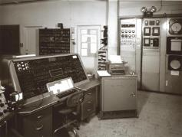
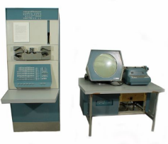
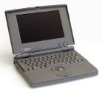
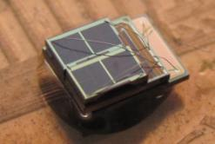

Classes of computation
Mainframe
[Bell et al. Computer, 1972, ACM, 2008]
Workstation
Laptop
Smart Sensors
Mini Computer
Ubiquitous
Personal Computer
Smartphone

Slide 12
Number of computers per person grows over time
Mainframe
1 per Enterprise
[Bell et al. Computer, 1972, ACM, 2008]
Workstation
1 per Engineer
Laptop
1 per Professional
log (people per computer)
Smart Sensors
Mini Computer
Ubiquitous
1 per Company
Personal Computer
100 – 1000’s per person
1 per Family
1 per person
Smartphone

Slide 13
Computer volume shrinks by 100x every decade
Mainframe
1 per Enterprise
100x smaller every decade
Workstation
1 per Engineer
[Nakagawa08]
Laptop
1 per Professional
Smart Sensors
Mini Computer
Ubiquitous
1 per Company
Personal Computer
100 – 1000’s per person
1 per Family
1 per person
Smartphone

Slide 14

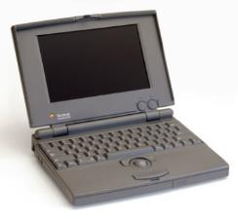


Price falls dramatically, enabling new applications
Mainframe
Workstation
Number Crunching
Data Storage
Laptop
productivity
interactive
Mini Computer
streaming
information
to/from the
physical
world
Smart Sensors
Personal Computer
Smartphone

Slide 15
What is an embedded system?
A computer built into a device
such that the device is interacted with,
not the computer
  E.g., not a desktop or laptop
  (although many of those deal with overlapping hardware/software issues)
Includes many domains
  Robotics
  Industrial processes
  Smart home
  Smart city
  Wearables and health sensing
  Internet of Things

Slide 16
Discussion: identify some embedded systems
What devices that you might not usually consider as computers actually have embedded computers in them?
  Talk with the others around you
  Goal: come up some unique ideas
  We’ll share ideas with the class afterwards

Slide 17
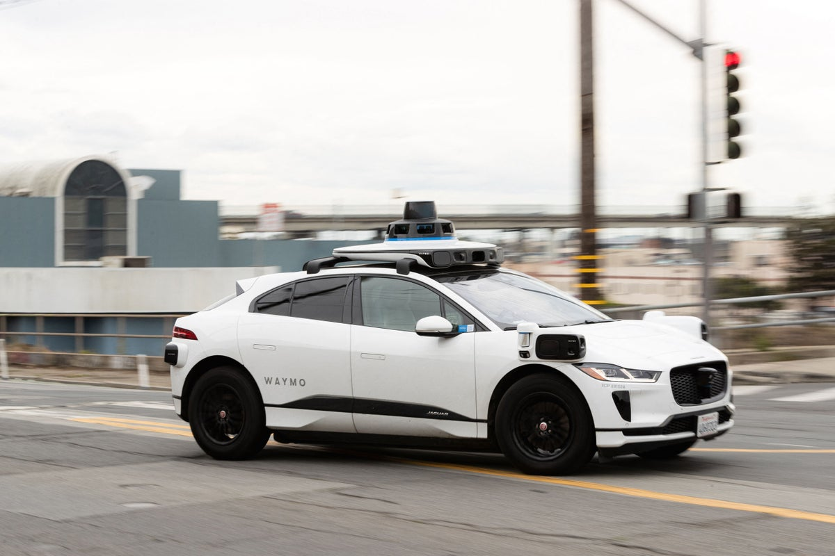
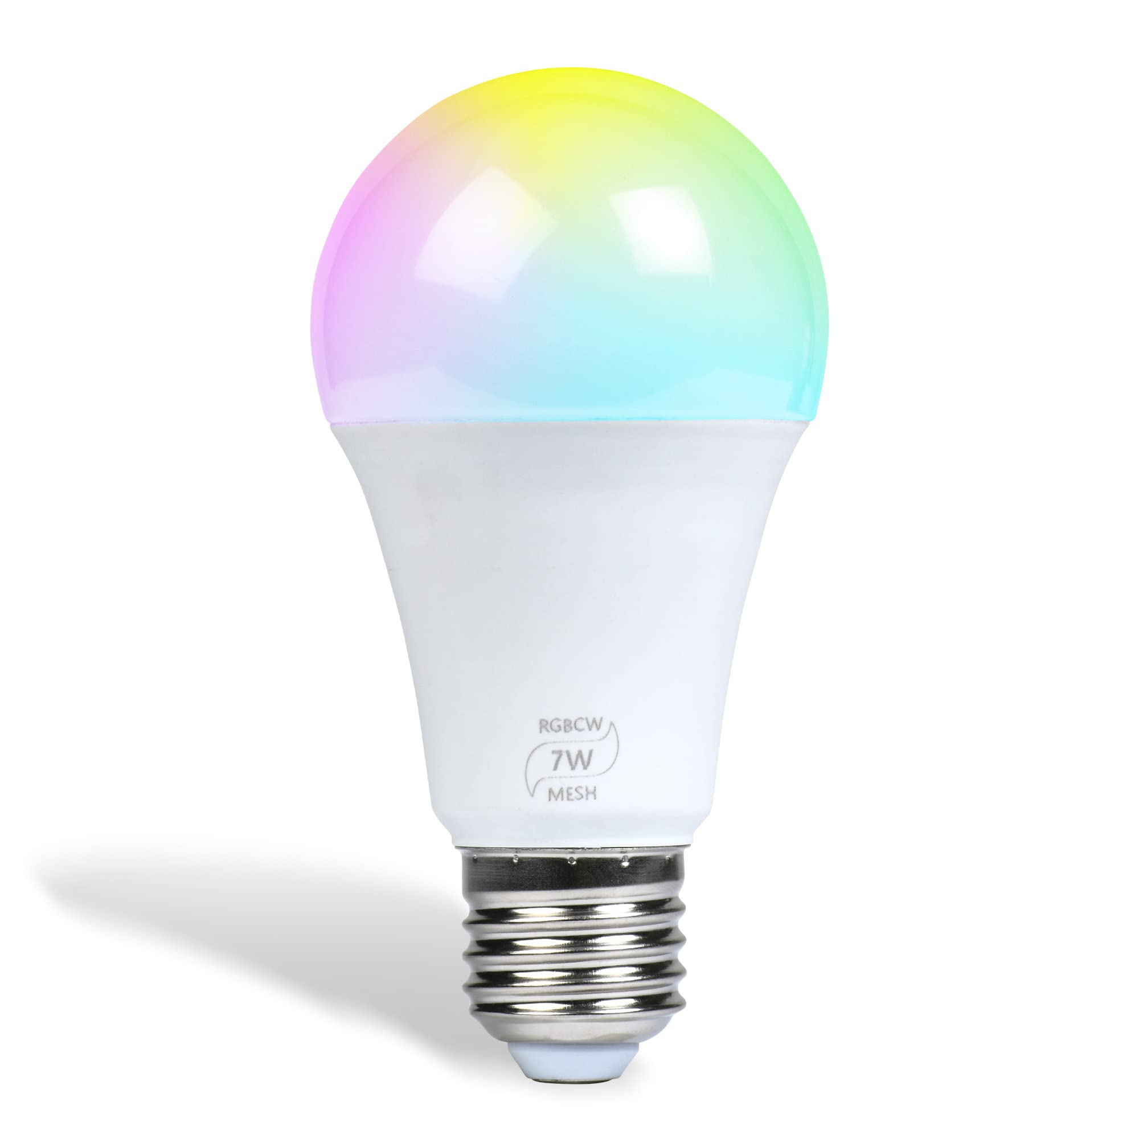
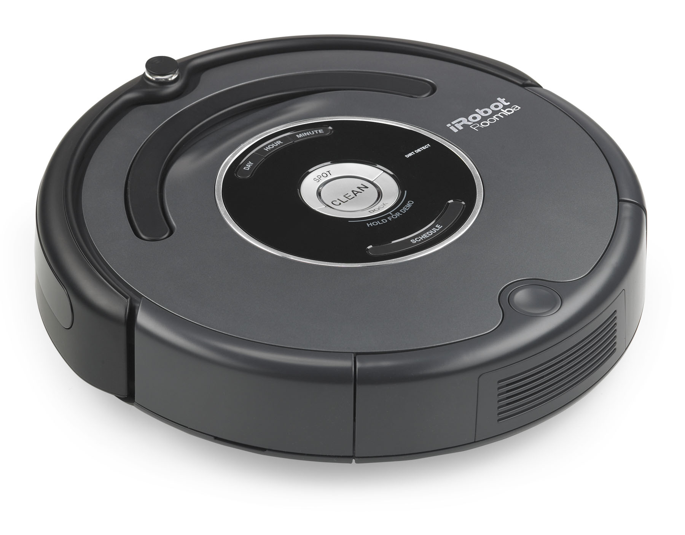
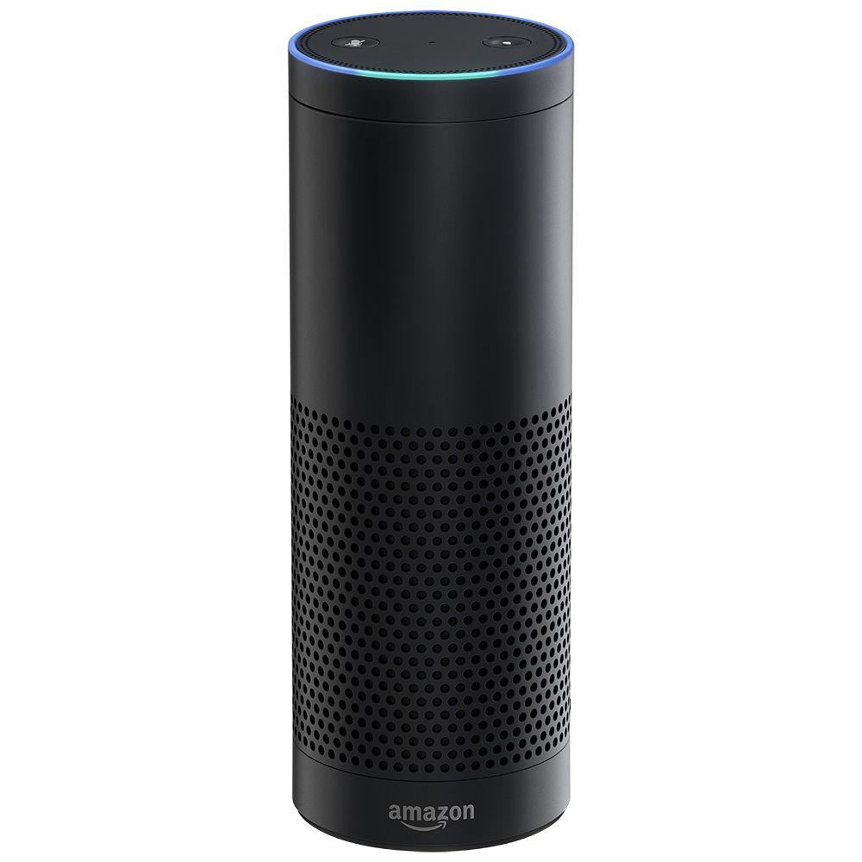
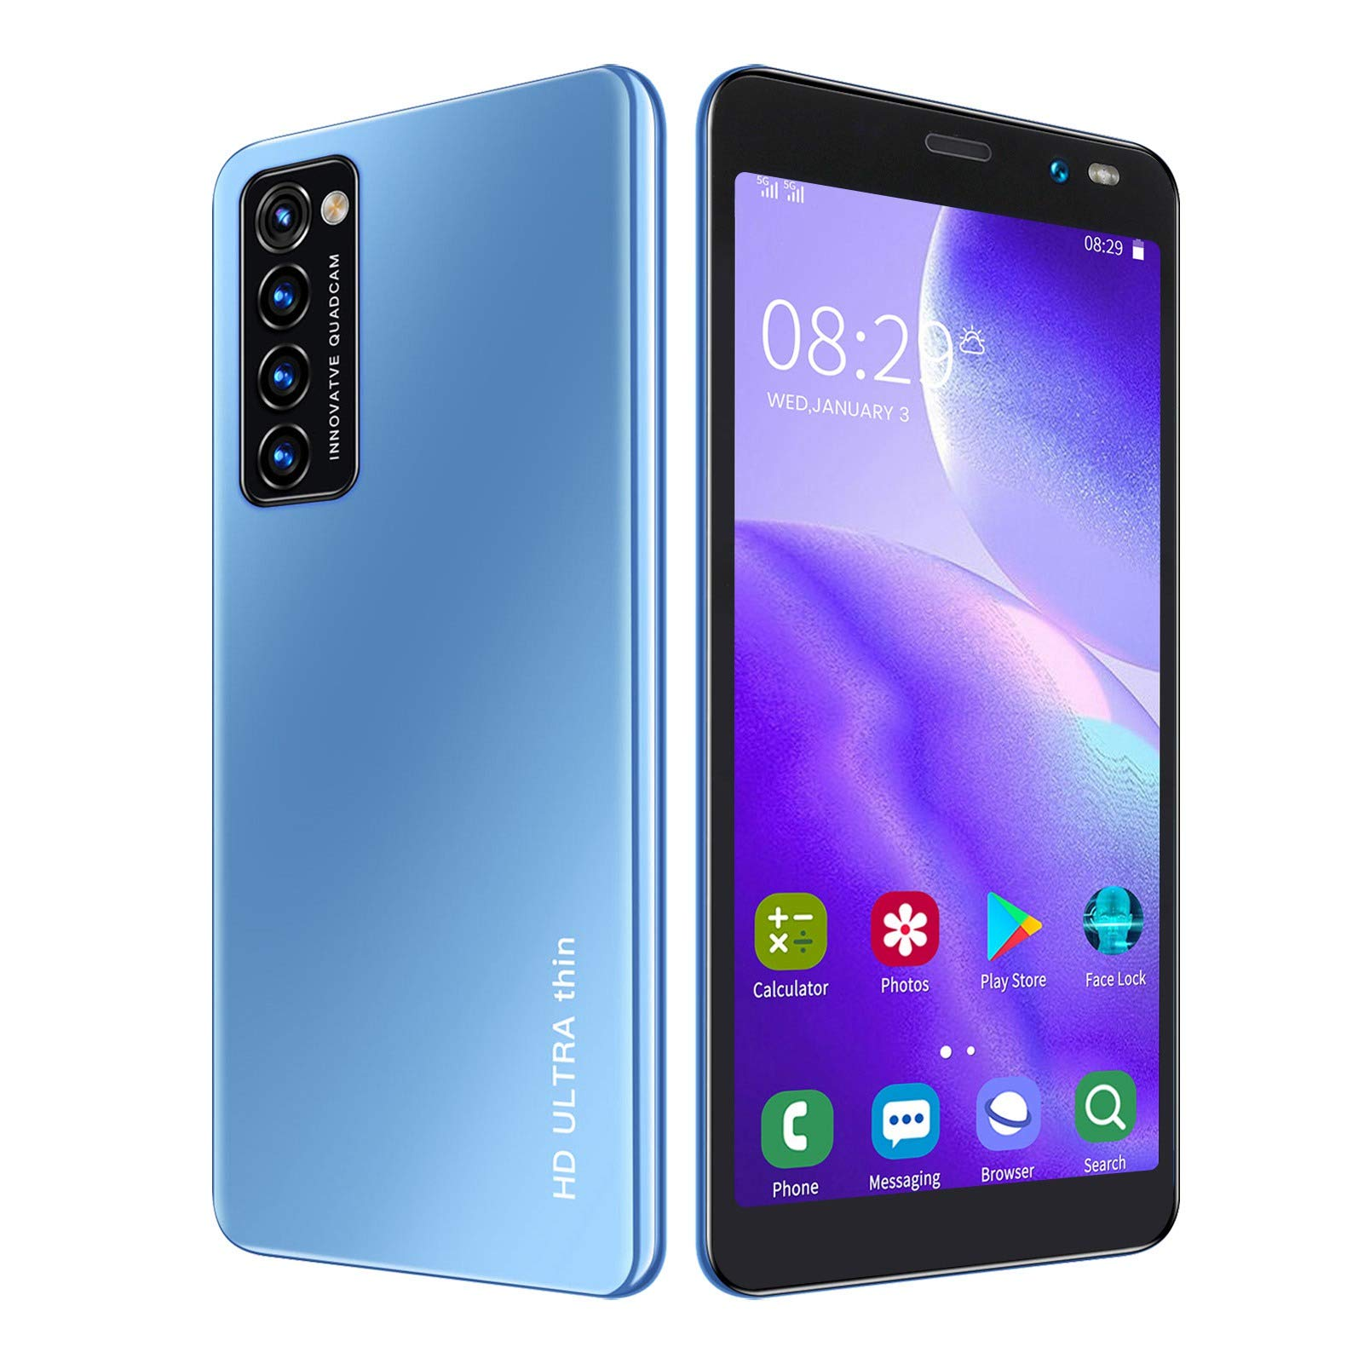
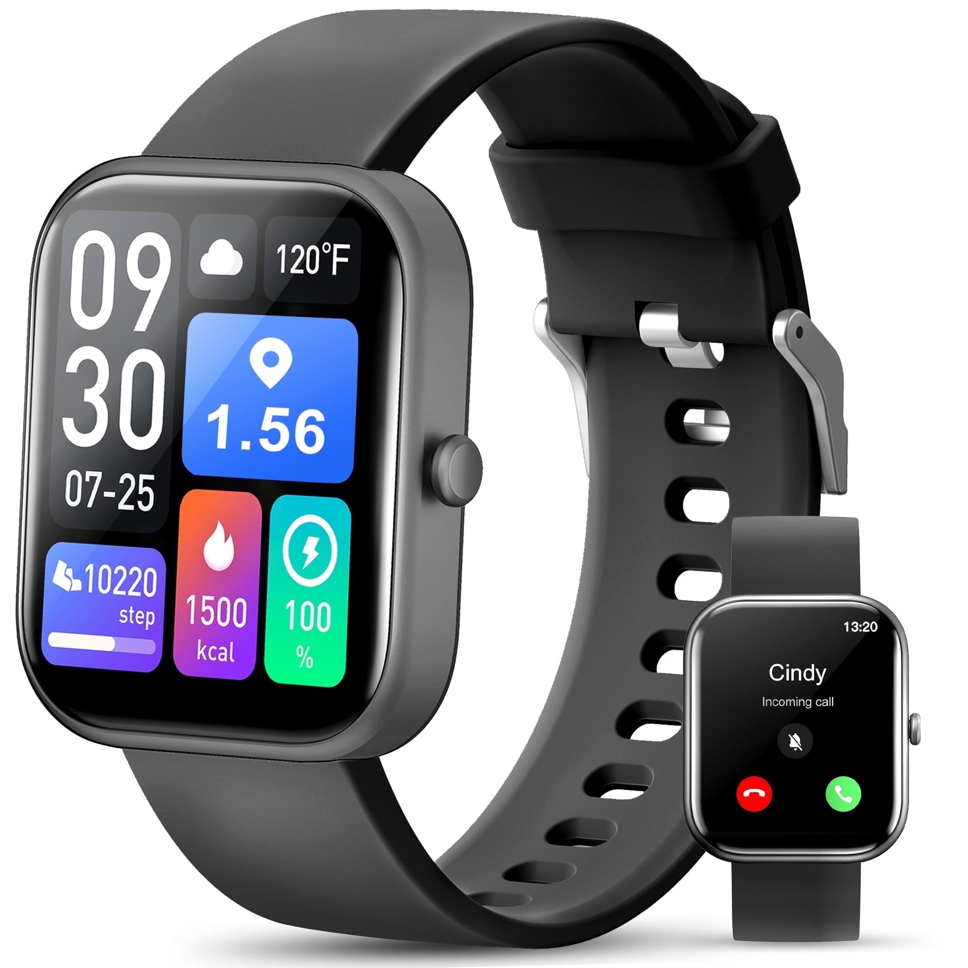
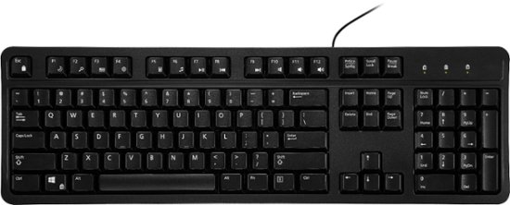
Discussion: what does and does not count
Share your thoughts
Is _____ an embedded system? Why or why not?
  Smart lightbulb
  Roomba
  Autonomous vehicle
  Smartwatch
  Smartphone
  Voice-assistant (Alexa)
  Keyboard

Slide 18
Thought experiment: high-capability computing
What if the smart lightbulb was powered by an entire desktop?
  16-core x86-64 processor, 64 GB RAM, 1 TB SSD
Could that still be an embedded system?
Why don’t we see that in practice?

Slide 19
Thought experiment: high-capability computing
What if the smart lightbulb was powered by an entire desktop?
  16-core x86-64 processor, 64 GB RAM, 1 TB SSD
Could that still be an embedded system?
  Yes
Why don’t we see that in practice?
  Cost

Slide 20
Trend: embedded computers instead of custom hardware
Some embedded devices could be a state machine in custom hardware instead
However, computers are increasingly common in those cases
  Embedded computers are increasingly cheap
  More software developers than hardware developers

Slide 21
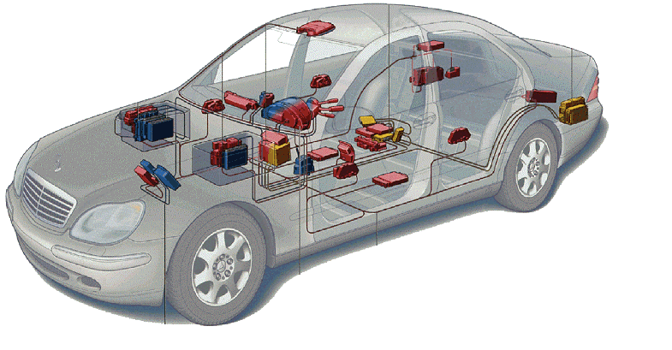
Related area: Cyber-Physical Systems
Systems that are part computational and part real-world
  Example: autonomous vehicles
Combines multiple fields to handle this problem
  Embedded Systems
  Electronics
  Controls
  Software Engineering
  Computer Theory
Automotive

Slide 22
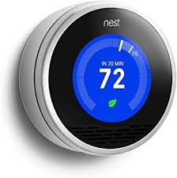
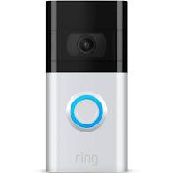
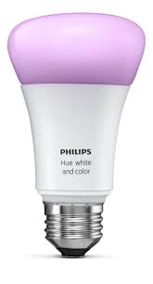
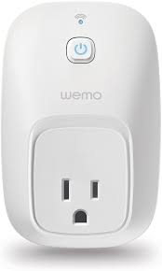
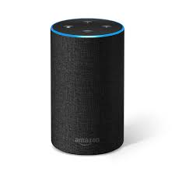
Related area: Internet-of-Things devices

Slide 23
What makes resource-constrained embedded systems interesting?
Focus on the real world
  You can actually see the purpose and effects of your applications
  Easily explainable to non-engineer humans
Challenging limitations
  Limited memory and processing
  Energy concerns

Slide 24
What makes resource-constrained embedded systems frustrating?
Challenging limitations
  Limited memory and processing
  Energy concerns
Full-stack development means problems could be anywhere
  Hardware problems
  Firmware problems
  Software problems
  Example: my first grad project, eye-tracking glasses
    Camera -> ADC -> FPGA -> Linux driver -> Linux app -> Network -> Visualizer app

Slide 25
Outline
Who and Why
Embedded Systems
  Microcontrollers
Course Overview
Class Hardware
Project Ideas

Slide 26
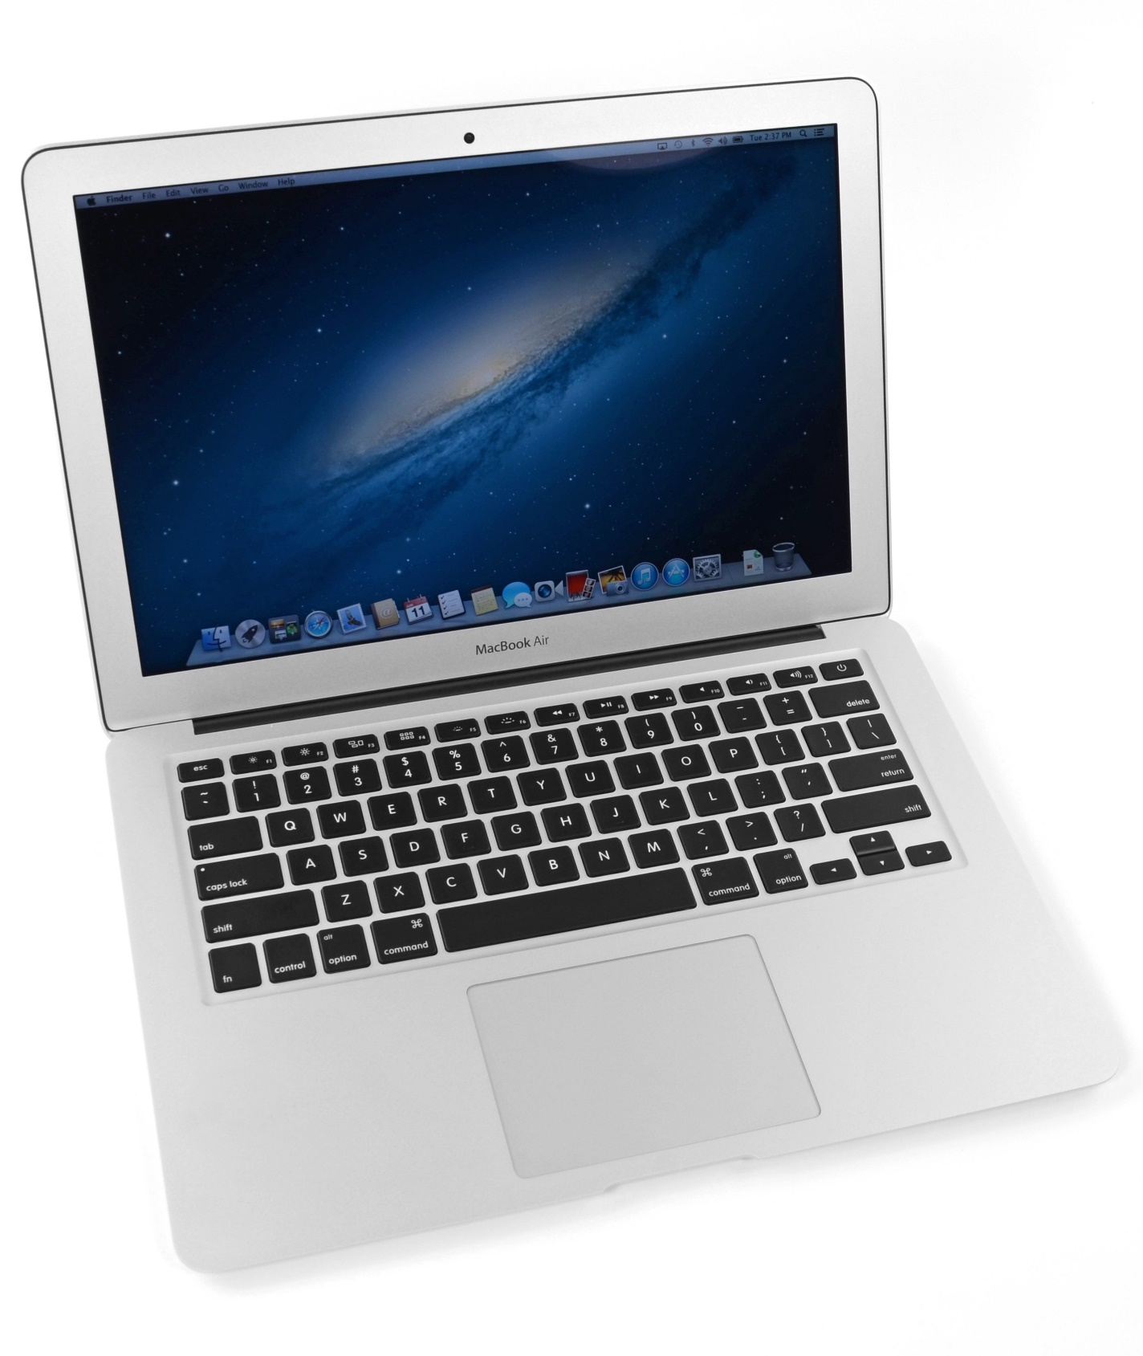
What’s inside a computer?
Macbook Air (circa 2013, 2nd gen)
  Modern computers are mostly similar
  Intel Core i5 processor
  128 GB Flash storage
  4 GB DDR3 RAM
  1440x900 pixel display
Picked because there is a teardown I like of an embedded device from the same year
https://www.ifixit.com/Teardown/MacBook+Air+13-Inch+Mid+2013+Teardown/15042

Slide 27
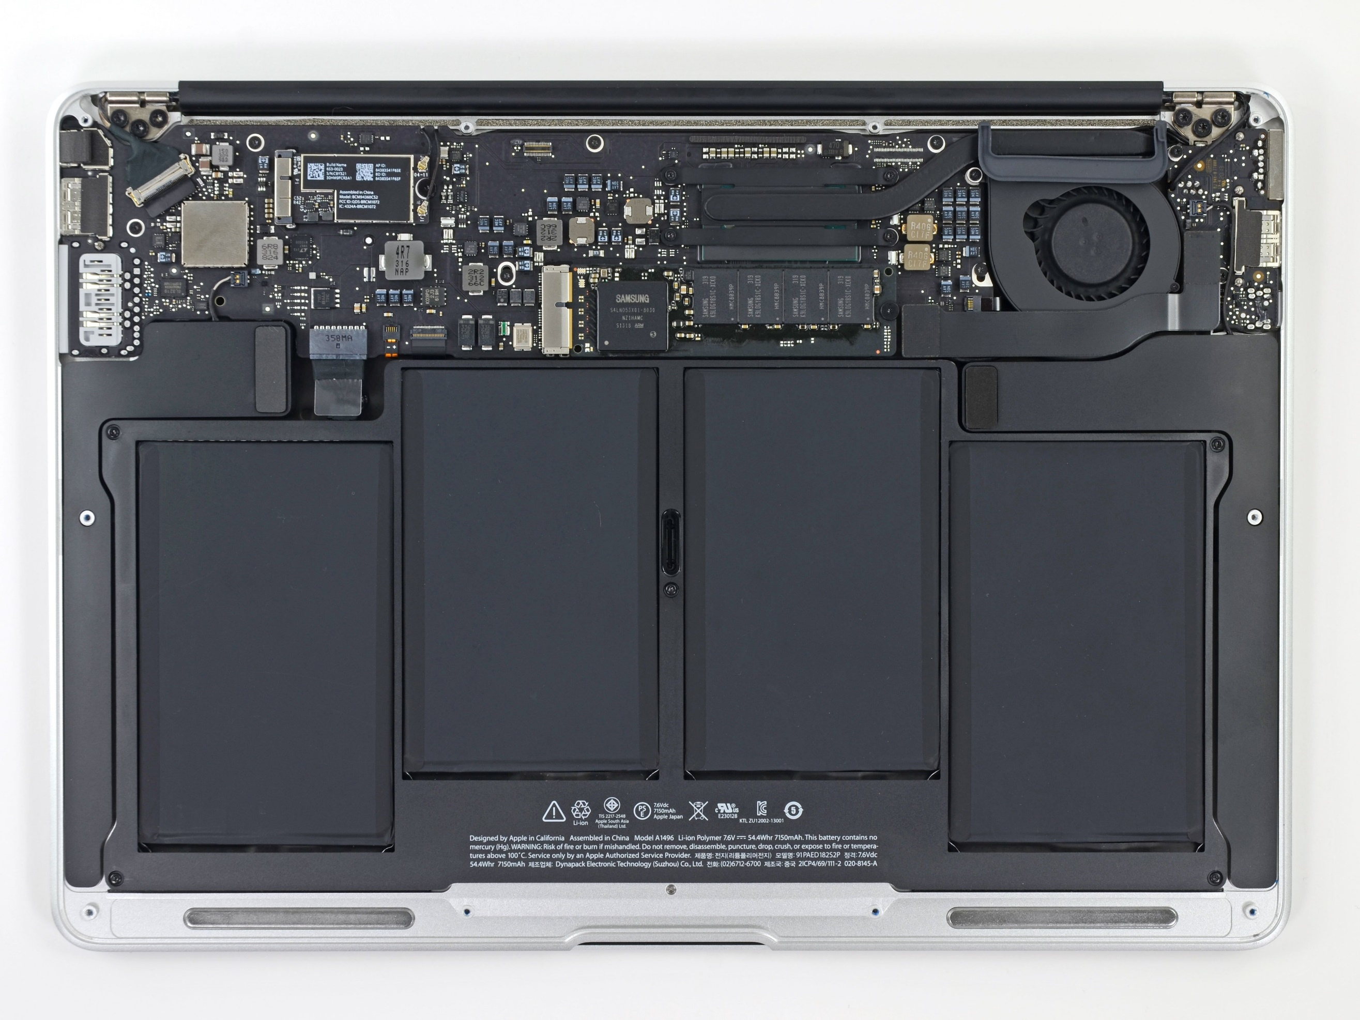
Unscrewing the bottom cover
Top half is the motherboard
  Holds and connects all the parts of the computer
Bottom half are battery packs

Slide 28
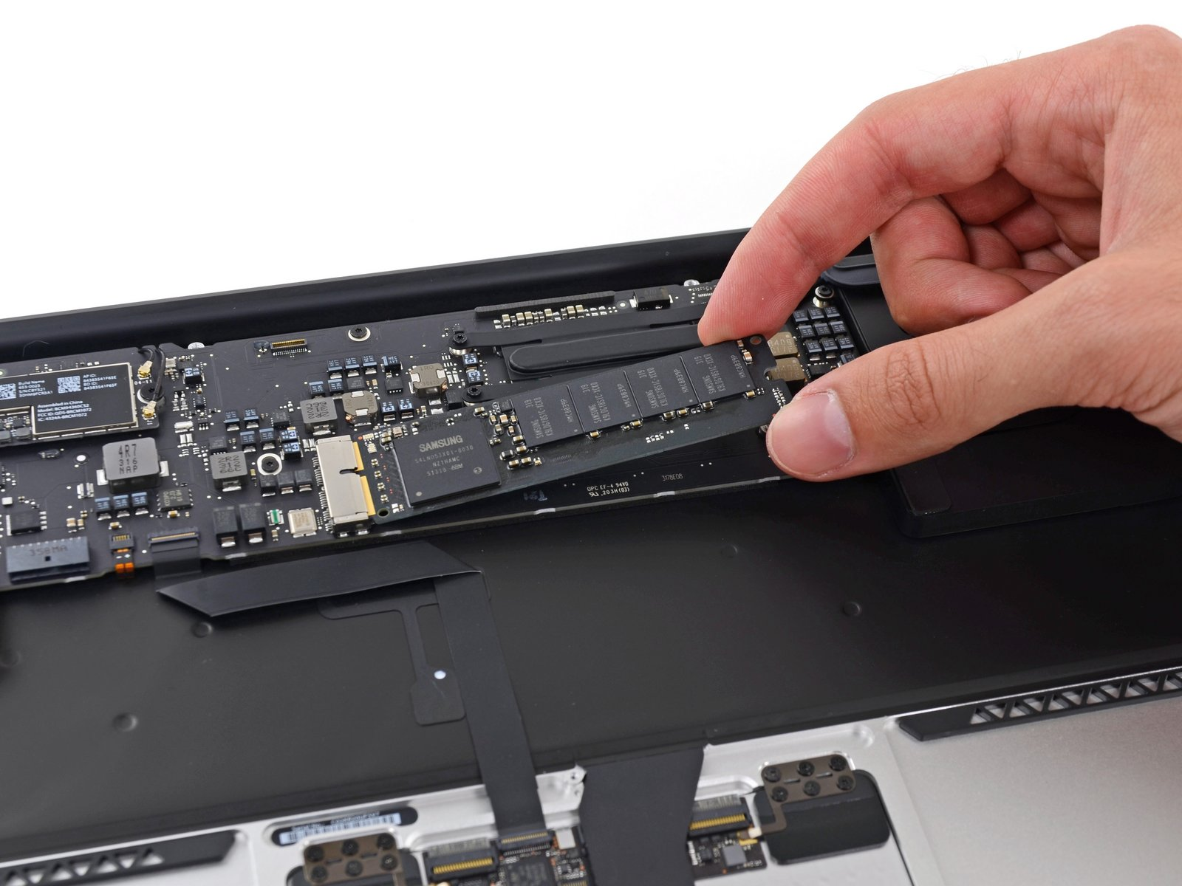
Non-volatile long-term storage: SSD
The SSD is a module that connects through PCIe
In modern laptops the SSD is often soldered directly onto the motherboard

Slide 29
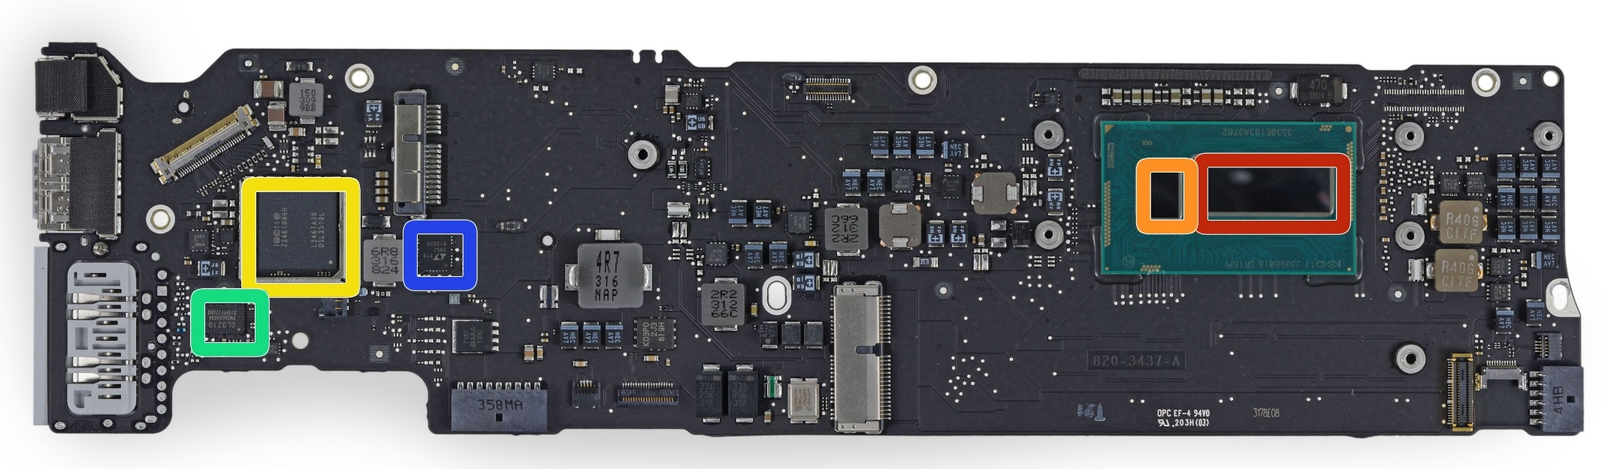
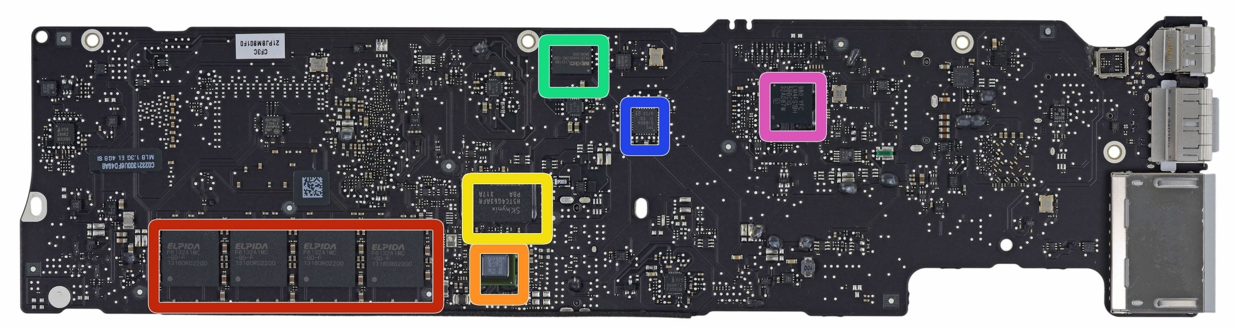
Investigating the motherboard
Red (front, right)
  Intel core i5 processor
Red (bottom, left)
  Elpida LPDDR3 RAM, 4 GB
Other stuff are mostly radios, USB/Thunderbolt controllers, and power supply
Front
Back

Slide 30
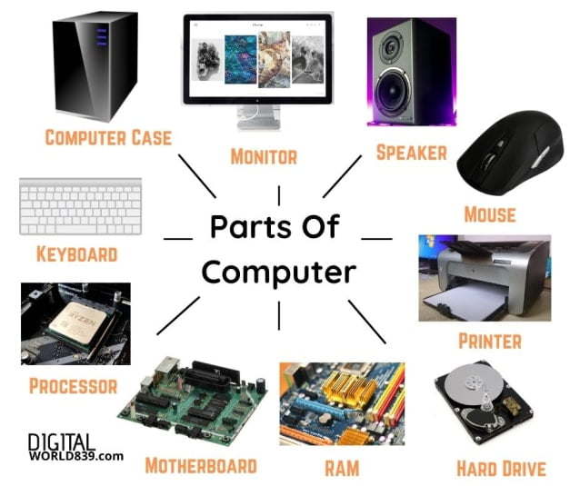
Generalizing computer design
Computers usually need
  Processor
  Memory (RAM)
  Storage (Flash/SSD)
  External communication
    USB, Thunderbolt, SATA, HDMI, WiFi
  Power management
    Maybe batteries and charging
  Something to connect it all: motherboard

Slide 31
What’s inside a Fitbit?
Fitbit flex (circa 2013)
Features
  Counts your steps
  Reports via Bluetooth Low Energy
  Lights up some LEDs based on your goals
  Vibrates when its battery is low
https://www.ifixit.com/Teardown/Fitbit+Flex+Teardown/16050
Notes:
Fitbit, Wearables, microcontrolles

Slide 32
Fitbit teardown
Notes:
Fitbit, Wearables, microcontrolles

Slide 33
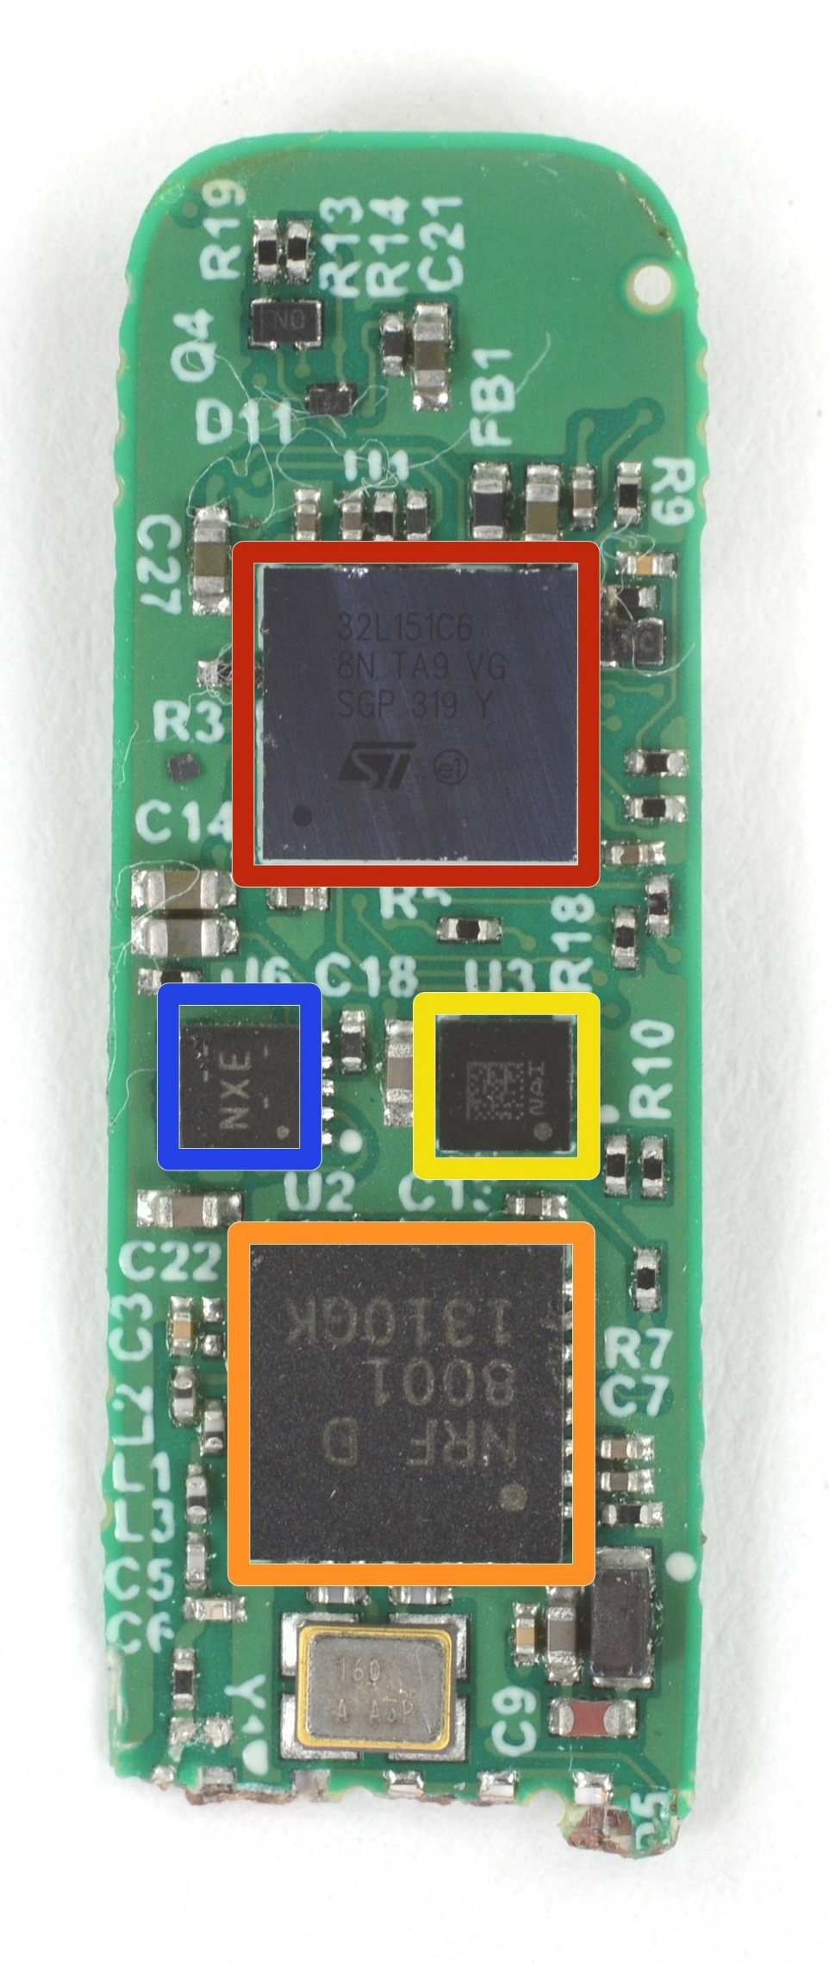
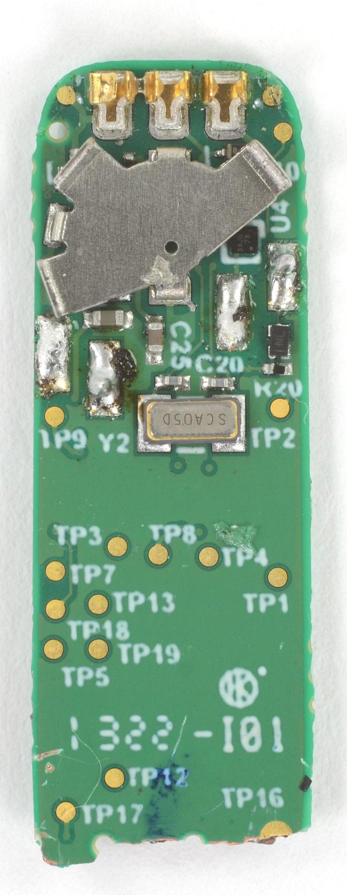
Fitbit circuit board front
The back is uninteresting
Red (top)
  STMicro 32L151C6 Microcontroller
Blue (left)
  TI BQ24040 Battery Charger
Yellow (right)
  STMicro LIS2DH Accelerometer
Orange (bottom)
  Nordic nRF8001 Bluetooth Low Energy Radio

Slide 34
Fitbit as a computer
Computers usually need
  Processor
  Memory (RAM)
  Storage (Flash/SSD)
  External communication
    USB, Thunderbolt, SATA, HDMI, WiFi
  Power management
    Maybe batteries and charging
  Something to connect it all: motherboard
  Microcontroller
  Bluetooth radio
  Vibratory motor
  Battery and power management
  Circuit board

Slide 35
Sidebar: you could make a Fitbit yourself
All those parts are commercially available, so you could make your own Fitbit if you wanted to
Make a circuit board
Buy those parts and solder them on
Write some embedded software
Make a plastic case
… build a big software backend for everything
You’ve got a Fitbit!

Slide 36
Generic microcontroller block diagram
Microcontroller
Processor
Peripherals
Pins
Memory

Slide 37
Peripherals
Hardware modules that perform some action
Common examples
  Control digital input and output pins
  Read analog inputs
  Send messages over various simple wire protocols (UART, SPI, I2C)
  Set and check timers
Less common examples
  Cryptography accelerators
  Complicated wire protocols (USB, CAN)
  Wireless radios (BLE, 802.15.4, WiFi)
We’ll spend most of class learning various peripherals

Slide 38
How is a microcontroller different?
A very constrained computer
  Simple processor
    16 or 32 bits (usually 32-bit these days)
    Processor speed in MHz
    Single core, pipelined processor
    No cache, or maybe a very small instruction cache
  Memory measured in kB
    Code executes right from read-only Flash (which is part of the address space)
  Sometimes no OS support at all
    “bare-metal” programming
  More focus on peripherals for interacting with the world

Slide 39
Break + Question
Why do laptops/desktops use external memory chips instead of building it into the processor (like a microcontroller)?

Slide 40
Break + Question
Why do laptops/desktops use external memory chips instead of building it into the processor (like a microcontroller)?
  Flexibility
    If it’s built into the processor, you’re limited to whatever they picked
  Fabrication issues
    DRAM and CMOS gates are somewhat different manufacturing processes (affects yield and costs)
    DRAM takes up a lot of space (multiple chips for many GBs of RAM)
  Some systems are doing this
    Apple M4 includes separate RAM silicon dies in the same processor package

Slide 41
Outline
Who and Why
Embedded Systems
  Microcontrollers
Course Overview
Class Hardware
Project Ideas

Slide 42
Course Staff and Office Hours
Four PMs who previously took the class
  Alex Huggins
  Isa Gonzalez
  Jayden Wool
  Lucas Takayasu
  They will help out during labs and also provide lab office hours
Office Hours: TBD
  We’ll post a schedule soon (should be M, T, W, and R)
  Also by request! (especially during projects)

Slide 43
Course details – how to learn stuff
Lecture: Tuesdays and Thursdays 3:30-4:50pm
  Tech LR5
Provides background on everything we’ll be doing in labs
  Lectures are automatically recorded so you can review them
  Slides are posted to the Canvas homepage right before class
No textbook for this class
  Nobody seems to write a good one
  The datasheet for our microcontroller (nRF52833) will be important though!

Slide 44
Asking Questions
Class and office hours are always an option!
  We can do extra questions right after class too
Piazza:
  Post questions
  Answer each other’s questions
  Find posts from the course staff
  Post private info just to course staff
Post on Piazza – do NOT send me emails
  Messages are kept in one place and stay “unanswered”
  You can post directly to “Instructors” if it is private
    Use that feature to request office hour appointments if desired
    Or to tell me that you’re sick and can’t attend lab

Slide 45
Course grade components
42% Labs
  6 labs at 7% each
  Guided exploration of course concepts
  Staff gives checkoffs as you complete parts
20% Quizzes
  Four timed quizzes at 5% each
  Covers lecture material from last two weeks
  In-class at the end of class, schedule on Canvas
38% Final Project
  Open-ended group project (will explain in a minute)

Slide 46
Class lab sessions
Lab: Fridays 1:00-2:50pm OR 3:00-4:50pm, Frances Searle 2370
  Mandatory attendance for these (part of your lab grade)
  Let me know ASAP if you’re sick and will miss
Labs start next week Friday and are weekly from there
  Six labs total
  When labs run out, I’ll use the time for project meetings with groups
  Optional lab this Friday for software setup
Warning: labs won’t usually be finished during the lab sessions
  You’ll have to work on them on your own time too
  We’ll have office hours for checkoffs

Slide 47
Labs
MMIO and Interrupts
Virtual Timers
LED Matrix
Breadboarding
Audio Input/Output
I2C Accelerometer/Magnetometer
Labs will be partner work
  You choose, but different partner each week
  MUST work with a partner
Due one week from start of lab
  You’ll need to get checkoffs in lab or during office hours

Slide 48
Late Penalties
10% reduction in maximum points per day late
  Just applies to the labs. Quizzes and Projects can’t be late
Sometimes stuff just doesn’t work. Especially when we’re working with hardware. We can be flexible about deadlines
  If you’re having problems and tell us
  Less flexible if you don’t communicate or if you started late
In general, communicate for any problems outside of your control and we can provide flexibility

Slide 49
Quizzes
In-class, on-paper, closed notes quizzes
  Usually about 15 minutes and held at the end of lecture
Cover the last two weeks worth of material
  So make sure you’re up-to-date on what we’re talking about
First quiz is Tuesday, April 15th (third week of classes)

Slide 50
Final projects
Opportunity for you to apply your interests to this course
  In groups of 2-3 students (maybe 4 for a really big idea)
  Groups of three in encouraged
Demonstrate course knowledge through any application
  Microbit (99% required) in our C software system (99.9% required)
  Various hardware I’ll have on hand
  Decent budget for purchasing additional stuff
  (up to $40 per person in team)

Slide 51
Project Logistics
Week 4: Proposals due
  I’ll get feedback to teams I’m concerned about
Week 6: Project Design Presentations
  Short presentations in class about your proposed project and design
  Chance to give each other useful feedback about how to proceed
Week 8-10: Labs are done and Fridays are used for update meetings
Exam Week: Live project demos!!
  Public demo session (invite friends!)
  Tuesday of exam week (usually half of the class at a time for a 2-3 hour block)

Slide 52
Details about who is in the class
55 total students
  Grad: 6
  Undergrad: 49
Majors
  Computer Science: 37
  Computer Engineering: 12
  Data science: 10
  Electrical Engineering: 3
  Industrial engineering: 1
  Biomedical engineering: 1
  Engineering Other: 3
You don’t all know the same things, and that’s okay!!
This class thrives on a variety of backgrounds
  Software
  Hardware
  Data Interpretation
  Applications
The best projects often have a mix of backgrounds

Slide 53
Break + Architecture of a lecture
Full
Administrivia
+ stretch break
Open
Question
Summary
+ Bonus
Attention
0
20
25
50
53
78
80
Time (minutes)

Slide 54
Outline
Who and Why
Embedded Systems
  Microcontrollers
Course Overview
Class Hardware
Project Ideas

Slide 55
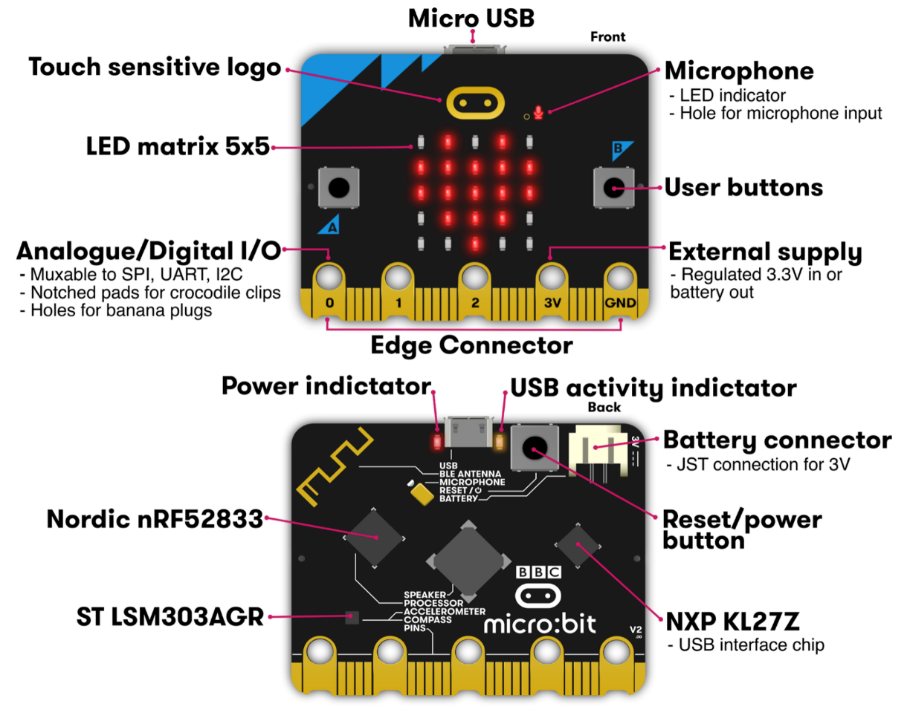
Micro:bit v2
Legacy from 1980s “BBC Computer Literacy Project”
  Reimagined today
Around $20
  Modern microcontroller AND sensors
Plan for class:
  Explore most of its functionality

Slide 56
Getting your own Microbit
You do NOT need to buy your own Microbit
  I have enough for everyone in the class to borrow one for the quarter
If you want your own though, they’re pretty cheap:
  $17.95 Adafruit: https://www.adafruit.com/product/4781
  $16.50 Sparkfun: https://www.sparkfun.com/products/17287
  $20.99 Amazon: https://www.amazon.com/Seeed-Studio-BBC-Micro-Accelerometer/dp/B0BDFD1ZM1

Slide 57
Labs will use your own laptops
All labs will use your own computers
In the past we used the computers in CG50
  About one computer would crash per lab session
  Super crammed in there with no elbow room or walking room
  And you had to physically go there to work on labs
Setup for your own computers won’t be that hard
  Native MacOS or Linux works great
  For Windows, VMWare Workstation + Ubuntu is pretty easy, but requires ~20 GB
Concern of mine: equal access to labs
  If you don’t have a laptop or don’t think it’ll work, let me know!

Slide 58
Poll of the room
MacOS users
Linux users
Windows users
  WSL users?
Other?

Slide 59
Lab0: Software Setup
Should release tonight, or maybe early tomorrow
Optionally, I’ll be at the lab sessions on Friday if you want help with your setup
  If you have a weird computer setup
  Or if you feel uncomfortable installing a bunch of tooling
If you feel comfortable with it, you’re welcome to do this first “lab” on your own
  And you don’t have to attend lab this Friday

Slide 60
Outline
Who and Why
Embedded Systems
  Microcontrollers
Course Overview
Class Hardware
Project Ideas

Slide 61
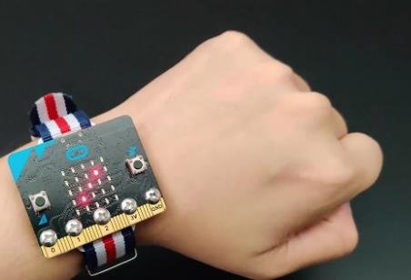
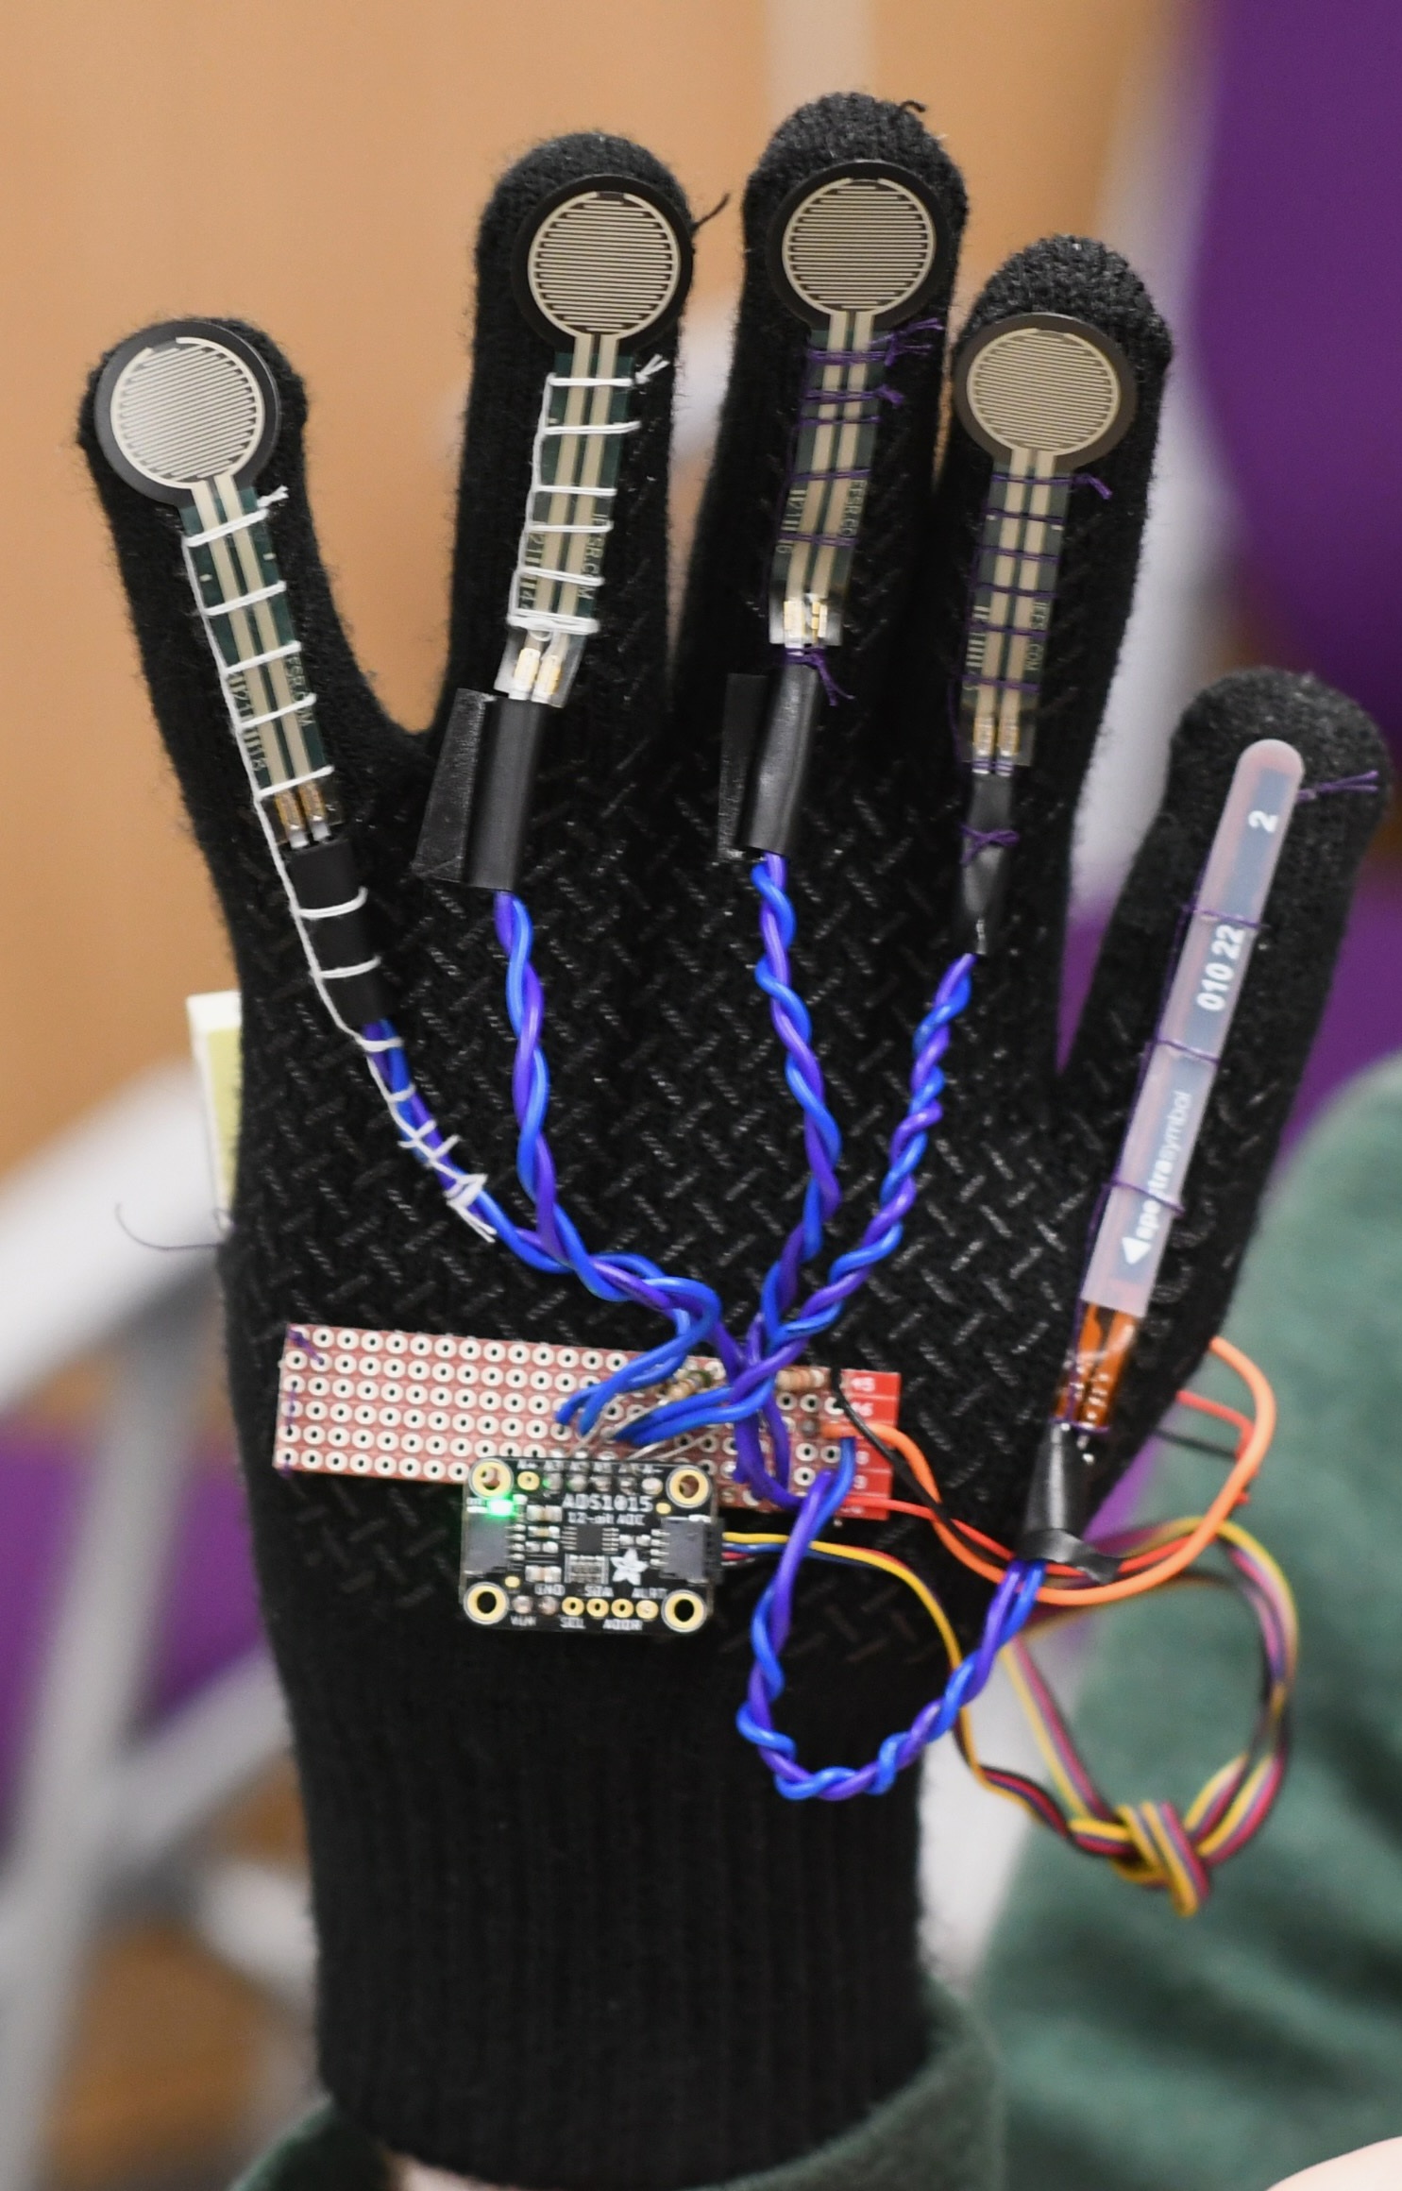
Project Ideas
Some ideas to get you thinking
  Game with interesting control mechanism
  Smart gloves
  Smartwatch
  Simple robotic systems
Projects can use
  Multiple Microbits
  A personal computer for some amount of coordination
  Small screens and displays
  Lots of different sensors or actuators
    Go explore Sparkfun and Adafruit

Slide 62
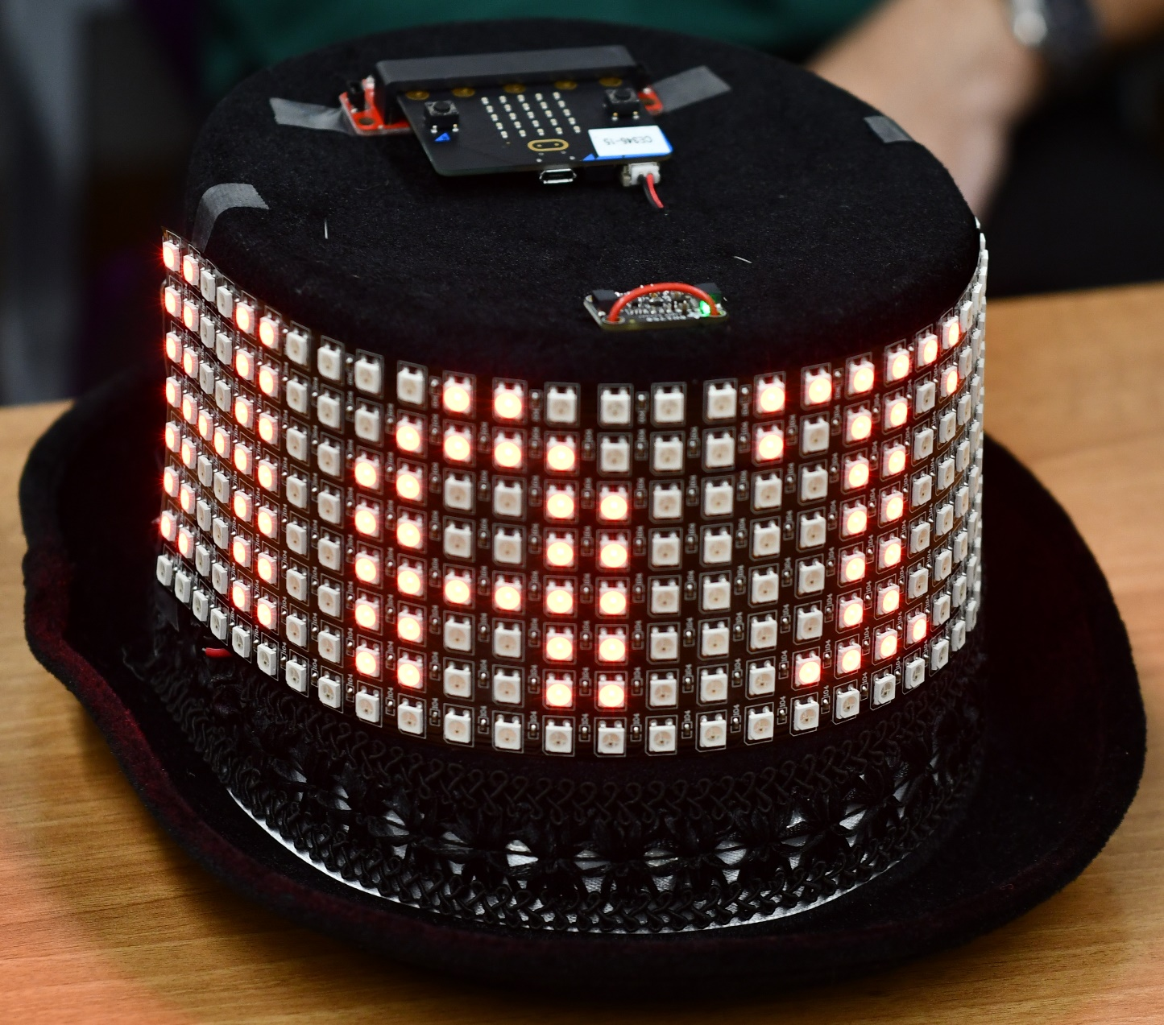
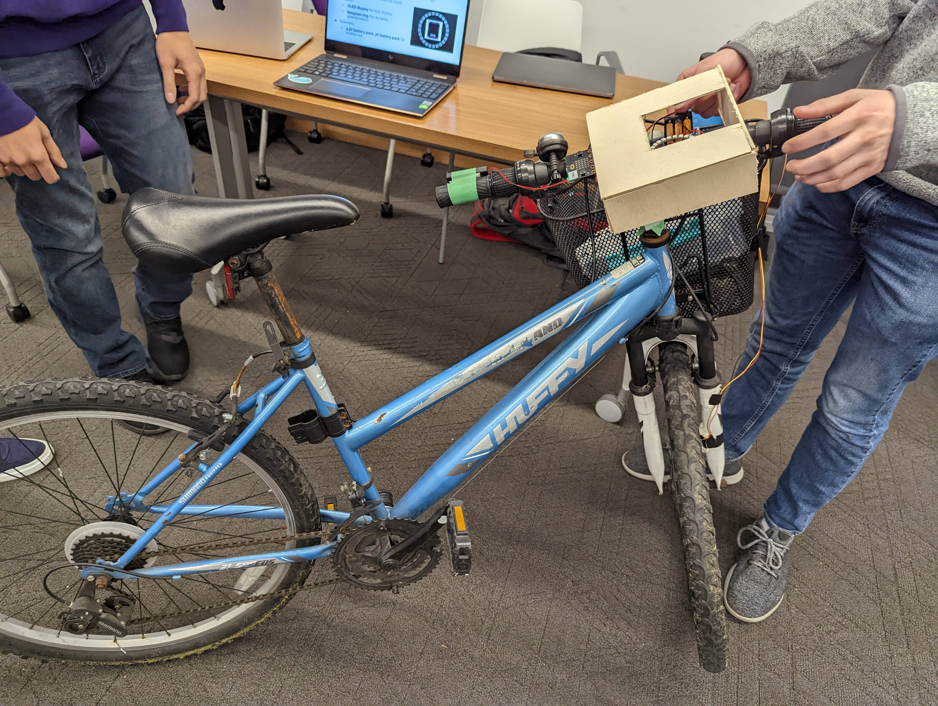
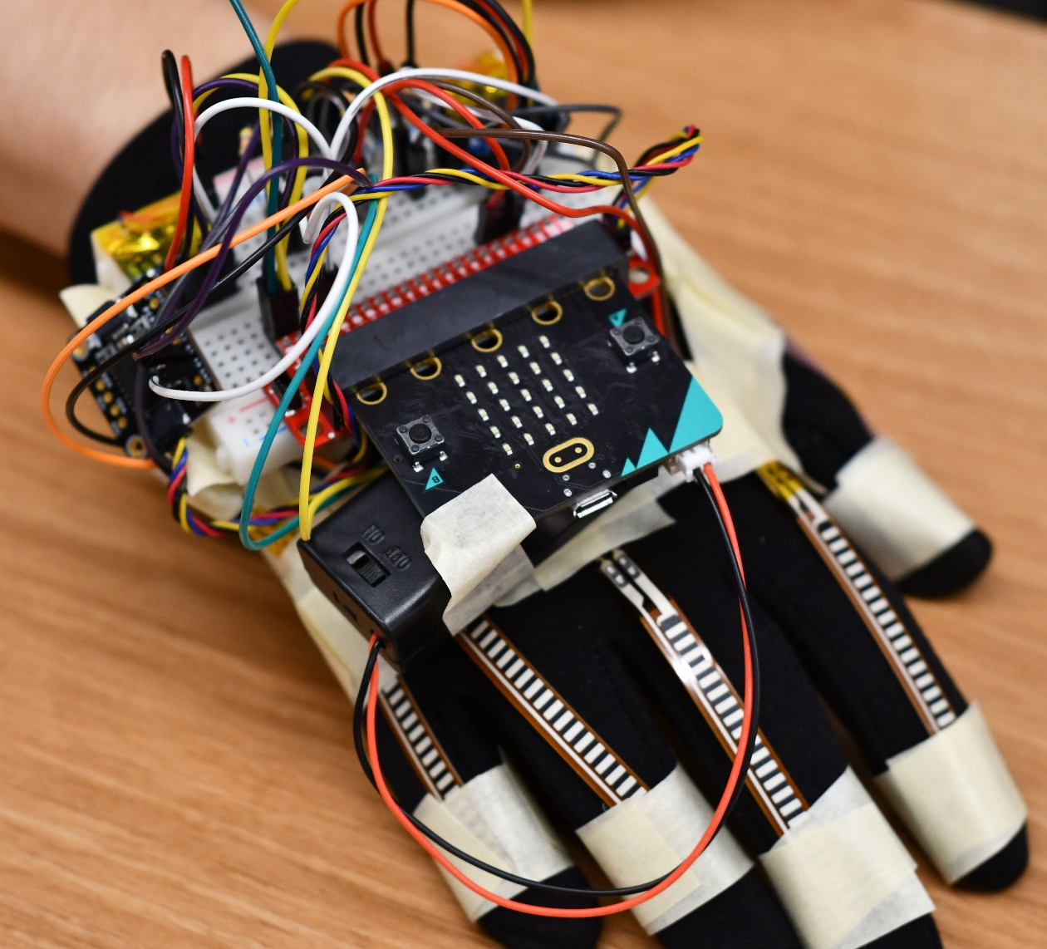
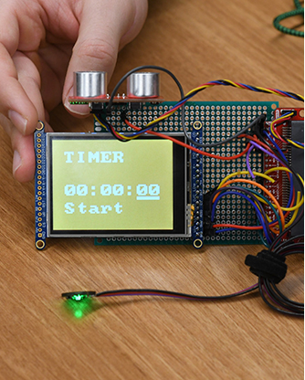
Some awesome projects – interactable objects

Slide 63
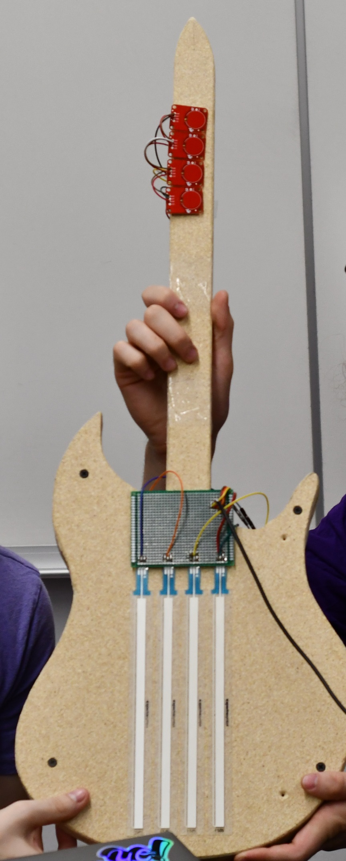
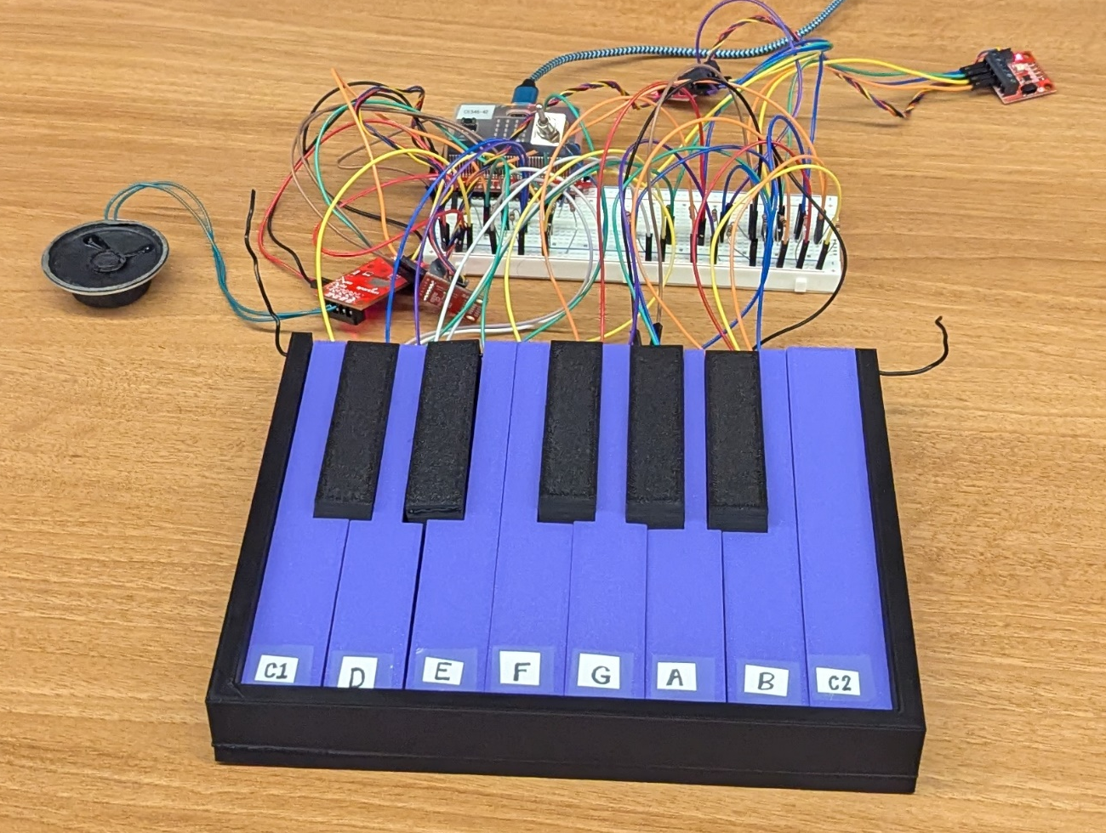
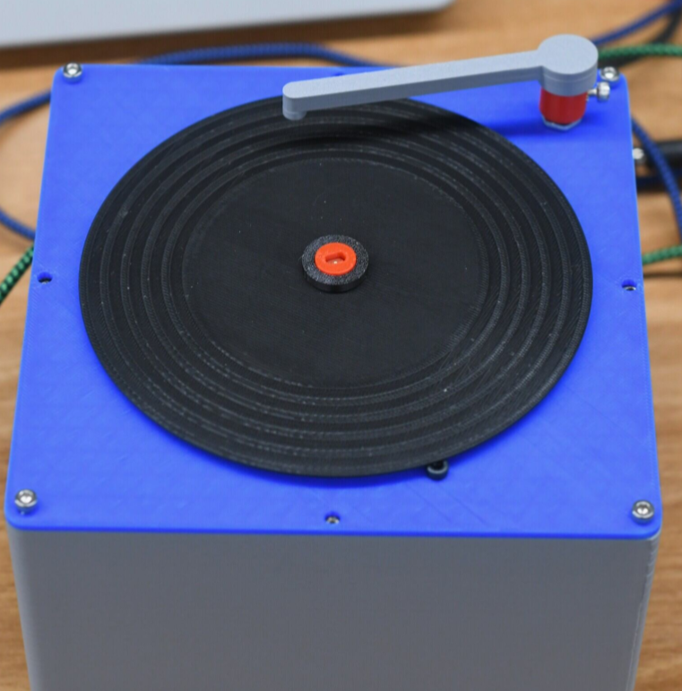
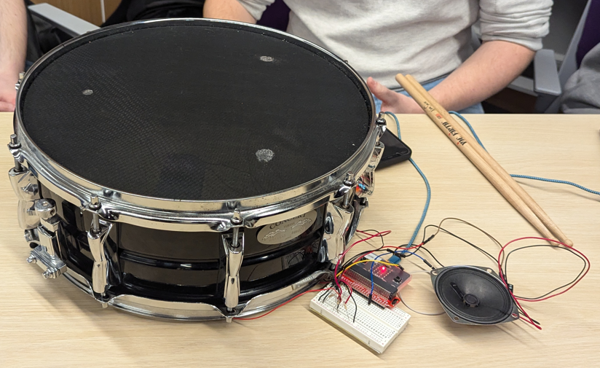
Some awesome projects – electronic music

Slide 64
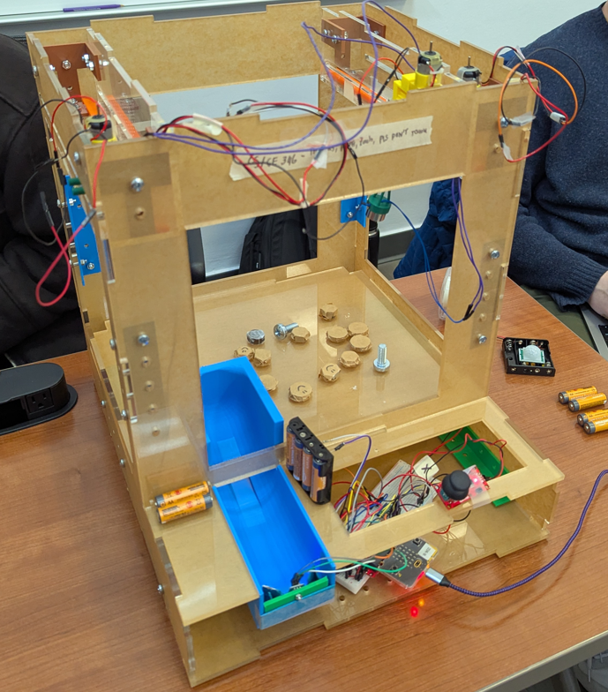
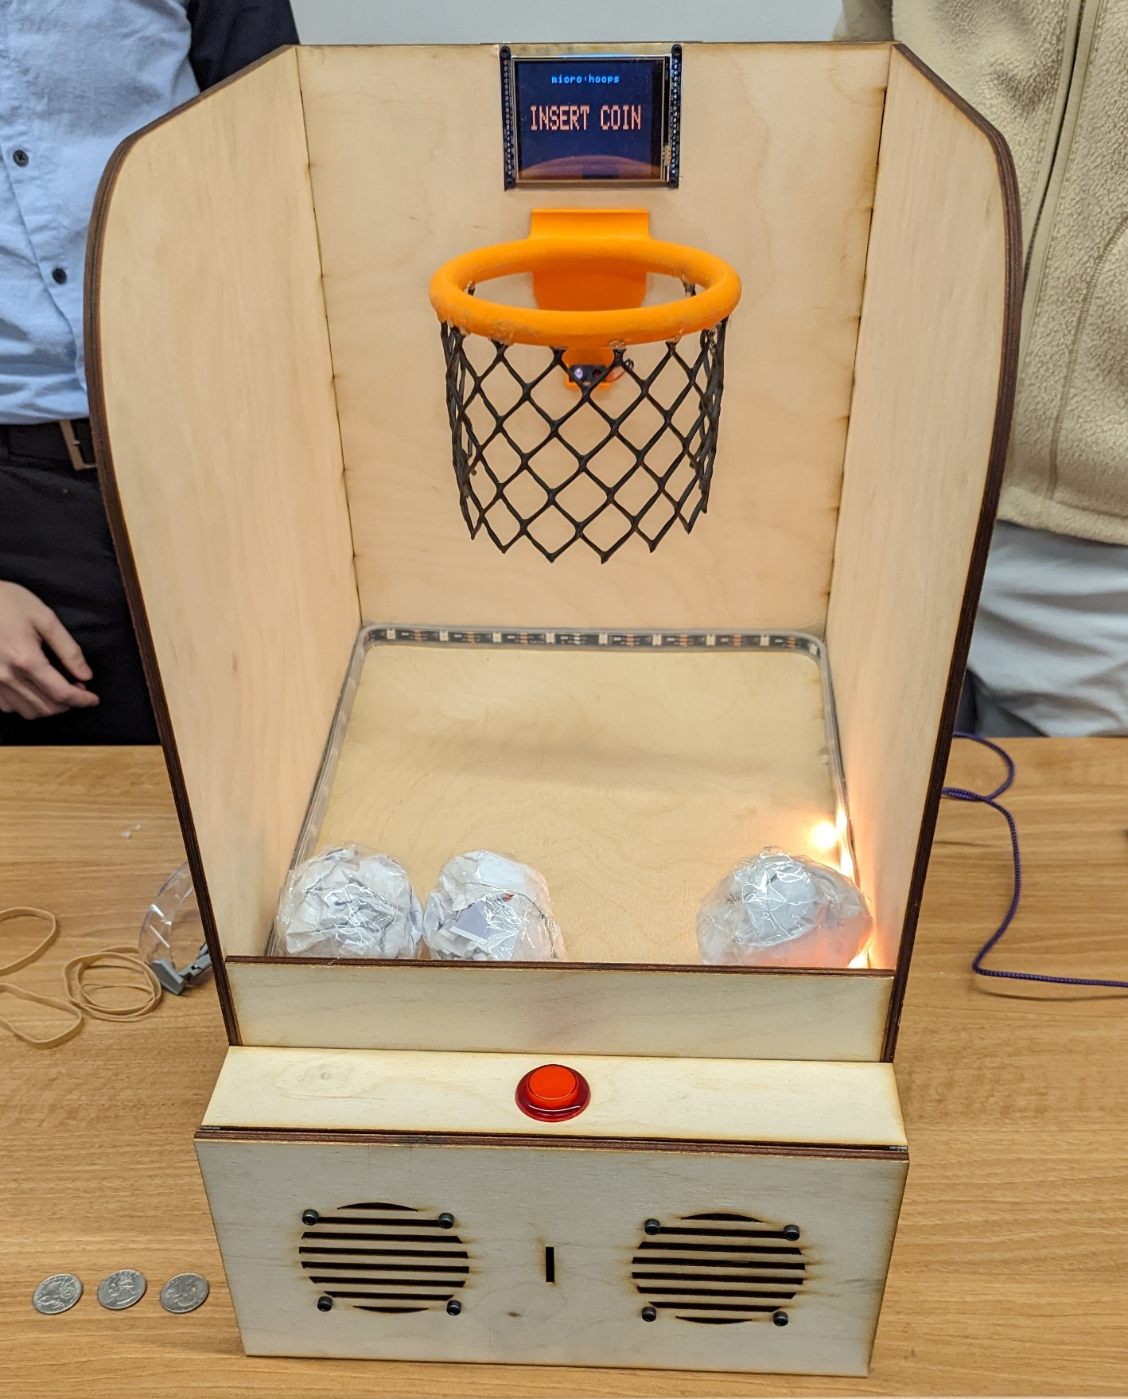
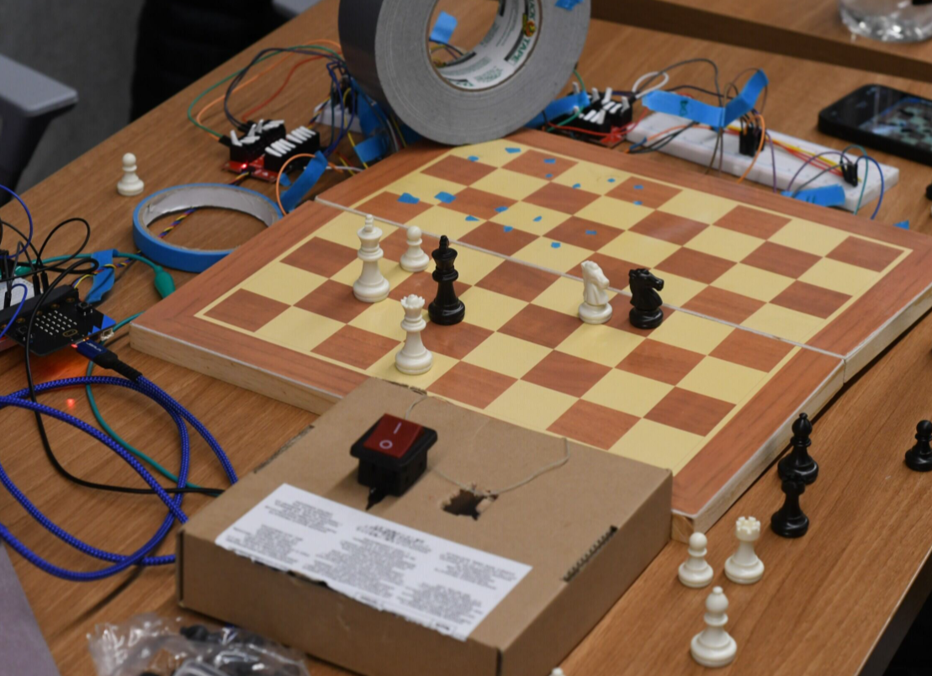
Some awesome projects – playable games

Slide 65
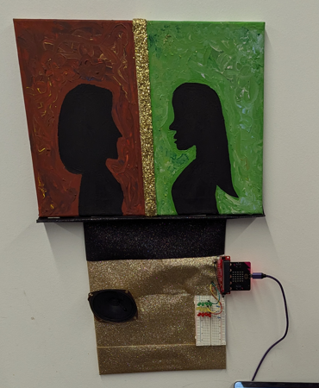



Some awesome projects – interactable art and robotics

Slide 66
Outline
Who and Why
Embedded Systems
  Microcontrollers
Course Overview
Class Hardware
Project Ideas

