Slide 1
Lecture 18 Wrapup
CE346 – Microprocessor System Design
Branden Ghena – Spring 2021
Some slides borrowed from: Josiah Hester (Northwestern), Prabal Dutta (UC Berkeley)

Slide 2
Administrivia
This is the last lecture!! 😭
No class on Monday
Friday: Quiz 4
Next week: Project Demos
See signup and details on Campuswire

Slide 3
Today’s Goals
Discuss remaining parts of the Microbit and nRF52833
Realize that we’ve covered almost everything on the system!!
Explore sensing systems research

Slide 4
Outline
What haven’t we talked about?
Microbit
nRF52833
Sensing Systems Research

Slide 5
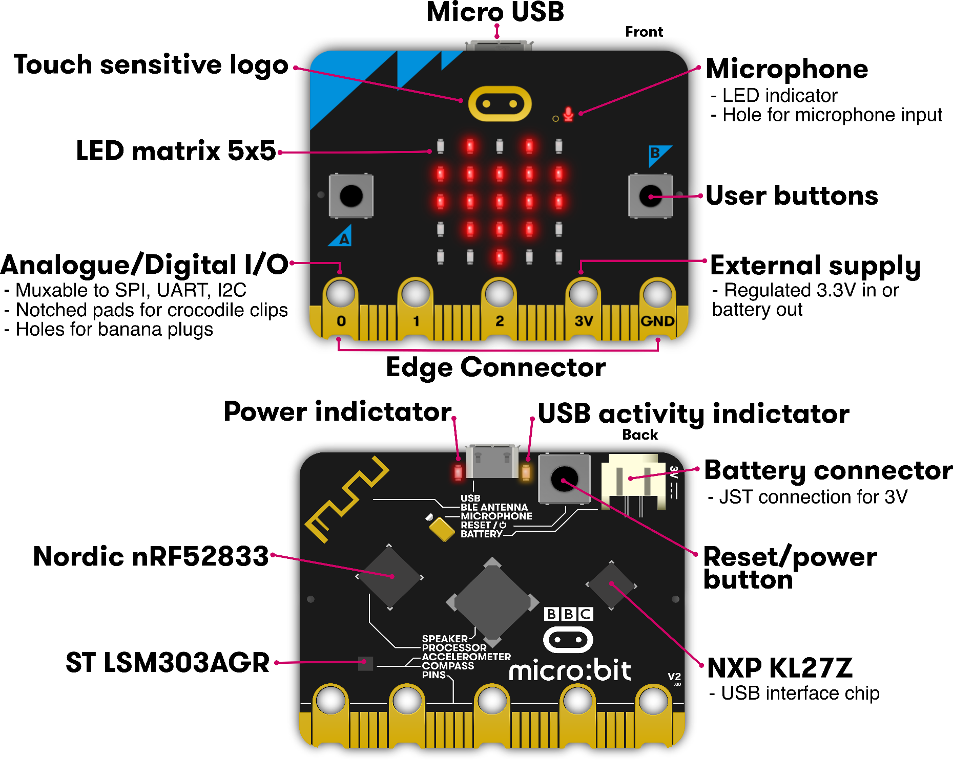
Microbit
Used almost all of this!
Remaining:
Batteries
Wireless
KL27Z I2C
Touch sensitive pads

Slide 6
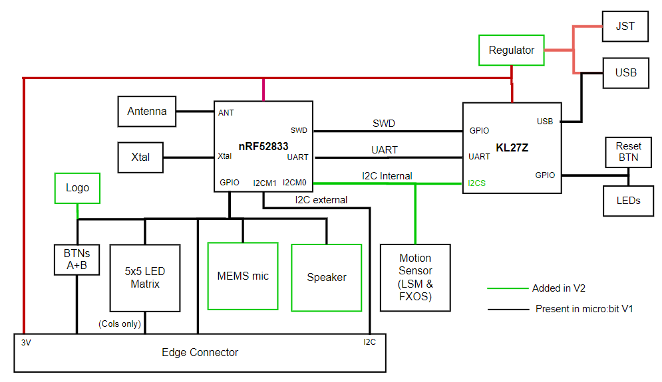
Internal Microbit connections

Slide 7
KL27 I2C Interface
Device information
Version of board and JTAG firmware
Power state of board
USB, Battery, both
Voltage values for battery and VIN
USB connection state
Disable the power LED!!
Flash Storage
128 kB of the KL27’s Flash is readable/writable over I2C

Slide 8
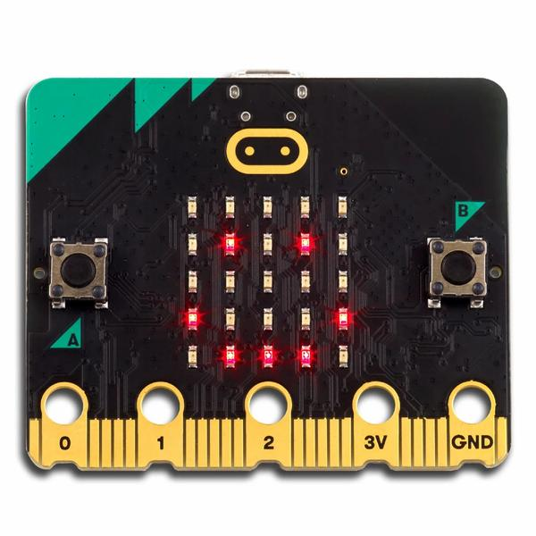
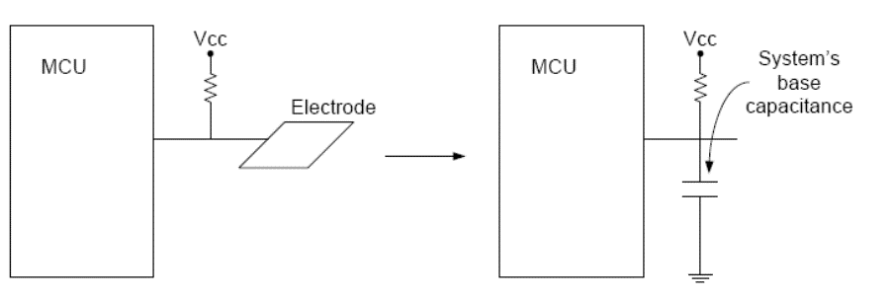
Capacitive Touch Sensor
Pull-up resistors connected to metal pads
Also connected to GPIO pin
Acts as a capacitor connected to ground

Slide 9
Capacitive touch sensing method
Drive GPIO pin low
Connects the pad to ground
Set GPIO pin as input and enable low-to-high interrupt
Pad is pulled high. This takes time based on capacitance
Use a timer to determine time until interrupt (order ~10 μs)
Repeat periodically
Sudden large increase in rise time ⇨ someone is touching!
Finger acts as a large capacitor

Slide 10
Capacitive touch works on any metal surface
Idea: Microbit door handle sensor
Connect a wire and a pull-up resistor to a metal door handle to sense when someone is touching it!
Timing will be very different from capacitive pad, but should be repeatable and distinguishable from human touch

Slide 11
Outline
What haven’t we talked about?
Microbit
nRF52833
Sensing Systems Research

Slide 12
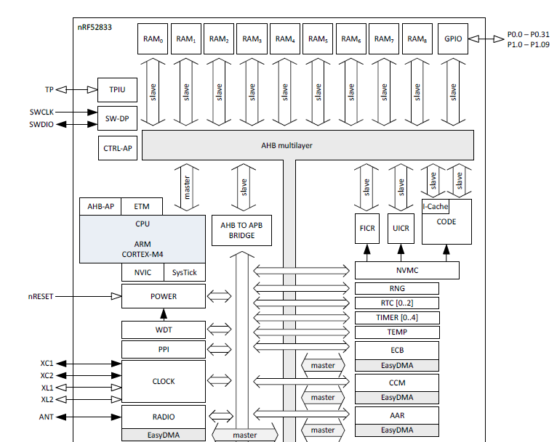
nRF52833 Peripherals
Tour of the nRF52833 peripherals
With some details on the ones we haven’t talked about
Wireless
Crypto
Audio

Slide 13
nRF52833 Peripherals
Cortex-M4F processor
32-bit ARM core
Floating point
Includes Interrupt control and SysTick (an extra timer)

Slide 14
nRF52833 Peripherals
Memory buses

Slide 15
nRF52833 Peripherals
JTAG and Debugging
Allows code updates
Allows GDB to step through code

Slide 16
nRF52833 Peripherals
Volatile memory
SRAM, 128 kB

Slide 17
nRF52833 Peripherals
Nonvolatile memory
Flash, 512 kB
Non-Volatile Memory Controller

Slide 18
nRF52833 Peripherals
Power and Clock management

Slide 19
nRF52833 Peripherals
GPIO pins

Slide 20
nRF52833 Peripherals
Various timers
Watchdog Timer
Real-Time Counter
Timer peripheral

Slide 21
nRF52833 Peripherals
Programmable Peripheral Interconnect
Random Number Generator
Temperature sensor

Slide 22
nRF52833 Peripherals
Wireless radio
Bluetooth Low Energy
802.15.4 (Zigbee or Thread)
Cryptography
ECB (AES mode)
CCM (AES mode)
AAR (Accelerated Address Resolver)
For BLE random addresses

Slide 23
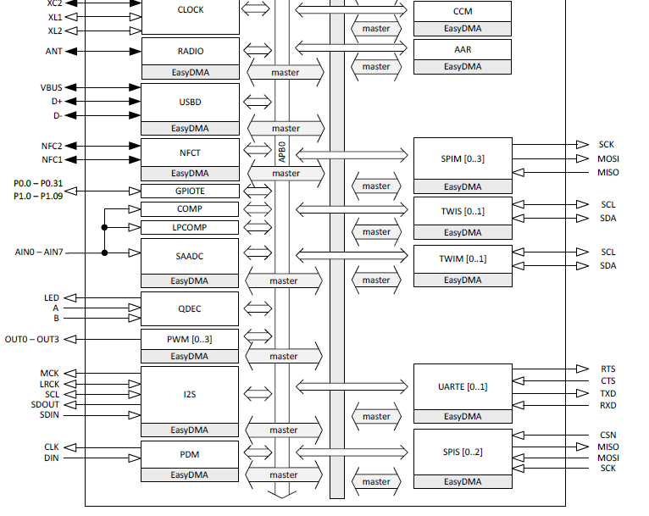
nRF52833 Peripherals
Wired communication protocols
USB Device
SPI
Controller/Peripheral
TWI (I2C)
Controller/Peripheral
UART

Slide 24
nRF52833 Peripherals
Inter-IC Sound (I2S)
Wired communication bus explicitly for audio data
Unrelated to I2C
Like a synchronous UART
Clock, data in, data out
Additional signals
MCK – synchronization
LRCK – left/right channel select

Slide 25
nRF52833 Peripherals
NFC
Near-Field Communication
Close-range wireless communication protocol
“Tap-to-pay” systems

Slide 26
nRF52833 Peripherals
GPIOTE
GPIO interrupts

Slide 27
nRF52833 Peripherals
Analog inputs
Comparator
Low-Power Comparator
Successive Approximation Analog-to-Digital Converter

Slide 28
nRF52833 Peripherals
Quadrature Decoder peripheral
Detects rotation speeds and direction
Usually for motors

Slide 29
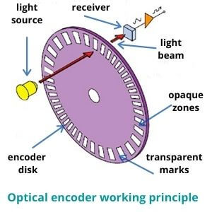
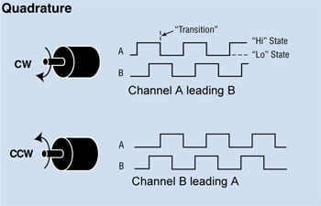
Quadrature Encoding

Slide 30
nRF52833 Peripherals
Pulse Width Modulation
Pulse Density Modulation
Similar idea to PWM
Input-only peripheral
Targets microphones

Slide 31
nRF52833 is complete
That’s just about everything!
First 550 out of 600 pages of nRF52833 datasheet
Remaining 50 are hardware details
Pinout for different packages
Recommended circuit layout
Soldering details

Slide 32
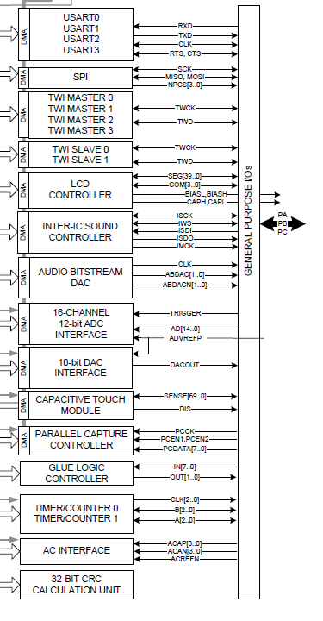
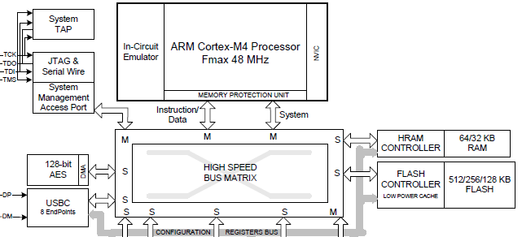
This knowledge is transferrable!
Example: SAM4L datasheet
Atmel Cortex M4F
Various peripherals
USART, SPI, TWI, I2S, DAC, ADC, Timer, …

Slide 33
Outline
What haven’t we talked about?
Microbit
nRF52833
Sensing Systems Research

Slide 34
Conferences for sensing systems research
SenSys
Conference on Embedded Networked Sensor Systems
IPSN
Conference on Information Processing in Sensor Networks
MobiCom
Conference on Mobile Computing and Networking
UbiComp
Conference on Pervasive and Ubiquitous Computing
Various other systems or HCI venues
Occasionally Electrical or Civil Engineering venues too

Slide 35
Sensing systems research
Combination of engineering and exploration
Generally divides into two different focuses
Often projects will mix some of each domain
Platforms
How to improve the capabilities of sensing systems
Examples: lower power, better wireless, new sensors
Applications
How to use sensing systems to meet some desired goal
Examples: track human interactions, measure household energy use

Slide 36
Sensing systems research
Platforms
How to improve the capabilities of sensing systems
Examples: lower power, better wireless, new sensors
Applications
How to use sensing systems to meet some desired goal
Examples: track human interactions, measure household energy use

Slide 37
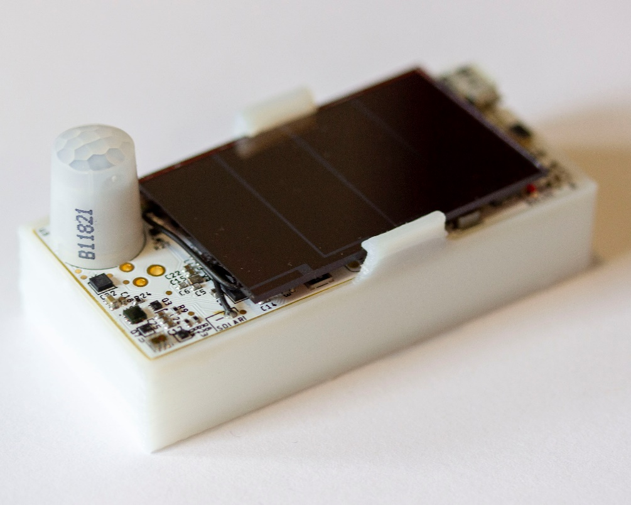
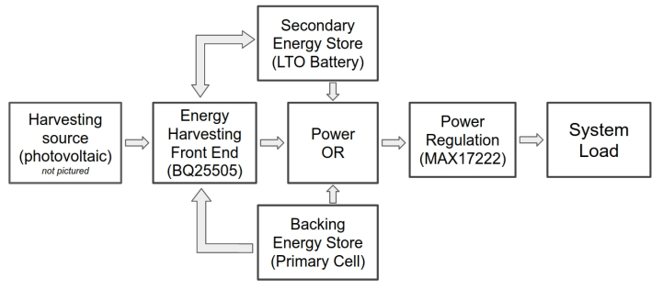
Permamote (Jackson, Adkins, Dutta)
Goal: create a 10-year wireless sensor
Solutions
Modern sensors and microcontroller
Energy harvesting combined with rechargeable battery
Non-rechargeable battery as backup power
https://lab11.eecs.berkeley.edu/content/pubs/jackson19capacity.pdf

Slide 38
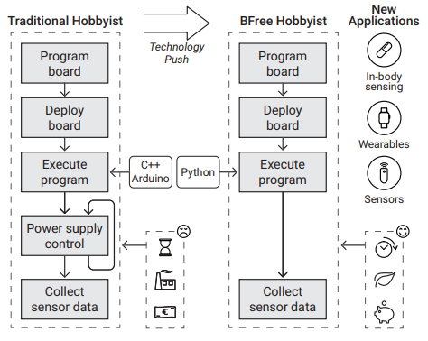
Bfree (Kortbeek, Bakar, Cruz, Yildririm, Pawelczak, Hester)
Goal: hobbyist intermittent systems
Solutions
Automatic checkpointing in python runtime
Hardware module for easy prototyping
User studies to demonstrate improvements
https://dl.acm.org/doi/abs/10.1145/3432191

Slide 39
Tock (Levy, Campbell, Ghena, Giffin, Pannuto, Dutta, Levis)
Goal: safe and reliable embedded OS
Demonstrate this is possible on small embedded platforms
Solutions
Dedicated OS kernel with separate applications
Protect applications with hardware features
Memory Protection Unit
Protect kernel with language features
Rust programming language
https://lab11.eecs.berkeley.edu/content/pubs/levy17multiprogramming.pdf

Slide 40
Tock software organization
C App Ported to Tock
App written in Rust
[Service] BLE Environmental Sensing Profile
while(1)
😈
Untrusted
(isolated by the MPU and preemptively scheduled)
Syscall Interface
libtock
libtock-rs
libtock
libnrf
Kernel (Rust)
System Calls
Thread
Virt. Timer
BLE
Temp. Sensor
Untrusted
(unsafe forbidden)
Capsules
6LoWPAN
SD Card
Console
SI7021
Core Kernel
Scheduler, Process management, etc.
Standardized Hardware Interface Layer (HIL)
Trusted
(unsafe allowed for MMIO, PIC, etc.)
Microcontroller-specific Peripheral Drivers
SPI
RNG
Timer
ADC
GPIO
I2C
UART
AES
DAC
USB
Hardware
CPU
SPI
RNG
Timer
ADC
GPIO
I2C
UART
AES
DAC
USB

Slide 41
Sensing systems research
Platforms
How to improve the capabilities of sensing systems
Examples: lower power, better wireless, new sensors
Applications
How to use sensing systems to meet some desired goal
Examples: track human interactions, measure household energy use

Slide 42
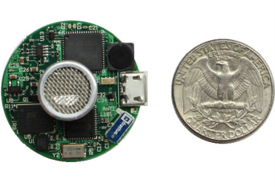
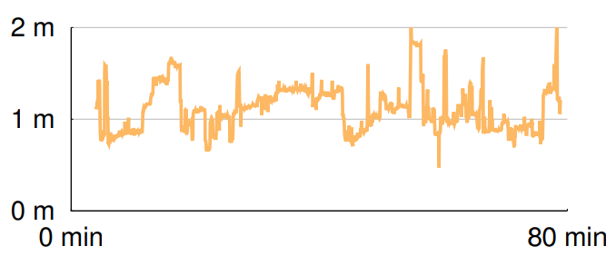
Opo (Huang, Kuo, Pannuto, Dutta)
Goal: sense distance of human interactions
Real-time, high accuracy, deployable
Solutions
Ultrasonic allows for low-power detection of nearby devices
Also provides directionality
Measure difference in arrival time of RF and Ultrasonic to determine distance
https://lab11.eecs.berkeley.edu/content/pubs/huang14opo.pdf

Slide 43
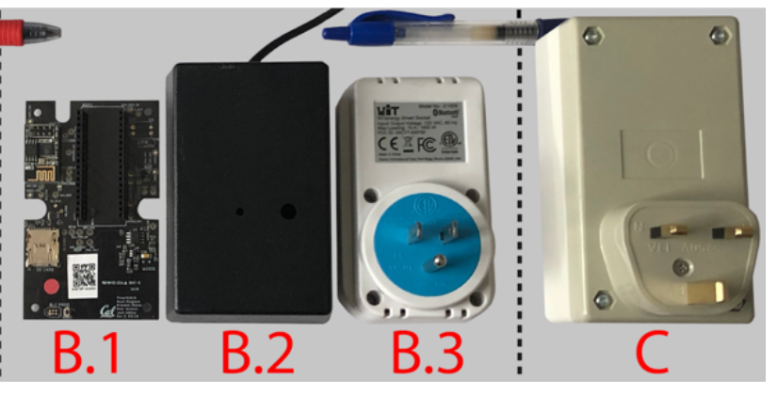
Powerwatch (Klugman, Adkins, et al.)
Goal: measure electric grid reliability in developing regions
“Access alone is insufficient. Reliability matters too.”
Solutions:
Wall-powered sensor with battery-backup to detect outages and report over cellular
Infrastructure to collect measurements and cross-correlate
Create a team to manage the deployment
https://lab11.eecs.berkeley.edu/content/pubs/klugman19scale.pdf

Slide 44
Outline
What haven’t we talked about?
Microbit
nRF52833
Sensing Systems Research

Slide 45
Bonus: Signpost
(Adkins, Ghena, Jackson, Pannuto, Rohrer, Campbell, Dutta)
https://lab11.eecs.berkeley.edu/content/pubs/adkins18signpost.pdf

Slide 46
What things might we want to sense at the scale of a city?

Slide 47
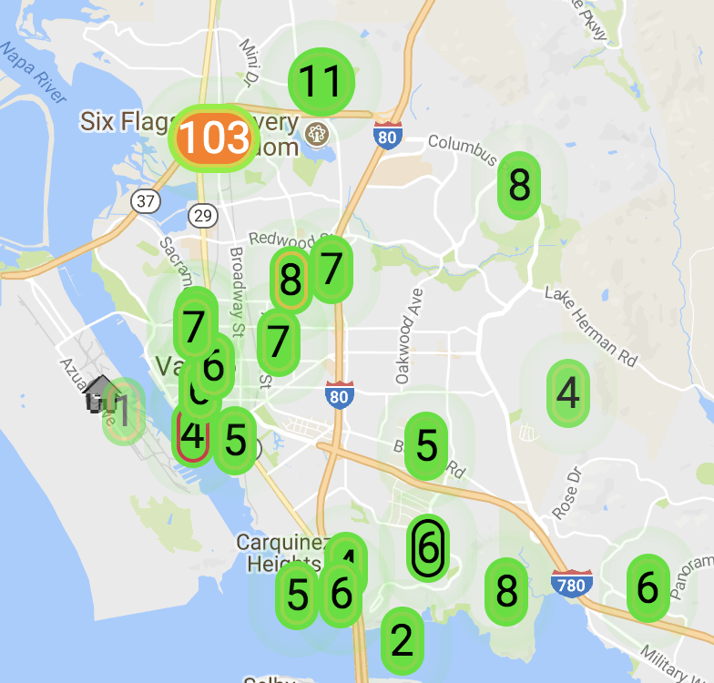
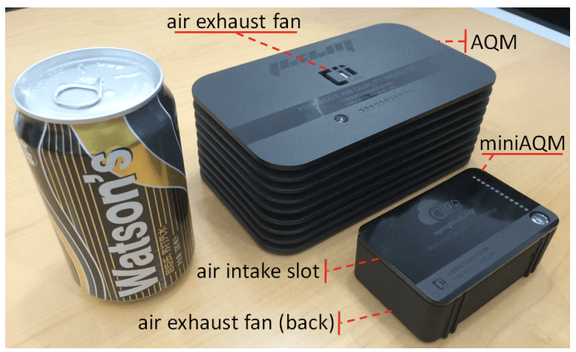
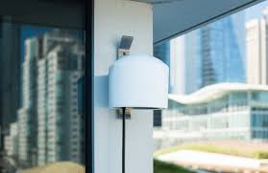
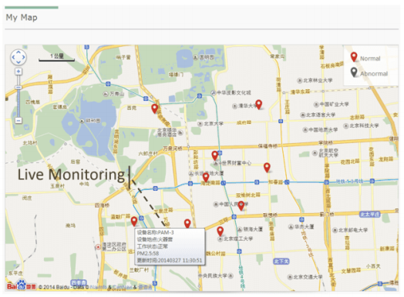
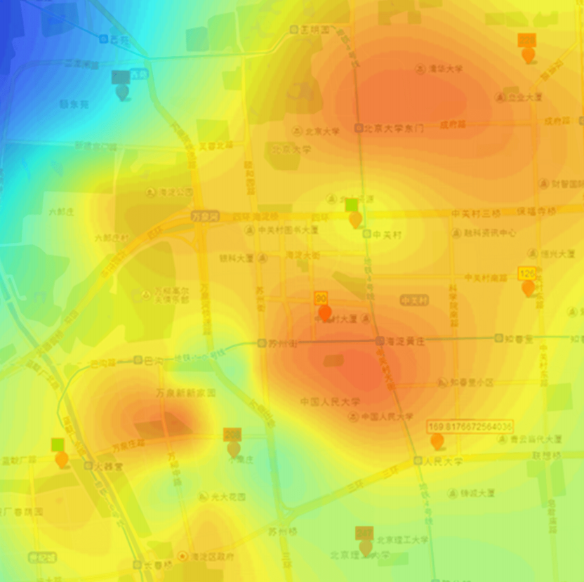
Air quality monitoring
[2]
[2]
[1]
[1]
[1] Cheng et al. AirCloud: a cloud-based air-quality monitoring system for everyone. 2014. [2] Purple Air. 2018.

Slide 48
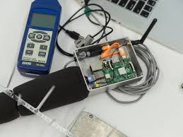
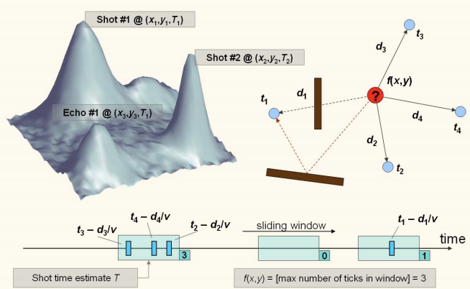
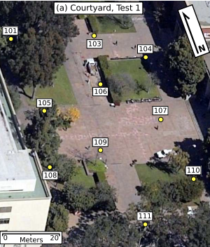
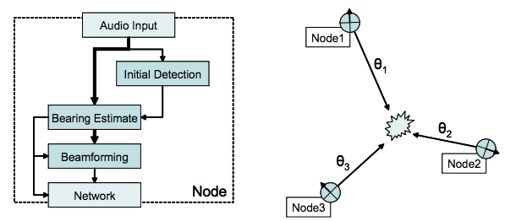
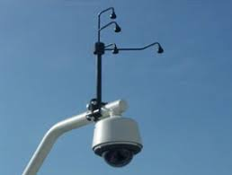
Audio detection, classification, and localization
[3]
[2]
[1]
[1]
[1] Girod et al. The Design and Implementation of a Self-Calibrating Distributed Acoustic Sensing Platform. 2006. [2] Lédeczi et al. Multiple Simultaneous Acoustic Source Localization in Urban Terrain. 2005. [3] Sounds of New York City. 2016.

Slide 49
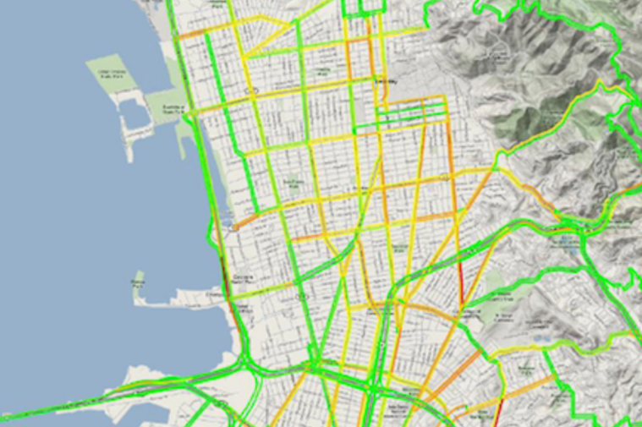
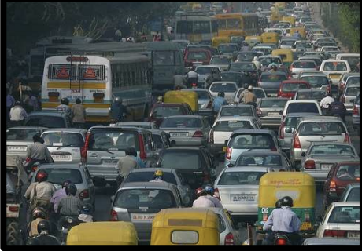
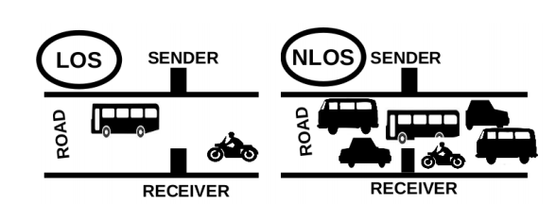
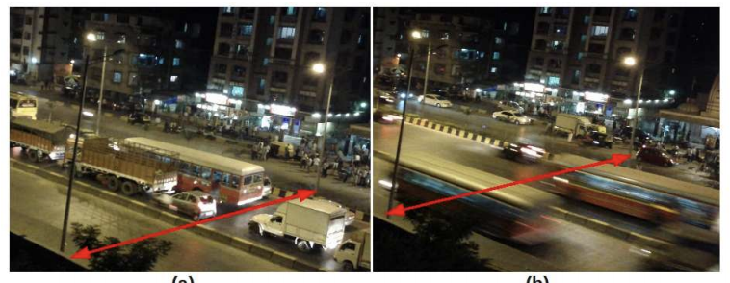
Traffic queue sensing and congestion control
[1]
[1]
[1]
[1] Sen et al. Kyun Queue: A Sensor Network System To Monitor Road Traffic Queues, 2012

Slide 50
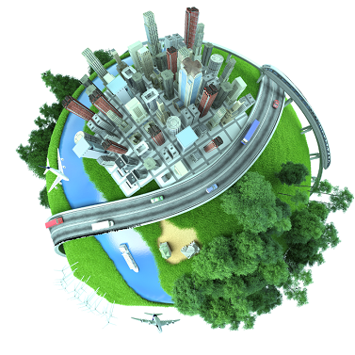

Slide 51
City-Scale Sensing Introduction
Signpost
Motivation
Shared Resources
Deployability
Implementation
Evaluation

Slide 52
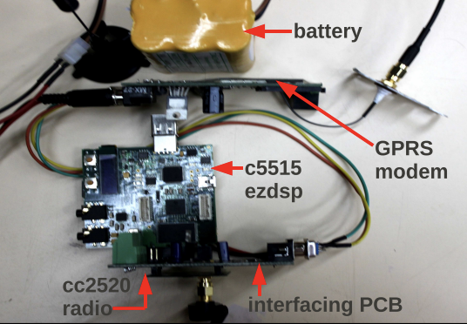
Air Quality Monitoring
Urban Noise Classification
Traffic Queue Sensing
[1]
[2]
[3]
Lots of interesting applications and interested parties. But let’s look at the process of actually creating and deploying an application.
[1] Cheng et al. AirCloud: a cloud-based air-quality monitoring system for everyone. 2014. [2] Sounds of New Your City. 2016. [3] Sen et al. Kyun Queue: A Sensor Network System To Monitor Road Traffic Queues, 2012

Slide 53
Many steps to building traffic queue sensing
Sensing Hypothesis/Hardware
[1] Sen et al. Kyun Queue: A Sensor Network System To Monitor Road Traffic Queues, 2012

Slide 54
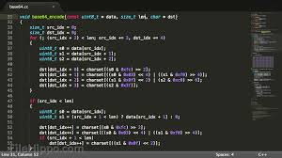
Many steps to building traffic queue sensing
Sensing Hypothesis/Hardware
Networking
Networking Driver
[1] Sen et al. Kyun Queue: A Sensor Network System To Monitor Road Traffic Queues, 2012

Slide 55
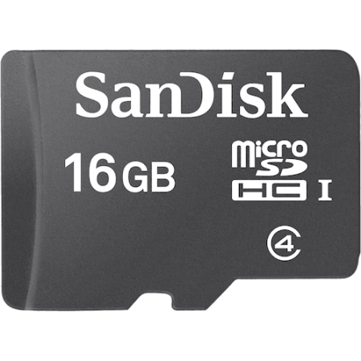
Many steps to building traffic queue sensing
Sensing Hypothesis/Hardware
Networking
Networking Driver
Storage
Storage Driver
[1] Sen et al. Kyun Queue: A Sensor Network System To Monitor Road Traffic Queues, 2012

Slide 56
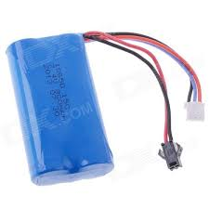
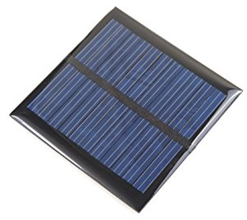
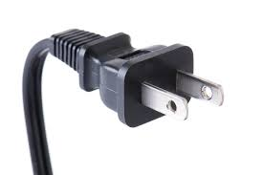
Many steps to building traffic queue sensing
Sensing Hypothesis/Hardware
Networking
Networking Driver
Storage
Storage Driver
Sustainable Power
[1] Sen et al. Kyun Queue: A Sensor Network System To Monitor Road Traffic Queues, 2012

Slide 57
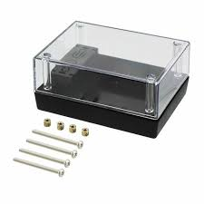
Many steps to building traffic queue sensing
Sensing Hypothesis/Hardware
Networking
Networking Driver
Storage
Storage Driver
Sustainable Power
Weatherproof Casing
[1] Sen et al. Kyun Queue: A Sensor Network System To Monitor Road Traffic Queues, 2012

Slide 58
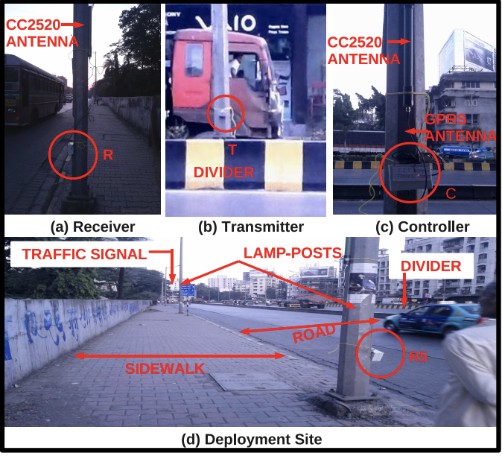
Many steps to building traffic queue sensing
Sensing Hypothesis/Hardware
Networking
Networking Driver
[1]
Storage
Storage Driver
Sustainable Power
Weatherproof Casing
Deploy
[1] Sen et al. Kyun Queue: A Sensor Network System To Monitor Road Traffic Queues, 2012

Slide 59
Key functions are repeated
[1]
Sensing Hypothesis/Hardware
Networking
Networking Driver
[1]
Storage
Storage Driver
Sustainable Power
Weatherproof Casing
Deploy
[1] Sounds of New York City. 2016

Slide 60
Key functions are repeated
[1]
Sensing Hypothesis/Hardware
Networking
Networking Driver
[1]
Storage
Storage Driver
Sustainable Power
Weatherproof Casing
Deploy
[1] Purple Air. 2018

Slide 61
Signpost Enables City-Scale Sensing
[1]
[1]
Sensing Hypothesis/Hardware
Deploy
Integrate with Signpost
Joshua Adkins, Branden Ghena, Neal Jackson, Pat Pannuto, Samuel Rohrer, Bradford Campbell, and Prabal Dutta ”The Signpost Platform for City-Scale Sensing." IPSN’18
[1] Purple Air. 2018.

Slide 62
City-Scale Sensing Introduction
Signpost
Motivation
Shared Resources
Deployability
Implementation
Evaluation

Slide 63
Key functions are repeated
[1]
Sensing Hypothesis/Hardware
Networking
Networking Driver
[1]
Storage
Storage Driver
Sustainable Power
Weatherproof Casing
Deploy
[1] Purple Air. 2018

Slide 64
Higher power/linux class processing
Can be provided with a GPS
Deployment | Services Needed
 | Power | Networking | Processing | Storage | Time | Synch | Location
Caraoke [3]
Bouillet et al. [4]
Aircloud [5]
Girod et al. [6]
Ledeczi et al. [7]
SenseFlow [8]
Argos [9]
SONYC [1]
Kyun Queue [10]
Micronet [11]

Slide 65
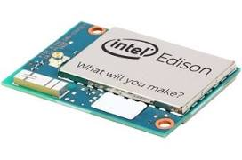
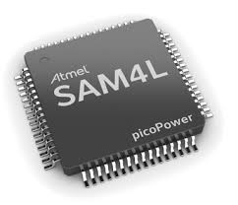
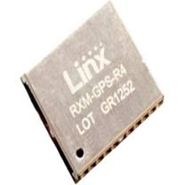
Software abstraction through a single interface
Sensor
Platform
Networking
Storage
Platform Interface
Platform Controller
High Performance Processing
Sensing Hypothesis/Hardware
- Ubiquitous
- Easy to adapt/implement
- Physically pluggable
Sustainable Power
GPS

Slide 66
Abstracting away functionality
Sensor
Platform
Networking
Networking Driver
Storage
Storage Driver
Sensing Hypothesis/Hardware
Sustainable Power
Weatherproof Casing

Slide 67
A hardware abstraction is not sufficient
Sensor
Platform
Networking
Storage
Sensing Hypothesis/Hardware
High Performance Processing
Sustainable Power
GPS

Slide 68
A hardware abstraction is not sufficient
Sensor
Platform
Networking Interface
Storage Interface
Networking
Storage
Processing Interface
Sensing Hypothesis/Hardware
High Performance Processing
GPS Interface
Sustainable Power
GPS
Multiple Interfaces = Multiple Drivers

Slide 69
Software abstraction through a single interface
Sensor
Platform
Networking
Storage
Platform Interface
Platform Controller
High Performance Processing
Sensing Hypothesis/Hardware
Sustainable Power
GPS

Slide 70
City-Scale Sensing Introduction
Signpost
Motivation
Shared Resources
Deployability
Implementation
Evaluation

Slide 71
Some applications require granularity
Data can change greatly in low distances
Outlier
Notes:
If we want to

Slide 72
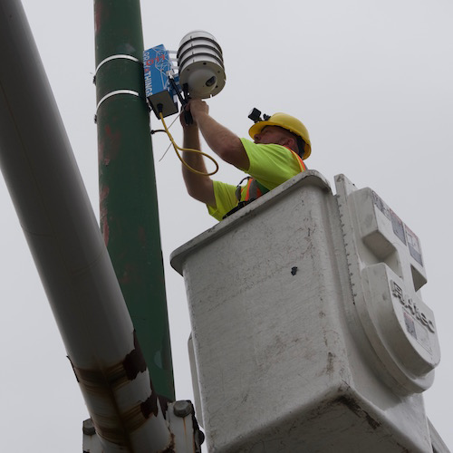
Deployment overhead drives cost
Expensive to work with the city
Time consuming
Not conducive to experimentation!
Do not rely on wired infrastructure
No wired power
Solar provides more power density than batteries
No wired networking
Should not modify existing infrastructure

Slide 73
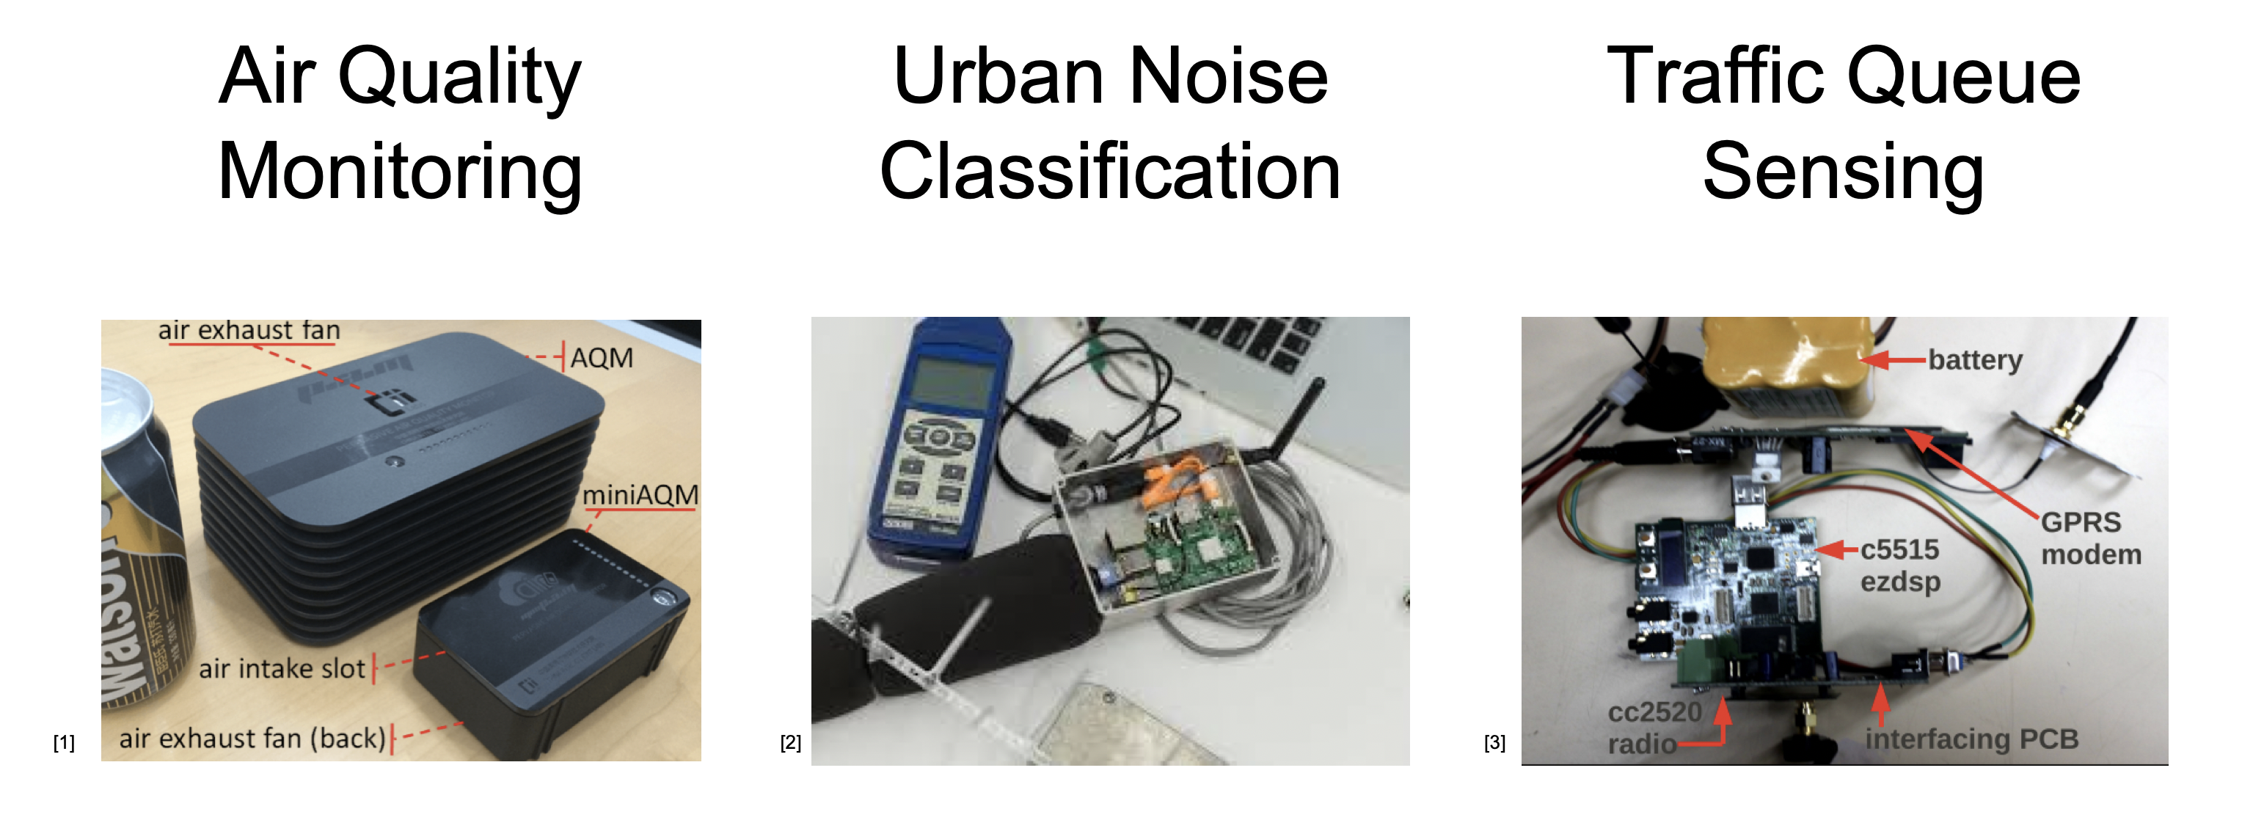
Multi-tenancy is beneficial to testbeds
One deployment can enable many stakeholders simultaneously
Need to ensure that they do not conflict

Slide 74
City-Scale Sensing Introduction
Signpost
Motivation
Shared Resources
Deployability
Implementation
Evaluation

Slide 75
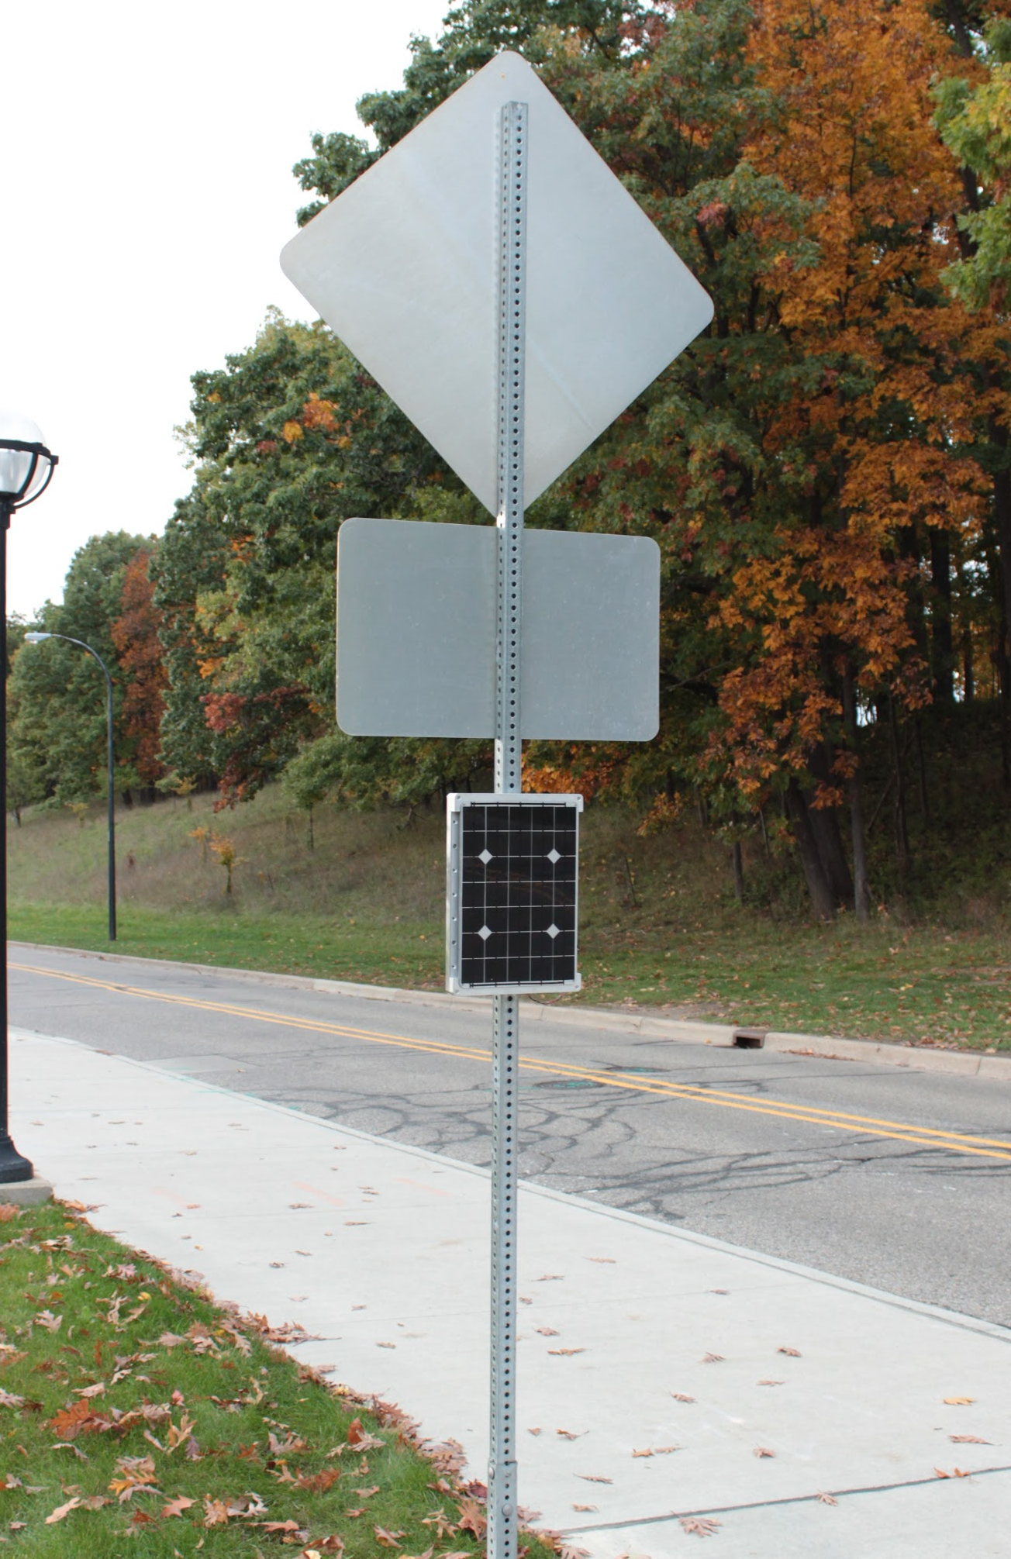
The Signpost Platform

Slide 76
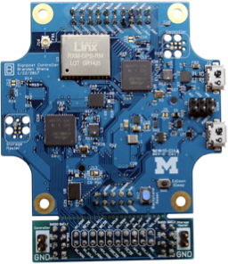
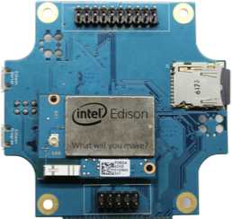
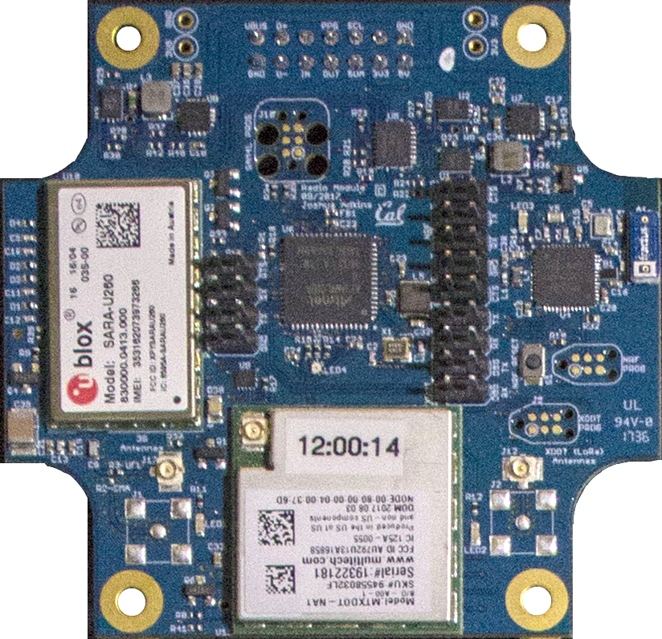
Core modules provide shared resources
Control Module
Radio Module
GPS
Storage
3G
Networking
BLE
Processing
LoRa
Making the platform modular supports upgradeability

Slide 77
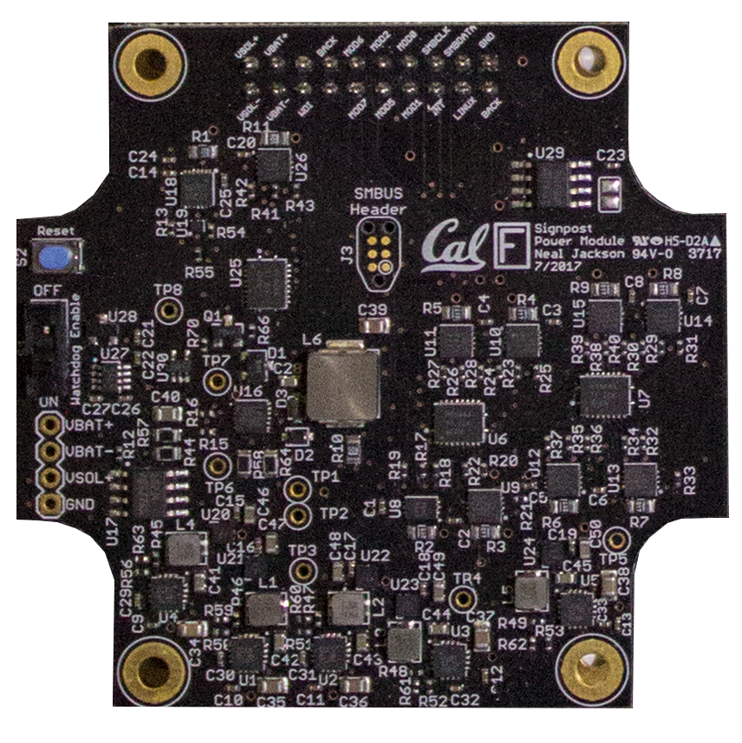
Measurement and isolation support multi-tenancy
Isolation
& Monitoring
Power Metering

Slide 78
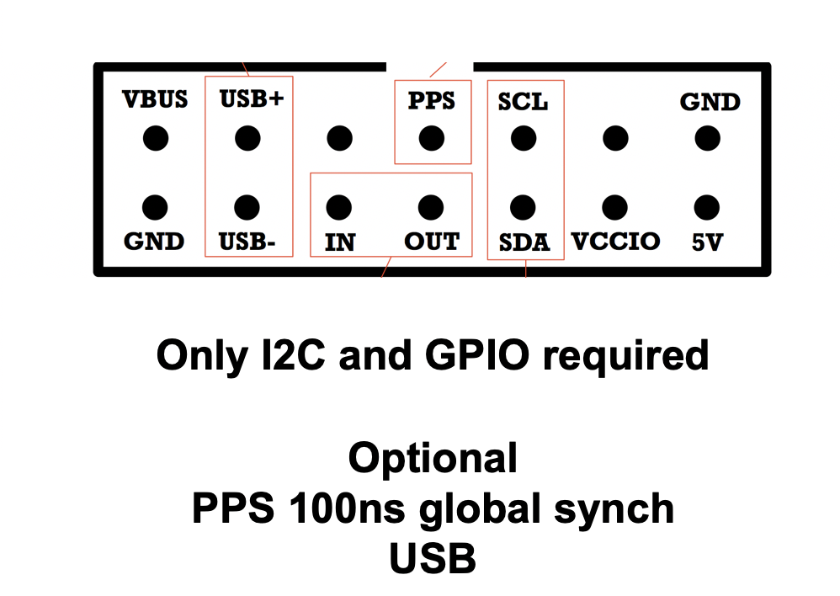
Standard interface for accessing shared resources
Any software framework can be used for modules

Slide 79
Array of Things is one platform approach
Include sensors as platform resources
Applications are software that act on sensor data
High-power hardware and expensive to deploy

Slide 80
Signpost explores the other end of the spectrum
What can we do with less?
Low-power, low-capability, extremely deployable
Limited provided resources, but lots of extensibility
Focus on modularity
Too difficult to start from scratch for every upgrade/change
Components are more expensive
Deployments is more difficult
The platform should be viewed as shared infrastructure!
Amortize cost with multiple sensors and applications

Slide 81
City-Scale Sensing Introduction
Signpost
Motivation
Shared Resources
Deployability
Implementation
Evaluation

Slide 82
How much power does a Signpost harvest?
Higher daily variations than directional variations
Notes:
Bigger text ,fix font
Write takeaways on the slide

Slide 83
How much power can each module draw?
Notes:
Make sure to say it only gets better with scaling - better look
takeaway

Slide 84
How much power can each module draw?
Seattle 95th Percentile = 3 mW
San Diego 95th Percentile = 162 mW
Notes:
Make sure to say it only gets better with scaling - better look
takeaway

Slide 85
How much power can each module draw?
Notes:
Make sure to say it only gets better with scaling - better look
takeaway

Slide 86
Resources are charged to modules which use them
Notes:
Fix font

Slide 87
Applications running on Signpost
Environmental monitoring (posting to Weather Underground)
Vehicle counting (and bell tower)
TV whitespace sensing
Notes:
Fix font, callout on diurnal power patter/concert

