Slide 1
Lecture 17 Energy Management
CE346 – Microprocessor System Design
Branden Ghena – Spring 2021
Some slides borrowed from: Josiah Hester (Northwestern), Prabal Dutta (UC Berkeley), Brandon Lucia (Carnegie Mellon)

Slide 2
Administrivia
Quiz 4 is available
Due Friday
Demo details coming on Wednesday
~9 days to complete your project

Slide 3
Today’s Goals
Consider energy and microcontroller systems
What are the energy sources?
What are the energy sinks?
Understand sleep mode on a microcontroller
Discuss software for low-energy operation

Slide 4
Outline
Energy Sources
Energy Management
Sleep
Intermittent computing

Slide 5
Energy sources
Need some way to gain energy to power system
Choices affect mobility, lifetime, software design, and capabilities
Is the device tied to its power source?
Must a human manually provide more energy?
How do I write software to ensure “progress” is made?
What sensors/actuators can the device run?

Slide 6
Measuring energy use
Base equations
Power = Current * Voltage (Watts)
Energy = Power * Time (Joules)
Energy = volts * amps * seconds
Voltage is usually constant for a system
Time is how long you are running for / measurement period
Current changes based on activities being done
Often energy is presented as a current draw
Maybe an average current draw
With Voltage and Time implicit

Slide 7
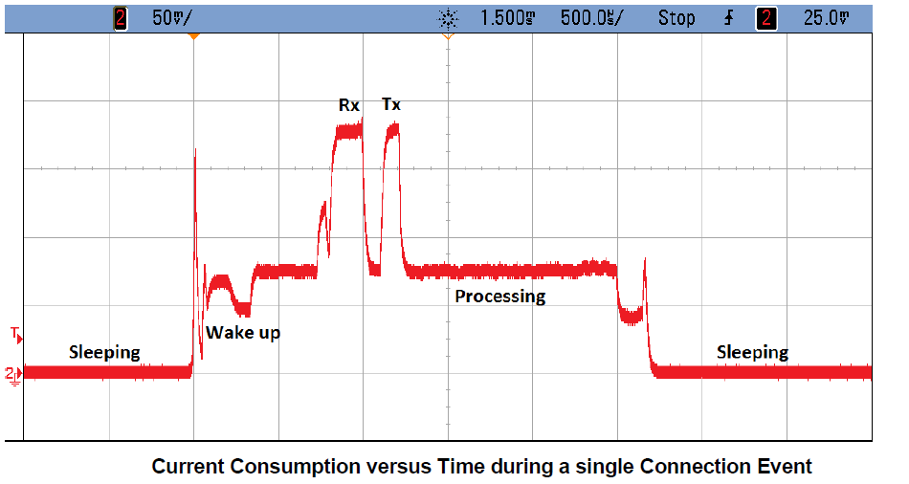
Example current trace during wireless communication

Slide 8
Wired power through USB
Provides 5v at up to 500 mA (USB 2.0) or 900 mA (USB 3.0)
Or power delivery specifications, which can do far more power
Must be converted to different voltage to use
Voltage regulator takes in 5v and spits out 3.3v
Has its own maximum current!
System is limited by the minimum of USB or regulator power
Microbit: regulator gives 3.3v at up to 600 mA
USB 2.5 Watts, Regulator 1.98 Watts ⇨ System 1.98 Watts
This is a max! Stay 15-30% below regulator limit

Slide 9
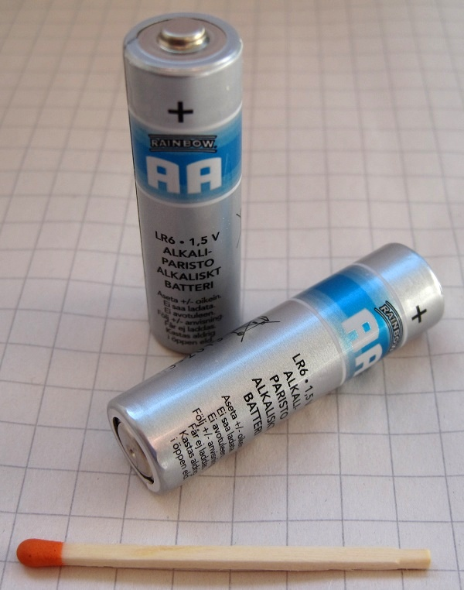
Thinking about energy
Batteries often list energy in mA*h (milliamp – hours)
Coin cell battery: 3v at 220 mAh
2x AA battery: 3v at 2000 mAh
iPhone 11 battery: 3.7v at 3000 mAh
Also usually limited by regulator
Sometimes just directly connected to system
We can run at 3v just fine! (3.7v is no good though)
Voltage can vary with charge
But only a little, right before battery is depleted
Example: coin cell goes down to ~2.7 volts

Slide 10
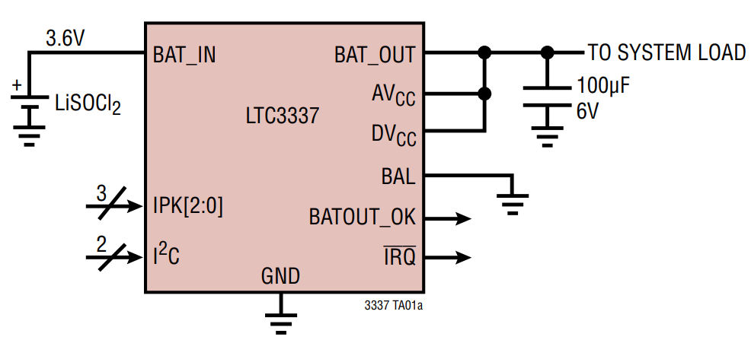
How are batteries measured?
Measuring energy remaining is a difficult problem
Many questions to be handled
How much did it start with?
How much energy has been used?
What type of battery is it?
Energy is not as constant a quantity as one would hope
Pulling out lots at once has an overhead penalty
Coulomb Counter (aka Battery Fuel Gauge)
Designed for a specific battery “chemistry”
Monitors charge flowing in each direction
I2C interface for reading battery state
Accuracy is not exact, more of an educated guess

Slide 11
How are batteries managed?
Usually a dedicated IC for charging and managing battery packs
Recharges battery with appropriate amount of current
Monitors issues of battery health
Various status monitoring
Overcharge, undercharge
Overcurrent
Overtemperature, undertemperature
Will go so far as to cut off the system to protect the battery
Takeaway: complicated problem, approach with caution!
Best to reuse an existing design, if possible

Slide 12
Microbit only uses battery energy in a simple way
Battery input connects directly to regulator
No protection for battery health
No battery charging capabilities
Usually this is fine for simple, low-power systems

Slide 13
Energy harvesting
Grab energy from the environment and use that!
Could augment with a battery and use energy to recharge
Could go entirely batteryless and live on harvested energy alone
Sources
Light (outdoor or indoor. most successful)
Airflow (outdoor or air vents)
Motion (on human body)
Temperature differential (difficult in practice)
RF (very low energy source)

Slide 14
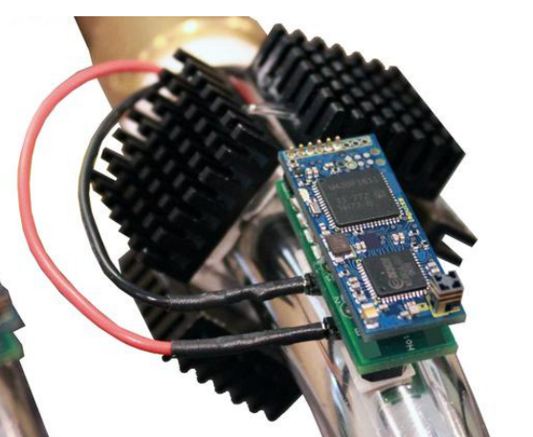
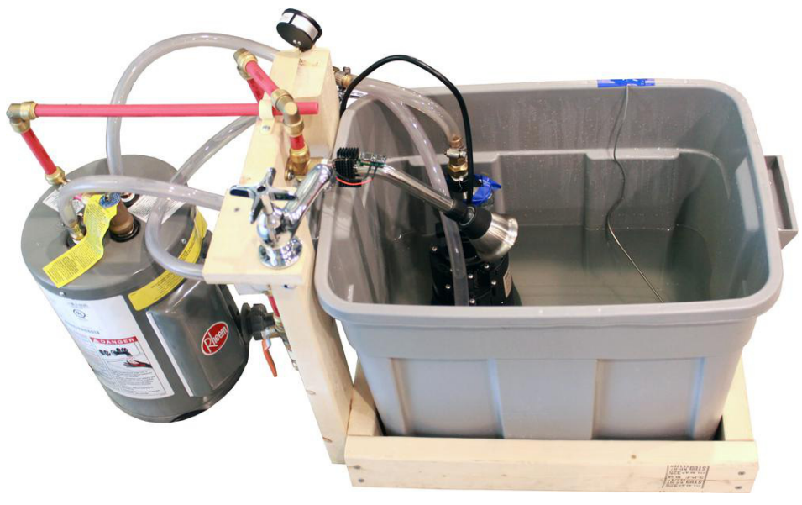
Temperature harvesting from hot pipes
Peltier junctions create a voltage from temperature differential
Challenge: needs a large differential for more energy

Slide 15
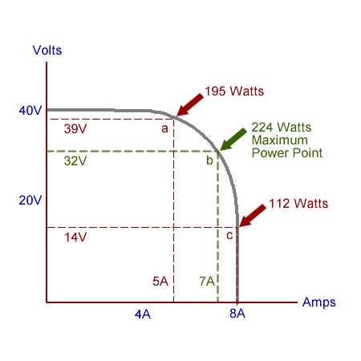
Managing harvested energy
Often uses an IC to pull in energy and provide to system
Harvested voltage/current are often very small
Signal in millivolts is pretty common
Need to accumulate over time to power system
Fill up a capacitor
Need particular load for maximum power
ICs often implement Maximum Power Point Tracking (MPPT)
Varies load automatically to always harvest the most possible energy

Slide 16
Outline
Energy Sources
Energy Management
Sleep
Intermittent computing

Slide 17
Thinking about energy
Battery energy
Coin cell battery: 3v at 220 mAh
2x AA battery: 3v at 2000 mAh
iPhone 11 battery: 3.7v at 3000 mAh
nRF52833 active current: 5.6 mA (at 3v)
Coin cell: 40 hours -> ~2 days
2x AA: 360 hours -> ~15 days
iPhone 11: 535 hours -> ~22 days
So how does any of this work???

Slide 18
Sleep mode power draw

Slide 19
Microcontroller sleep modes
Sleep mode
Processor stops running
Most peripherals are disabled
Continues until an interrupt occurs and wakes the microcontroller
Usually a timer or GPIO input
nRF52833 sleep mode current: 1.8 μA (GPIO port event only)
Coin cell: 122222 hours -> ~5000 days -> ~14 years
Low-power systems shoot for less than 1% duty cycle
Average current of ~100 μA or less
Warning: other stuff on the board counts!!
LEDs are 1-10 mA each… Power is not a concern of the Microbit

Slide 20
Microbit current draw (microcontroller)
Active CPU
5.6 mA (executing from Flash)
1.8 μA (sleep mode with RAM retention)
Transmitting RF packet
15.5 mA (+8 dBm)
Other peripherals
SAADC: 1.37 mA
Timer: 729 μA (for any Timer peripheral)
I2C: 6.6 mA (pull-down resistors when transmitting 0 bit)
Everything else is handfuls of μA

Slide 21
Microbit current draw (non-microcontroller)
KL27 (JTAG interface microcontroller)
2 μA sleep, 8 mA active
Speaker
0-27.5 mA (changes with input signal)
Microphone
0-120 μA (activated with GPIO pin)
Accelerometer/Magnetometer
2-212 μA (depends on sensing rates, 200 is magnetometer)
LEDs
0-230 mA (can be activated individually)
Everything else
0-1 mA (mostly due to pull-up resistors)

Slide 22
Max and min current for Microbit
Maximum current: 280 mA at 3.3 volts (~1 W)
With everything active
Well within limits of regulator
Minimum current
~15 mA (always-on power LED)
If you removed the power LED:
<100 μA (with everything off)

Slide 23
nRF52 sleep mode
Triggered with assembly instruction
WFI (Wait For Interrupt) or WFE (Wait For Event)
Stops processor until woken by interrupt, exception, or event
On nRF52 automatically disables high frequency clock if unneeded

Slide 24
Software stops when the processor does, but peripherals continue
Problem: when the processor is off, no code is running
Solutions
Peripherals can wake it up again
Can probably go for milliseconds to minutes without any actions
Timer interrupt can wake processor to do things
Have hardware handle some parts in the background without the processor’s involvement
DMA
PPI

Slide 25
Controlling peripherals while processor sleeps
DMA (Direct Memory Access)
Set up a pointer to memory and a length
Peripheral can load/store memory without processor’s involvement
Usually use completion interrupt to wake processor
PPI (Programmable Peripheral Interconnect)
Any Event can be tied to any Task within the nRF52
Allows for complicated actions to be chained together

Slide 26
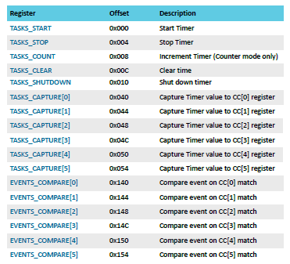
nRF52 Tasks and Events
Example: Timer peripheral
Tasks are used to perform some operation
Often written to by software
Events change value when some change in status occurs
Often used to trigger interrupts
PPI peripheral can connect any TASK to any EVENT

Slide 27
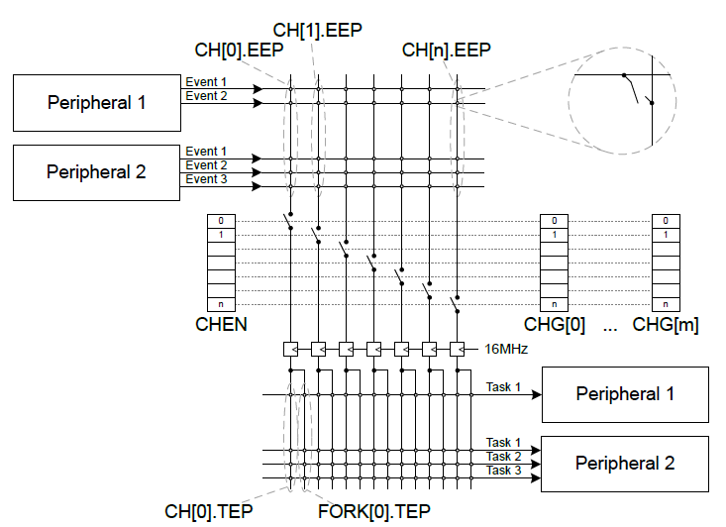
nRF52 PPI peripheral
Connects Events to Tasks via hardware
Each channel gets one Event pointer and up to two Task pointers
Must point to Event/Task registers

Slide 28
Example PPI use case
Automatic high-speed ADC sampling
Software configures and sleeps
ADC (buffer and enable)
Timer (prescaler, compare value, short from compare to clear, and start)
PPI: When Timer fires (EVENTS_COMPARE[0]),
Sample ADC (TASKS_SAMPLE)
PPI: When ADC buffer full (EVENTS_END),
Stop Timer (TASKS_STOP)
Fork: wake processor (via software interrupt from EGU)

Slide 29
Outline
Energy Sources
Energy Management
Sleep
Intermittent computing

Slide 30
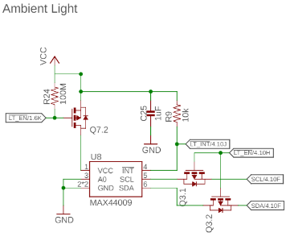
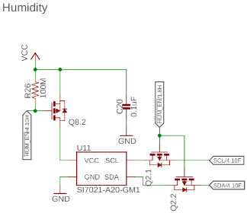
Reducing energy consumption even further
If sleep isn’t enough, you can power things off completely
Transistor can be used to turn off the sensor

Slide 31
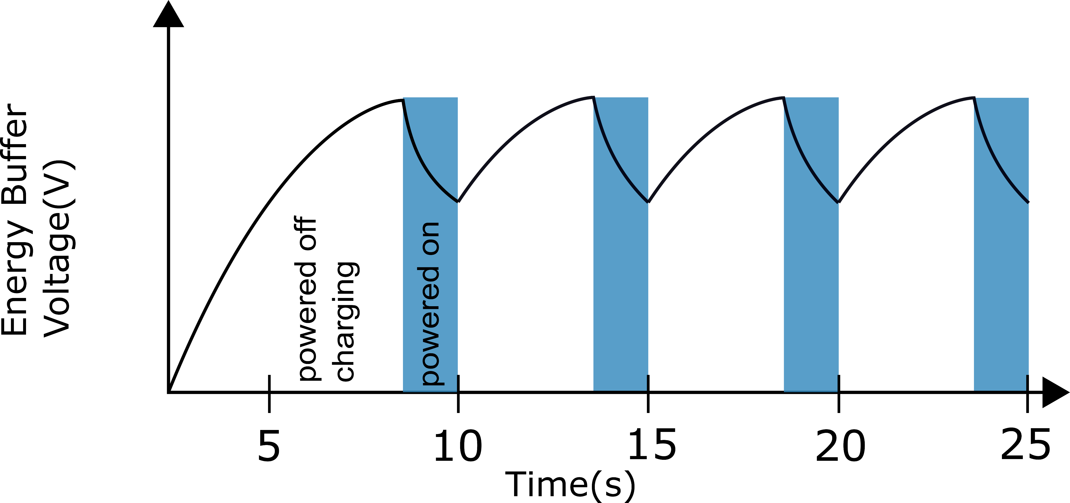
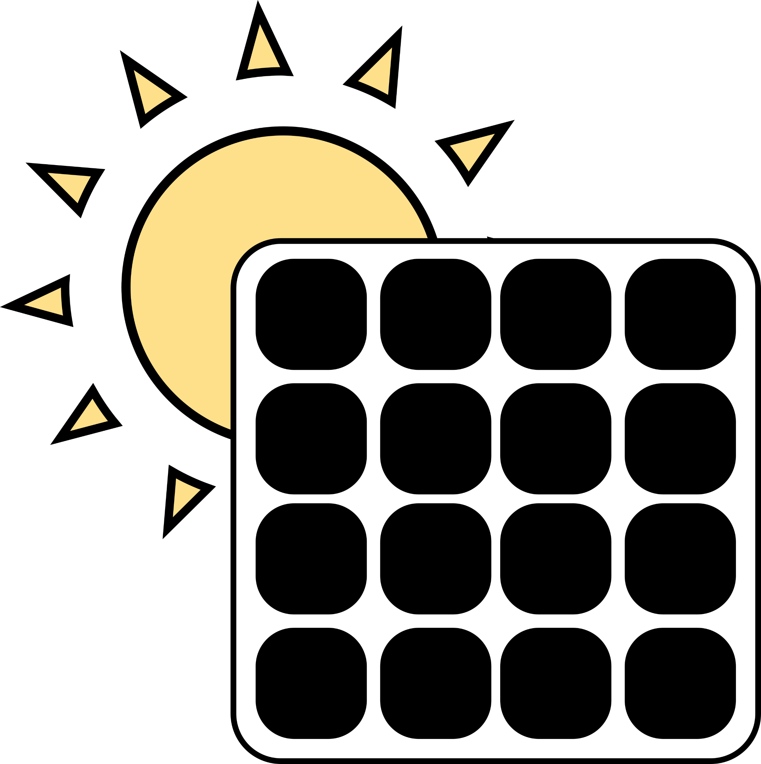
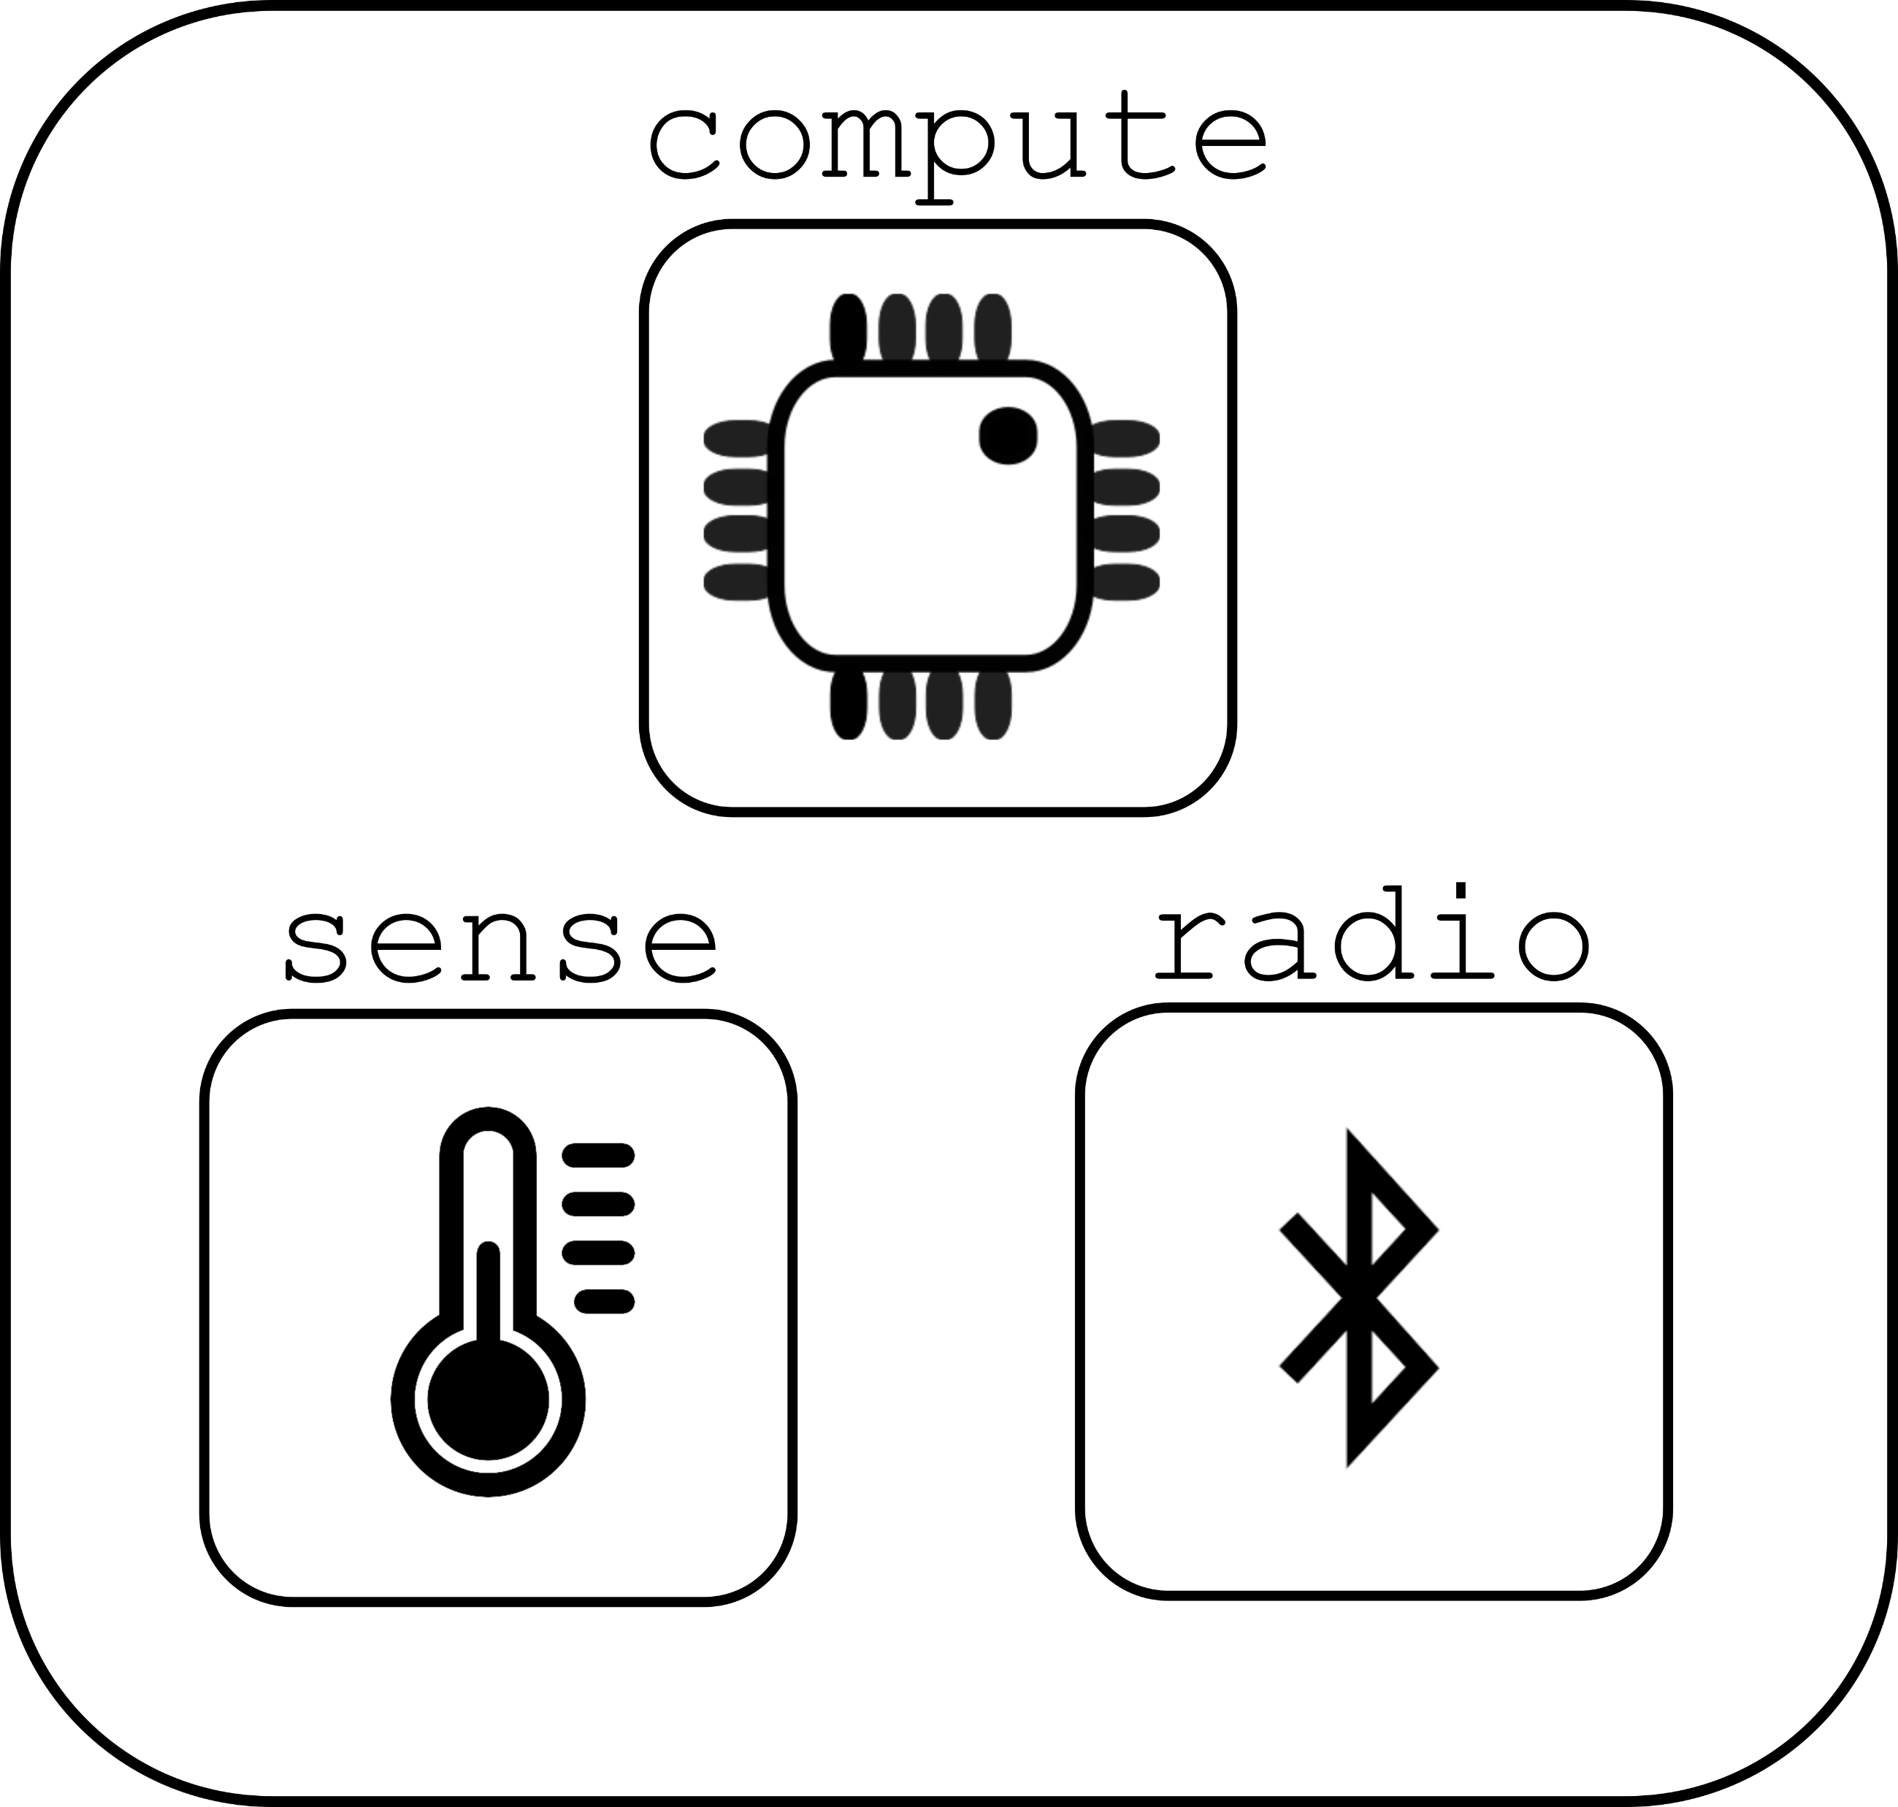
Energy harvesting can lead to intermittent computing

Slide 32
Disabling the microcontroller
Even 2 μA sleep current might be too much for energy harvesting
Can turn off microcontroller periodically
Enable it again once VCC returns
Problem: how do you write software to deal with intermittency?
Run-to-completion with relatively quick code
Initialize, sample sensor, send packet, turn off again
Code checkpointing
Save state from code and restore when power resumes
Might be as little as which state the system is in, plus some samples
Might be as much as saving entire stack state
Needs low-energy, nonvolatile storage (FRAM or MRAM help!)

Slide 33
Programs may not finish
int process() {
count++;
buf[count] = accel();
avg = sum(buf)/count;
transmit(avg);
}
count++
buf[count] = accel()
Power fail
Execution Time
Notes:
More detailed explanation WHY volatile/non-volatile etc. Perhaps split to two slides
Add callout saying we need latch, etc.
Make capy bigger

Slide 34
Programs may not finish
int process() {
count++;
buf[count] = accel();
avg = sum(buf)/count;
transmit(avg);
}
count++
buf[count] = accel()
Power fail
Execution Time
count++;
buf[count] = accel()
Power fail
.
.
.
Notes:
More detailed explanation WHY volatile/non-volatile etc. Perhaps split to two slides
Add callout saying we need latch, etc.

Slide 35
Programs may not finish
int process() {
count++;
buf[count] = accel();
avg = sum(buf)/count;
transmit(avg);
}
count++
buf[count] = accel()
Power fail
Execution Time
count++;
buf[count] = accel()
Power fail
.
.
.
Need to latch execution state periodically!
Notes:
More detailed explanation WHY volatile/non-volatile etc. Perhaps split to two slides
Add callout saying we need latch, etc.

Slide 36
Checkpointing enables progress
int process() {
count++;
buf[count] = accel();
avg = sum(buf)/count;
transmit(avg);
}
Execute with checkpoints
count++
buf[count] = accel()
count++
buf[count] = accel()
Checkpoint
Power fail
Power fail
Execution Time
count++;
buf[count] = accel()
Power fail
.
.
.
Need to latch execution state periodically!
Notes:
More detailed explanation WHY volatile/non-volatile etc. Perhaps split to two slides
Add callout saying we need latch, etc.

Slide 37
Checkpointing enables progress
int process() {
count++;
buf[count] = accel();
avg = sum(buf)/count;
transmit(avg);
}
Execute with checkpoints
count++
buf[count] = accel()
count++
buf[count] = accel()
Checkpoint
Power fail
Power fail
Execution Time
count++;
buf[count] = accel()
buf[count] = accel()
avg = sum(buf)/count
transmit-
Power fail
Checkpoint
Power fail
.
.
.
Need to latch execution state periodically!
Notes:
More detailed explanation WHY volatile/non-volatile etc. Perhaps split to two slides
Add callout saying we need latch, etc.

Slide 38
Checkpointing enables progress
int process() {
count++;
buf[count] = accel();
avg = sum(buf)/count;
transmit(avg);
}
Execute with checkpoints
count++
buf[count] = accel()
count++
buf[count] = accel()
Checkpoint
Power fail
Power fail
Execution Time
count++;
buf[count] = accel()
buf[count] = accel()
avg = sum(buf)/count
transmit-
Power fail
Checkpoint
Power fail
.
.
.
Need to latch execution state periodically!
transmit(avg)
Notes:
More detailed explanation WHY volatile/non-volatile etc. Perhaps split to two slides
Add callout saying we need latch, etc.

Slide 39
Checkpointing goals
Have the compiler automatically insert checkpoints as needed
Human doesn’t have to think about them when programming
Limit checkpointing overhead while maximizing forward progress
Checkpointing will take time to perform, so want to do it rarely
Rarer checkpoints mean more progress is lost in average outage
Need to compromise on the two based on available energy

Slide 40
Outline
Energy Sources
Energy Management
Sleep
Intermittent computing

