Slide 1
Lecture 08 Analog Input
CE346 – Microprocessor System Design
Branden Ghena – Spring 2021
Some slides borrowed from: Josiah Hester (Northwestern), Prabal Dutta (UC Berkeley)

Slide 2
Today’s Goals
Explore methods for sensing analog signals
Comparators
Analog-to-Digital Converters
Discuss nRF implementation of these peripherals

Slide 3
Outline
Comparators (and nRF implementations)
General ADC Design
nRF ADC Implementation

Slide 4
Analog signals
Exist in infinite states
From a maximum to a minimum
Often used for interactions with the real world
Sensors usually generate analog signals
Microbit example: microphone

Slide 5
Interacting with analog signals
Microcontrollers are inherently digital
Need a method for translating analog signal into a digital one
Options:
Determine if signal is higher or lower than some amount (Boolean)
Determine voltage value of signal (N-bit number)

Slide 6
Interacting with analog signals
Microcontrollers are inherently digital
Need a method for translating analog signal into a digital one
Options:
Determine if signal is higher or lower than some amount (Boolean)
Determine voltage value of signal (N-bit number)
Determination is done by a Comparator

Slide 7
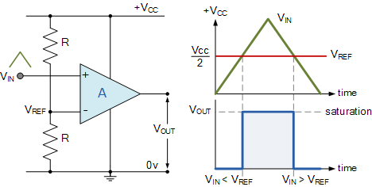
General comparator design
Compares an analog input signal to a reference voltage
V_{OUT} digital signal
High: V_{IN} > V_{REF}
Low: V_{IN} < V_{REF}
Advantages:
Simple
Low power

Slide 8
Comparator design questions
What reference voltages are available?
Usually a few internal voltages
Usually also allows external references
When is an output generated?
Usually when status changes
Low-to-high, High-to-low, Both (like GPIO interrupts)

Slide 9
Hysteresis
A window added around signal state changes to prevent small amounts of noise from changing the output

Slide 10
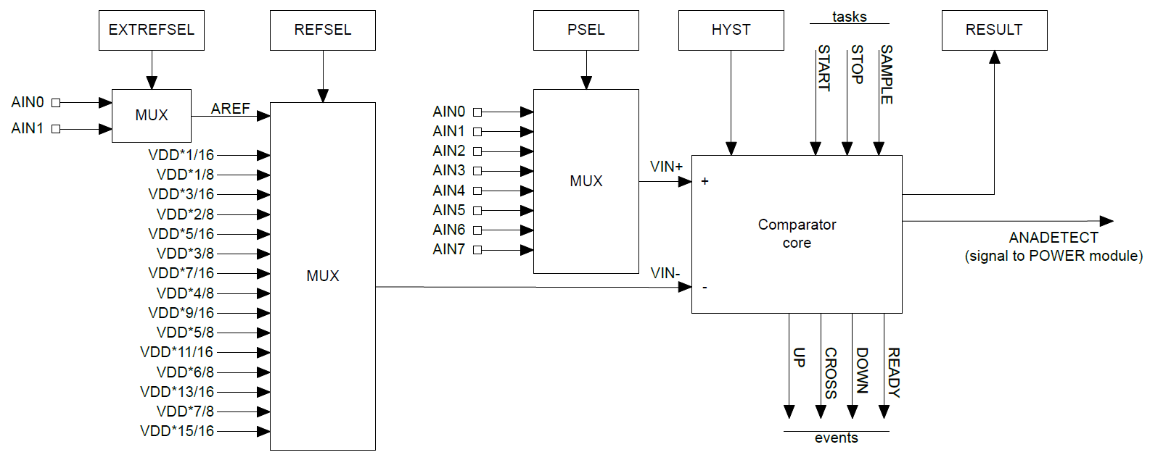
nRF low-power comparator (LPCOMP)

Slide 11
nRF low-power comparator (LPCOMP)
Input: one of eight analog input pins

Slide 12
nRF low-power comparator (LPCOMP)
Reference: one of two analog inputs or selection of VDD * N/16

Slide 13
nRF low-power comparator (LPCOMP)
Hysteresis: +/- 50 mV range around VIN- when enabled

Slide 14
nRF low-power comparator (LPCOMP)
Events: transition signals + ready (~150 μs)

Slide 15
nRF low-power comparator (LPCOMP)
Can also request what the current comparison state is (high/low)

Slide 16
nRF low-power comparator (LPCOMP)
Can be used for low-power wakeup of microcontroller

Slide 17
nRF COMP peripheral
Analog Comparator (not low power)
More advanced version of a comparator (otherwise similar)
What advantages would a more capable comparator have?
More possible reference voltages
LPCOMP: VDD or input COMP: VDD, 1.2v, 1.8v, 2.4v, or input
LPCOMP: 16 levels COMP: 64 levels
Configurable hysteresis
LPCOMP: +/- 50 mV COMP: any of the N/64 voltage levels
Faster detection
LPCOMP: 5 μs COMP: 0.1-0.6 μs (depending on power mode)

Slide 18
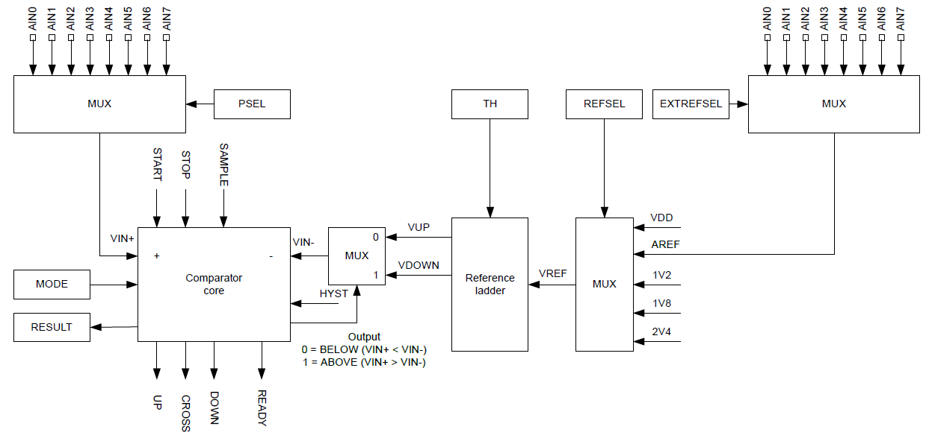
nRF COMP peripheral

Slide 19
Internal reference voltages
Why have internal voltage references other than VDD?

Slide 20
Internal reference voltages
Why have internal voltage references other than VDD?
What if want you want to measure is VDD?
Battery voltage
Did someone just unplug me?
etc.
What if VDD isn’t stable?
Battery voltage
Energy-harvesting system
Hard to know what any particular value means…

Slide 21
Outline
Comparators (and nRF implementations)
General ADC Design
nRF ADC Implementation

Slide 22
Interacting with analog signals
Microcontrollers are inherently digital
Need a method for translating analog signal into a digital one
Options:
Determine if signal is higher or lower than some amount (Boolean)
Determine voltage value of signal (N-bit number)
Translation is done by an Analog-to-Digital Converter (ADC)

Slide 23
Quantization
Analog voltages are represented by discrete voltage levels
Comparators are 1-bit ADCs
Split into two regions
Good ADCs split into 4000-16000 regions
More levels gives a more accurate representation of the signal

Slide 24
Translating voltage and ADC counts
Analog
Digital (8-bit)
Digital (12-bit)
3.3 V
255
4095
232
3723
$$Value = \frac{V_{IN}}{V_{REF}}∗\left(2^{Resolution}−1\right)$$
V_{REF} selects maximum range
Ground is usually minimum range
Resolution depends on hardware
Either hardcoded or a selection
3 V
155
2482
2 V
77
1241
1 V
0 V
0 V
0
0

Slide 25
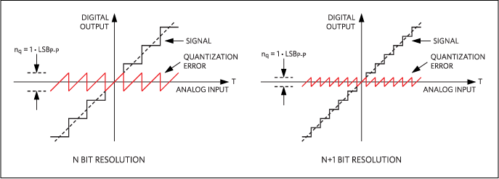
Quantization error
Resolution choice determines magnitude of error
Each extra bit halves the magnitude of error

Slide 26
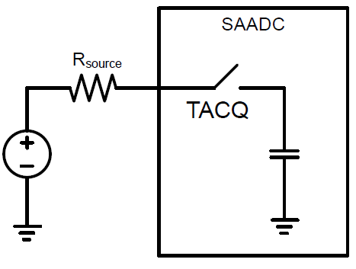
Analog to digital translation process
Two steps:
Acquisition
Read in signal for some amount of time
Signal connected to a capacitor
Fills capacitor up to voltage level
Speed depends on input resistance
1-100 μs is common
Conversion
Determine which digital value the read signal corresponds to

Slide 27
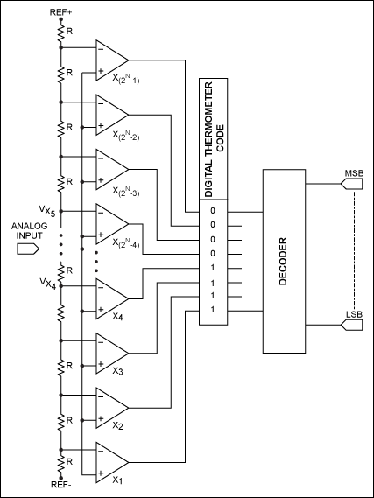
Direct-conversion ADC
Chain comparators together
Each with a separate reference voltage
Digital value determined immediately
Also known as “Flash” ADCs
Downside: needs 2^{n}-1 comparators
Reserved for expensive applications

Slide 28
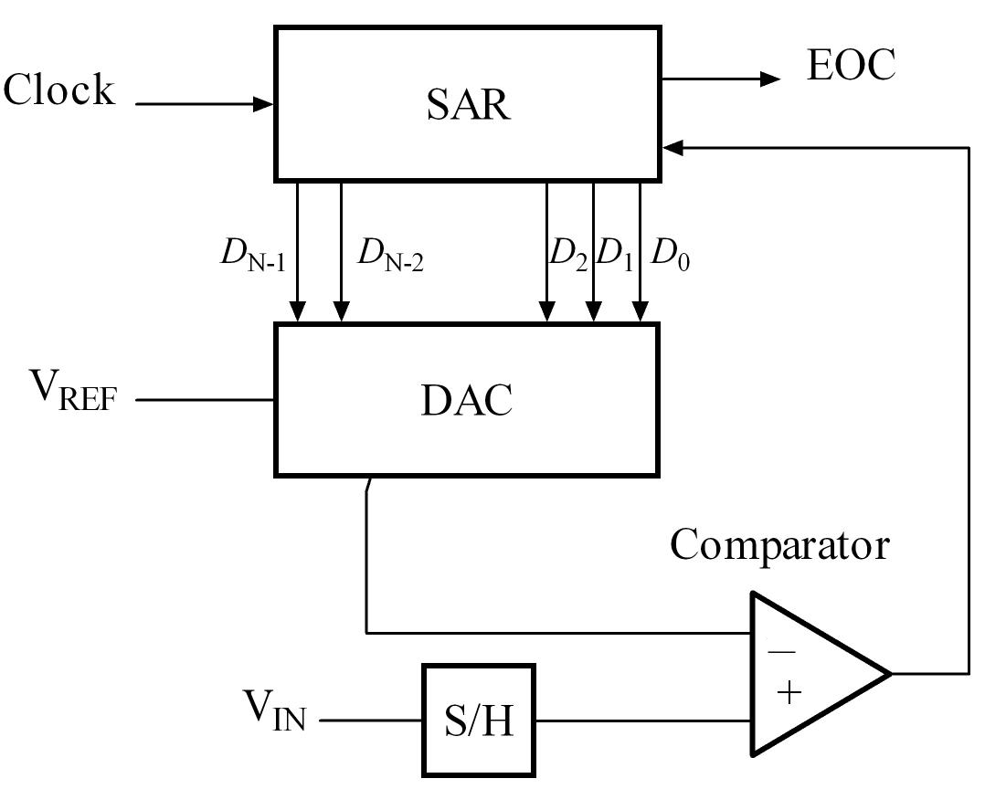
Successive-Approximation ADC
Method:
Compare signal to generated reference
Increase or decrease reference as needed
Repeat
DAC creates reference (Digital-to-Analog Converter)
Final value of DAC is the ADC value

Slide 29
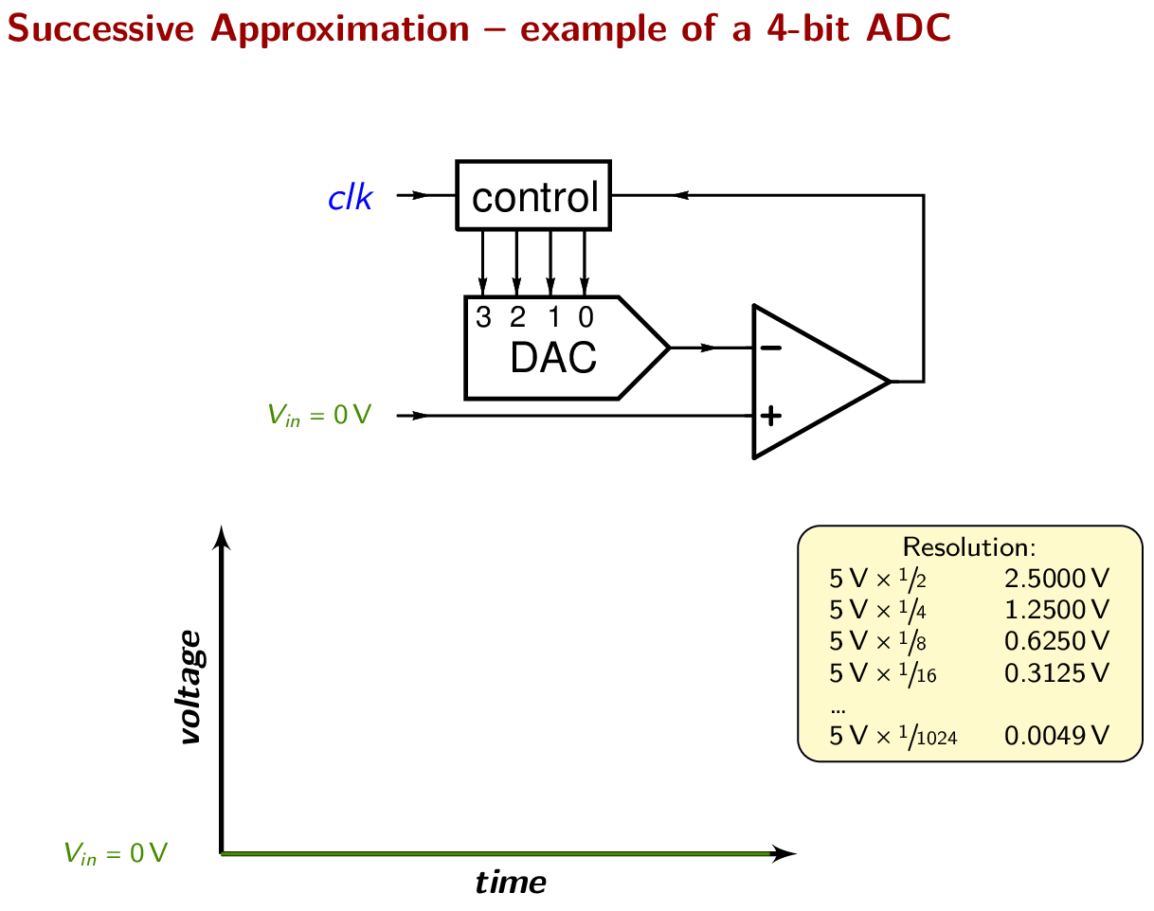
Successive Approximation Example
Performs a binary search to determine correct reference signal value
https://en.wikipedia.org/wiki/Successive-approximation_ADC

Slide 30
Higher resolution ADCs are not free
Direct-Conversion: more expensive (more silicon)
SAADC: more time consuming (more binary search time)
Resolution requirement depends on signal being sensed
Temperature sensor probably doesn’t need 16-bit ADC
Microphone might though!

Slide 31
Outline
Comparators (and nRF implementations)
General ADC Design
nRF ADC Implementation

Slide 32
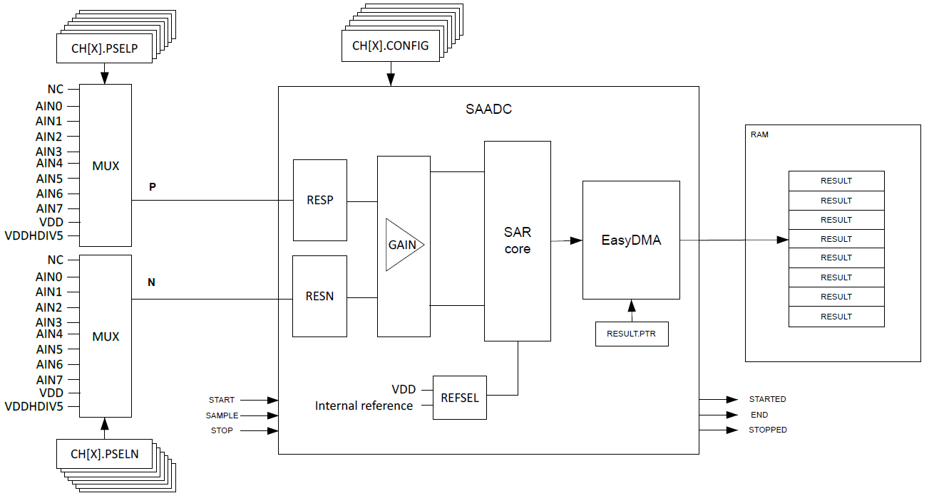
nRF SAADC (Successive Approximation ADC)

Slide 33
How most people use the SAADC

Slide 34
How most people use the SAADC
8 different channel configurations
Only one at a time
Samples each, one after the other
Essentially virtualization in hardware!

Slide 35
How most people use the SAADC
Input from analog pin (or VDD)

Slide 36
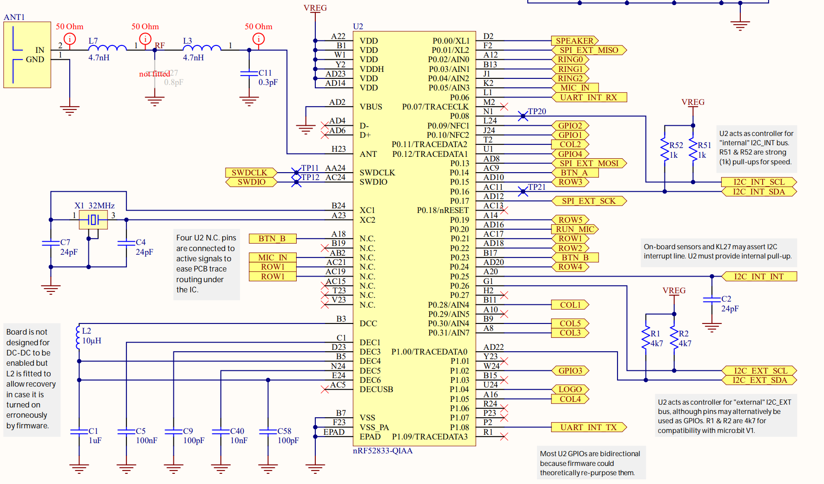
Analog inputs on the Microbit
P0.30 is actually AIN6

Slide 37
How most people use the SAADC
Maximum voltage range
VDD or Reference

Slide 38
How most people use the SAADC
DMA
Writes results directly to memory

Slide 39
SAADC Resolution and Sampling
Resolution is selectable (for the whole peripheral)
8, 10, 12, or 14 bits
Result stored as 16-bit value regardless
Sampling time is selectable (for each channel)
3-40 μs

Slide 40
Triggering sample collection
Can be triggered with TASK_START on demand
Including through EVENT->TASK chaining
Includes a timer within itself to automatically trigger sampling
Rate = 16 MHz / (2^{Scale}) where scale is 11 bits
Maximum rate is 7.8 kHz

Slide 41
EasyDMA on the SAADC
There is no register to read ADC results from
Instead, you must use DMA to collect samples
At configuration time, provide:
Pointer to RAM
Must be RAM, not Flash
Maximum count of 16-bit samples to be written starting at address
Up to 32768
When complete, a register tells you the amount of samples written to RAM

Slide 42
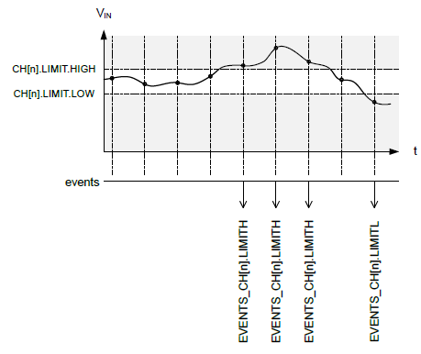
Event limit monitoring
Includes two comparators for each channel
High and Low limits
Generates events whenever transitioning to above High or below Low
Events can be ignored if unnecessary

Slide 43
Temperature sensitivity
ADCs are often temperature sensitive
nRF SAADC: 0.02% per degree C
Recommends recalibrating every change of 10 degrees C or more
Automatic task for calibration
Real concern for deployed devices
Outdoors
Wearable

Slide 44
Design question
How many analog samples can the Microbit hold?
Available: 128 kB RAM, 512 kB Flash (64000 samples in RAM)
Questions
Are they packed or padded to 16-bit?
How much memory are you using for other things?
Are you moving them into Flash periodically? (or external storage)

Slide 45
Outline
Comparators (and nRF implementations)
General ADC Design
nRF ADC Implementation

