Slide 1
Lecture 02 Microcontrollers
CE346 – Microprocessor System Design
Branden Ghena – Spring 2021
Some slides borrowed from: Josiah Hester (Northwestern), Prabal Dutta (UC Berkeley)

Slide 2
Class Updates
Reminder: fill out lab hardware survey ASAP
The link is on Campuswire
Starting orders after class
Let me know when people start receiving stuff
My office hours 1-2pm today
Feel free to swing by

Slide 3
Today’s Goals
Explore microcontrollers
Their purpose
Their capabilities
Design tradeoffs
Describe history and state-of-the-art for microcontrollers
Explore the microcontroller(s) on our Microbits

Slide 4
Outline
Microcontroller Background
Microcontroller Design
Microcontroller History
Microbit microcontroller

Slide 5
Source: iFixit
Notes:
Fitbit, Wearables, microcontrolles

Slide 6
Source: iFixit
Samsung Galaxy S20 Ultra
Samsung K3LK4K40BM-BGCN 12 GB LPDDR5 RAM layered over Qualcomm 865 SoC
Notes:
SoC, LOTS of microcontrollers and accelerators, multiple things all on one die (often the CPU, an accelerator of some kind for example to speed up video processing, and a comms unit like a Wifi or BLE chip).

Slide 7
Source: iFixit
LR35902 4.19 Mhz CPU …Z80 Microprocessor
The Nintendo Game Boy was initially released in Japan on April 21, 1989

Slide 8
…computing everywhere!

Slide 9
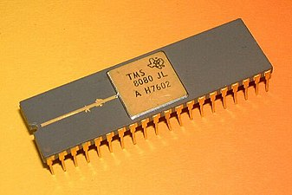
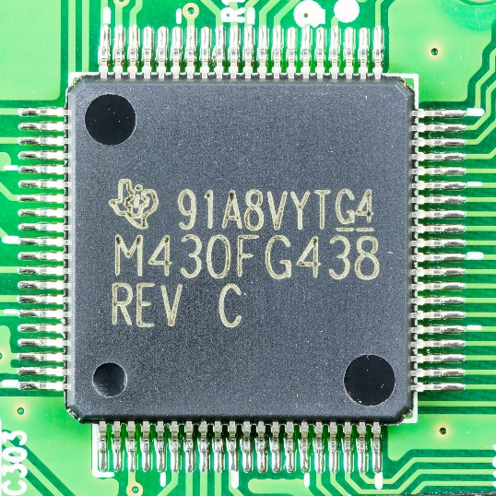
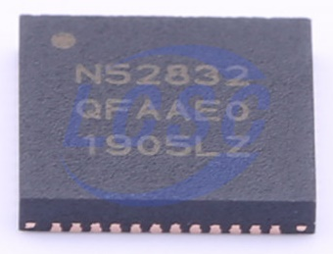
Categories of computer chips
Microprocessor (MPU or Processor)
CPU + Bus/Pins
No memory or peripherals
Microcontroller (MCU)
CPU + Pins + Memory + Peripherals
Peripherals: separate hardware units within chip
Often I/O interfaces
System on a Chip (SoC)
Microcontroller + Extensive Peripherals
Example: Radios or ML Accelerators
Essentially multiple chips combined
Evolution of increased complexity over time

Slide 10
Outline
Microcontroller Background
Microcontroller Design
Microcontroller History
Microbit microcontroller

Slide 11
Generic microcontroller block diagram
Microcontroller
Processor
Peripherals
Pins
Memory

Slide 12
Processor
Microcontroller needs to execute software instructions
Emphasis: simple and reliable
i.e. not x86 CISC
Often simple, in-order, short-pipeline RISC architectures
Literally a three-stage pipeline you likely learned in CS361
Many different ISAs are possible
Custom ISAs and ARM (ARMv7E-M) are both common

Slide 13
Reminder: Instruction Set Architecture
ISA includes the actual instructions as well as the model for how the computer interacts with memory
Does the ISA for a microcontroller matter if you’re not programming in assembly?

Slide 14
Reminder: Instruction Set Architecture
ISA includes the actual instructions as well as the model for how the computer interacts with memory
Does the ISA for a microcontroller matter if you’re not programming in assembly?
Yes
Differences in instruction efficiency and amount are important
Differences in compiler support are VERY important

Slide 15
Processor design choices
How many bits is the architecture?
8-bit and 16-bit not uncommon
64-bit is very rare (who has that much memory?)
What instructions are supported?
Normal stuff yes
What about single-cycle multiply?
What about floating-point operations?
Vector instructions?
How fast does it run?
1-100 MHz is common on modern systems (faster is more energy cost)
Occasionally MUCH slower (think 32 KHz)

Slide 16
Memory
Common memory hierarchy
What’s missing? Why?
Registers
RAM
ROM

Slide 17
Memory
Common memory hierarchy
What’s missing? Why?
Cache
Makes timing unreliable
Registers
RAM
ROM
More modern microcontrollers often have optional instruction caches
Can be enabled by software

Slide 18
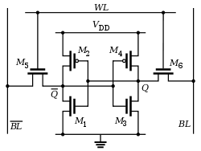
Volatile memory: SRAM
Same design as registers in traditional computer systems
No need to refresh it -> lower energy costs
Tradeoff:
More expensive
Physically larger

Slide 19
Non-Volatile memory: Flash (usually)
Same design as SSDs and Flash drives
Memory is stored with no energy costs
Reading is lowish energy and quick
Writing is high energy and very slow
Writing also has to occur in blocks (e.g. 512 bytes)
Concern: Flash has a limited lifetime ~10,000 writes
Only writing to Flash when you load code? Essentially forever
Recording data to Flash every second? 2.8 hours

Slide 20
SRAM (RAM) versus Flash (ROM) memory
Size and time difference between non-volatile and volatile memory is significantly reduced from traditional computing
Non-volatile store 2-10x larger than volatile
Single-cycle RAM. Maybe two-cycles to Flash (to read)
Major difference: energy and writability
SRAM is low-energy to read and write (no refresh needed)
Flash is lowish-energy to read, but very high energy to write
Hierarchical structure is not enforced
Same address space for RAM and Flash (very different from traditional)
Run instructions right inside of Flash
Keep variables in RAM (or const variables in Flash)

Slide 21
Memory design choices
How much memory can we fit without making it too high cost or too high power?
The answer has slowly increased over time
15 years ago: 2 KB RAM – 32 KB Flash
Today: 256 KB RAM – 1 MB Flash
How to provide memory safety?
Usually no virtual memory (all addresses are real addresses)
Nothing stops arbitrary memory overwriting
Modern systems: Memory Protection Unit
Specify a small number of ranges and permissions

Slide 22
Peripherals
Hardware modules the perform some action
Common examples
Control digital input and output pins
Read analog inputs
Send messages in a given wire protocol (UART, SPI, I2C)
Set and check timers
Less common examples
Cryptography accelerators
Complicated wire protocols (USB, CAN)
Wireless radios (BLE, 802.15.4, WiFi)
We’ll spend most of class learning various peripherals

Slide 23
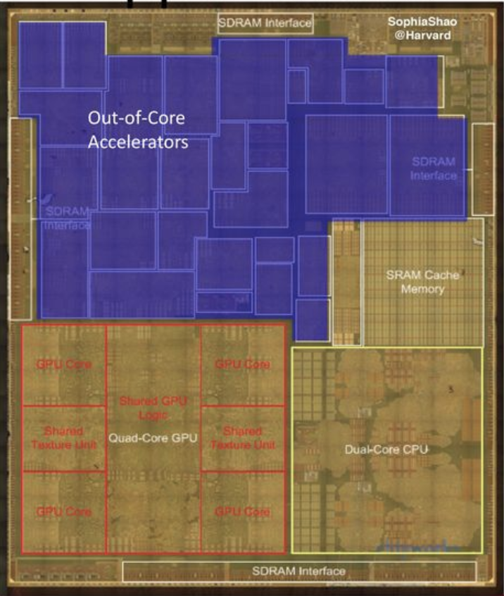
Peripheral design choices
More peripherals mean more use cases
But also means more cost for the chip
Peripherals occupy silicon
Most peripherals will go unused for a given application…
Flexibility within a given peripheral
One capability is easier to use
Many capabilities are more useful
Apple A8 SoC

Slide 24
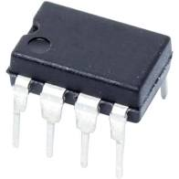
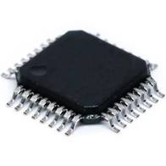
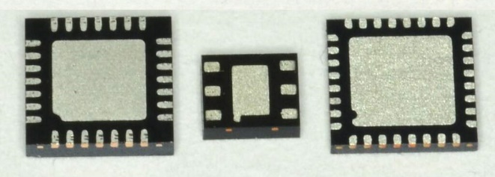
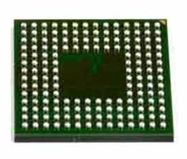
Pins
Peripherals need to electrically connect to outside world
Attach to pins on the exterior of the chip
More pins allow for more connections
At increased cost and size
Pin layouts can add more pins for cheaper
But make soldering and debugging difficult

Slide 25
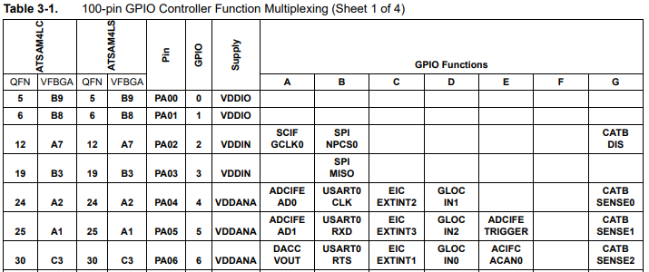
Internal connections to pins
Peripherals need to connect to external pins
Can any peripheral connect to any pin, or are there limited mappings?
Modern microcontrollers allow any-to-any connections
Older MCUs had mapping tables and pin selection was more challenging

Slide 26
What haven’t we talked about?
Microcontroller
Processor
Peripherals
Pins
Memory

Slide 27
What haven’t we talked about?
Power
Programming
Others?
Clocks
Antennas
Microcontroller
Processor
Peripherals
Pins
Memory

Slide 28
Powering microcontrollers
Usually require a specific voltage
E.g. 5 volts, 3.3 volts, 1.8 volts
Must be stable and supply enough current (or MCU “browns out”)
Noisy power supply can be an issue
Some microcontrollers have wider ranges of acceptable voltages
Need to pay attention to acceptable range on I/O though

Slide 29
Programming microcontrollers
JTAG (Joint Test Action Group)
Hardware built into the microcontroller for testing purposes
Can arbitrarily read/write memory
Can single step process too, at runtime!
GDB can connect to it! (sort of)
Bootloaders
Software runs on the microcontroller at boot that waits a short time for someone to contact it and upload code
Via I/O pins
Convenient, but sometimes unreliable

Slide 30
Outline
Microcontroller Background
Microcontroller Design
Microcontroller History
Microbit microcontroller

Slide 31
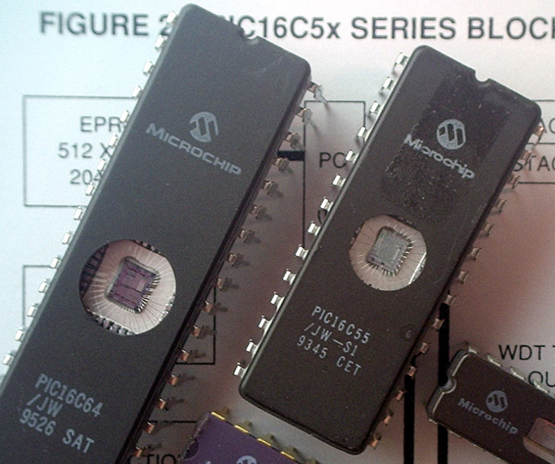
Older microcontrollers (90s-00s)
Focus: cheap, small computer systems
PIC
8, 16, and 24-bit MIPs architecture
PICAXE available with Basic interpreter
AVR
8-bit custom architecture (AVR architecture)
Used in Arduinos
AT Tiny 4: $0.30 per unit
4 I/O pins, 32 Bytes RAM, 512 Bytes ROM

Slide 32
More capable microcontrollers (00s-10s)
Focus: diversify into extreme low power and more capable systems
MSP430
16-bit custom architecture (MSP430 architecture)
Capable, but also extremely low power
<1 μA sleep current
STM32, Atmel SAM series (Cortex-M0, M3, M4, M4F)
32-bit ARM architecture (ARMv7)
Leverage success of ARM on smartphones
Every peripheral under the sun. Plus a variety of memory choices

Slide 33
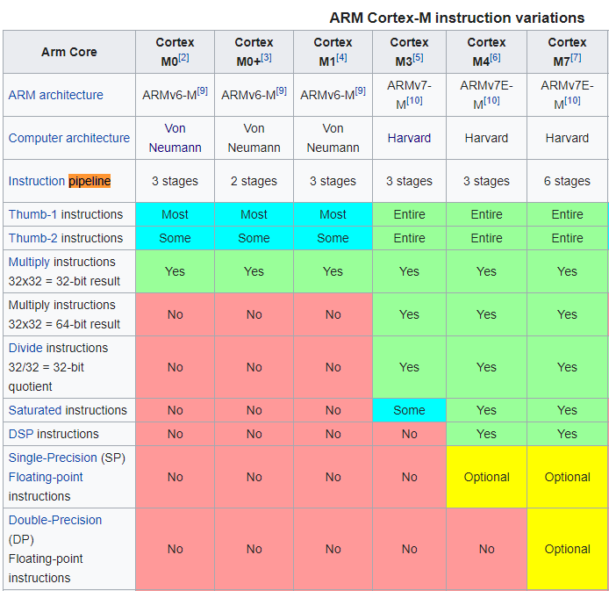
Cortex M Series
A number of options for increasing capabilities
In practice:
Cortex-M0+ for low-end systems
Coretx-M4 for high capability systems

Slide 34
Modern system-on-chips (10s-?)
Focus: increase memory and capability
Include radios in the same chip
nRF51 and nRF52 series
32-bit ARM microcontrollers (Cortex M)
Include 2.4 GHz radio: Bluetooth Low Energy and 802.15.4/Thread
Others have followed this same path
TI CC26XX
Apollo3
STM32WL

Slide 35
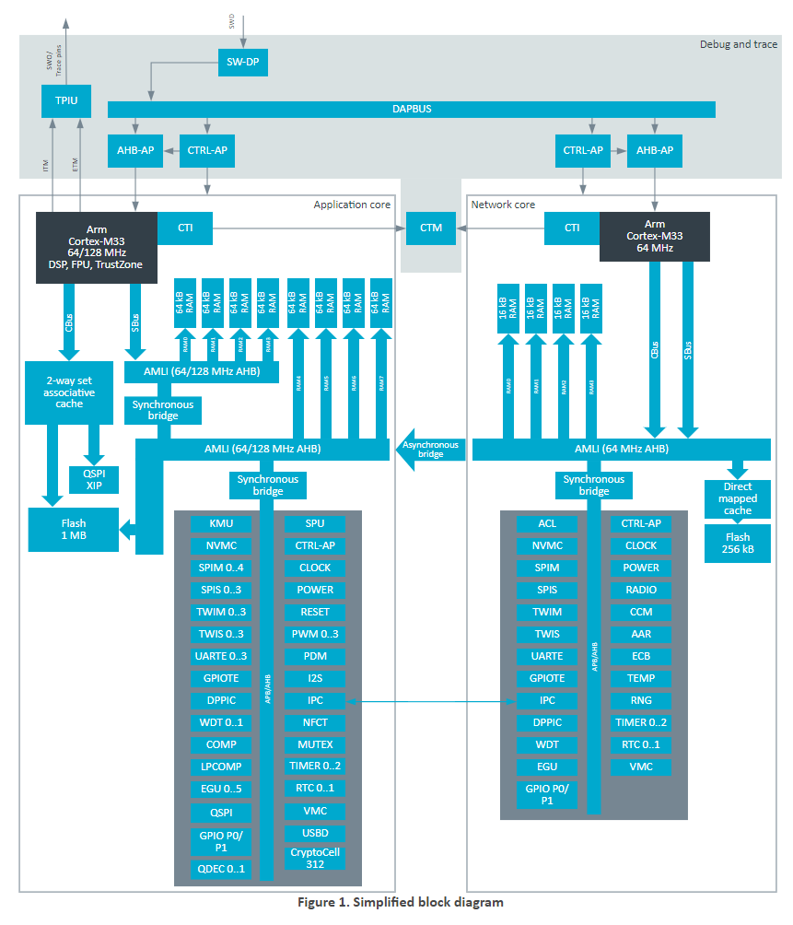
Future microcontrollers
Multi-core systems
Not for performance, but for separation of concerns
Run radio code on one core
Application code goes on the other core
Also allows BIG.little architecture
Higher performance core when interpreting data
Lower performance core for sampling sensors
nRF53 series is already doing this
But support is still nascent

Slide 36
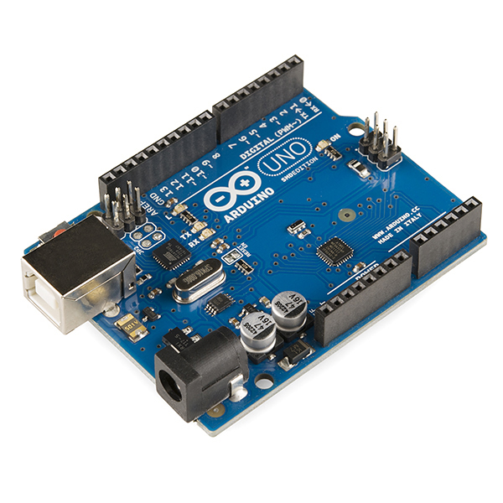
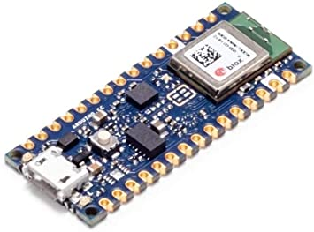
Popular components rarely die
Majority of popular older options still exist
Designers can trade off cost, capability, and efficiency alongside “modern features”
Upgrading for an existing product is unlikely
Large cost, little benefit
Example: Arduino still primarily uses AVR
Works just fine for its needs
Also releases new boards with nRF52s (Arduino Nano 33 BLE)

Slide 37
Outline
Microcontroller Background
Microcontroller Design
Microcontroller History
Microbit microcontroller

Slide 38
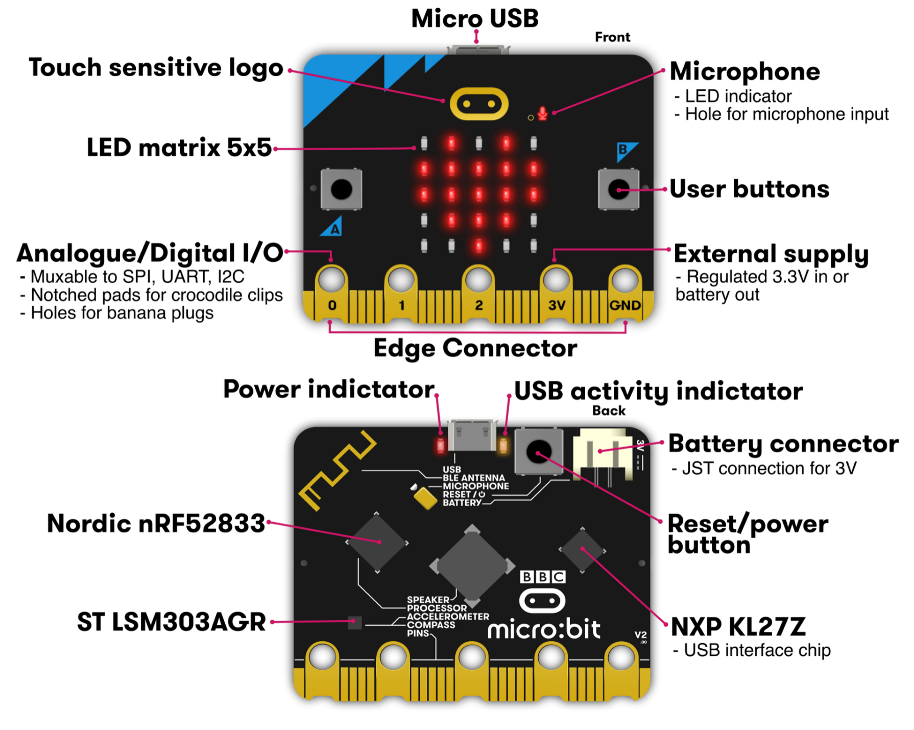
Micro:bit v2
Circuit board
Entire thing
a.k.a “Dev Board”
a.k.a PCB (Printed Circuit Board)
Microcontroller
The computer on it
Microbit has two
One as a programmer
One for applications
Microcontrollers

Slide 39
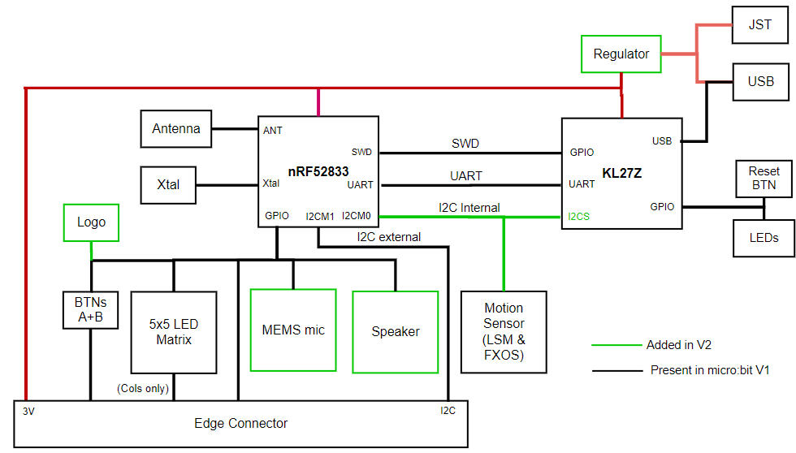
KL27Z – Programmer on the Micro:bit v2
32-bit ARM Cortex-M0+ microcontroller
48 MHz core, 16 KB RAM, 256 KB Flash
Acts as a programming interface to nRF52833
Connects to USB and to JTAG (SWD)

Slide 40
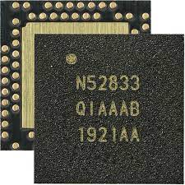
nRF52833 – Microcontroller on the Micro:bit v2
32-bit ARM Cortex-M4F microcontroller
64 MHz core, 128 KB RAM, 512 KB Flash
Floating point support
2.4 GHz Radio: Bluetooth Low energy / 802.15.4
Various peripherals
ADC, PWM
I2C, UART, SPI, USB
RNG, 32-bit Timers, Watchdog, Temperature
Up to 42 I/O pins

Slide 41
To the datasheet!
nRF52833 Product Specification
Online: https://infocenter.nordicsemi.com/index.jsp?topic=%2Fps_nrf52833%2Fkeyfeatures_html5.html
PDF: https://infocenter.nordicsemi.com/pdf/nRF52833_PS_v1.3.pdf

Slide 42
Outline
Microcontroller Background
Microcontroller Design
Microcontroller History
Microbit microcontroller(s)

