Slide 1
Lecture 14
Wireless Communication
CE346 – Microcontroller System Design
Branden Ghena – Fall 2024
Some slides borrowed from:
Josiah Hester (Northwestern), Prabal Dutta (UC Berkeley)

Slide 2
Administriva
Last postlab questions! Be sure the answer them
I’m still ordering more hardware if people need things
  I’ll place the next order on Friday
  After that I’ll probably order things once a week
How to get project help
  Office hours
  Piazza post (I’ve added some posts on general stuff)
  Find guides on the Internet

Slide 3
Today’s Goals
Explore important issues in wireless communication
  Physical and Data Link layers particularly
Describe several wireless networks that are very important to modern Internet of Things devices
  Bluetooth Low Energy
  Thread and Zigbee (802.15.4)
  WiFi (802.11)
  Low-Power Wide-Area Networks
nRF52833 supports these!
But our Microbit library doesn’t 😢
Except for 15.4, which IS now supported! See example apps

Slide 4
Outline
Wireless Communication Overview
Wireless Protocols
  Overview
  Bluetooth Low Energy
  802.15.4
  WiFi
  Low-Power Wide-Area Networks

Slide 5
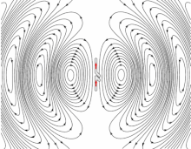
Wireless: high-level idea
Normally, we want to keep all electric signals contained in a wire
  Don’t want to receive interference from other signals or cause interference
Antennas are good at the opposite:
  They spill electrical signals out into the world
  They receive electrical signals from the world
This means we can send information
from one device to another without wires!

Slide 6
Why use wireless?
There are no wires!
No need to install and maintain wires
  Reduces cost
  Simplifies deployment – place devices wherever makes sense
Supports mobile users
  Move around office, campus, city
  Move devices around home

Slide 7
What is hard about wireless?
There are no wires!
Wired networks are constant, reliable, and physically isolated
  Ethernet has the same throughput minute-to-minute
  Bits sent through Ethernet or USB are (usually) received
Wireless networks are variable, error-prone, and shared
  WiFi throughput changes based on location and walls
  Signals from nearby devices interfere with your signals
  Individual bits might flip or never be heard at all

Slide 8
Wireless is a shared medium
Wired communication has signals confined to a conductor
  Copper or fiber
  Guides energy to destination
  Protects signal from interference
Wireless communication is inherently broadcast
  Energy is distributed in space
  Signals must compete with other signals in same frequency band

Slide 9
Increasing network capacity is challenging
Wired networks just add more wires
  Buses are many signals in parallel to send more data
Wireless networks are harder
  Adding more links just increases interference
  Need to expand to different frequencies

Slide 10
Model of RF communication
Energy that radiates spherically from an antenna at a “carrier frequency”
  Good enough for understanding communication
Attenuation with distance
  Density of energy reduces over time, distance
  Signal strength reduced, errors go up
Two key features
  Range and data rate affect error rates
  Spatial reuse of frequencies

Slide 11
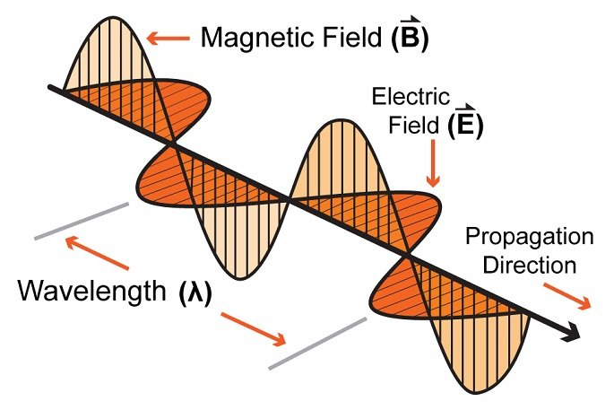
Signal qualities
Signal strength
  The amount of energy transmitted/received
Signal frequency and bandwidth
  Which “channel” the signal is sent on
Signal modulation
  How data is encoded in the signal

Slide 12
Signal qualities
Signal strength
  The amount of energy transmitted/received
Signal frequency and bandwidth
  Which “channel” the signal is sent on
Signal modulation
  How data is encoded in the signal

Slide 13
Wireless signals are incredibly low power
Maximum BLE transmit power for the nRF52840:
  8 dBm -> 6.31 mW (10⁻³)
Minimum BLE receive power for the nRF52840:
  -95 dBm -> 316.2 fW (10⁻¹⁵)
Signal strength decreases in energy spherically
  Eventually the signal is too quiet to receive reliably

Slide 14
Signal strength varies significantly across technologies
Bluetooth Low Energy (local area)
  nRF52840 transmit power: 8 dBm (6.31 milliwatt)
  nRF52840 receive sensitivity: -95 dBm (316.2 femtowatt)
LoRa (wide area)
  SX127X LoRa transmit power: 20 dBm (100 milliwatt)
  SX127X LoRa receive sensitivity: -148 dBm (1.6 attowatt)

Slide 15
Signal qualities
Signal strength
  The amount of energy transmitted/received
Signal frequency and bandwidth
  Which “channel” the signal is sent on
Signal modulation
  How data is encoded in the signal

Slide 16
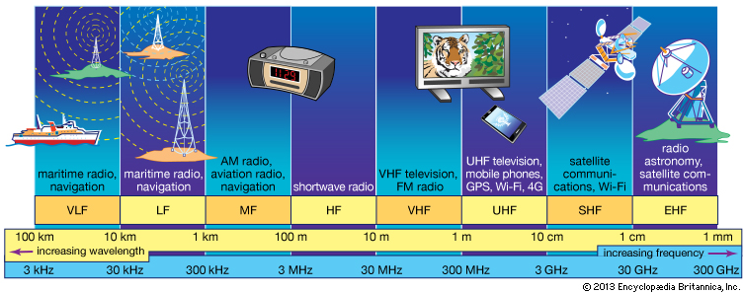
RF communication
IoT focus

Slide 17
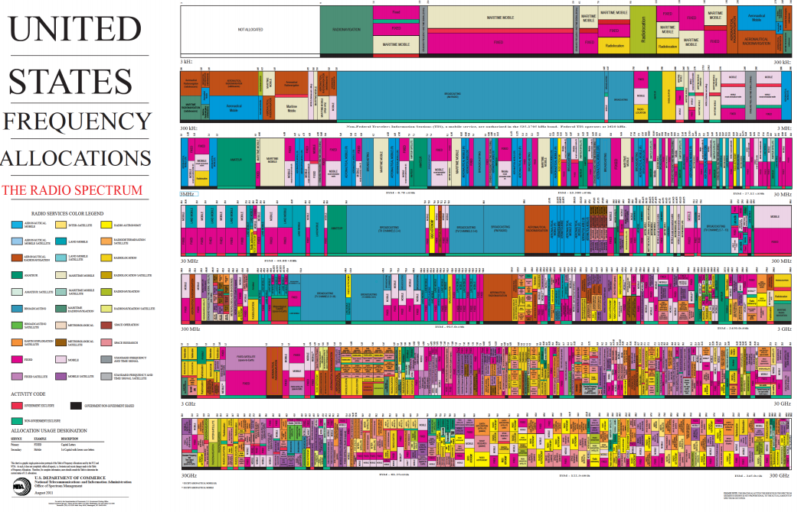
Wireless spectrum is allocated to specific uses

Slide 18
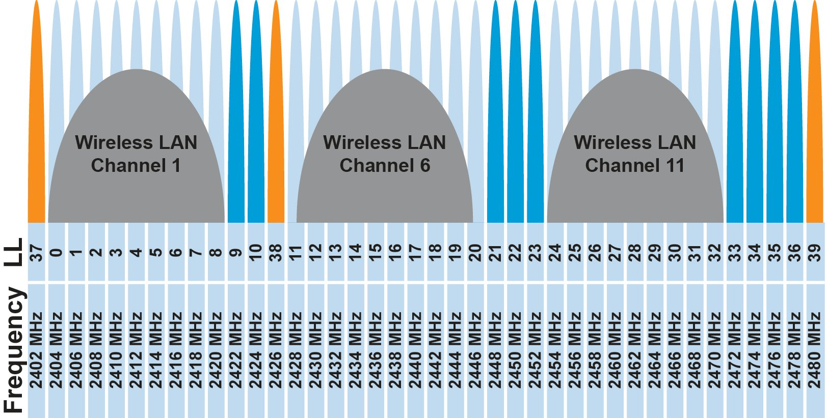
Unlicensed bands are where IoT thrives
902 MHz – 928 MHz
  LPWANs
2.4 GHz to 2.5 GHz
  WiFi, BLE, Thread
5 GHz
  Faster WiFi
Cellular uses licensed bands at great cost
  Why pay?

Slide 19
Unlicensed bands are where IoT thrives
902 MHz – 928 MHz
  LPWANs
2.4 GHz to 2.5 GHz
  WiFi, BLE, Thread
5 GHz
  Faster WiFi
Cellular uses licensed bands at great cost
  Why pay? No interference from other users

Slide 20
Signal qualities
Signal strength
  The amount of energy transmitted/received
Signal frequency and bandwidth
  Which “channel” the signal is sent on
Signal modulation
  How data is encoded in the signal

Slide 21
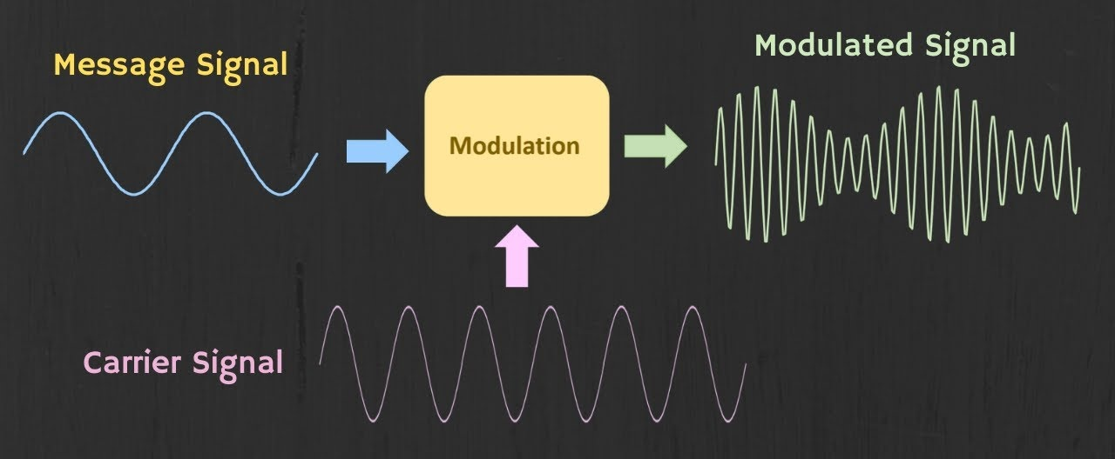
Modulation
Encoding signal data in an analog “carrier” signal
  Carrier signal defines the frequency
  Modulation scheme + data define bandwidth required

Slide 22
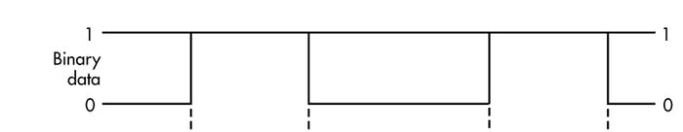
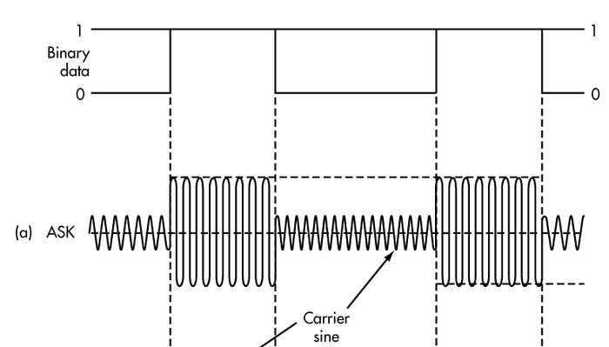
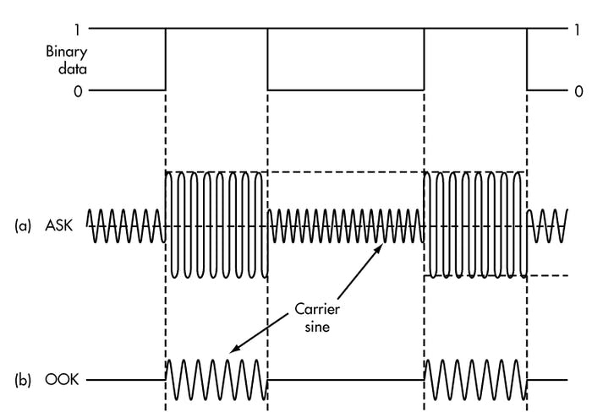
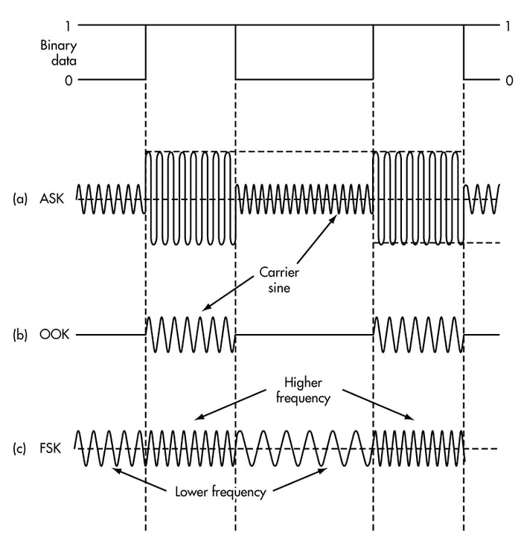
Common modulation types
Encoding binary data on a signal
Amplitude-shift Keying (ASK)
  Modify amplitude of carrier signal
  On-Off Keying (OOK) is an extreme example
Frequency-shift Keying (FSK)
  Modify frequency of carrier signal

Slide 23
Break + Open Question
What lets some protocols travel further than others?
  WiFi is about 100 meters
  Cellular is more than 1000 meters

Slide 24
Break + Open Question
What lets some protocols travel further than others?
  WiFi is about 100 meters
  Cellular is more than 1000 meters
Multiple different parameters affect this
  More transmit power
  More receive sensitivity (receive at a lower power)
  Modulation that makes it easier to recover bits without errors
  Bandwidth can also affect error rates, which in turn affects distance
  Frequency kinda-sorta, but not as much as people think

Slide 25
Outline
Wireless Communication Overview
Wireless Protocols
  Overview
  Bluetooth Low Energy
  802.15.4
  WiFi
  Low-Power Wide-Area Networks

Slide 26
What is the role of a wireless protocol?
Multiple methods exist for sending bits wirelessly
Protocols make choices about how to use them
  Select exact configurations for bit communication (Physical Layer)
  Determine how to send packets of data (Data Link Layer)
    What are the fields within a packet?
    Which device sends a packet and when can it do so?
  Organize communication between devices (Network Layer)
    How are devices named?
    How is communication directed between those devices?

Slide 27
Framing
Typical packet structure
  Preamble - Existence of packet and synchronization of clocks
  Header - Addresses, Type, Length
  Data - Payload plus higher layer headers (e.g. IP packet)
  Trailer - Padding, CRC
Wireless considerations
  Control information for Physical Layer
  Ensure robustness for header
  Possibly different data rates for different parts of packet
Preamble | Destination Address | Source Address | Type and Length | Data | CRC

Slide 28
Medium Access Control
How does a network determine which transmitter gets to transmit?
Remember: the wireless medium is inherently broadcast
  Two simultaneous transmitters may lose both packets

Slide 29
Analogy: wireless medium as acoustic
Activity: How do we determine who gets to speak?
  Two simultaneous speakers also lose both “transmissions”

Slide 30
Analogy: wireless medium as acoustic
Activity: How do we determine who gets to speak?
  Two simultaneous speakers also lose both “transmissions”
Eye contact (or raise hand) -> out-of-band communication
Wait until it’s quiet for some time -> carrier sense multiple access
Strict turn order -> time division multiple access
Just speak and hope it works -> ALOHA
Everybody sing at different tones -> frequency division multiple access
(stretching the metaphor)
Others?

Slide 31
ALOHA
ALOHAnet (1971)
  University of Hawaii – Norman Abramson
  First demonstration of wireless packet network
Rules
  If you have data to send, send it
Two (or more) simultaneous transmissions will collide and be lost
  Wait a duration of time for an acknowledgement
  If transmission was lost, try sending again “later”
    Want some kind of exponential backoff scheme here

Slide 32
CSMA/CA – Carrier Sense Multiple Access with Collision Avoidance
First listen for a duration and determine if anyone is transmitting
  If idle, you can transmit
  If busy, wait and try again later
“listen before send”
More expensive than Aloha, but far more reliable
  Higher energy and lower data rate due to time spent listening
  Don’t mess up messages that have already started
    Collisions can only occur if there are multiple waiting devices

Slide 33
TDMA – Time Division Multiple Access
Split transmissions in time
  Devices share the same channel
Splits time into fixed-length windows
  Each device is assigned one or more windows
  Can build a priority system here with uneven split among devices
Requires synchronization between devices
  Often devices must listen periodically to resynchronize
  Less efficient use of slots reduce synchronization
    Large guard windows. E.g., 1.5 second slot for a 1 second transmission

Slide 34
Break + Question
Access controls to shared busses in wired systems as well!
Which of these MAC protocols is I2C using?
Which of these MAC protocols is USB using?

Slide 35
Break + Question
Access controls to shared busses in wired systems as well!
Which of these MAC protocols is I2C using?
  CSMA/CA – senses the carrier to detect collisions
Which of these MAC protocols is USB using?
  TDMA – Host decides when each device can talk

Slide 36
Outline
Wireless Communication Overview
Wireless Protocols
  Overview
  Bluetooth Low Energy
  802.15.4
  WiFi
  Low-Power Wide-Area Networks

Slide 37
Comparison of wireless protocols
Data
Throughput
Bluetooth
BLE
Zigbee
Range

Slide 38
Comparison of wireless protocols
WiFi
Data
Throughput
Bluetooth
BLE
Zigbee
Range

Slide 39
Comparison of wireless protocols
WiFi
Cellular
Data
Throughput
Bluetooth
Low-Power
Wide-Area Networks
BLE
Zigbee
Range

Slide 40
Comparison of wireless protocols
WiFi
Cellular
Why don’t we always max out range and throughput?
Data
Throughput
Bluetooth
Low-Power
Wide-Area Networks
BLE
Zigbee
Range

Slide 41
Comparison of wireless protocols
WiFi
Higher Power
& Higher Cost
Cellular
Data
Throughput
Bluetooth
Low-Power
Wide-Area Networks
BLE
Zigbee
Lower Power
& Lower Cost
Range

Slide 42
Protocols
Bluetooth Low Energy
802.15.4 – Zigbee and Thread
WiFi
Low-Power Wide-Area Networks

Slide 43
Bluetooth Low Energy
Bluetooth Classic was good for enabling device to device communication
  But not particularly fast discovery or low energy operation
Bluetooth Low Energy was developed to improve this
  Focuses on low-energy interactions
  Much lower throughput that Bluetooth
Supported by hardware devices already in smartphones
  Humans can interact directly with nearby devices!!

Slide 44
BLE mechanisms
Advertising
  Discovery
  Advertisements – broadcast messages indicating device details
  Ephemeral, uni-directional communication from Advertiser to Scanner(s)
  ALOHA access control
Connections
  Interaction
  Bi-directional communication between Peripheral and Central
  Maintained for some duration
  TDMA access control

Slide 45
BLE network topology
Peripheral
Connection
Central & Scanner
Scanner
Connection
Peripheral
Advertisement
Advertisement
Advertisement
Advertisement
Advertiser
Advertiser
Advertiser

Slide 46
Protocols
Bluetooth Low Energy
802.15.4 – Zigbee and Thread
WiFi
Low-Power Wide-Area Networks

Slide 47
802.15.4 & Thread & Zigbee
802.15.4 is a low-energy method for transmitting bits (physical layer)
  Radio chips have been widely available for 15-20 years
Significant amounts of sensor network research have focused on building layers on top of 802.15.4
  Access control layers (CSMA)
  Network layers
Thread is a selection of these possibilities to make a network
  Uses IPv6 networking!!
Zigbee makes slightly different selections
  Focuses on automatic interpretation and discovery of sensors and actuators

Slide 48
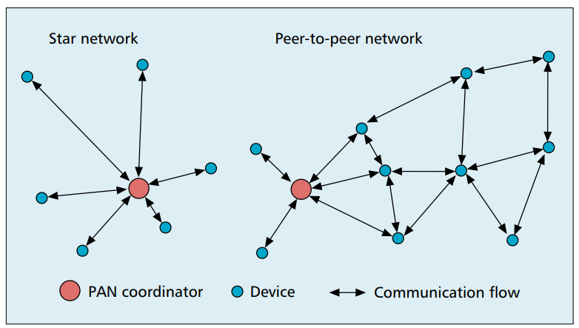
802.15.4 topology
Expects use cases as Star or Mesh networks

Slide 49

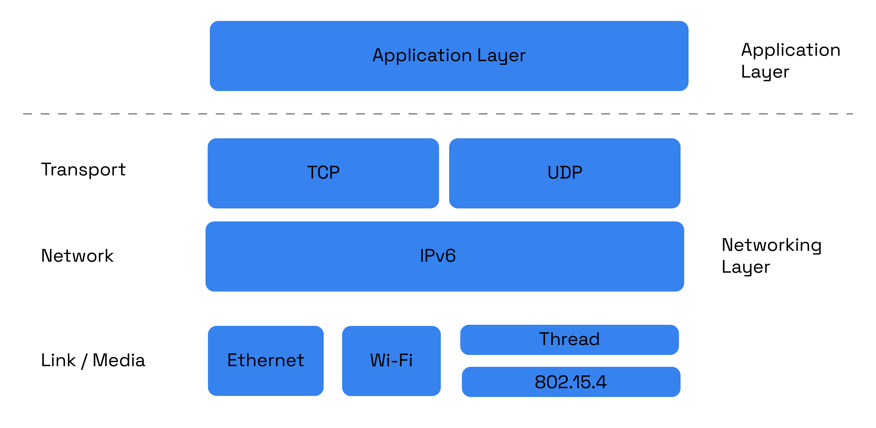
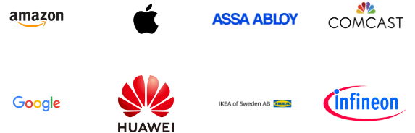
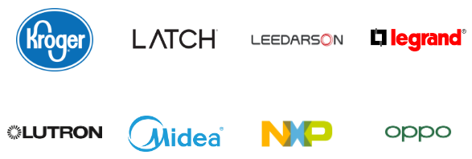
Matter standard
Lots of member companies
Standard for interoperable smart home devices (October 2022)
  Uses IPv6 over 802.15.4/Thread to send packets
  Uses standardized device classes with descriptors for application logic

Slide 50
Protocols
Bluetooth Low Energy
802.15.4 – Zigbee and Thread
WiFi
Low-Power Wide-Area Networks

Slide 51
WiFi (802.11)
Ubiquitous wireless communication
  High energy requirements for high throughput communication
Now accessible through relatively low power radios
  ESP32, Electric Imp, and company
  Still significantly more effort than BLE or Thread
IoT devices can use the same WiFi that’s already available
  No need for additional infrastructure!!

Slide 52
802.11 major amendments
802.11b was very popular but is now usually unsupported
802.11a never saw major deployment
WiFi Alliance rebranded 802.11ac as “WiFi 5” and backported scheme
 | Protocol | Year | Frequency | PHY | Max Rate | Range
- | 802.11 | 1997 | 2.4 GHz | DSSS/FHSS | 2 Mbps | 20 m
1 | 802.11b | 1999 | 2.4 GHz | DSSS | 11 Mbps | 35 m
2 | 802.11a | 1999 | 5 GHz | OFDM | 54 Mbps | 35 m
3 | 802.11g | 2003 | 2.4 GHz | OFDM | 54 Mbps | 38 m
4 | 802.11n | 2009 | 2.4/5 GHz | OFDM + MIMO | 600 Mbps | 70 m
5 | 802.11ac | 2013 | 5 GHz | OFDM + MIMO | 3.4 Gbps | 35 m

Slide 53
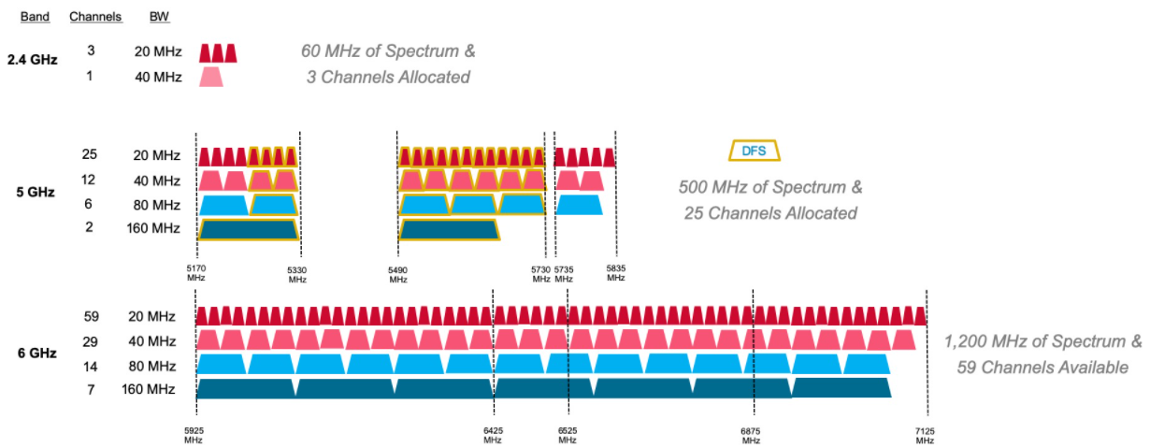
WiFi bandwidth
More bandwidth means higher data rate (with same error rate)

Slide 54
WiFi bandwidth
More bandwidth means higher data rate (with same error rate)
5 GHz band allows larger bandwidth allocations for more data rate

Slide 55
WiFi 6E: WAY more bandwidth means better data rates

Slide 56
Protocols
Bluetooth Low Energy
802.15.4 – Zigbee and Thread
WiFi
Low-Power Wide-Area Networks

Slide 57

LPWANS: How do we collect data from a sensor?
Manually collect measurements
  Too much work
Connect it to WiFi (or Ethernet)
  Too many separate networks
Pay for cellular access
  Too expensive for many devices

Slide 58
LPWANS: How do we collect data from MANY sensors?
Manually collect measurements
  Too much work
Connect it to WiFi (or Ethernet)
  Too many separate networks
Pay for cellular access
  Too expensive for many devices

Slide 59
We need another network option
Requirements:
Wide area of coverage
  Deploy fewer gateways
Low power
  So we can deploy on batteries
Doesn’t need high throughput
  Sensor data is relatively small

Slide 60
LPWANs (Low-Power Wide-Area Networks)
How do we collect data from city-scale deployments?
  There’s an unmet need for long-range, but low-throughput networks
  Existing cellular technologies focus on human requirements
Still a brand new space (relatively)
  Unlicensed-band technologies since 2015: Sigfox and LoRaWAN
  Cellular technologies since 2019: LTE-M and NB-IoT
Focus on long-range, low-energy, low-throughput
  One gateway can cover an entire city!!

Slide 61
LoRaWAN
Open communication standard built with proprietary LoRa PHY
Low rate (1-20 kbps) and long range (~5 km)
  Shorter range than Sigfox but much higher bit rate
Most popular LPWAN protocol
  Target of academic research
  Industry involvement in hardware and deployments

Slide 62
LoRaWAN network details

Slide 63
If you find this interesting…
I also teach a special topics course!
  CS433 Wireless Protocols for the Internet of Things
    Spring quarter 2025
  Lab course, similar to this one but more on-your-own
    Design project instead of a final project
Spend some time learning and playing around with wireless protocols. Especially
  Bluetooth Low Energy
  802.15.4 (Thread and Zigbee)
  WiFi (802.11)
  LPWANs (LoRaWAN and others)

Slide 64
Outline
Wireless Communication Overview
Wireless Protocols
  Overview
  Bluetooth Low Energy
  802.15.4
  WiFi
  Low-Power Wide-Area Networks

