Slide 1
Lecture 09
Analog Input
CE346 – Microcontroller System Design
Branden Ghena – Fall 2024
Some slides borrowed from:
Josiah Hester (Northwestern), Prabal Dutta (UC Berkeley)

Slide 2

Administrivia
Guest lab TA this Friday!
  Alexis Shuping
  CE PhD student
    Background in embedded systems
    Worked with Josiah Hester and Seda Ogrenci
  She’s awesome and super knowledgable

Slide 3
Today’s Goals
Explore methods for sensing analog signals
  Comparators
  Analog-to-Digital Converters
Discuss nRF implementation of these peripherals

Slide 4
Outline
Comparators (and nRF implementations)
General ADC Design
nRF ADC Implementation

Slide 5
Analog signals
Exist in infinite states
  From a maximum to a minimum
Often used for interactions with the real world
  Sensors usually generate analog signals
Microbit example: microphone

Slide 6
Interacting with analog signals
Microcontrollers are inherently digital
Need a method for translating analog signal into a digital one
Options:
  Determine if signal is higher or lower than some amount (Boolean)
  Determine voltage value of signal (N-bit number)

Slide 7
Interacting with analog signals
Microcontrollers are inherently digital
Need a method for translating analog signal into a digital one
Options:
  Determine if signal is higher or lower than some amount (Boolean)
  Determine voltage value of signal (N-bit number)
  Determination is done by a Comparator

Slide 8
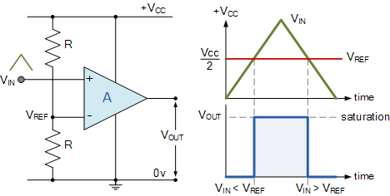
General comparator design
Compares an analog input signal to a reference voltage
V_{OUT} digital signal
  High: V_{IN} > V_{REF}
  Low: V_{IN} < V_{REF}
Advantages:
  Simple
  Low power

Slide 9
Comparator design questions
What reference voltages are available?
  A few internal voltages
  Usually also allows external references from input pins
When is an output generated?
  Usually when status changes
    Low-to-high, High-to-low, Both (like GPIO interrupts)

Slide 10
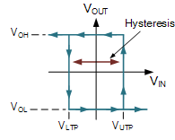
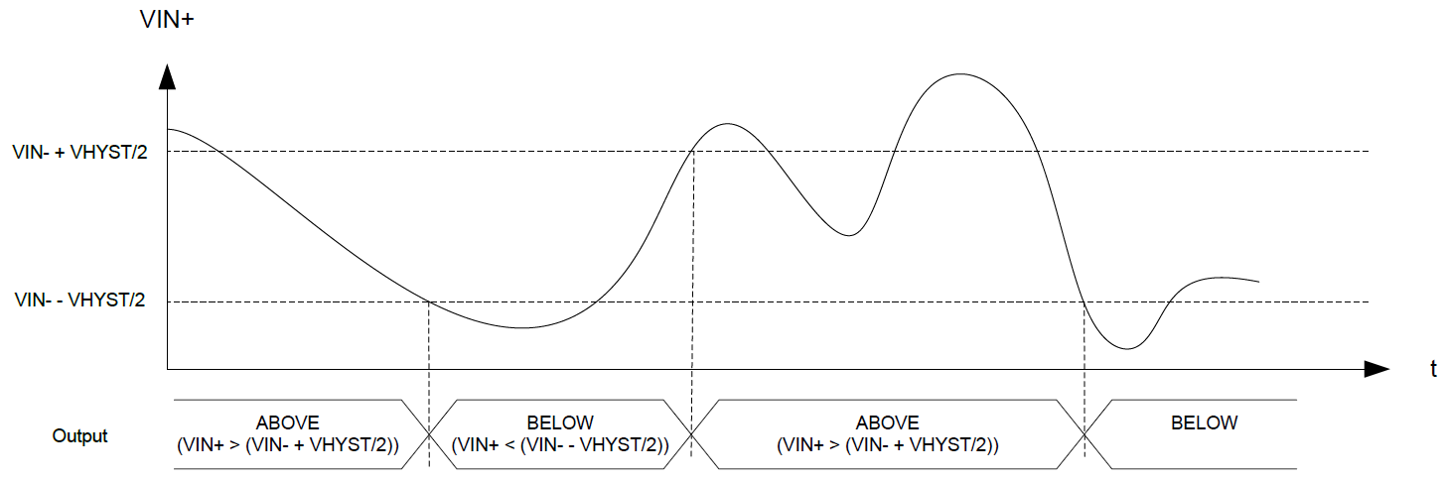
Hysteresis
A window added around signal state changes to prevent small amounts of noise from changing the output

Slide 11
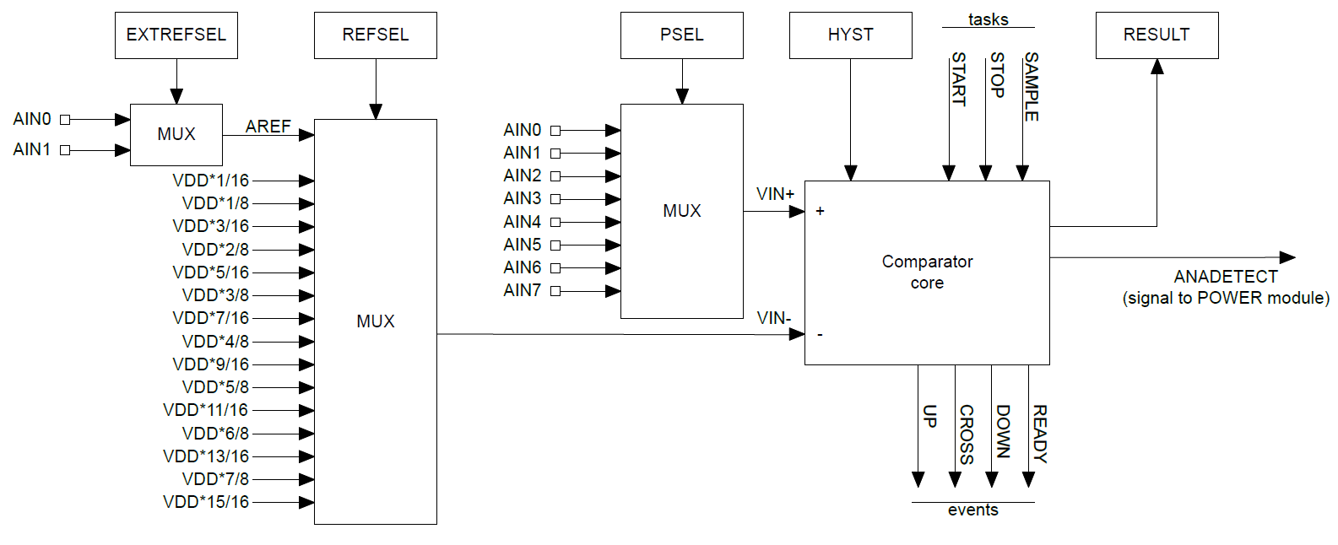
nRF low-power comparator (LPCOMP)

Slide 12
nRF low-power comparator (LPCOMP)
Input: one of eight analog input pins

Slide 13
nRF low-power comparator (LPCOMP)
Reference: one of two analog inputs or selection of VDD * N/16
  VDD: Input voltage of the system

Slide 14
nRF low-power comparator (LPCOMP)
Hysteresis: +/- 50 mV range around VIN- when enabled

Slide 15
nRF low-power comparator (LPCOMP)
Events: transition signals + ready (~150 μs startup time)

Slide 16
nRF low-power comparator (LPCOMP)
Can also request what the current comparison state is (high/low)

Slide 17
nRF low-power comparator (LPCOMP)
Can be used for low-power wakeup of microcontroller

Slide 18
nRF COMP peripheral
Analog Comparator (not low power)
  More advanced version of a comparator (otherwise similar)
What advantages would a more capable comparator have?
  Configurable hysteresis
    LPCOMP: +/- 50 mV COMP: any of the N/64 voltage levels
  Faster detection
    LPCOMP: 5 μs COMP: 0.1-0.6 μs (depending on power mode)
  More possible reference voltages
    LPCOMP: VDD or input COMP: VDD, 1.2v, 1.8v, 2.4v, or input
    LPCOMP: 16 levels COMP: 64 levels

Slide 19
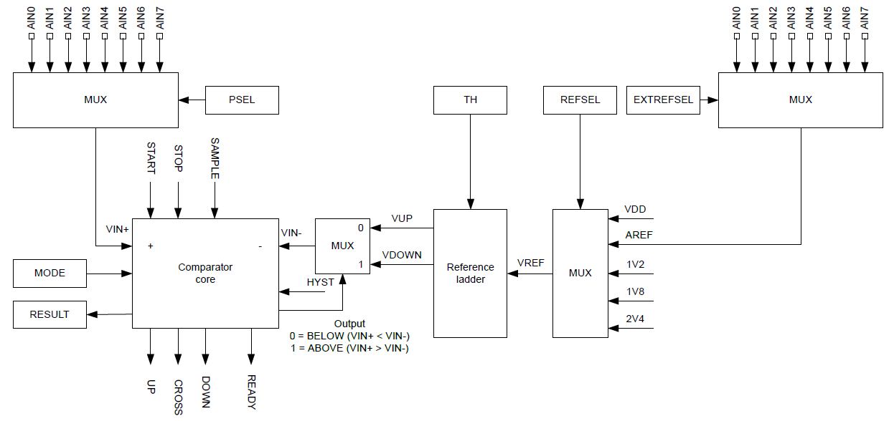
nRF COMP peripheral

Slide 20
Break + Question: Internal reference voltages
Why have internal voltage references other than VDD?

Slide 21
Break + Question: Internal reference voltages
Why have internal voltage references other than VDD?
  What if want you want to measure is VDD?
    Battery voltage
    Did someone just unplug me?
    etc.
  What if VDD isn’t stable?
    Battery voltage
    Energy-harvesting system
    Hard to know what any particular value means…

Slide 22
Outline
Comparators (and nRF implementations)
General ADC Design
nRF ADC Implementation

Slide 23
Interacting with analog signals
Microcontrollers are inherently digital
Need a method for translating analog signal into a digital one
Options:
  Determine if signal is higher or lower than some amount (Boolean)
  Determine voltage value of signal (N-bit number)
  Translation is done by an Analog-to-Digital Converter (ADC)

Slide 24
Quantization
Analog voltages are represented by discrete voltage levels
Comparators are 1-bit ADCs
  Split into two regions
  Good ADCs split into 4000-16000 regions
More levels gives a more accurate representation of the signal

Slide 25
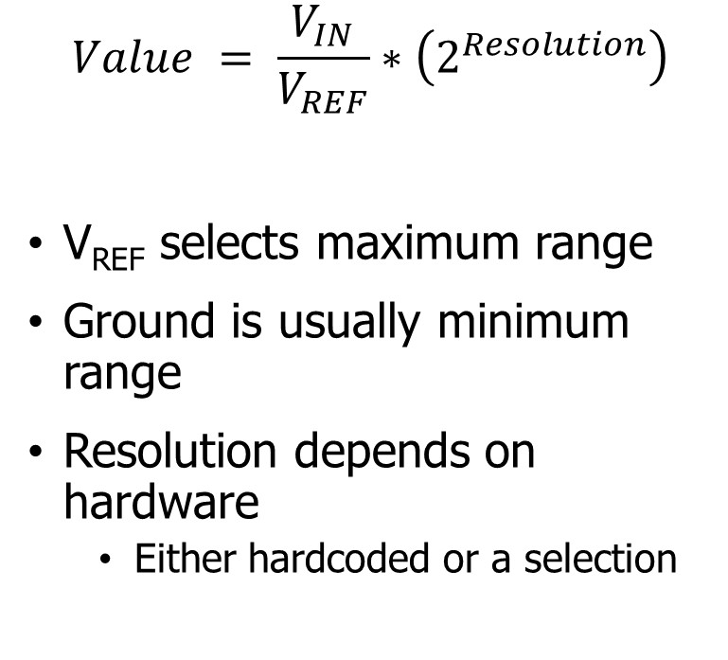
Translating voltage and ADC counts
Analog
Digital (8-bit)
Digital (12-bit)
3.3 V
256
4096
232
3723
$$Value = \frac{V_{IN}}{V_{REF}}∗\left(2^{Resolution}\right)$$
V_{REF} selects maximum range
Ground is usually minimum range
Resolution depends on hardware
  Either hardcoded or a selection
3 V
155
2482
2 V
77
1241
1 V
0 V
0 V
0
0

Slide 26
Wait, shouldn’t that range have a -1 somewhere?
TLDR: no
  https://electronics.stackexchange.com/questions/286949/what-value-to-use-to-convert-adc-value-to-voltage
Each bit pattern represents a range of analog values
  Using 2^{Resolution} minimizes the error for each bit within that range
Alternative important point:
  The error in an ADC will be +/- at least one bit anyways, so this doesn’t matter

Slide 27
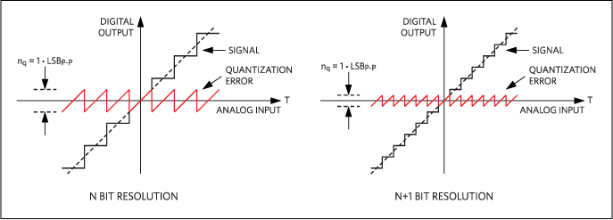
Quantization error
Resolution choice determines magnitude of error
  Each extra bit halves the magnitude of error

Slide 28
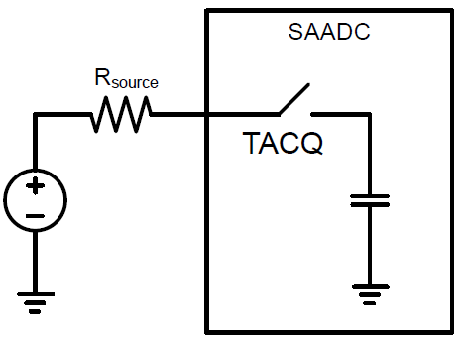
Analog to digital translation process
Two steps:
Acquisition
  Read in signal for some amount
  of time
  Signal connected to a capacitor
  Fills capacitor up to voltage level
  Speed depends on input resistance
    1-100 μs is common
Conversion
  Determine which digital value the read signal corresponds to

Slide 29
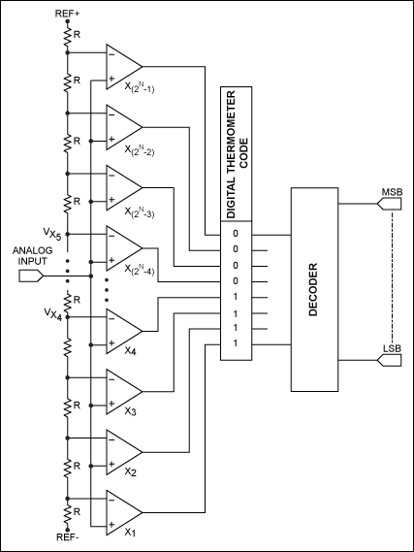
Direct-conversion ADC
Chain comparators together
  Each with a separate reference voltage
Digital value determined immediately
  Also known as “Flash” ADCs
Downside: needs 2^{n}-1 comparators
  Reserved for expensive applications

Slide 30
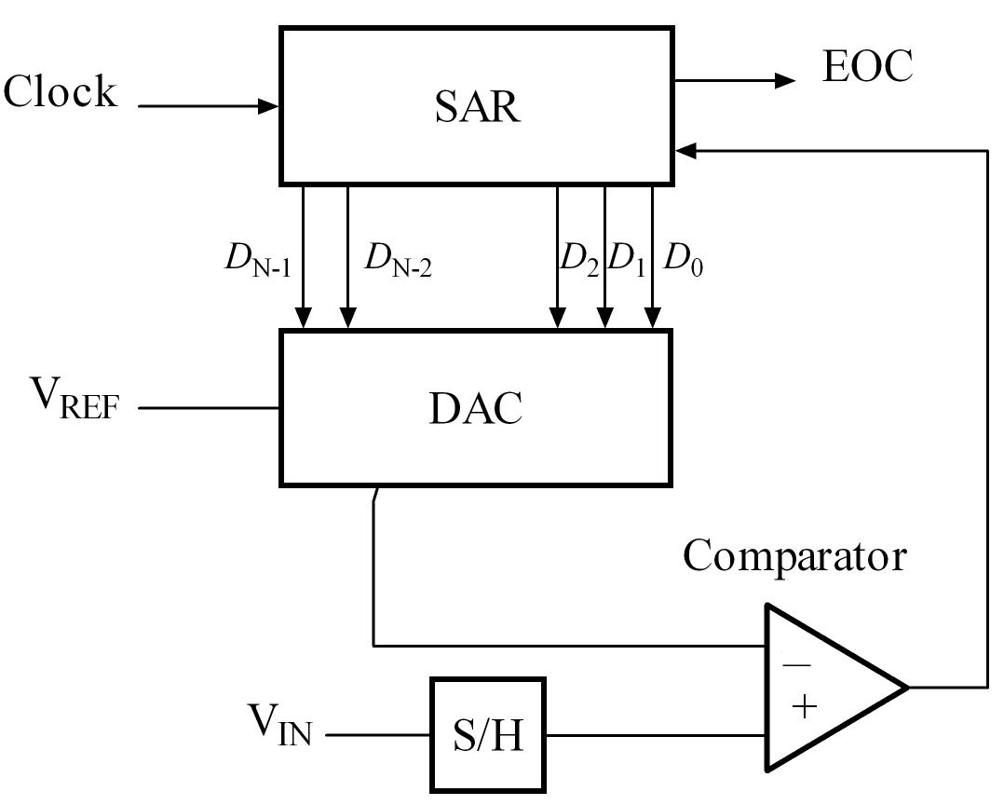
Successive-Approximation ADC
Method: Binary Search
  Compare signal to generated reference
  Increase or decrease reference as needed
  Repeat
DAC creates reference
(Digital-to-Analog Converter)
  Final value of DAC is the ADC value

Slide 31
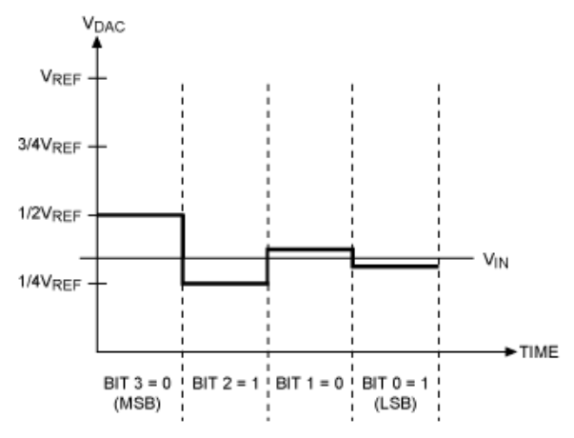
Successive Approximation Example
4-bit ADC with an input signal V_{IN}

Slide 32
Successive Approximation Example
Compare ½ V_{REF} (0b????) to V_{IN}
  If V_{IN} is greater, bit is 1. Else zero

Slide 33
Successive Approximation Example
Compare ½ V_{REF} (0b0???) to V_{IN}
  If V_{IN} is greater, bit is 1. Else zero
  V_{IN} is less. So set that bit to zero

Slide 34
Successive Approximation Example
2. Compare 1/4 V_{REF} (0b0???) to V_{IN}
  If V_{IN} is greater, bit is 1. Else zero

Slide 35
Successive Approximation Example
2. Compare 1/4 V_{REF} (0b01??) to V_{IN}
  If V_{IN} is greater, bit is 1. Else zero
  V_{IN} is greater. So set that bit to one

Slide 36
Successive Approximation Example
3. Compare 3/8 V_{REF} (0b01??) to V_{IN}
  If V_{IN} is greater, bit is 1. Else zero

Slide 37
Successive Approximation Example
3. Compare 3/8 V_{REF} (0b010?) to V_{IN}
  If V_{IN} is greater, bit is 1. Else zero
  V_{IN} is less. So set that bit to zero

Slide 38
Successive Approximation Example
4. Compare 5/16 V_{REF} (0b010?) to V_{IN}
  If V_{IN} is greater, bit is 1. Else zero

Slide 39
Successive Approximation Example
4. Compare 5/16 V_{REF} (0b0101) to V_{IN}
  If V_{IN} is greater, bit is 1. Else zero
  V_{IN} is greater. So bit is one

Slide 40
Successive Approximation Example
5. Output is 5/16 V_{REF} (0b0101)
  Slight underestimate of the real value, but as close as we can get
  More bits would get us even closer

Slide 41
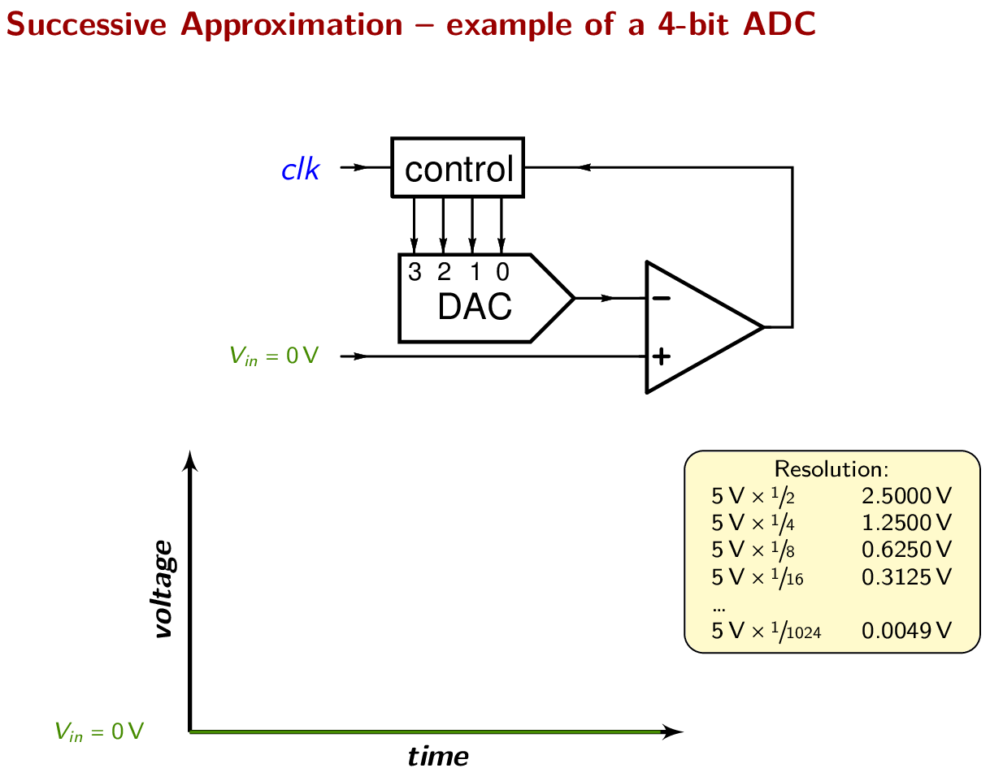
Successive Approximation Example
Performs a binary search to determine correct reference signal value
https://en.wikipedia.org/wiki/Successive-approximation_ADC

Slide 42
Tradeoffs in ADC design
Direct-Conversion: more expensive (more silicon)
SAADC: more time consuming (more binary search time)
Most microcontrollers land on successive-approximation designs
  The slowdown isn’t an issue for slowly changing signals
  Quickly changing signals probably need special hardware anyways

Slide 43
Break + Critical Thinking
How much ADC resolution is needed?

Slide 44
Break + Critical Thinking
How much ADC resolution is needed?
  Resolution requirement depends on signal being sensed
  Temperature sensor probably doesn’t need 16-bit ADC
    Difference between 30.001℃ and 30.002℃ is usually irrelevant
  Microphone might though!
    Differences are audible until they are small enough
    16-bit or 24-bit tend to be common choices for audio data

Slide 45
Outline
Comparators (and nRF implementations)
General ADC Design
nRF ADC Implementation

Slide 46
nRF SAADC (Successive Approximation ADC)
Only one actual ADC peripheral in the chip
  One measurement at any given time
However, provides 8 different “channels” with unique configurations
  Virtualization in hardware!
  Typical setup is to sample each channel one-after-the-other

Slide 47
SAADC Resolution and Sampling
Resolution is selectable (for the whole peripheral)
  8, 10, 12, or 14 bits
  Result stored as 16-bit value regardless
Sampling time is selectable (for each channel)
  3-40 μs
  Longer sampling time is important
  for very low-current signals

Slide 48
nRF SAADC Inputs
Can read the system voltage directly
Or read one of 8 different analog input pins
  These pins ARE fixed and not totally reconfigurable
  Analog signals are more susceptible to interference
Need to make sure that you’re connecting to an analog input pin

Slide 49
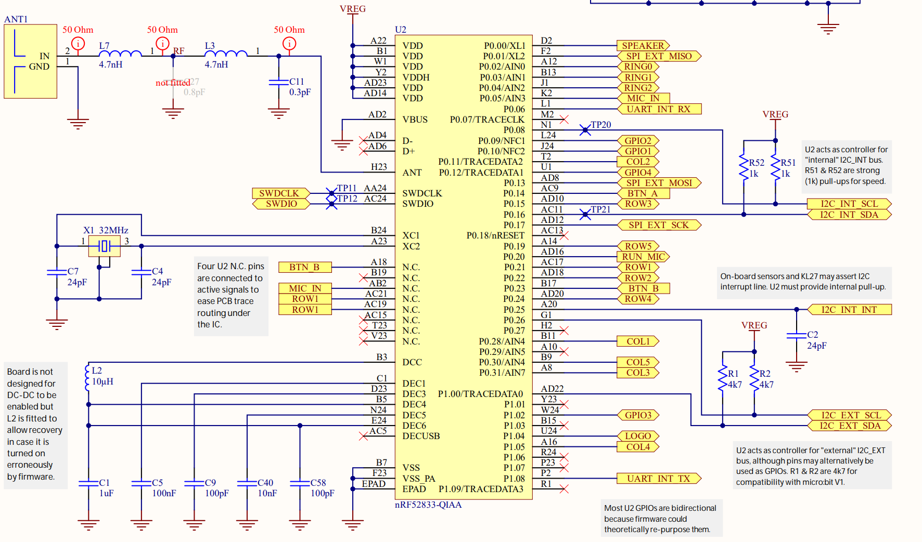
Analog inputs on the Microbit
Of the 8 analog input pins
  One for microphone
  One is not connected
  Three are repurposed for the LED matrix
  Three are available as external inputs
For projects, students sometimes end up with external ADCs
P0.30 is actually AIN6

Slide 50
Triggering sample collection
Can be triggered with TASK_START on demand
  Including through EVENT->TASK chaining
Includes a timer within itself to automatically trigger sampling
  Rate = 16 MHz / (2^{Scale}) where scale is 11 bits
  Maximum rate is 7.8 kHz

Slide 51
EasyDMA on the SAADC
There is no register to read ADC results from
Instead, you must use DMA to collect samples
At configuration time, provide:
  Pointer to RAM
    Must be RAM, not Flash
  Maximum count of 16-bit samples to be written starting at address
    Up to 32768
When complete, a register tells you the amount of samples written to RAM

Slide 52
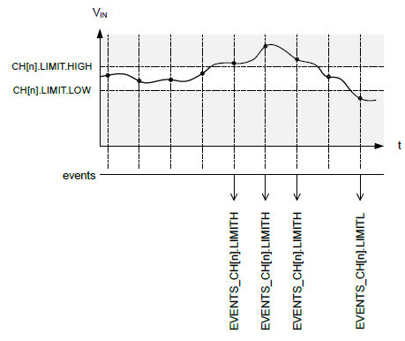
Analog signal monitoring
Includes two comparators for each channel
  High and Low limits
Generates events whenever transitioning above High or below Low
  Events can generate interrupts if desired

Slide 53
Temperature sensitivity
ADCs are often temperature sensitive
  nRF SAADC: 0.02% per degree C
Recommends recalibrating every change of 10 degrees C or more
  Automatic task for calibration
  Real concern for deployed devices
    Outdoors
    Wearable

Slide 54
Design question
How many analog samples can the Microbit hold?

Slide 55
Design question
How many analog samples can the Microbit hold?
  Available: 128 kB RAM, 512 kB Flash (64000 samples in RAM)
  Questions
    Are they packed or padded to 16-bit?
    How much memory are you using for other things?
    Are you moving them into Flash periodically? (or external storage)

Slide 56
Outline
Comparators (and nRF implementations)
General ADC Design
nRF ADC Implementation

