Slide 1
Lecture 08
Driver Design
CE346 – Microcontroller System Design
Branden Ghena – Fall 2024
Some slides borrowed from:
Josiah Hester (Northwestern), Prabal Dutta (UC Berkeley)

Slide 2
Administriva
Postlab 2 questions due today. Don’t forget!
Project Proposals due today!
  A few are in so far and they look great and I’m super excited!!!!!
  My goal is get you feedback sometime next week
Otherwise, class keeps going as usual
  Still have four more lab sessions
  Still have three more quizzes
  Lots more content to cover

Slide 3
Today’s Goals
Deep-dive into driver design options
Explore another aspect of device driver design
  Non-blocking vs Blocking interfaces
Discuss how interrupts interact with these
  Event-loop as a partial alternative
Introduce State Machines for coordinating logic
Consider how an LED matrix driver could be constructed

Slide 4
Outline
Driver Interfaces (Blocking and Non-Blocking)
Event-driven Model
State Machines
Continuous Operation

Slide 5
How should we write driver software?
There are various knobs available to us from hardware
  Polling, Interrupts, DMA
There are also various software interface design
  Synchronous
  Asynchronous
    Callback
    Event-driven model

Slide 6
Synchronous device drivers
Synchronous functions
  Function call issues a command
  Does not return until action is complete and result is ready
Example: most functions we’re used to
  sqrt() for example
  printf() also usually works this way (with some exceptions)
Arduino interfaces are usually like this!
  Easy to get started with and understand

Slide 7
Downside of synchronous code: the waiting
How long will it take until the function returns?
  Immediately, seconds, minutes?
What if there’s an error and the device never responds?
  More advanced interface could include a timeout option
Synchronous designs require other synchronous designs
  We can build synchronous interfaces from asynchronous ones
  But we can’t go the other way

Slide 8
Asynchronous drivers
Goal: let the hardware run on its own and have the code get back to it later
Challenge: programmers don’t think that way
Other challenge: how do we “get back to it later”?
  Callbacks
  Event-driven model

Slide 9
Callbacks
Callbacks reuse a similar idea to interrupts
  When the event occurs, call this function
General pattern
  Call driver function with one argument being a function pointer
  Driver sets up interaction and returns immediately
  Later the event happens and the driver calls the function pointer

Slide 10
Function pointers in C
Harder than in Javascript or C++. Can’t define anonymous function inline
  Instead create a pointer to an existing function in your code
void myfun(int a) {
// do something here
}
void main() {
void (*fun_ptr)(int) = &myfun;
fun_ptr(10); // dereference happens automatically
}
& is actually unnecessary. With or without are identical.

Slide 11
Callback functions
uint32_t timer_start(
uint32_t microseconds,
void (*callback_fn)(void*),
void* context
);
timer_start(duration, my_timer_handler, context);
“Context” is often provided as well (void*)
  Ability for caller to pass an argument for the callback function
  Often a pointer to a position in a structure or a shared variable to modify

Slide 12
Callbacks usually run in an interrupt mode
If the interrupt handler calls the callback, the callback will be within that same interrupt mode
Be careful which variables you modify!!
  Could lead to concurrency issues if you modify a public structure
Starts to get pretty annoying
  Embedded systems have to deal with concurrency issues just like OSes

Slide 13
Building synchronous code out of callbacks
Callback handlers can be used to build synchronous code
void myfun(void* context) {
*(boolean*)context = true; // context is the flag pointer
}
void timer_start_blocking(duration) {
volatile boolean flag = false;
timer_start(duration, &myfun, &flag);
while (!flag) { // spin-loop }
}

Slide 14
Live Coding: Temp driver example
nu-microbit-base/software/apps/temp_driver/
Some necessary functions
  NVIC_EnableIRQ(irq); // TEMP_IRQn is for the Temperature Sensor
  NVIC_SetPriority(irq, priority)

Slide 15
Outline
Driver Interfaces (Blocking and Non-Blocking)
Event-driven Model
State Machines
Continuous Operation

Slide 16
Interrupts are frustrating
We do not always want to block on every call
We also do not want to deal with concurrency issues
An alternative: one main event loop
  Polls necessary sensors
  Iterates through state machine and determine actions
  Runs at a certain frequency

Slide 17
Event loop
Rather than polling a single driver, poll all of them
  Each time through the loop check all relevant inputs
  Respond to events that are necessary
  Sleep until ready to start again
    while (1) {
    time start = get_time();
    boolean result = check_timer();
    if (result) { check_gps(); }
    adjust_throttle();
    delay_ms(1000 – (get_time() – start));
    }

Slide 18
Downsides of event loop design
Timeliness can be a problem
How long between the timer being ready and the GPS being checked in this example?
  Maximum of 1 second plus the time spent checking other stuff
while (1) {
time start = get_time();
boolean result = check_timer();
if (result) { check_gps(); }
adjust_throttle();
delay_ms(1000 – (get_time() – start));
}

Slide 19
Top-half / Bottom-half handler design
Top half
  Interrupt handler
    Immediately continues next transaction
    Or signals for top half to continue (often with shared variable)
Bottom half
  Performs logic to actually process and respond to the event
  Run in a non-interrupt context when the scheduler is ready for it
    Usually safe to run it even while interrupts could be occurring

Slide 20
Live Codeing: Temperature event-loop example
nu-microbit-base/software/apps/temp_event_loop/
Some necessary functions
  NVIC_EnableIRQ(irq); // TEMP_IRQn is for the Temperature Sensor
  NVIC_SetPriority(irq, priority)

Slide 21
Outline
Driver Interfaces (Blocking and Non-Blocking)
Event-driven Model
State Machines
Continuous Operation

Slide 22
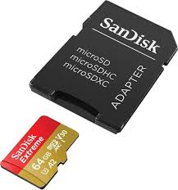
Complex devices often have multiple states of operation
Temperature peripheral
  Start a temperature measurement
  Wait for temperature to be ready
SD Card
  Can accept data very quickly, but then takes a while to process the data
    Write configuration for which block you’re accessing
    Wait as it reconfigures itself
    Write data to the SD Card
    Wait as the SD Card records the data
    Repeat

Slide 23
Finite State Machine (FSM)
Model of computation
  Often used in code and hardware design
FSM components
  A set of states for some system
  Inputs to the system
  Transitions between states based on inputs
    Not necessarily all states can connect to all other states
FSMs can generate output
  Moore machine: output depends on the current state
  Mealy machine: output depends on the current state plus the current inputs

Slide 24
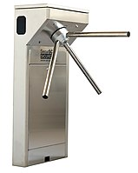
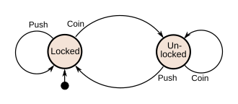
State machine for a turnstyle
Starts in the “Locked” state
Inputs are “Coin” or “Push”
Transitions are shown with arrows
Output: status of the user (stuck still or moving through)

Slide 25
State machines can help structure actions in code
if (state == A){
// do A actions here
state = B;
} else if (state == B) {
// do B actions here
if (input == VALUE) {
state = C;
} else {
state = A;
}
} else if (state == C) {
// do C actions here
state = A;
}
A
B
C

Slide 26
Truncated example of SD Card driver state machine
On error
On error
Idle
InitReset
StartReadBlocks
InitCheckVersion
WaitReadBlocks
InitRepeatHCSInit
InitAppSpecificInit
ReadBlockComplete
InitCheckCapacity
…
InitComplete
https://github.com/tock/tock/blob/master/capsules/extra/src/sdcard.rs#L482

Slide 27
Calling into the state machine
Might be executed each time through the loop
  Just call “advance_state_machine()” each time through the main loop
Could advance through interrupts or timers
  On hardware event, run the state machine and determine what to do now

Slide 28
Outline
Driver Interfaces (Blocking and Non-Blocking)
Event-driven Model
State Machines
Continuous Operation

Slide 29
Continuous operation
For some sensors/actuators they might be continuously updating in the background
For those, we only need one init_and_start() function and a read or write function
  Continuous sensors are always ready with the most recent sample
  Continuous actuators will always update to the new command as soon as possible
    They might skip a command if you give it multiple very quickly

Slide 30
Continuously updating temperature
Temperature driver design
  In the interrupt handler, copy over the value
  Start the next event, which will automatically re-trigger the interrupt
  No more is_ready() function, data is always ready with the most up-to-date value
    Might be a little behind real-time, but only by one sample
This particular implementation would mean a TON of interrupts
  Probably want to combine with a timer to run it more slowly

Slide 31
LED Matrix design
This is a good example of a continuous operation actuator
General driver design
  Split operation between a Model and a View
  (Model-View-Controller design)
  Model contains what you want the state of the LEDs to be
    Only updates when the user calls a function
    Updates immediately (non-blocking)
  View contains the code to take the model and display it on the LEDs
    Continuously updates the LED states with a timer

Slide 32
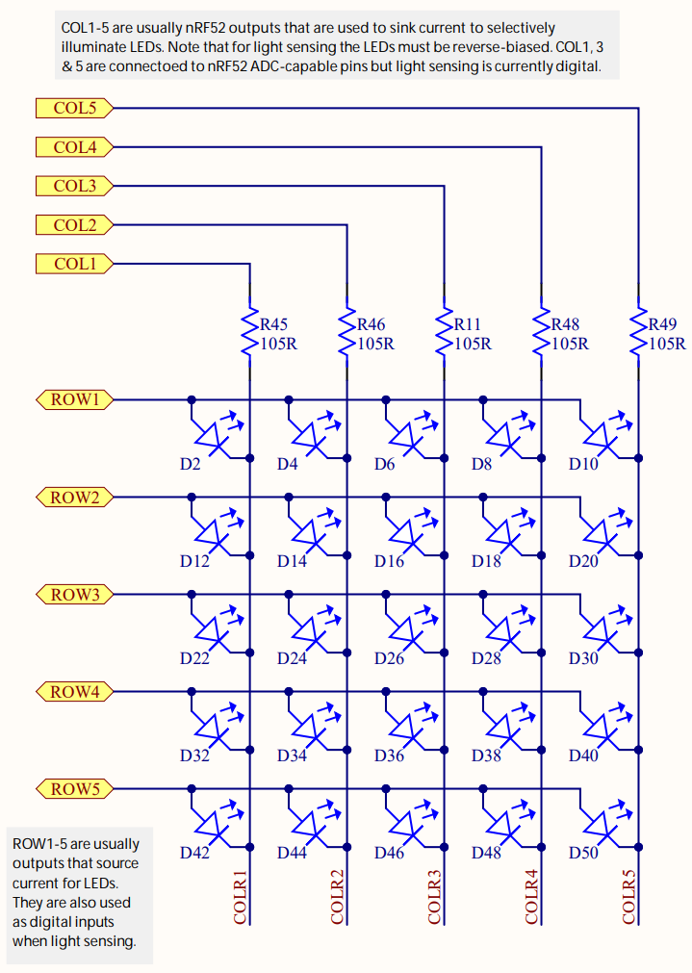
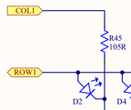
LEDs on the Microbit
Use two GPIO pins to control each LED
  Row high as VDD
  Column low as Ground
Remember, connections only exist where there are dots

Slide 33
Controlling the LED matrix
LOW
We can light up all the LEDs at once:
  Set all rows to High
  Clear all columns to Low
LOW
LOW
LOW
LOW
HIGH
HIGH
HIGH
HIGH
HIGH

Slide 34
Controlling the LED matrix
LOW
But now how do we turn off the right middle LED?
LOW
LOW
LOW
LOW
HIGH
HIGH
HIGH
HIGH
HIGH

Slide 35
Can we control by row?
LOW
But now how do we turn off the right middle LED?
What if we clear the row to Low?
  Messes up the entire row
LOW
LOW
LOW
LOW
HIGH
HIGH
LOW
HIGH
HIGH

Slide 36
Can we control by column?
HIGH
But now how do we turn off the right middle LED?
What if we set the column to High?
  Messes up the entire column
We don’t actually have arbitrary control over the whole thing at once
LOW
LOW
LOW
LOW
HIGH
HIGH
HIGH
HIGH
HIGH

Slide 37
Persistence of vision
The solution here is to abuse how human eyes work
Eyes can’t detect changes in light that are going faster than a certain speed
  Or if they do at all, it’s interpreted as slightly dimmer light
  Any given LED should be above ~100 Hz to keep humans from noticing the flicker

Slide 38

Persistance of vision on an LED matrix

Slide 39
One column at a time
HIGH
What if we instead control a single column at a time?
First column, all LEDs on
HIGH
HIGH
HIGH
LOW
HIGH
HIGH
HIGH
HIGH
HIGH

Slide 40
One column at a time
HIGH
What if we instead control a single column at a time?
Same for second column through fourth column
HIGH
HIGH
LOW
HIGH
HIGH
HIGH
HIGH
HIGH
HIGH

Slide 41
One column at a time
HIGH
What if we instead control a single column at a time?
Same for second column through fourth column
HIGH
LOW
HIGH
HIGH
HIGH
HIGH
HIGH
HIGH
HIGH

Slide 42
One column at a time
HIGH
What if we instead control a single column at a time?
Same for second column through fourth column
LOW
HIGH
HIGH
HIGH
HIGH
HIGH
HIGH
HIGH
HIGH

Slide 43
One column at a time
LOW
What if we instead control a single column at a time?
Last column we only turn on some of the LEDs
As long as we keep cycling through columns fast enough, the whole thing becomes a display
HIGH
HIGH
HIGH
HIGH
HIGH
HIGH
LOW
HIGH
HIGH

Slide 44
LED matrix full design
Requires GPIO pins and a Timer
When the Timer fires
  Change which column you are displaying
  Update the row pins based on this new column
    Read row data from a 5x5 array that models what the screen should show
When the user wants to change the display
  Update that 5x5 array in memory
  It’ll start getting drawn on the screen the next time the Timer fires

Slide 45
Outline
Driver Interfaces (Blocking and Non-Blocking)
Event-driven Model
State Machines
Continuous Operation

