Slide 1
Lecture 07
Sensors
CE346 – Microcontroller System Design
Branden Ghena – Fall 2024
Some slides borrowed from:
Josiah Hester (Northwestern), Prabal Dutta (UC Berkeley)

Slide 2
Administrivia
Project Proposals due Thursday!
  I’ve heard ideas from a few groups already and I’m super excited!!!!!
  My goal is get you feedback sometime in the next week after they’re submitted
  If you still need a partner, fill out the partnership form ASAP
    You MAY NOT do the final project alone
    It is worth almost half of your grade

Slide 3
Today’s Goals
Think about sensing and sensors
Explore a variety of sensor types, how they are made, and what their capabilities are
Discuss an example research platform with a custom sensor

Slide 4
Outline
Sensing Overview
Types of Sensors
  Temperature
  Light
  Inertial
  Others
Capacitive Touch Sensing

Slide 5
Definitions
A sensor is a device that measures a physical quantity
  Temperature sensor
  Light sensor
  Microphone
An actuator is a device that modifies a physical quantity
  Heater
  Motor
  Speaker

Slide 6
Analog signals
Exist in infinite states
  From a maximum to a minimum
Often used for interactions with the real world
  Sensors usually generate analog signals
Microbit example: microphone

Slide 7
Sensors transform quantity into an electric signal
Microcontrollers can interact with analog signals
  Generating an analog signal proportional to physical quantity makes the quantity able to be sensed
  Microcontrollers will transform this analog signal into a binary value with an analog-to-digital converter
How do we generate an electrical signal?
  Ohm’s Law: V = I * R (Voltage = Current * Resistance)
  Vary any one of these three and an analog signal is created
    Resistive sensors are common
    As are sensors that produce a voltage/current

Slide 8
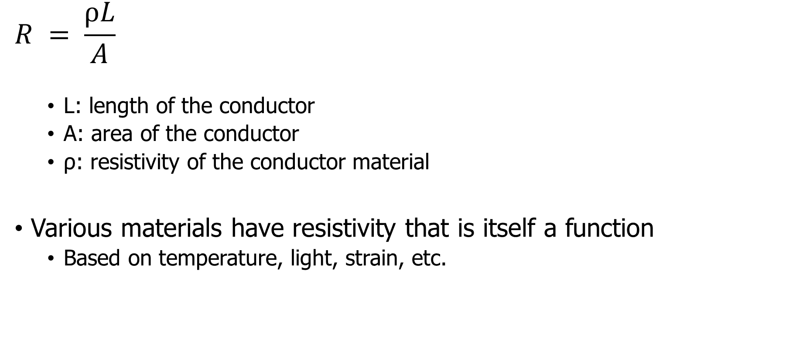
Resistive sensors
$$R = \frac{ρL}{A}$$
  L: length of the conductor
  A: area of the conductor
  ρ: resistivity of the conductor material
Various materials have resistivity that is itself a function
  Based on temperature, light, strain, etc.

Slide 9
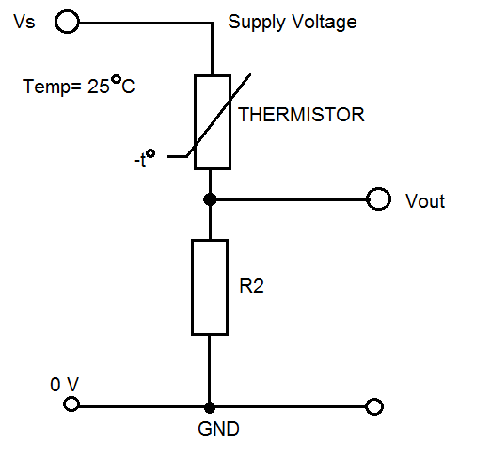
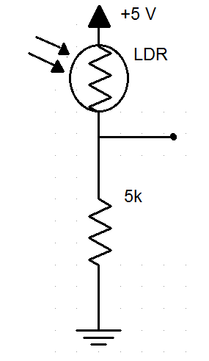
Using a resistive sensor
Place in series with another resistor
  Between VCC and ground
Measure voltage between the two relative to ground
Forms a “voltage divider”

Slide 10
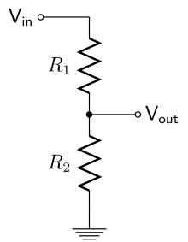
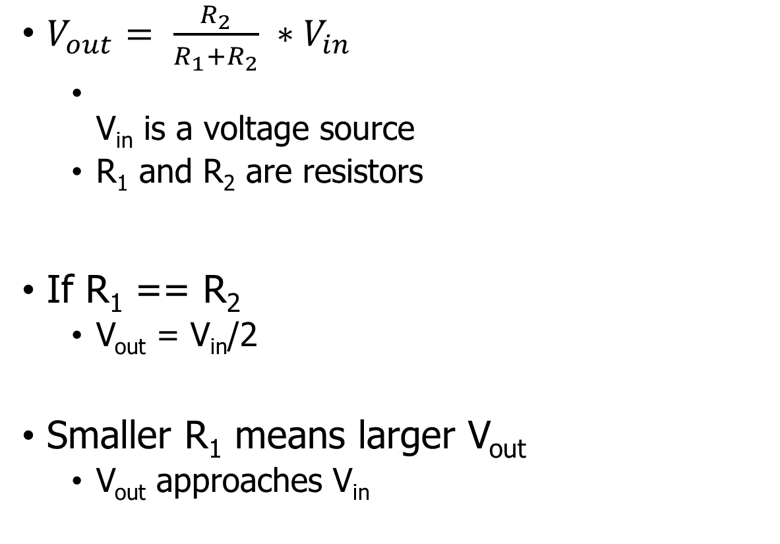
Voltage divider
Important! Learn this
$V_{out}= \frac{R_{2}}{R_{1}+R_{2}} ∗V_{in}$
  V_{in} is a voltage source
  R₁ and R₂ are resistors
If R₁ == R₂
  V_{out} = V_{in}/2
Smaller R₁ means larger V_{out}
  V_{out} approaches V_{in}

Slide 11
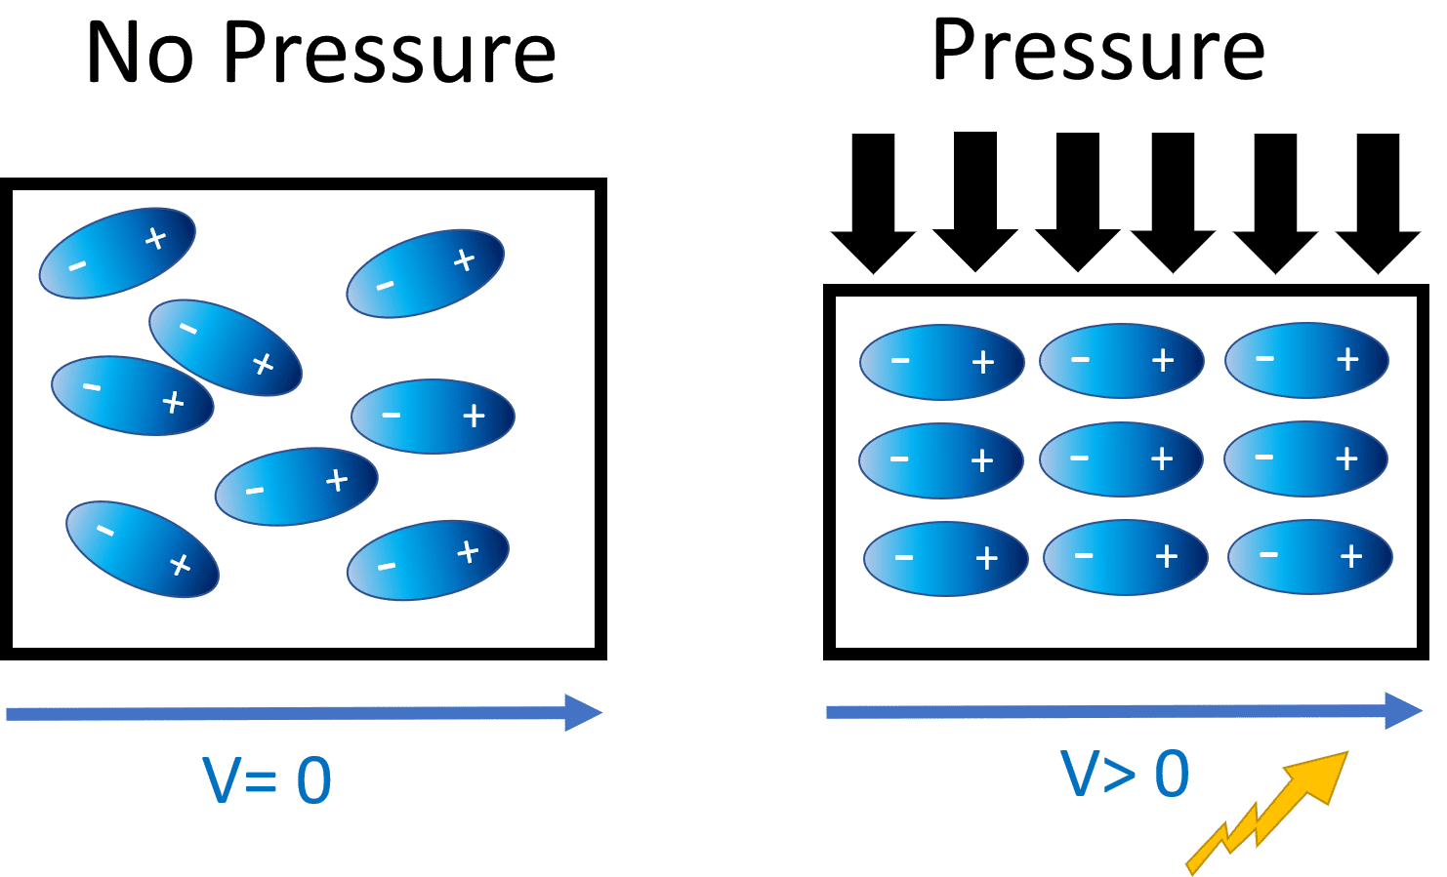
Generating voltage via piezoelectric effect
Compression of the
material generates
a voltage
Various sources of
compression:
  Air Pressure
  Acceleration
  Strain
Alternative to resistive sensors. But, a voltage is still the output

Slide 12
Understanding sensor voltage
Once you get a voltage, what do you do with it?
Need to understand the transfer function between voltage and the sensed quantity
  Examples for an accelerometer: senses acceleration
Hopefully, function is linear
  Frequently, function is NOT

Slide 13
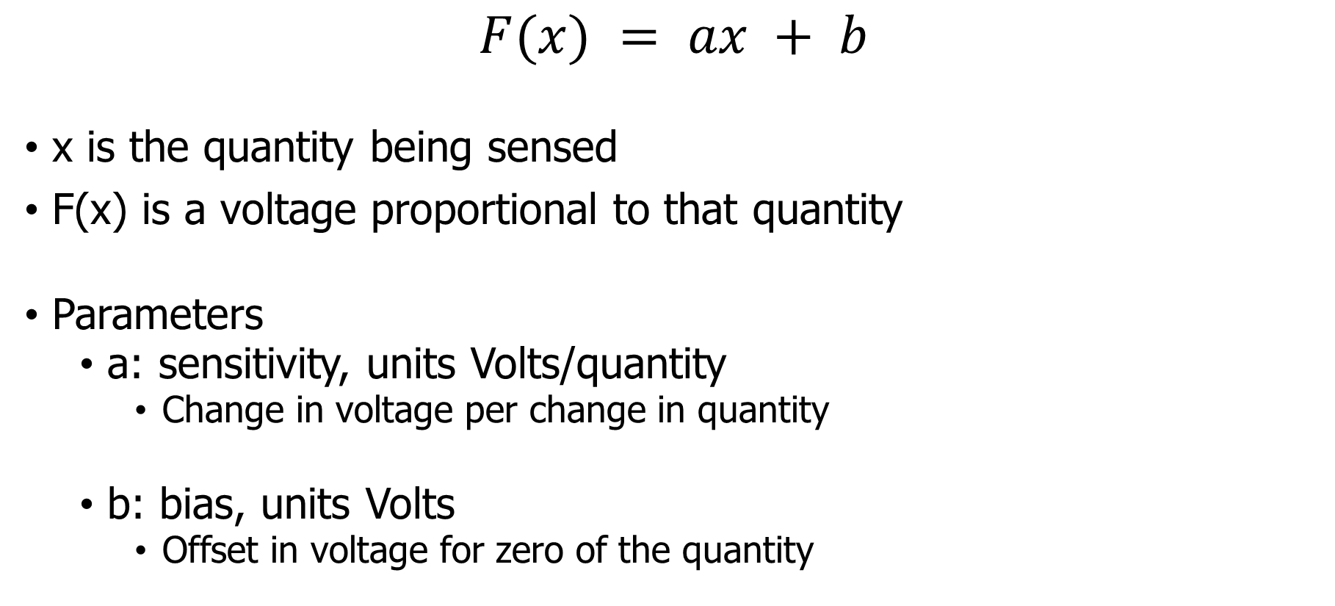
Affine sensor model (for linear sensors)
$$F(x) = ax + b$$
x is the quantity being sensed
F(x) is a voltage proportional to that quantity
Parameters
  a: sensitivity, units Volts/quantity
    Change in voltage per change in quantity
  b: bias, units Volts
    Offset in voltage for zero of the quantity

Slide 14
Bias and sensitivity example
Accel
x(g)
-3.6
0
3.6
0
1.5
3.0
V_{readout} (V)
F(x)
F(x) = ax+b
b = 1.5
a = 1.5/3.6 = 0.417 V/g
ADC (16-bit)
[0,3 V] → [0, 2¹⁶-1]
0
32768
65535

Slide 15
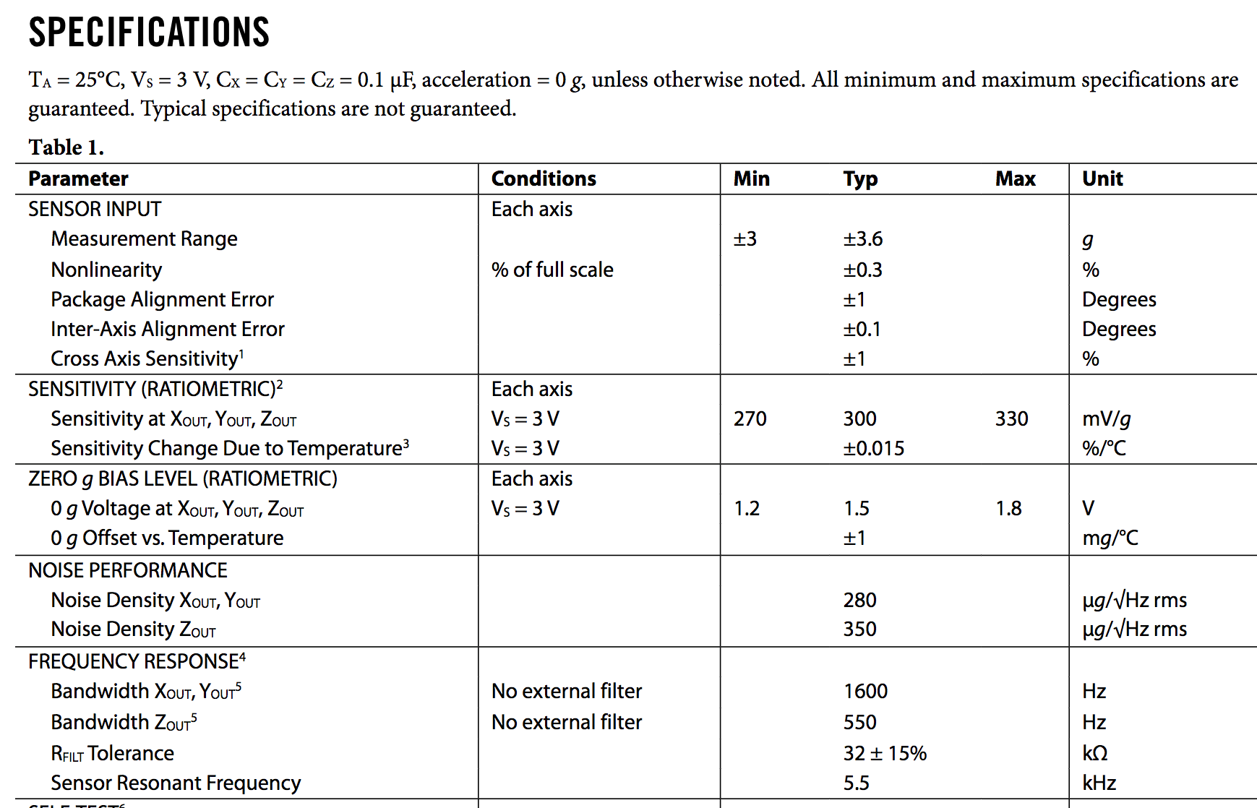
Understanding transfer function: ADXL330 datasheet
Ratiometric
  Relative
  to sensor
  voltage
Bandwidth
  ≈Data update speed of the sensor
  Data changes above 1600 Hz are less detectable

Slide 16

Break + Question
$$F(x) = ax + b$$
  x is the quantity being sensed
  F(x) is a voltage proportional to that quantity
  a: sensitivity, units Volts/quantity
    Change in voltage per change in quantity
  b: bias, units Volts
    Offset in voltage for zero of the quantity
Accelerometer
  Measures 0-5 g
  Over a 0-5v range
What is sensitivity?
What is bias?
What acceleration is the voltage reading 3.5 volts?

Slide 17

Break + Question
$$F(x) = ax + b$$
  x is the quantity being sensed
  F(x) is a voltage proportional to that quantity
  a: sensitivity, units Volts/quantity
    Change in voltage per change in quantity
  b: bias, units Volts
    Offset in voltage for zero of the quantity
Accelerometer
  Measures 0-5 g
  Over a 0-5v range
What is sensitivity? 1 v/g
What is bias? 0 v
What acceleration is the voltage reading 3.5 volts?
  3.5 v = 1v/g * x + 0v -> 3.5 g

Slide 18
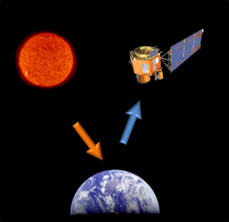
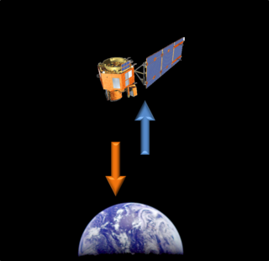
Active and passive sensing
Passive Sensing
Active Sensing

Slide 19
Active and passive sensing
We usually focus on passive sensing
  Cheaper and lower energy costs!
Active sensing examples
  Flash photography
  Ultrasonic distance sensing
  Lidar and Radar

Slide 20
Intelligent sensors
Many embedded sensors are more intelligent than simple analog
Combine it with a built-in ADC (analog-to-digital converter)
  Can be more finely tuned and calibrated for accuracy
  Now gives digital output over some wired communication mechanism
Combine it with additional circuitry / computation
  Automatically filter data
  Detect specific signal patterns and interrupt
I point most groups at intelligent sensors for projects
  More expensive but easier to use

Slide 21
Outline
Sensing Overview
Types of Sensors
  Temperature
  Light
  Inertial
  Others
Capacitive Touch Sensing

Slide 22
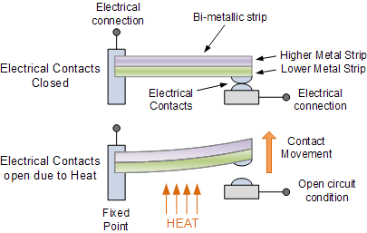
Digital temperature sensor
Thermostat
  Original meaning of the word
Heat bends a strip of two different metals
Switches circuit on/off based on the temperature

Slide 23
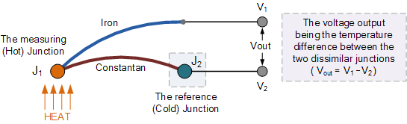
Thermo-electric temperature sensing
Thermocouple generates a voltage based on temperature
Can be used to harvest energy to run system
  Part of RTG design

Slide 24
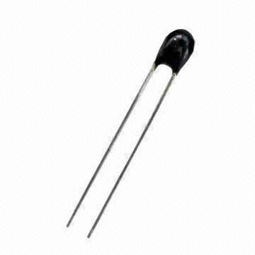
Resistive temperature sensing
Thermistor varies resistance based on temperature
Set up as a voltage divider to measure
Advantages: extremely cheap and easy to use
Disadvantages: non-linear transfer function

Slide 25
Outline
Sensing Overview
Types of Sensors
  Temperature
  Light
  Inertial
  Others
Capacitive Touch Sensing

Slide 26
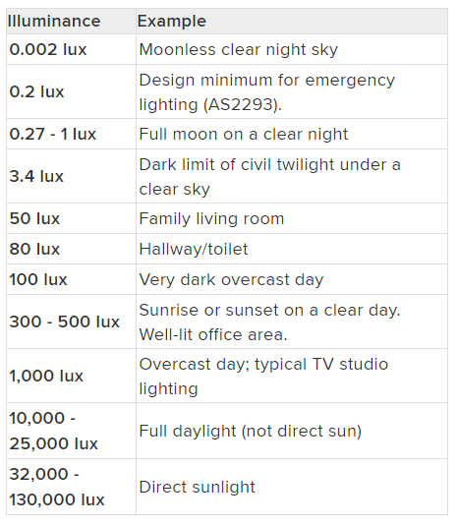
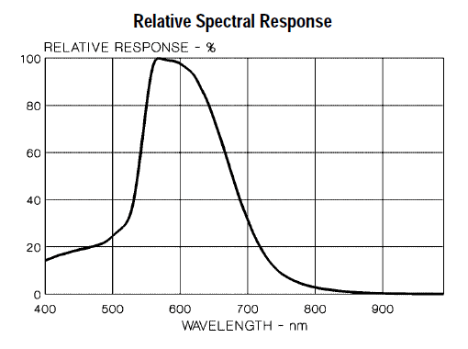
Measuring light
Lux: unit of illuminance
Beware spectrum sensitivity

Slide 27
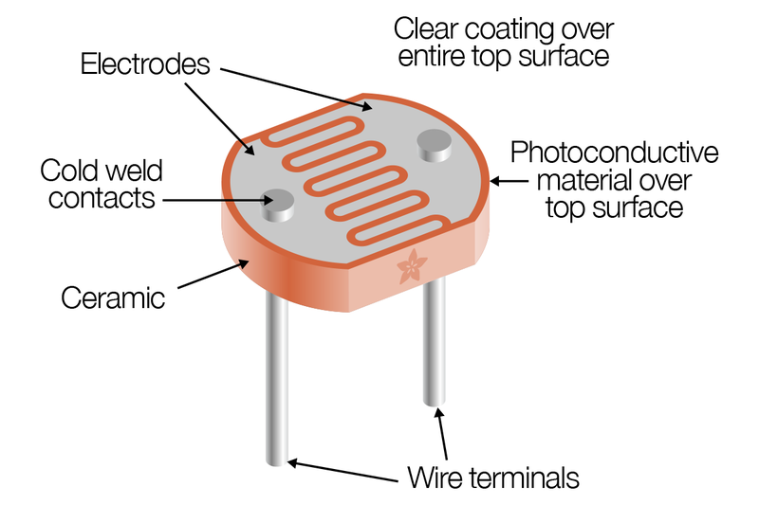
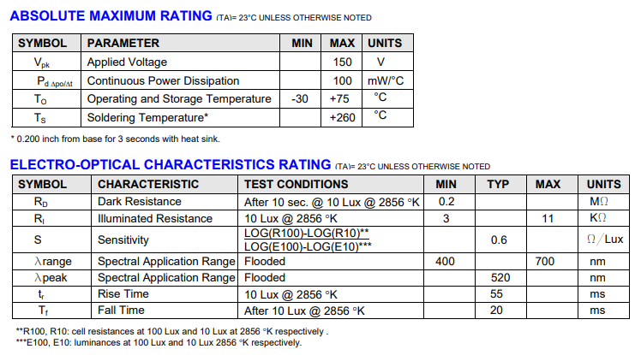
Resistive light sensing
Photocell changes resistance with light (non-linear)
Kit version:
10 kΩ when dark
1 kΩ when light

Slide 28
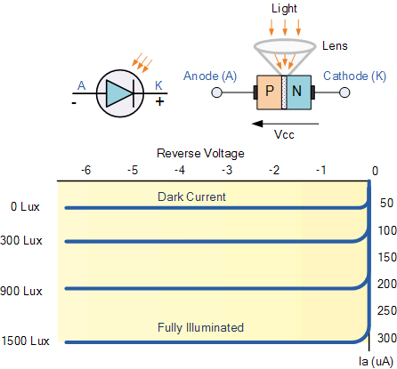
Photodiodes leak current based on light levels
When voltage is applied in reverse to an ideal diode, no current flows
But some small amount of current leaks for real-world diodes
  Proportional to light levels!
LEDs can be used as (crappy) photodiodes as well!
  Apply reverse voltage
  Read in leak current as voltage across a resistor using ADC
https://wiki.analog.com/university/courses/electronics/electronics-lab-led-sensor

Slide 29
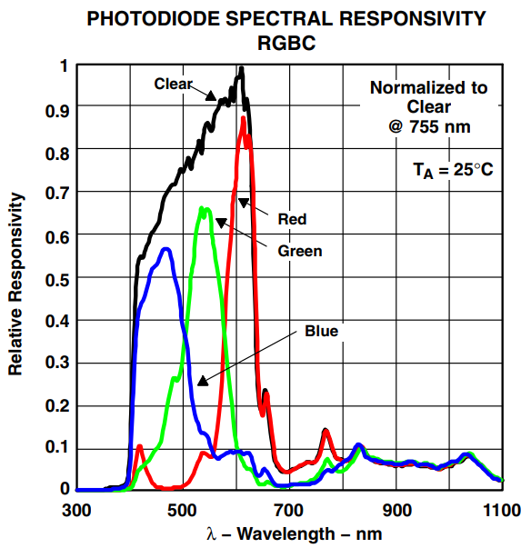
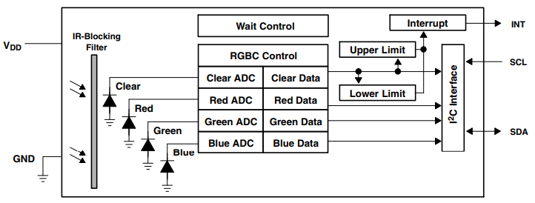
Light color sensing
Respond to specific light colors separately
Intelligent sensor: photodiodes combined with ADCs and a wired interface (I2C)
Allows interrupting based on comparator too

Slide 30
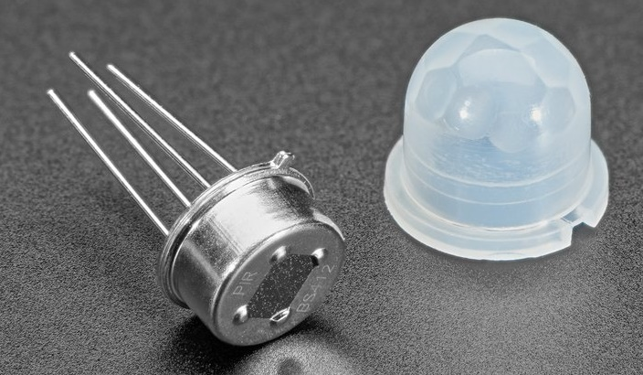
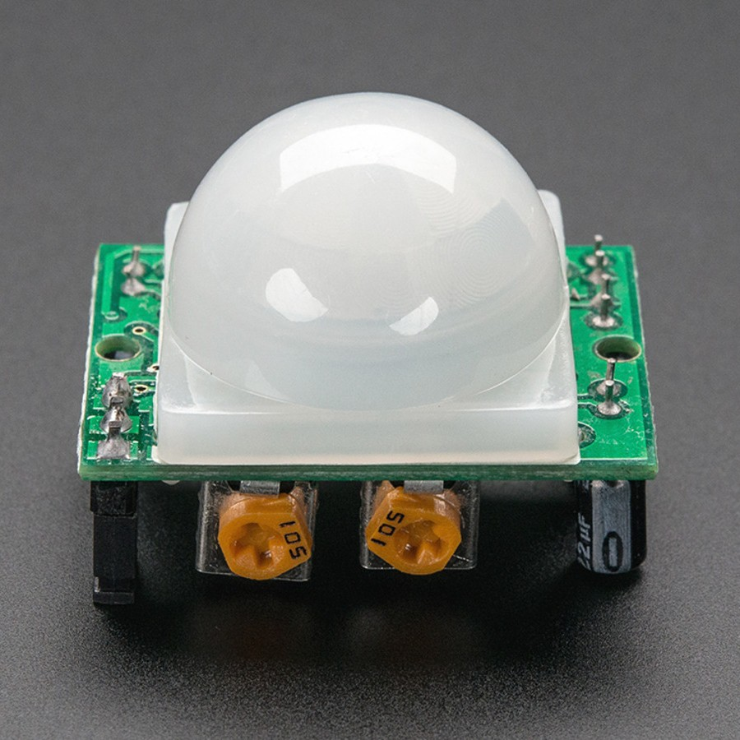
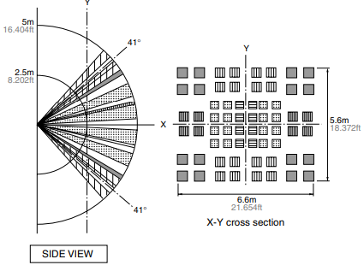
Passive Infrared (PIR) sensor
Detect movement in the environment
  By detecting change in IR levels
Often come with plastic lens cover to improve field of view and range

Slide 31
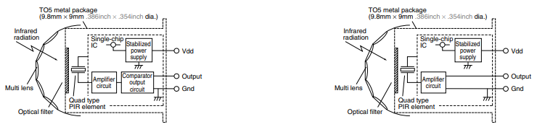
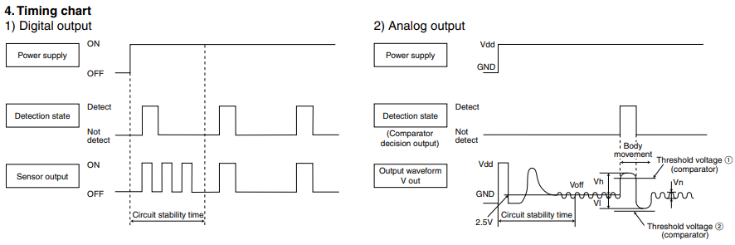
PIR sensors come in digital and analog forms
Digital includes a preconfigured comparator

Slide 32
Outline
Sensing Overview
Types of Sensors
  Temperature
  Light
  Inertial
  Others
Capacitive Touch Sensing

Slide 33
Inertial Measurement Unit (IMU)
IMUs (a.k.a 9 degree-of-freedom, 9DOF) are used for tracking motion of a device
  Acceleration (X, Y, Z axes)
  Rotation (X, Y, Z axes)
  Magnetism (X, Y, Z axes)
  Sometimes 6DOF with Acceleration + one of the others
Intelligent sensing: combines multiple sensors, ADCs, and computation with a wired interface
  9 analog inputs would otherwise be too many
Can be used to track motion, determine transportation method
  Smartphones, Robotics, etc.

Slide 34
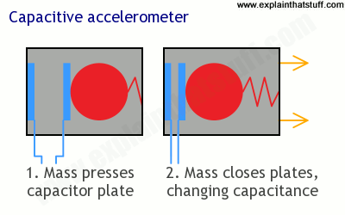
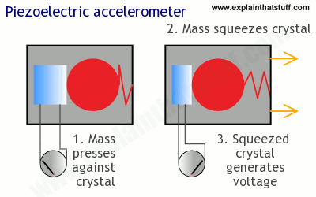
Sensing acceleration
Goal: create a voltage that changes based on force

Slide 35
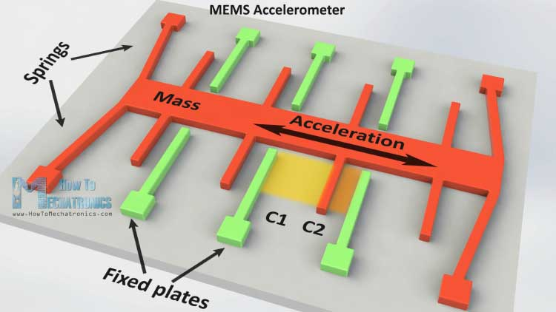
Microelectromechanical Systems (MEMS)
Same concept, but within an IC and 1 to 100 micrometers in size

Slide 36
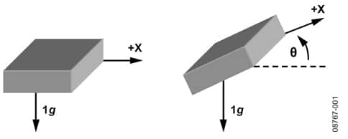
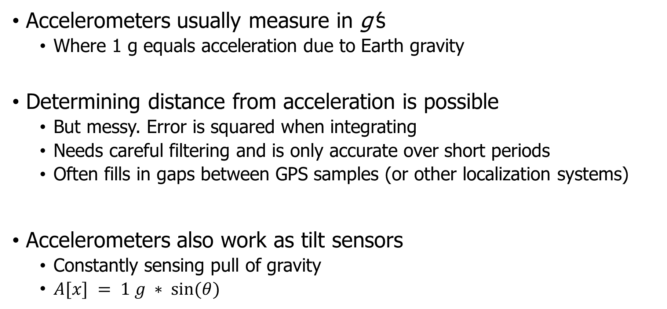
Using accelerometers
Accelerometers usually measure in g’s
  Where 1 g equals acceleration due to Earth gravity
Determining distance from acceleration is possible
  But messy. Error is squared when integrating
  Needs careful filtering and is only accurate over short periods
  Often fills in gaps between GPS samples (or other localization systems)
Accelerometers also work as tilt sensors
  Constantly sensing pull of gravity
  $A[x] = 1 g ∗ sin⁡(θ)$

Slide 37
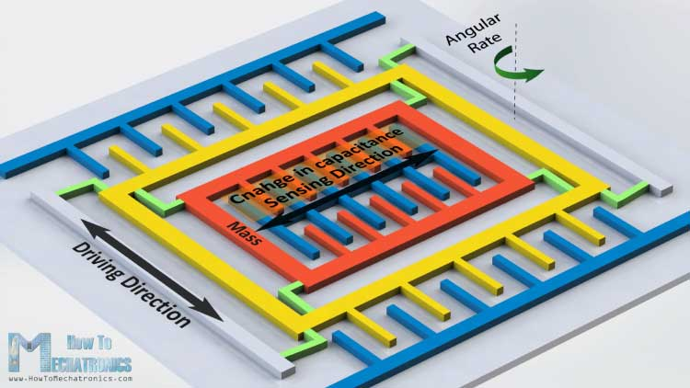
Gyroscopes
Measures angular velocity
  Usually lower limit than you might hope
  <10 rotations per second
Usually, we want angle instead of rotation speed
  Integrate signal to determine current angle
  Combine noise and DC bias with integration and you get a
  continuously accumulating error: drift

Slide 38
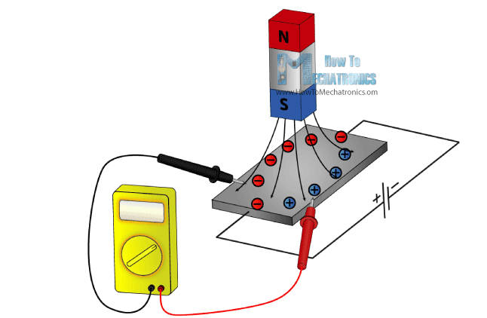
Magnetometer
Measures the magnetic field
Usually used in devices as a compass
  Detect Earth’s magnetic field orientation
Problem: Earth’s magnetic field often overwhelmed by local magnetism when indoors
  Large chunks of metal in walls, for example
  Or other metal parts nearby on the circuit board!!
Satellites can use magnetometers for localization

Slide 39
Outline
Sensing Overview
Types of Sensors
  Temperature
  Light
  Inertial
  Others
Capacitive Touch Sensing

Slide 40
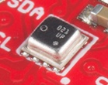
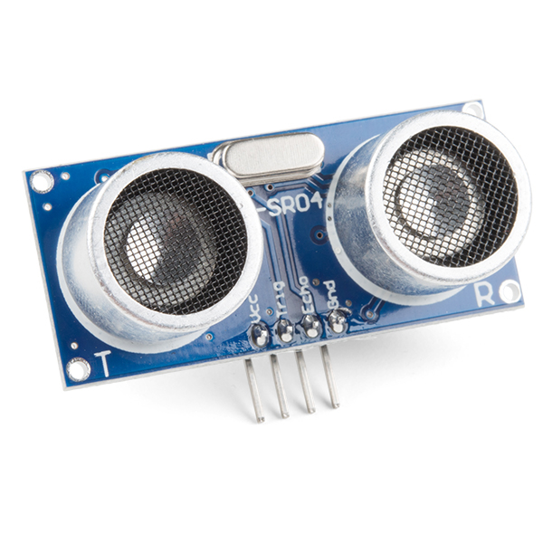
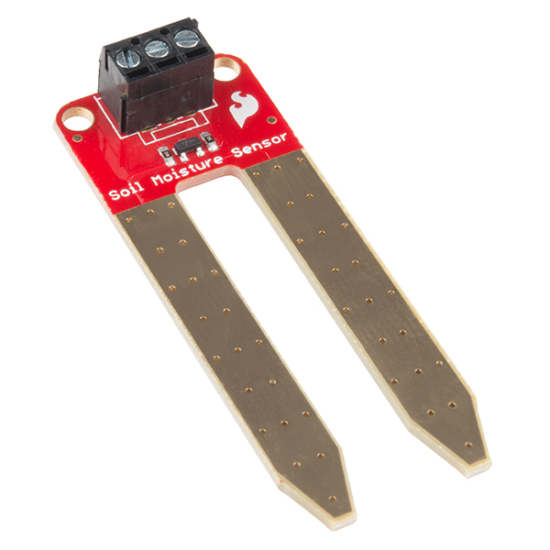
Other sensors
Environment: Pressure, Humidity, Air Velocity, Air Quality
Distance: Ultrasonic, Lidar, or Radar
Biometric: Pulse Oximeter, Heart Rate
Agricultural: Soil moisture

Slide 41
Break + Open Question
How are new sensors discovered/created?

Slide 42
Outline
Sensing Overview
Types of Sensors
  Temperature
  Light
  Inertial
  Others
Capacitive Touch Sensing

Slide 43
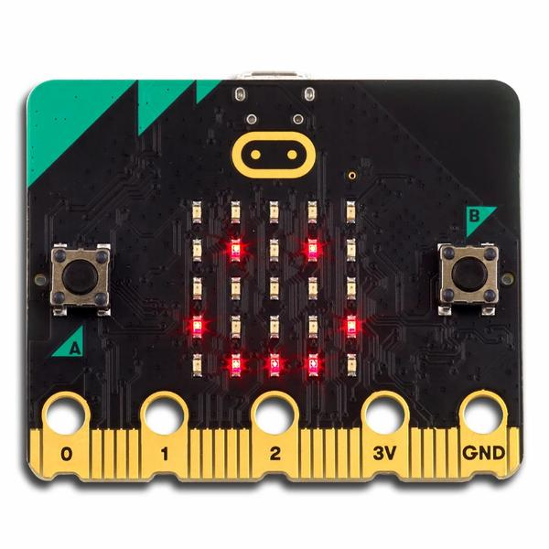
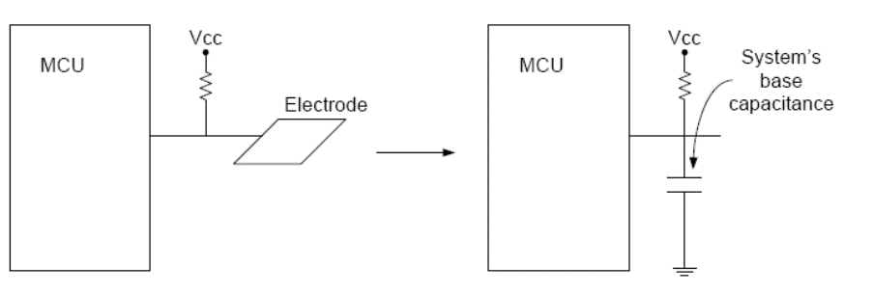
Capacitive Touch Sensor
Pull-up resistors connected to metal pads
  Also connected to GPIO pin
Acts as a capacitor connected to ground

Slide 44
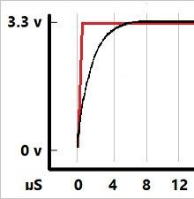
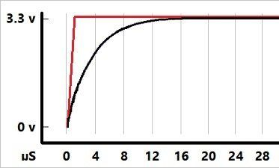
The touch pad recharges on its own
If you drive the GPIO pin attached to it low, touchpad clears low
If you make the GPIO pin an input (high impedance)
  The touchpad gets pulled high, which takes some amount of time
Low Capacitance
High Capacitance
The more capacitance the longer this takes!
And fingers are GIANT capacitors

Slide 45
Capacitive touch sensing method
Drive GPIO pin low
  Connects the pad to ground
Set GPIO pin as input and enable low-to-high interrupt
  Gets an interrupt when the pad finally becomes high on its own
  Use a timer to determine time until interrupt
    ~70 μs with no finger, <= milliseconds with finger
  Needs to timeout after a few milliseconds to declare “touched” as there might be enough capacitance to never go fully high
Repeat periodically (a few times a second is probably good enough)
Sudden large increase in rise time ⇨ someone is touching!
  Finger acts as a large capacitor

Slide 46
Capacitive touch works on any metal surface
Idea: Microbit door handle sensor
Connect a wire and a pull-up resistor to a metal door handle to sense when someone is touching it!
  Timing will be very different from capacitive pad, but should be repeatable and capable of distinguishing human touch

Slide 47
Outline
Sensing Overview
Types of Sensors
  Temperature
  Light
  Inertial
  Others
Capacitive Touch Sensing

Slide 48
Bonus
Research case study

Slide 49
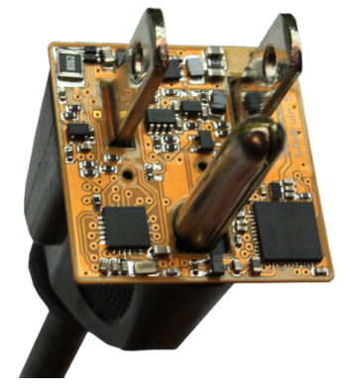
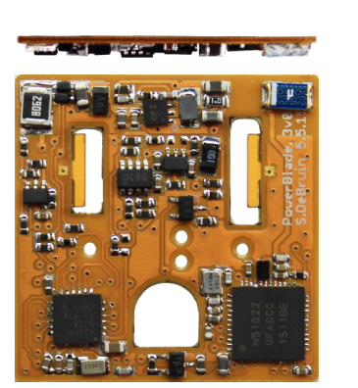
PowerBlade current sensing
Example of creating a custom sensor
PowerBlade goals
  Sense current and voltage in real-time
  Be small enough to be deployable
Problem
  To measure current, you usually have to break the circuit
  But PowerBlade attaches in parallel

Slide 50
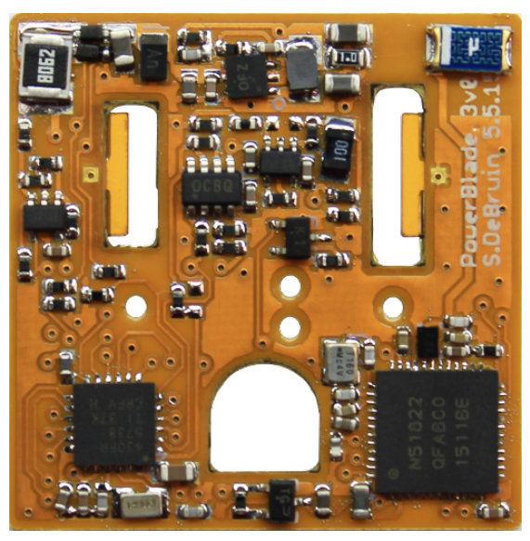
Measuring current
Coil of wire in a changing electric/magnetic field produces a voltage
One way to make inductors is as a coil of wire wrapped horizontally around a magnetic core
Re-purpose horizontally wire-wound inductor as current sensor!

Slide 51
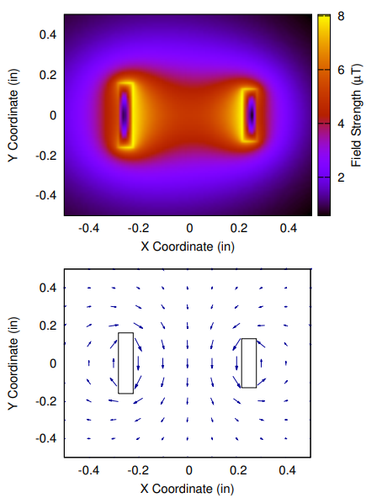
Sensor placement
Is in the middle or close to a prong the best choice?
Turns out it’s closer to a prong
  Decreases with distance squared
Angled like the magnetic field is

Slide 52
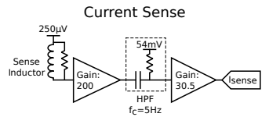
Measuring sensor values
Sensor output is very small
Amplify to make output large enough to accurately measure with ADC
Need to pick sampling rate
  AC: 60 cycles per second in US
  Need N * 60 measurements per second
  N=42 (as fast as we can measure)
    2520 measurements per second

Slide 53
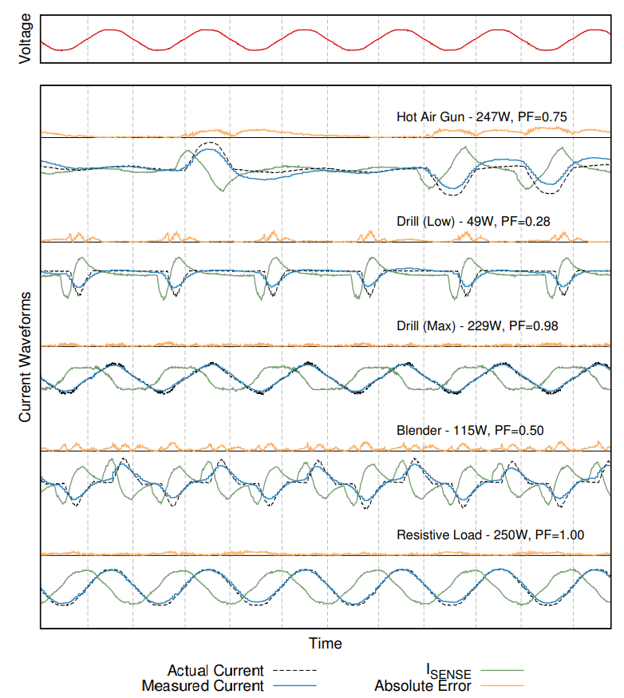
At first, our output signal was this green line

Slide 54

Measurement into current
Search coil measures the derivative of current!!
Need to integrate to get signal and apply sensitivity and bias

