Slide 1
Lecture 05
Prototyping & Digital Circuits
CE346 – Microcontroller System Design
Branden Ghena – Fall 2024
Some slides borrowed from:
Josiah Hester (Northwestern), Prabal Dutta (UC Berkeley)

Slide 2
Administrivia
Labs
  See schedule of Lab hours available on Canvas for checkoffs
    Due by end-of-day Thursday
    Postlab Questions are also available (also due by end-of-day Thursday)
Quiz
  Today at end of class! (tell your friends who aren’t here)
  Someone remind me at ~4:30 if I don’t stop

Slide 3
Project Proposals
It is time to start forming teams and working on Proposals
  Due next week Thursday! (10/17)
  Project details are posted to Piazza
  Specific proposal details are linked on Piazza and Canvas
    1-2 pages, with some specific items you MUST include
Project teams are 2-3 students (4 under rare occasions)
  You may NOT work alone
  There is a partnership survey if you want us to match you with someone
    Due by end-of-day Sunday

Slide 4
Today’s Goals
Explore another peripheral interaction pattern: DMA
Understand the basics of digital circuitry
  Enough to be able to interact with the Microbit
Discuss prototyping methods and basic circuits components

Slide 5
Outline
DMA
Digital Circuits
Prototyping
Components

Slide 6
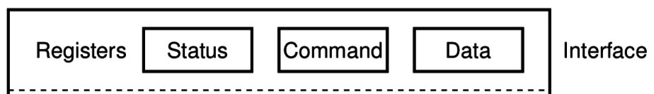
Reminder: Polling I/O
    while STATUS==BUSY; Wait
      (Need to make sure device is ready for a command)
    Write value(s) to DATA
    Write command(s) to COMMAND
    while STATUS==BUSY; Wait
      (Need to make sure device has completed the request)
    Read value(s) from Data
This is the “polling” model of I/O.
“Poll” the peripheral in software repeatedly to see if it’s ready yet.

Slide 7
Reminder: Interrupts, visually
Some code
that’s executing
Interrupt triggers!
Interrupt handler
code
Continue
original code

Slide 8
Direct Memory Access (DMA)
Even with interrupts, providing data to the peripheral is time consuming for transferring lots of data
  Need to be interrupted every byte, to copy the next byte over
DMA is an alternative method that uses hardware to do the memory transfers for the processor
  Software writes address of the data and the size to the peripheral
  Peripheral reads data directly from memory
  Processor can go do other things while read/write is occurring

Slide 9
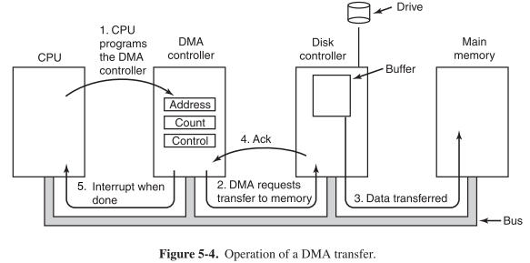
General-purpose DMA

Slide 10
Full peripheral interaction pattern
Configure the peripheral
Enable peripheral interrupts
Set up peripheral DMA transfer
Start peripheral
Continue on to other code
Interrupt occurs, signaling DMA transfer complete
Set up next DMA transfer
Continue on to other code, and repeat

Slide 11
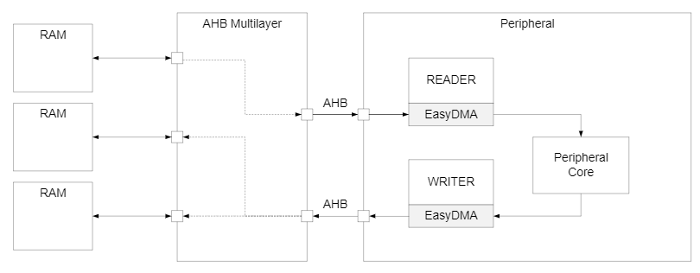
Special-purpose DMA
nRF52 uses “EasyDMA”, which is built into individual peripherals
  Only capable of transferring data in/out of that peripheral
  Easier to set up and use in practice
  Only available on some peripherals though (no DMA for TEMP)
Warning: addresses for DMA buffer MUST be in RAM!

Slide 12
Break + Open Question
What kinds of peripherals/devices should you use the DMA for?

Slide 13
Break + Open Question
What kinds of peripherals/devices should you use the DMA for?
  Anything where there is a lot of data coming in over a period of time
    Either a big buffer of lots of data, like a radio message
    Or a bunch of individual samples, coming in quickly
  Devices
    Messages to/from other devices (radios, wired busses)
    Sensor readings (if read quickly)
    Canonical example from general computing: disks (HDD/SSD)

Slide 14
Outline
DMA
Digital Circuits
Prototyping
Components

Slide 15
Digital signals
Exist in two states:
  High (a.k.a. Set, a.k.a. 1)
  Low (a.k.a. Clear, a.k.a. 0)
Simpler to interact with
  Constrained to two voltages
  With quick transitions between the two
  No math for voltage level
    Either high or low

Slide 16
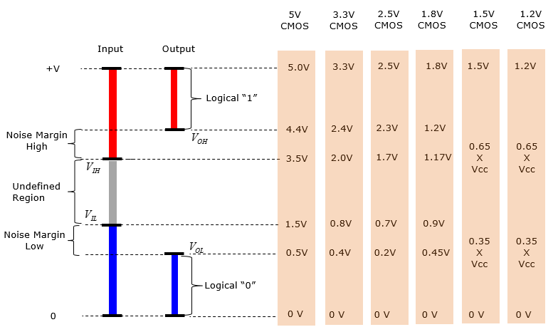
Digital signals map to voltage ranges
Upper range is high signal
  ~0.7*VDD
Bottom range is low signal
  ~0.3*VDD
Middle is undefined
  Only exists during transitions
http://www.sharetechnote.com/html/Electronics_CMOS.html

Slide 17
Digital circuits
Connecting components together with digital signals
  Mostly ICs
  Also buttons/switches and LEDs
Way simpler than analog circuits
  Mostly connecting boxes with wires
  Plus a few resistors here and there
An abstraction
  Not sufficient for fully understanding electronics behavior, but close

Slide 18
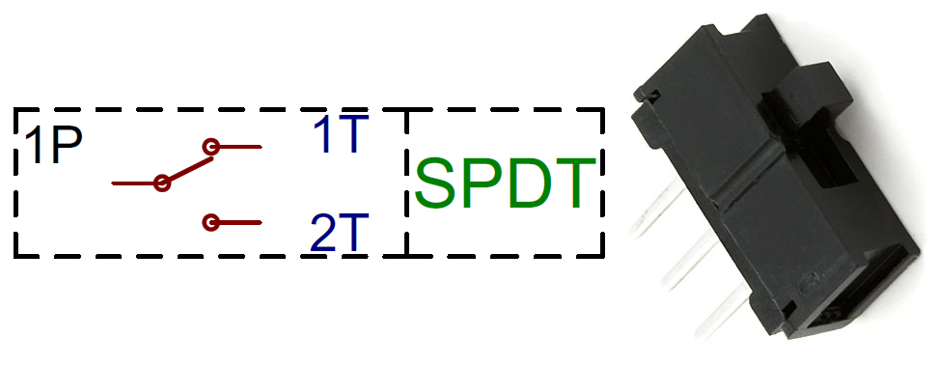
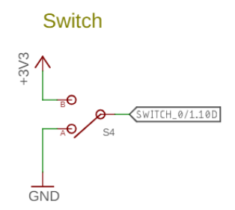
Switches
Single Pole, Double Throw switch
  Middle pin (Pole) connects to one of two outer pins (Throws)
For controlling microcontrollers
  Often connect outer pins to VCC and Ground respectively
  Input then goes High or Low depending on switch state
https://learn.sparkfun.com/tutorials/button-and-switch-basics/

Slide 19
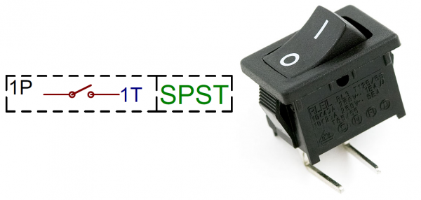
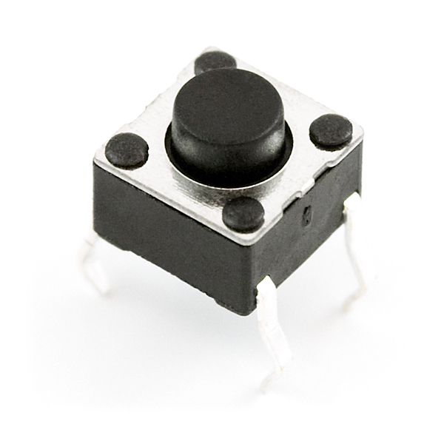
Buttons
Single Pole, Single Throw switch
  Pole pin either connects to Throw pin or is disconnected
  Come in normally-closed (connected) and normally-open (disconnected)

Slide 20
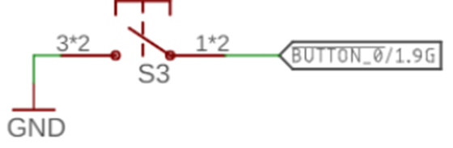
Disconnected circuits
When button is pushed, input signal is low
What is the value of the input when the button is unpressed?

Slide 21
Disconnected circuits
When button is pushed, input signal is low
What is the value of the input when the button is unpressed?
  Floating! Could be any voltage
  Solution: need to connect weakly to either high or low voltage

Slide 22
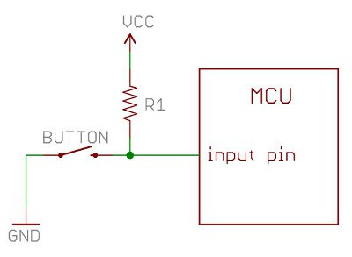
Current flows through the “path of least resistance”
Simplification
  Works well for the types of circuits we use
Pull-up resistor
  When button is open (disconnected),
  the only path is through the resistor
  When button is closed (connected)
  the least resistance path is through
  the button to Ground

Slide 23
Pull-up resistors and pull-down resistors
Resistor sets the “default” value of a wire
  Pull-up connects to VCC
  Pull-down connects to Ground
  Usually 10-100 kΩ
When button is open (disconnected)
  Connection through the resistor sets signal
When button is closed (connected)
  Signal is directly connected to a voltage source
  Much lower resistance means that signal dominates

Slide 24
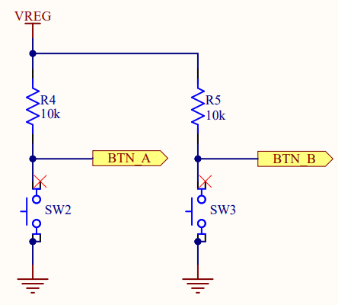
Buttons on the Microbit
Signal going to the Microcontroller
Normally open buttons
  Disconnected by default
Active low signal
  Activating (pushing) button creates a low signal
Pull-up resistors
  Set button signal high by default

Slide 25
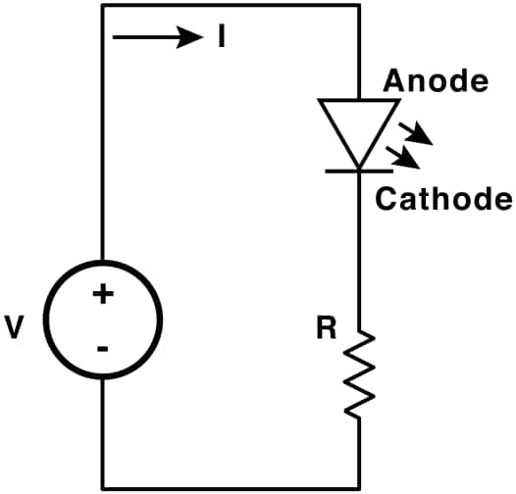
LEDs
Light Emitting Diodes
  Generate light as current passes through them
  Various colors available
Diodes
  Only allow current to go through one way
  Not particularly relevant for LEDs
    Treat as a digital component
Connect anode to high voltage and cathode to ground
  Plus a resistor to limit the total amount of current
https://learn.sparkfun.com/tutorials/light-emitting-diodes-leds

Slide 26
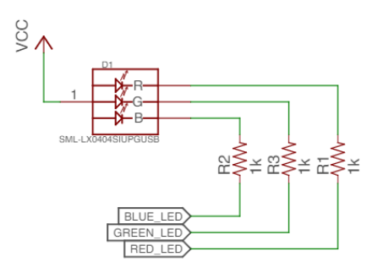
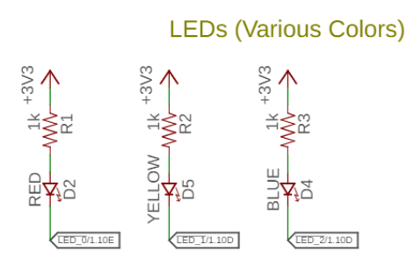
Active state for LEDs
LEDs can be active high or active low depending on configuration
  Active high is how people assume they work
  Active low is often used instead
    GPIO pins can usually sink more current than they can source

Slide 27
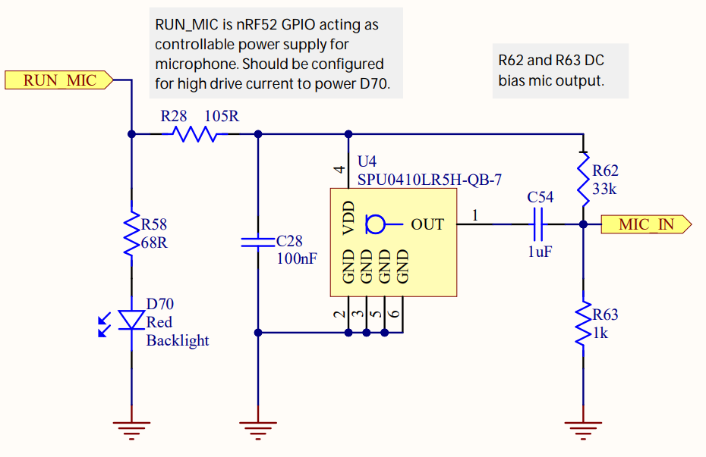
LEDs on the Microbit
Microphone LED
  Active high
Simple to use,
just set the GPIO
high to enable it
Ignore this other part for now

Slide 28
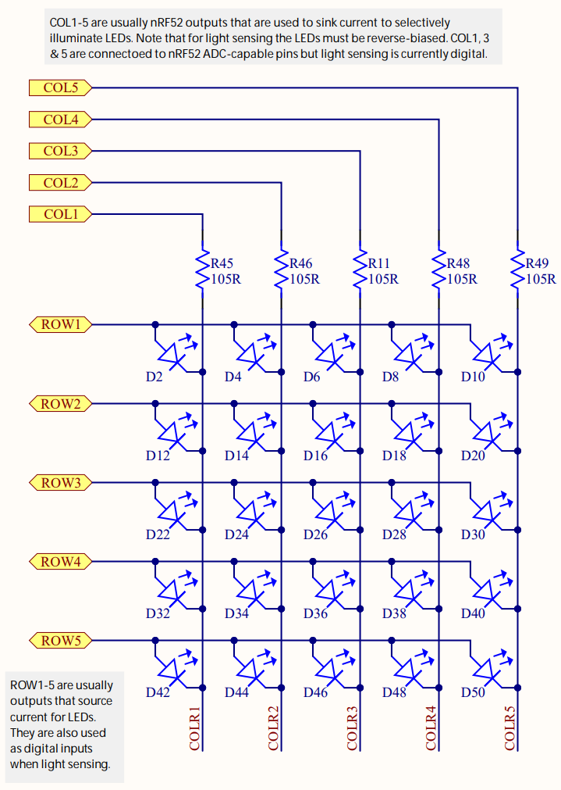
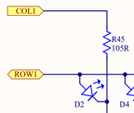
LEDs on the Microbit
Use two GPIO pins to control each LED
  Row high as VDD
  Column low as Ground
Remember, connections only exist where there are dots

Slide 29
Controlling the LED matrix
Cannot individually control all LEDs simultaneously
  Need to light one row at a time
  Iterate rows quickly to make them appear on all the time
We’ll have a lab on these later
  Combines GPIO and timers

Slide 30
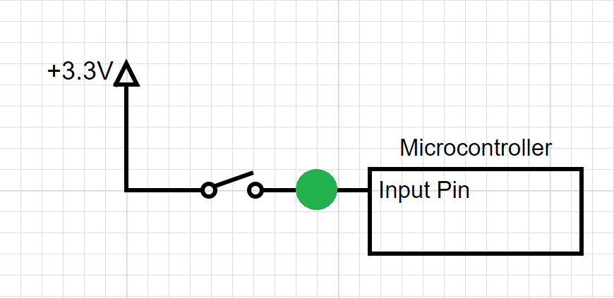
Break + Question
Should the spot in green have?
  Pull-up Resistor
  Pull-down Resistor
  Either
  Neither

Slide 31
Break + Question
Should the spot in green have?
  Pull-up Resistor
  Pull-down Resistor (needs to pull input low by default)
  Either
  Neither

Slide 32
Outline
DMA
Digital Circuits
Prototyping
Components

Slide 33
Prototyping goals
Does this thing work at all?
  Particular IC
  Circuit layout
  Software design
  etc.
Sometimes before doing something more serious with it
  Design a PCB, Make a product, etc.
  Not uncommon that the prototype is as far as you’ll get

Slide 34
Isolating tests
The goal when prototyping is to isolate the question at hand
Do consider
  New sensor/IC/component/whatever
Do not consider
  Power
  Interference
  Enclosure
  Stable microcontroller
  Soldering skills

Slide 35
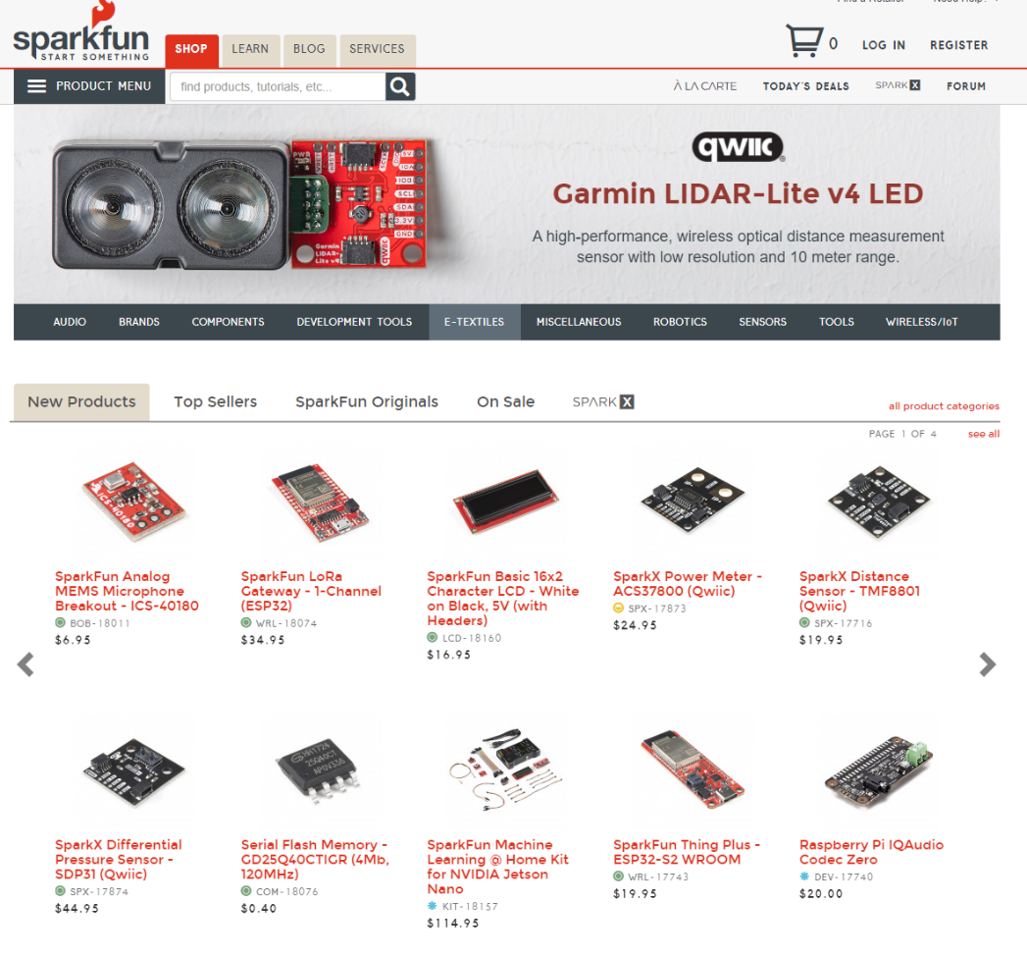
Buying Parts
Prototyping vendors
  Where you look for cool stuff to buy
  Sparkfun
  Adafruit
Electronics vendors
  Where you buy parts when you know what you need
  Digikey
  Mouser

Slide 36
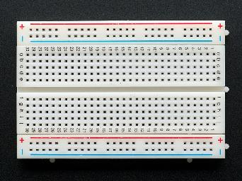
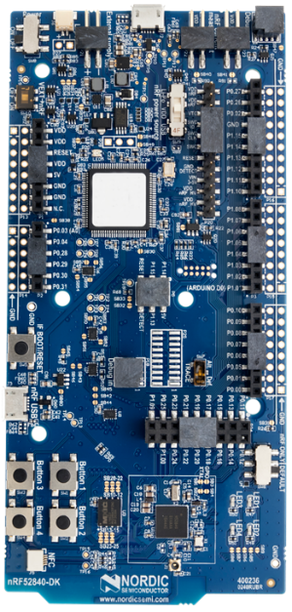
Prototyping methods
Breadboarding
  Plug and connect components as needed
  Build up arbitrarily complex designs from nothing
Development kits
  Pre-fabricated systems design for testing components
Small-scale test PCBs
  Design a PCB that demonstrates the thing you’re interested in
    Making a PCB is less hard than some might think (Eagle, Fritzing, etc.)
    $20-30 for small, low-speed PCBs from batch services like OSHPark

Slide 37
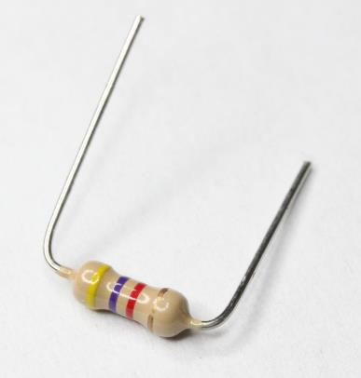
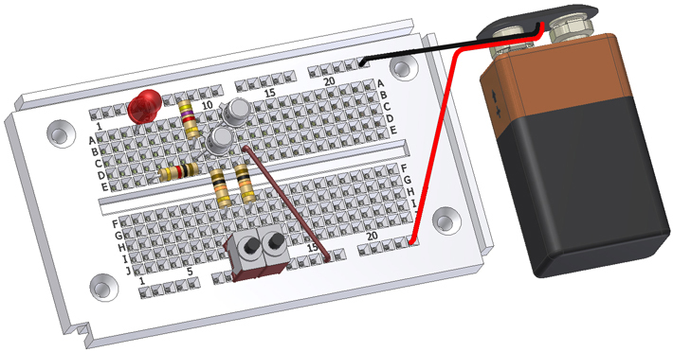
Breadboards for prototyping
Reusable platform for temporary circuits
Plug in jumper wires and through-hold components

Slide 38
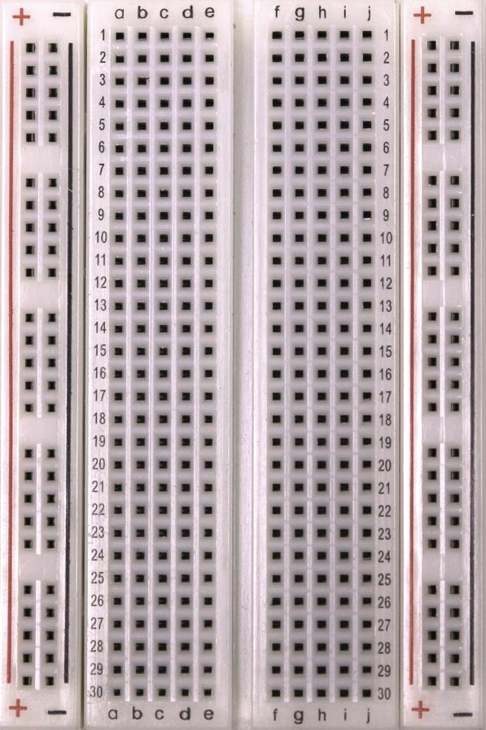
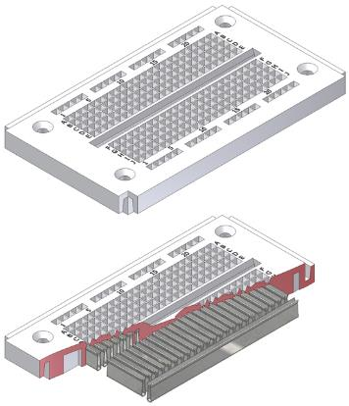
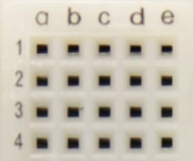
How a breadboard works
Component leads and wires are inserted into holes in the breadboard
Half-rows of five holes are connected
Vertical columns are connected for power/ground
Holes to
insert wires

Slide 39
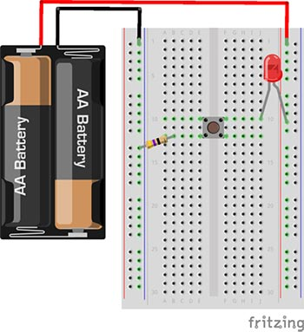
Breadboard LED example
Uses button to control LED

Slide 40
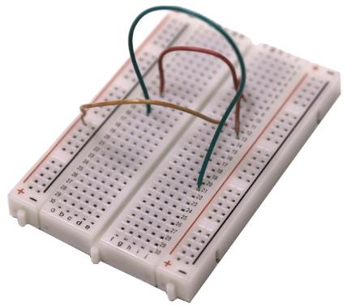
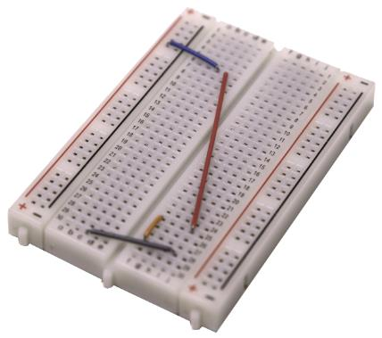
Breadboard guidelines
Long wires in large bird nests makes debugging very difficult
  Shorter, constrained wires are easier to understand
  In this class, we’ll only have large jumper wires though…
Use the minimum jumpers necessary,
mostly use breadboard for connections
Bad
Better

Slide 41
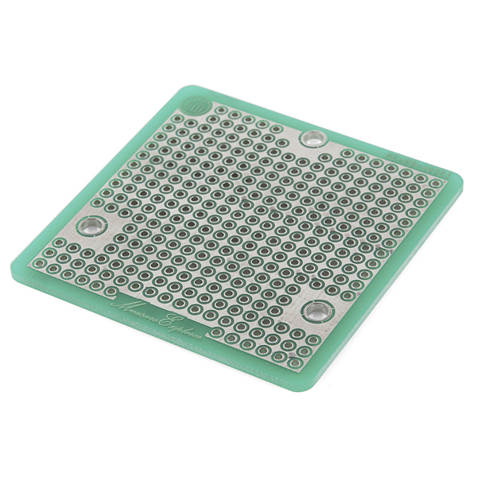
More permanent breadboards
Breadboards are also known as “Solderless Breadboards”
Protoboard allows configurable circuits
  Solder jumper wires between locations
  Solder adjacent pads to form connection
Usually not worth it (just make a PCB)
  Does solve core problem of breadboards:
  things getting unintentionally unplugged
  Might be useful for some projects!

Slide 42
When to not use breadboards
Breadboards work great for digital circuits and simple analog!
High voltage/current are bad for breadboards
  Honestly, anything above 12 volts DC shouldn’t be in a breadboard
  Also avoid high-power applications above a few Watts
  Never put AC in a breadboard!
Sensitive analog circuits
  Particularly anything sensitive to capacitance may not work right
  Sets of metal holes with strips connecting them function as capacitors
Anything in long term use

Slide 43
Outline
DMA
Digital Circuits
Prototyping
Components

Slide 44
Prototyping components
We’ve talked through the theoretical notions of many parts
  Buttons, Switches, Resistors, LEDs
Now let’s look at the real-world practicalities of working with them
  Again, some of you will have already learned this
  But many of you might not have used these things before

Slide 45
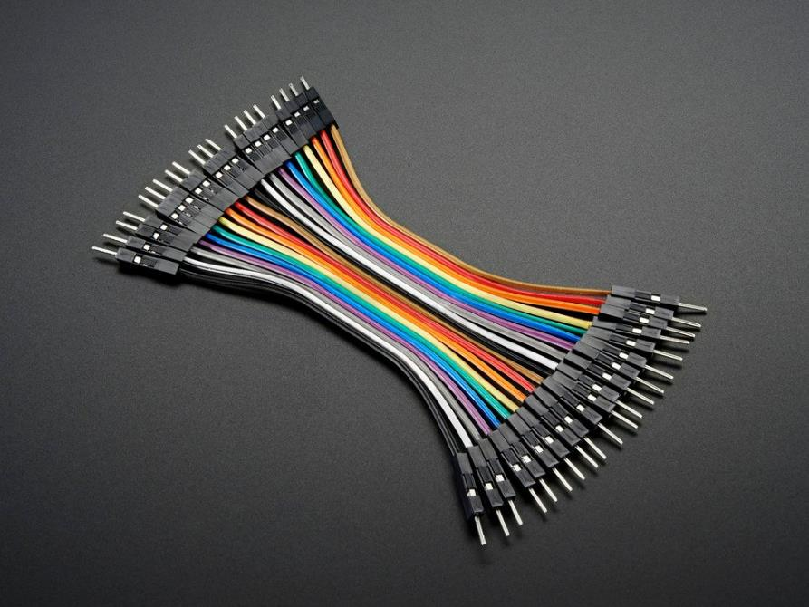
Jumper wires
Connect two rows in the breadboard together
Recommendation:
  Peel off sets of 2-4 wires and keep them stuck together
  Often want to run multiple at once

Slide 46
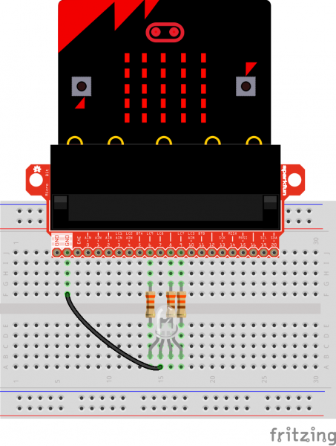

Microbit
Always connect LED matrix side up
Breaks out various pins from board
  Need to consult table to know which pins
  https://tech.microbit.org/hardware/schematic/
https://www.sparkfun.com/products/13989
https://learn.sparkfun.com/tutorials/microbit-breakout-board-hookup-guide

Slide 47
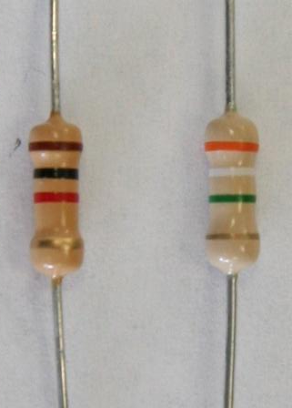
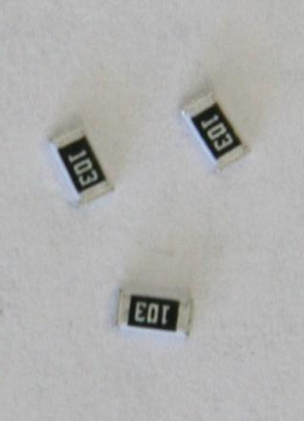
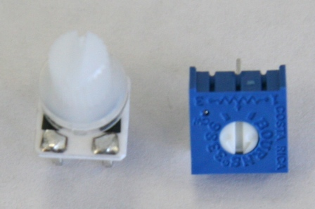

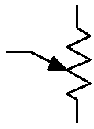
Resistors
Carbon Film Resistors
Surface Mount Resistors
Variable Resistors
(potentiometer)
4 Bands
Resistors are not directional
  Either orientation is fine and works identically

Slide 48
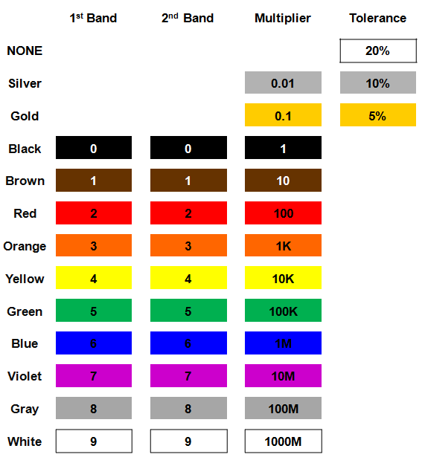
Resistor color codes
Colored bands on resistors label the resistance value of the part
First and second bands are the digits
Third band is multiplier
Fourth band is tolerance
  Usually gold: +/- 5%

Slide 49
Example: determine the resistor

Slide 50
Example: determine the resistor
56 x 10 Ω = 560 Ω (±5%)

Slide 51
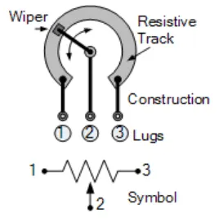
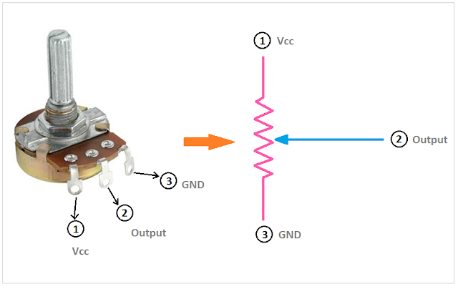
Potentiometers
Vary resistance between zero and some maximum
  1 kΩ, 10 kΩ, 100 kΩ common
Connect middle and an edge for just a changeable resistor
Middle terminal is a movable resistor divider
  Knob changes middle output if outer pins are VCC and Ground

Slide 52
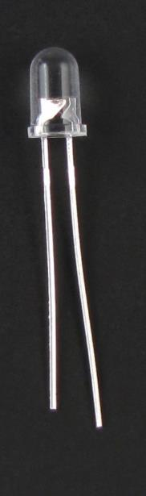
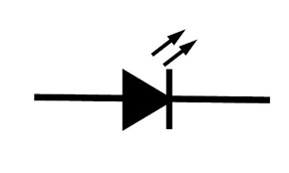
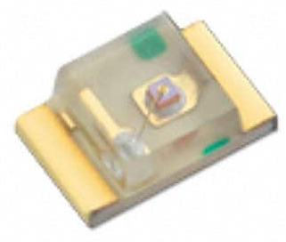
LEDs
Directional component: only allows current to flow one way
Shorter side is the negative one
  i.e. where current flows to
Larger metal component
inside of case or case flat spot is cathode or
negative (-) lead
Negative ( - ) lead
Schematic Symbol
Shorter wire is cathode or
negative (-) lead
Surface-mount LED

Slide 53
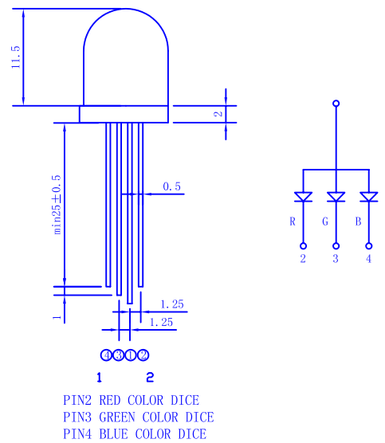
RGB LED
Three different colors of LED in a single large diffuser
Short leads are negative ends
  One for each color
Long lead is common power
  Common anode
Combinations of LEDs give other colors
  Cyan, Yellow, Violet, White
https://cdn-shop.adafruit.com/datasheets/FLR-100WAS-RGB.pdf

Slide 54
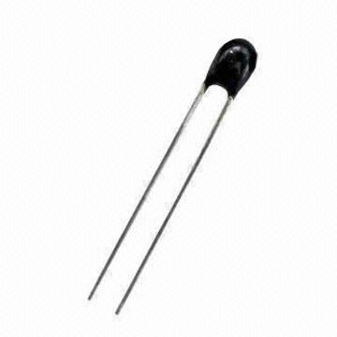
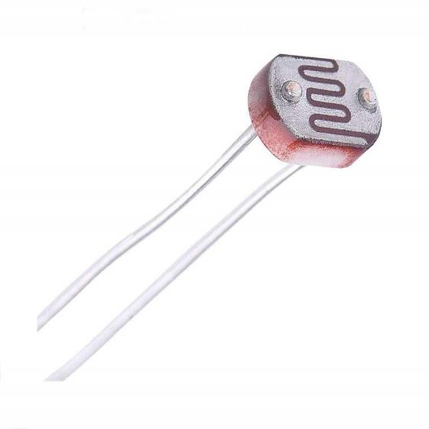
Sensors
Thermistor
Photoresistor
We’ll come back to these in a future lecture

Slide 55
Outline
DMA
Digital Circuits
Prototyping
Components

