Slide 1
Lecture 03
Embedded Software
CE346 – Microcontroller System Design
Branden Ghena – Fall 2024
Some slides borrowed from:
Josiah Hester (Northwestern), Prabal Dutta (UC Berkeley)

Slide 2
Administrivia
Make sure you have your personal lab setup working
  Ask in office hours or on Piazza if you run into issues
Office hours delayed until later this week
  I have time after class today if people have questions
Labs will start this Friday!!!
  You MUST come to your scheduled lab session
  Not really enough room for students to move sections
    If there’s some known obligation and you give me a heads up, I could approve a few per week

Slide 3
Today’s Goals
Discuss challenges of embedded software
Describe compilation and linking of embedded code
  Actually applies to all code, but you probably never learned much about linking before
Introduce new software pattern: interrupts
Explore the microcontroller boot process

Slide 4
Outline
Embedded Software
Embedded Toolchain
Lab Software Environment
Interrupts
Boot Process

Slide 5
Review: C memory layout
Address 0xFFFFFFFFFFFFFFFF
Stack Section
  Local variables
  Function arguments
Heap Section
  Memory granted through malloc()
Static Section (a.k.a. Data Section)
  Global variables
  Static function variables
Text Section (a.k.a Code Section)
  Program code
Stack
Heap
Static
Text
Address 0x0000000000000000

Slide 6
Assumptions of embedded programs
Expect limitations
  Very little memory
  Very little computational power
  Very little energy
Don’t expect a lot of support
  Likely no operating system
  Might not even have error reporting capabilities
Moral: think differently about your programs

Slide 7
Ramifications of limited memory
Stack and Data sections are limited
  Be careful about too much recursion
  Be careful about large local variables
  Large data structures defined globally are preferred
    Fail at compile time
    In embedded, we often encourage global variables for large things
Heap section is likely non-existent
  Why?

Slide 8
Ramifications of limited memory
Stack and Data sections are limited
  Be careful about too much recursion
  Be careful about large local variables
  Large data structures defined globally are preferred
    Fail at compile time
    In embedded, we often encourage global variables for large things
Heap section is likely non-existent
  Why?
    Malloc could run out of memory at runtime

Slide 9
Avoiding dynamic memory
Malloc is scary in an embedded context
What if there’s no more memory available?
  Traditional computer
    Swap memory to disk
    Worst case: wait for a process to end (or kill one)
  Embedded computer
    There’s likely only a single application
    And it’s the one asking for more memory
    So it’s not giving anything back anytime soon
This is unlikely to happen at boot
  Instead it’ll happen hours or days into running as memory is slowly exhausted…

Slide 10
Limitations on processing power
Typically not all that important
  Code still runs pretty fast
    10 MHz -> 100 ns per cycle (i.e. ~100 ns per instruction)
  Controlling hardware usually doesn’t have a lot of code complexity
    Quickly gets to the “waiting on hardware” part (apps are I/O bound)
Problems
  Machine learning
    Learning on the device is neigh impossible
    Memory limitations make it hard to fit weights anyways
  Cryptography
    Public key encryption takes seconds to minutes

Slide 11
Common programming languages for embedded
C
  For all the reasons that you assume
  Easy to map variables to memory usage and code to instructions
Assembly
  Not entirely uncommon, but rarer than you might guess
  C code optimized by a modern compiler is likely faster
  Notable uses:
    Cryptography to create deterministic algorithms
    Operating Systems to handle process swaps
C++
  Similar to C but with better library support
  Libraries take up a lot of code space though ~100 KB

Slide 12
Rarer programming languages for embedded
Rust
  Modern language with safety and reliability guarantees
  Increasingly relevant in the embedded space
    But with a high learning curve
Python, Javascript, etc.
  Mostly toy languages
  Fine for simple things but incapable of complex operations
    Especially low-level things like managing memory

Slide 13
What’s missing from programming languages?
The embedded domain has several requirements that other domains do not
What is missing from programming languages that it wants?
  Sense of time
  Sense of energy

Slide 14
Programming languages have no sense of time
Imagine a system that needs to send messages to a motor every 10 milliseconds
  Write a function that definitely completes within 10 milliseconds
Accounting for timing when programming is very challenging
  We can profile code and determine timing at runtime
  If we know many details of hardware, instructions can give timing
    Unless the code interacts with external devices

Slide 15
Determining energy use is rather complicated
Software might
  Start executing a loop
  Turn on/off an LED
  Send messages over a wired bus to another device
Determining energy these operations take is really difficult
  Even with many details of the hardware
  Different choices of processor clocks can have a large impact
  Often profiled at runtime after writing the code
    Iterative write-test-modify cycle

Slide 16
Break + Say hi to your neighbors
Things to share
  Name
  Major
  One of the following
    Favorite Candy
    Favorite Pokemon
    Favorite Emoji

Slide 17
Break + Say hi to your neighbors
Things to share
  Name -Branden
  Major -Electrical and Computer Engineering, and Computer Science
  One of the following
    Favorite Candy - Twix
    Favorite Pokemon - Eevee
    Favorite Emoji - 🍢

Slide 18
Outline
Embedded Software
Embedded Toolchain
Lab Software Environment
Interrupts
Boot Process

Slide 19
Embedded compilation steps
Same first steps as any system
Compiler
  Turn C code into assembly
  Optimize code (often for code size instead of speed)

Slide 20
Cross compilers compile for different architectures
The compiler we’ll be using is a cross compiler
  Run on one architecture but compile code for another
    Example: runs on x86-64 but compiles armv7e-m
GCC naming scheme: ARCH-VENDOR-(OS-)-ABI-gcc
  arm-none-eabi-gcc
    ARM architecture
    No vendor
    No OS
    Embedded Application Binary Interface
  Others: arm-none-linux-gnueabi-gcc, i686-pc-windows-msvc-gcc

Slide 21
Embedded compilation steps
Same first steps as any system
Compiler
  Turn C code into assembly
  Optimize code (often for size instead of speed)
Linker
  Combine multiple C files together
  Resolve dependencies
    Point function calls at correct place
    Connect creation and uses of global variables

Slide 22
Informing linker of system memory
Linker actually places code and variables in memory
  It needs to know where to place things
How do x86-64 compilers know which addresses to use?

Slide 23
Informing linker of system memory
Linker actually places code and variables in memory
  It needs to know where to place things
How do x86-64 compilers know which addresses to use?
  Virtual memory allows all applications to use the same memory addresses
Embedded solution
  Only run a single application
  Provide an LD file
    Specifies memory layout for a certain system
    Places sections of code in different places in memory

Slide 24
Anatomy of an LD file
nRF52833: 512 KB Flash, 128 KB SRAM
First, LD file defines memory regions
  MEMORY {
  FLASH (rx) : ORIGIN = 0x00000000, LENGTH = 0x80000
  RAM (rwx) : ORIGIN = 0x20000000, LENGTH = 0x20000
  }
A neat thing about microcontrollers: pointers have meaning
  Just printing the value of a pointer can tell you if it’s in Flash or RAM

Slide 25
Anatomy of an LD file
It then places sections of code into those memory regions
  .text : {
  KEEP(*(.Vectors))
  *(.text*)
  *(.rodata*)
  . = ALIGN(4);
  } > FLASH
  __etext = .;
  .data : AT (__etext) {
  __data_start__ = .;
  *(.data*)
  __data_end__ = .;
  } > RAM
  .bss : {
  . = ALIGN(4);
  __bss_start__ = .;
  *(.bss*)
  . = ALIGN(4);
  __bss_end__ = .;
  } > RAM

Slide 26
Sections of code
Where do these sections come from?
Most are generated by the compiler
  .text, .rodata, .data, .bss
  You need to be deep in the docs to figure out how the esoteric ones work
Some are generated by the programmer
  Allows you to place certain data items in a specific way
  __attribute__((section(".foo")))
  int test[10] = {0,0,0,0,0,0,0,0,0,0};

Slide 27
Embedded compilation steps
Same first steps as any system
Compiler
  Turn C code into assembly
  Optimize code (often for size instead of speed)
Linker
  Combine multiple C files together
  Resolve dependencies
    Point function calls at correct place
    Connect creation and uses of global variables
Output: a binary (or hex) file

Slide 28
Loading the hex file onto a board
This is a use case for JTAG
  You provide it a hex file which specifies addresses and values
  It writes those into Flash on the microcontroller
The LD file already specified addresses
  So passing around hex files is enough to load an application
  But a hex file for one microcontroller won’t work on another with a different memory layout

Slide 29
Example
Demonstrated in the blink application in lab repo
  https://github.com/nu-ce346/nu-microbit-base/tree/main/software/apps/blink

Slide 30
Outline
Embedded Software
Embedded Toolchain
Lab Software Environment
Interrupts
Boot Process

Slide 31
Embedded environments
There are a multitude of embedded software systems
  Every microcontroller vendor has their own
  Popular platforms like Arduino
We’re using the Nordic software development libraries plus some extensions made by my research group
  It’ll be a week until that matters for the most part
  We’ll start off by writing low-level drivers ourselves without libraries

Slide 32
Software Development Kit (SDK)
Libraries provided by Nordic for using their microcontrollers
  Actually incredibly well documented! (relatively)
  Various peripherals and library tools
SDK documentation
  https://docs.nordicsemi.com/bundle/sdk_nrf5_v16.0.0/page/index.html
  Warning: search doesn’t really work
Possibly more useful: the list of data structures
  Search that page for whatever “thing” you’re working with
  https://docs.nordicsemi.com/bundle/sdk_nrf5_v16.0.0/page/annotated.html

Slide 33

nRF52x-base
Wrapper built around the SDK by Lab11
  Branden Ghena, Brad Campbell (UVA), Neal Jackson, a few others
  Allows everything to be used with Makefiles and command line
  https://github.com/lab11/nrf52x-base
We include it as a submodule
  It has a copy of the SDK code and softdevice binaries
  It has a whole Makefile system to include to proper C and H files
  We include a Board file that specifies our specific board’s needs and capabilities
Go to repo to explain

Slide 34
Break

Slide 35
Outline
Embedded Software
Embedded Toolchain
Lab Software Environment
Interrupts
Boot Process

Slide 36
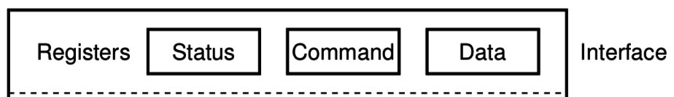
What do interactions with devices look like?
    while STATUS==BUSY; Wait
      (Need to make sure device is ready for a command)
    Write value(s) to DATA
    Write command(s) to COMMAND
    while STATUS==BUSY; Wait
      (Need to make sure device has completed the request)
    Read value(s) from Data
This is the “polling” model of I/O.
“Poll” the peripheral in software repeatedly to see if it’s ready yet.

Slide 37
Waiting can be a waste of CPU time
    while STATUS==BUSY; Wait
      (Need to make sure device is ready for a command)
    Write value(s) to DATA
    Write command(s) to COMMAND
    while STATUS==BUSY; Wait
      (Need to make sure device has completed the request)
    Read value(s) from Data
Problem: imagine a keyboard device
  CPU could be waiting for minutes before data arrives
  Need a way to notify CPU when an event occurs
    Interrupts!

Slide 38
Interrupts
What is an interrupt?
  Some event which causes the processor to stop normal execution
  The processor instead jumps to a software “handler” for that event
    Then returns back to what it was doing afterwards
What causes interrupts?
  Hardware exceptions
    Divide by zero, Undefined Instruction, Memory bus error
  Software
    Syscall, Software Interrupt (SWI)
  External hardware
    Input pin, Timer, various “Data Ready”

Slide 39
Interrupts, visually
Some code
that’s executing

Slide 40
Interrupts, visually
Some code
that’s executing
Interrupt triggers!
Interrupt handler
code

Slide 41
Interrupts, visually
Some code
that’s executing
Interrupt triggers!
Interrupt handler
code
Continue
original code

Slide 42
ARM Nested Vectored Interrupt Controller (NVIC)
Handles interrupt entry and exit
Stacking
Unstacking
Priorities
Interrupts can preempt other interrupts!
Jump directly to the interrupt handler
Manages interrupt requests (IRQ)
  Stores all caller-saved registers on the stack
    So the handler code doesn’t overwrite them
  Moves execution to proper handler, a.k.a. Interrupt Service Routine (ISR)
  Restores registers after handler returns and moves execution back

Slide 43
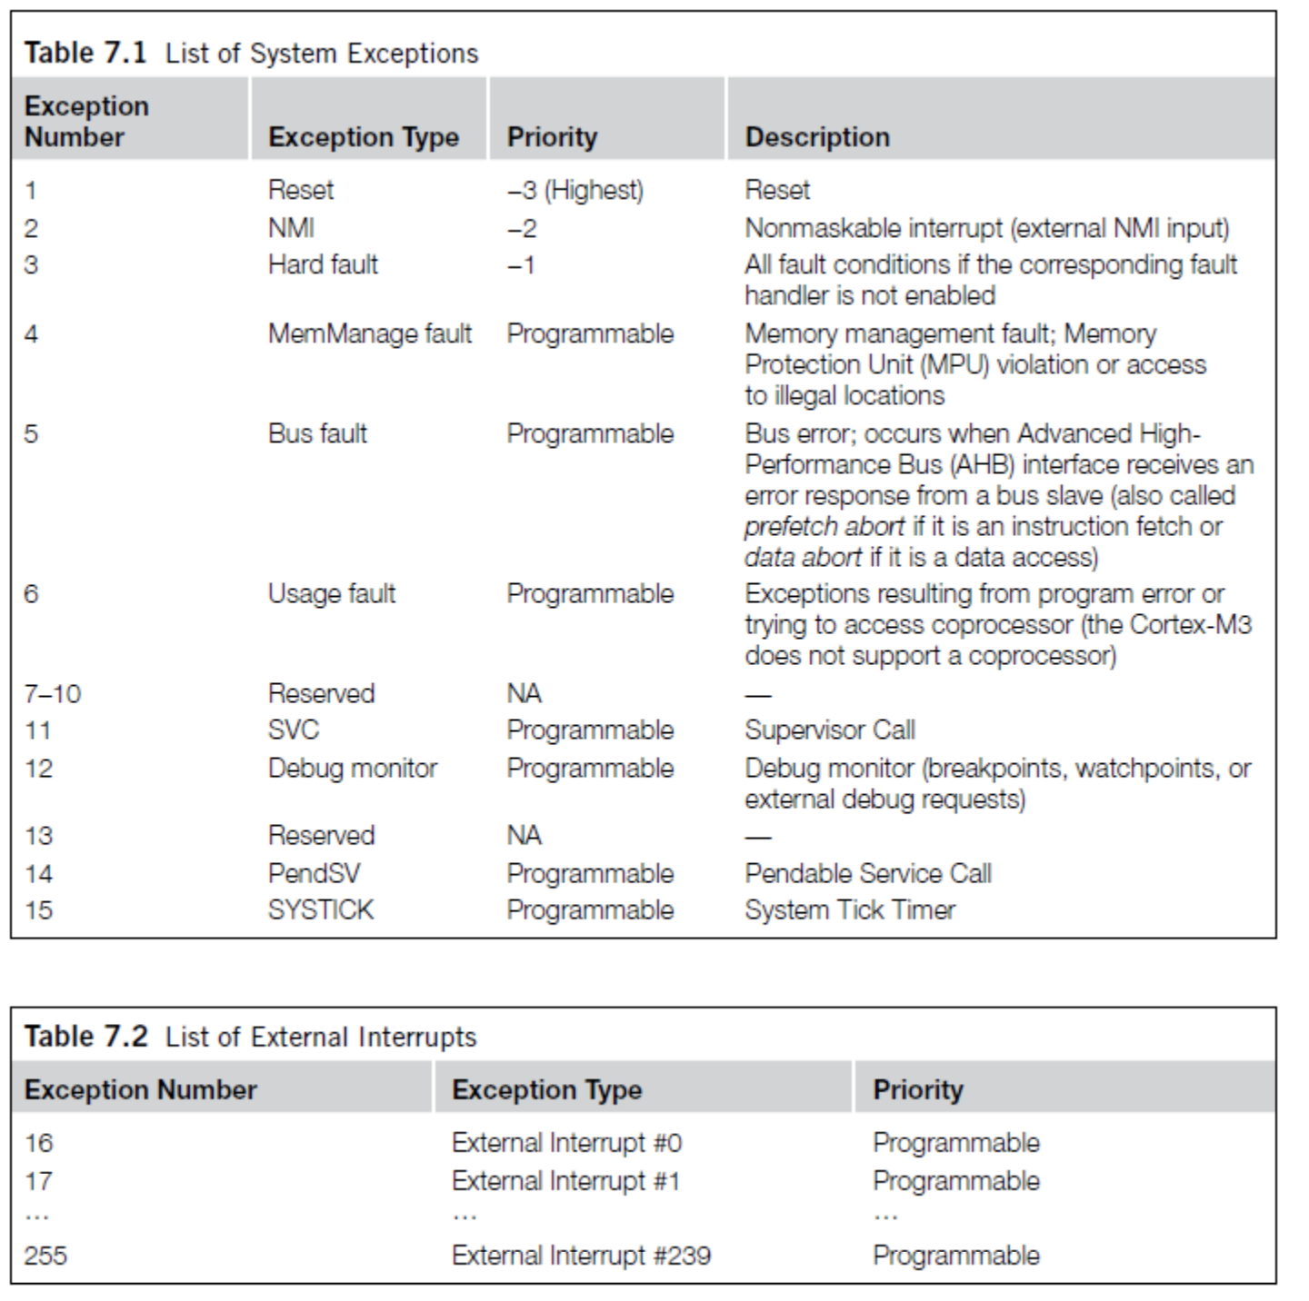
ARM Vector table
List of function pointers to handler for each interrupt/exception
First 15 are architecture-specific exceptions
After that are microcontroller interrupt signals

Slide 44
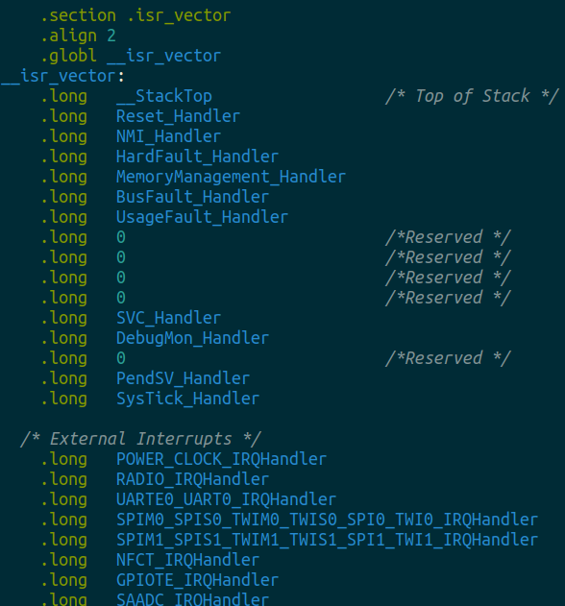
Vector table in software
Placed in its own section
  LD file puts it first in Flash
Reset_Handler determines where software starts executing
After that are all exception and interrupt handlers
  All function pointers to some C code somewhere

Slide 45
NVIC functionality
NVIC functions
  NVIC_EnableIRQ(number)
  NVIC_DisableIRQ(number)
  NVIC_SetPriority(number, priority)
    Technically 256 priorities
    Only 8 are implemented
Must enable interrupts in two places!
  Enabling interrupt in the peripheral will generate the signal
  Enabling interrupt in the NVIC will cause signal to jump to handler
Priority determines which interrupt goes first
  And determines how interrupts are nested

Slide 46
Nested interrupts, visually
Some code
that’s executing
Interrupt triggers!
Interrupt handler
Higher priority
Interrupt triggers!
Interrupt handler
continues
Continue
original code

Slide 47
Break + Open Question
When should a system use polling versus interrupts?

Slide 48
Break + Open Question
When should a system use polling versus interrupts?
Polling
  Great if the device is going to respond immediately (like 1 cycle)
  Important if we need to respond very quick (less than a microsecond)
Interrupts
  Great if we’ll need to wait a long time for status to change
  Still responds pretty quickly, but not immediately
    Needs to context switch from running code to interrupt handler

Slide 49
Outline
Embedded Software
Embedded Toolchain
Lab Software Environment
Interrupts
Boot Process

Slide 50
How does a microcontroller start running code?
Power comes on
Microcontroller needs to start executing assembly code
You expect your main() function to run
  But a few things need to happen first

Slide 51
Step 0: set a stack pointer
Assembly code might need to write data to the stack
  Might call functions that need to stack registers
ARM: Valid address for the stack pointer is at address 0 in Flash
  Needs to point to somewhere in RAM
  Hardware loads it into the Stack Pointer when it powers on

Slide 52
Step 1: set the program counter (PC)
a.k.a. the Instruction Pointer (IP) in x86 land
32-bit ARM: valid instruction pointer is at address 4 in Flash
  Could point to RAM, usually to Flash though
  In interrupt terms: this is the “Reset Handler”!
  Automatically loaded into the PC after the SP is loaded
    Again, hardware does this

Slide 53
Step 2: “reset handler” prepares memory
Code that handles system resets
  Either reset button or power-on reset
  Address was loaded into PC in Step 1
Reset handler code:
  Loads initial values of .data section from Flash into RAM
  Loads zeros as values of .bss section in RAM
  Calls SystemInit
    Starts correct clocks for the system
    Handles various hardware configurations/errata
  Calls _start
nu-microbit-base/software/nrf52x-base/sdk/nrf5_sdk_16.0.0/modules/nrfx/mdk/gcc_startup_nrf52833.S
nu-microbit-base/software/nrf52x-base/sdk/nrf5_sdk_16.0.0/modules/nrfx/mdk/system_nrf52.c

Slide 54
Step 3: set up C runtime
_start is provided by newlib
  An implementation of libc – the C standard library
  Startup is a file usually named crt0
Does more setup, almost none of which is relevant for our system
  Probably is this code that actually zeros out .bss
  Sets argc and argv to 0
  Calls main() !!!
https://sourceware.org/git/gitweb.cgi?p=newlib-cygwin.git;a=blob_plain;f=libgloss/arm/crt0.S;hb=HEAD

Slide 55
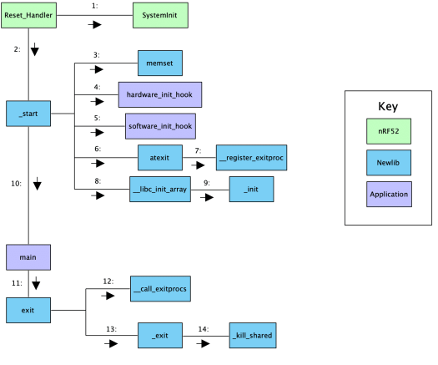
Online writeup with way more details and a diagram
Relevant guide!!
  https://embeddedartistry.com/blog/2019/04/17/exploring-startup-implementations-newlib-arm/
  Covers the nRF52!

Slide 56
Outline
Embedded Software
Embedded Toolchain
Lab Software Environment
Interrupts
Boot Process

