Slide 1
Lecture 02
Microcontrollers
CE346 – Microcontroller System Design
Branden Ghena – Fall 2024
Some slides borrowed from:
Josiah Hester (Northwestern), Prabal Dutta (UC Berkeley)

Slide 2
Class Updates
No “official” lab this Friday
Personal Software Setup will be posted tonight
  At some point
  Gotta finish updating it
Office hours will start sometime next week
  If you need help with the software setup, always feel free to reach out on Piazza!

Slide 3
Today’s Goals
Explore microcontrollers
  How do they compare to computers?
  Purpose, capabilities, tradeoffs
Describe history and state-of-the-art for microcontrollers
Explore the microcontroller(s) on the Microbit

Slide 4
Outline
Microcontrollers and Computers
Microcontroller Design
Microcontroller History
Microbit microcontroller

Slide 5
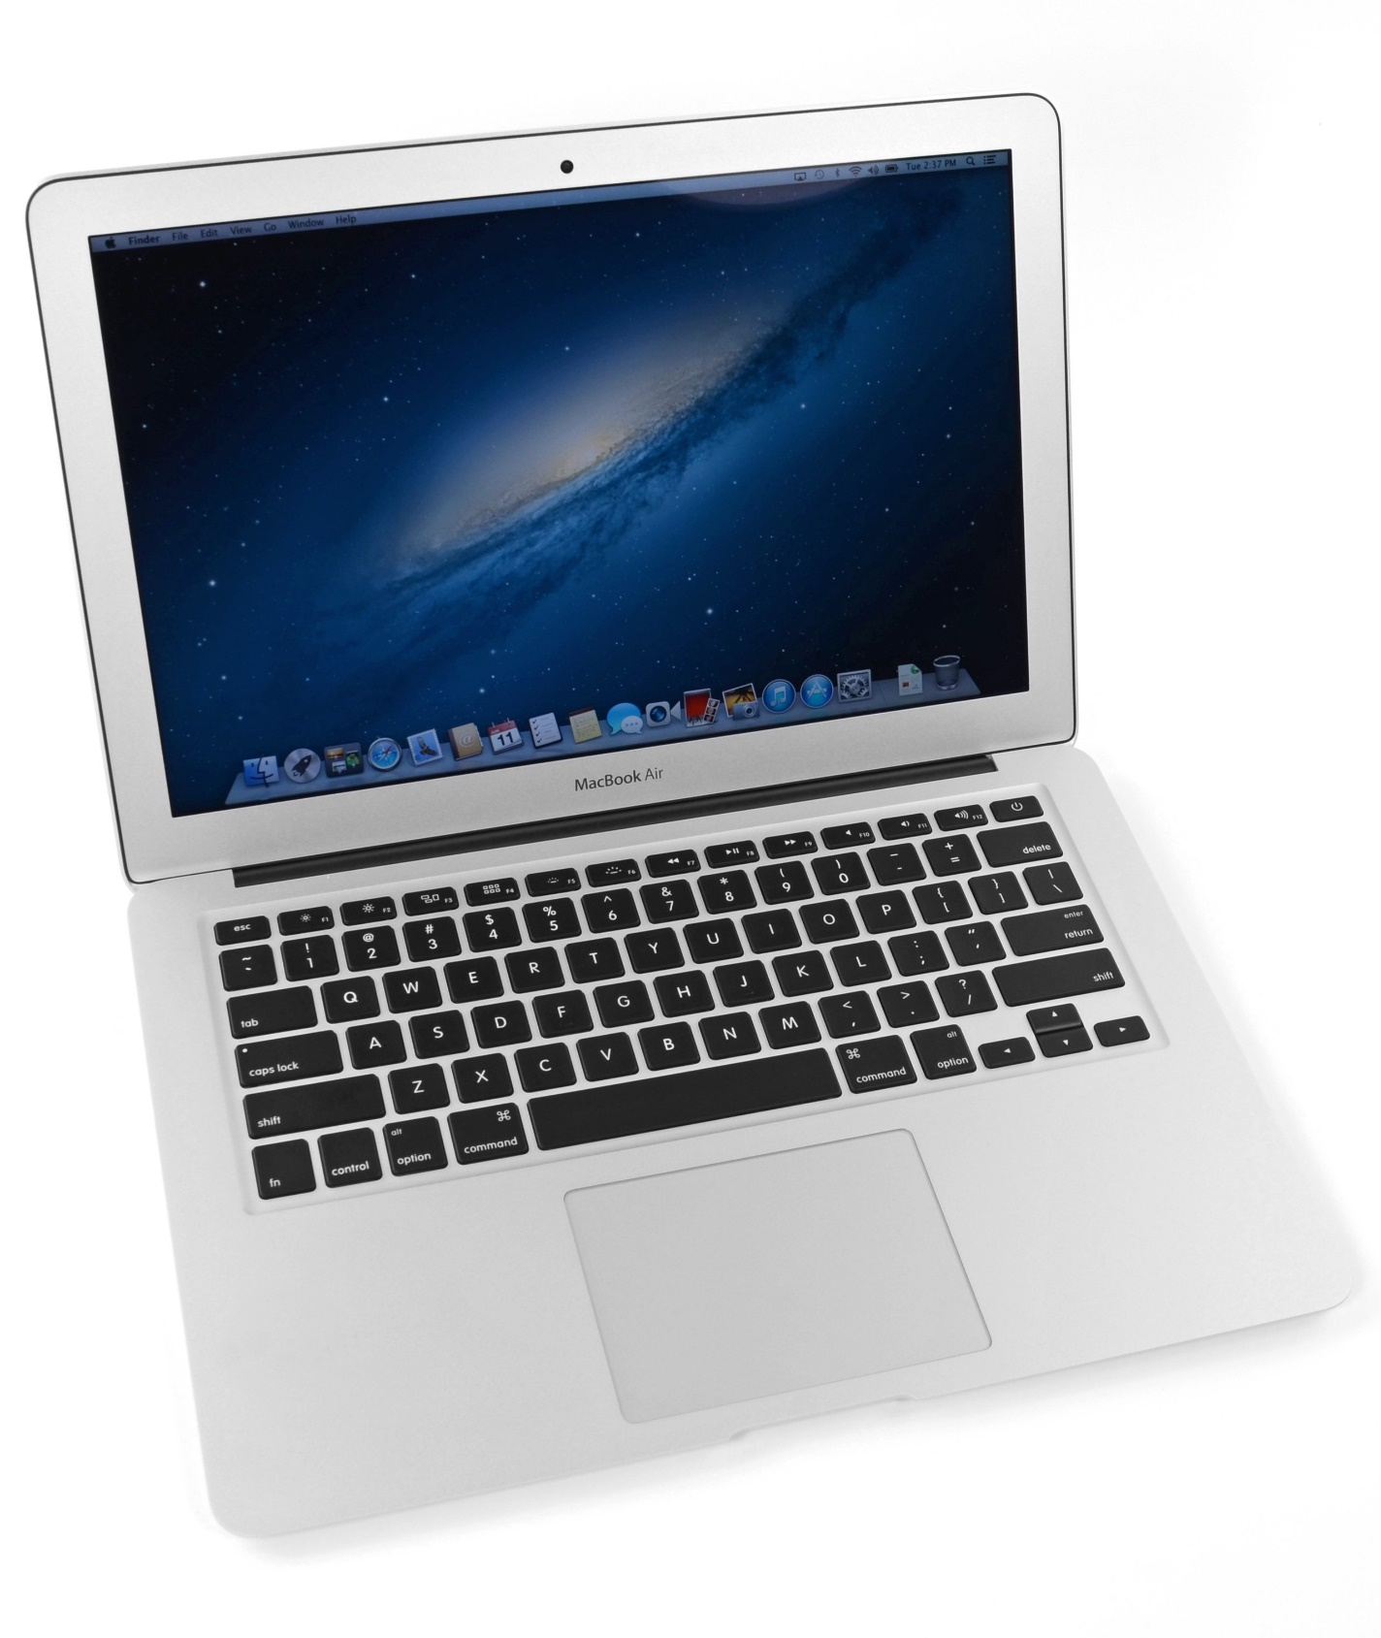
What’s inside a computer?
Macbook Air (circa 2013, 2nd gen)
  Modern computers are mostly similar
  Intel Core i5 processor
  128 GB Flash storage
  4 GB DDR3 RAM
  1440x900 pixel display
Picked because there is a teardown I like of an embedded device from the same year
https://www.ifixit.com/Teardown/MacBook+Air+13-Inch+Mid+2013+Teardown/15042

Slide 6
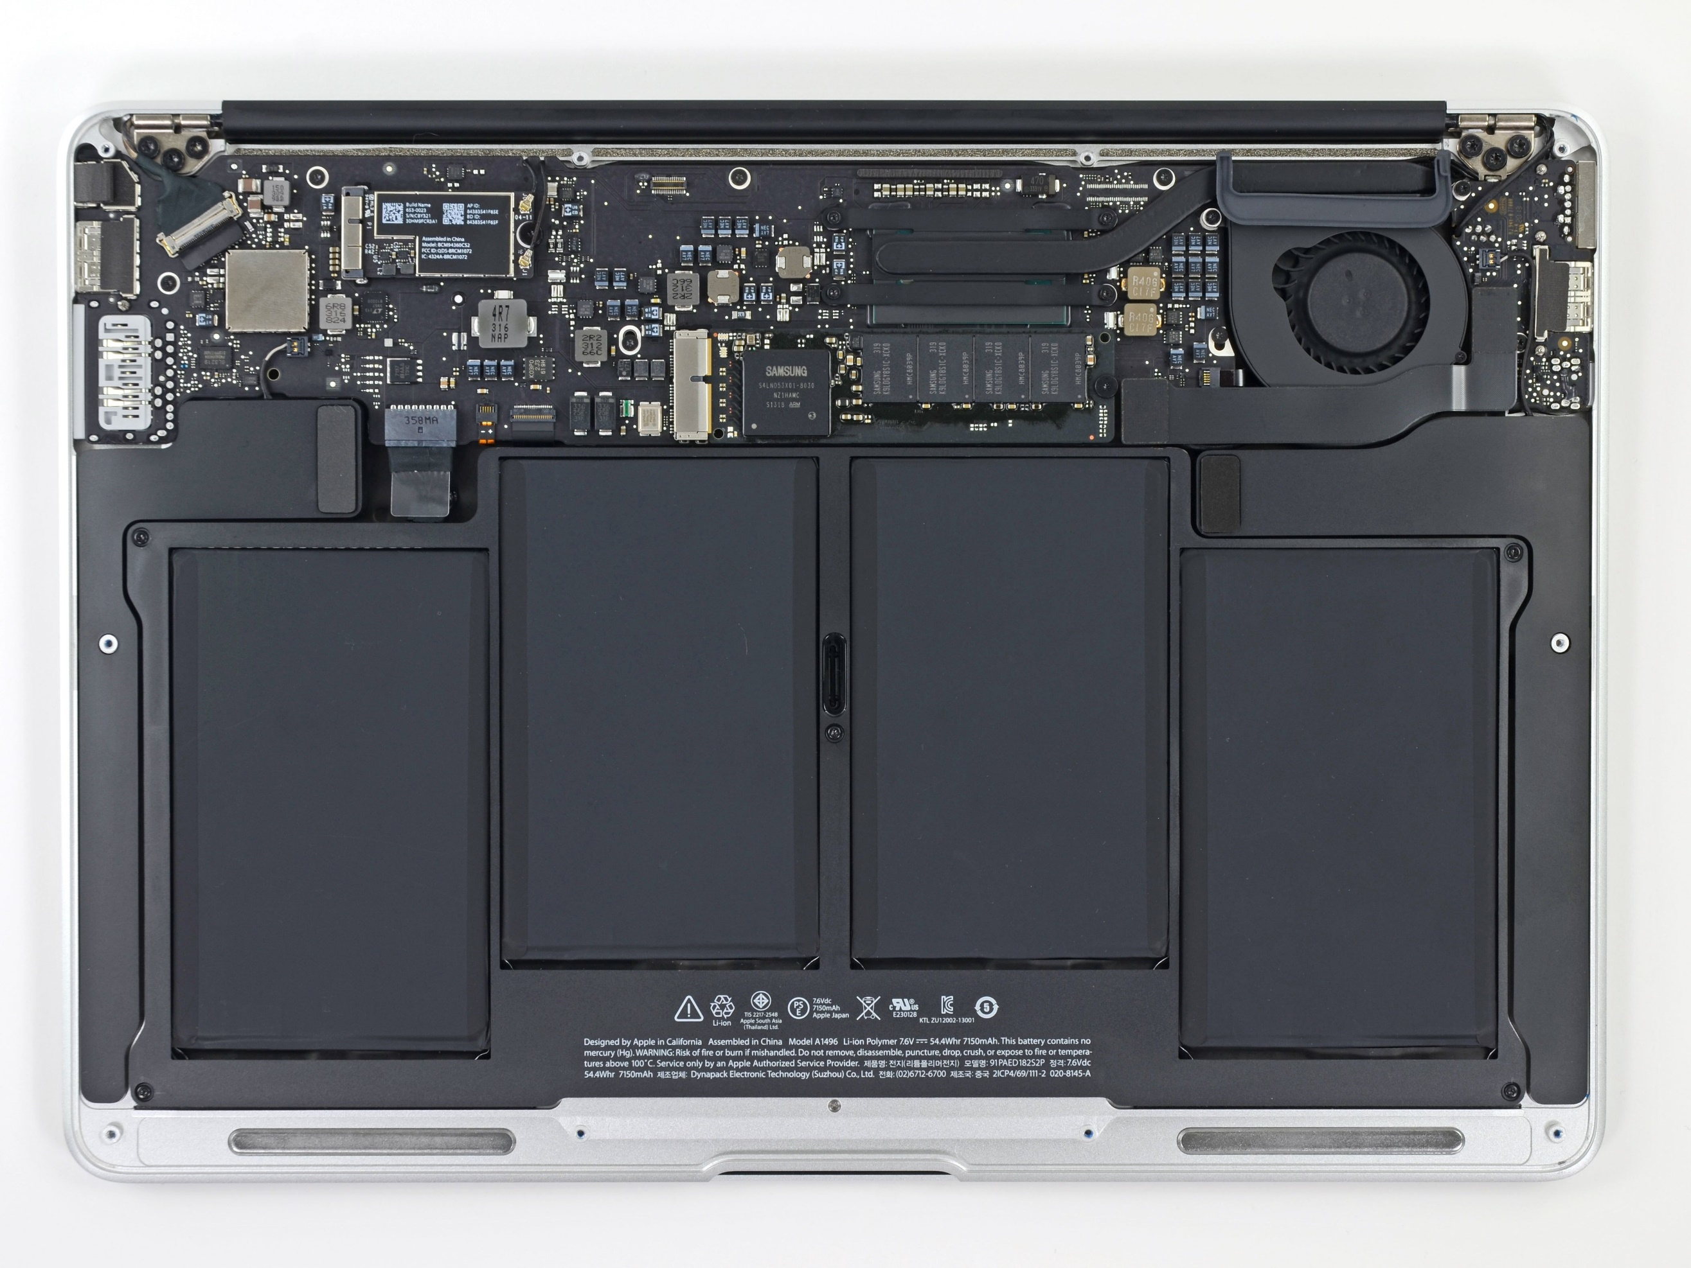
Unscrewing the bottom cover
Top half is the motherboard
  Holds and connects all the parts of the computer
Bottom half are battery packs

Slide 7
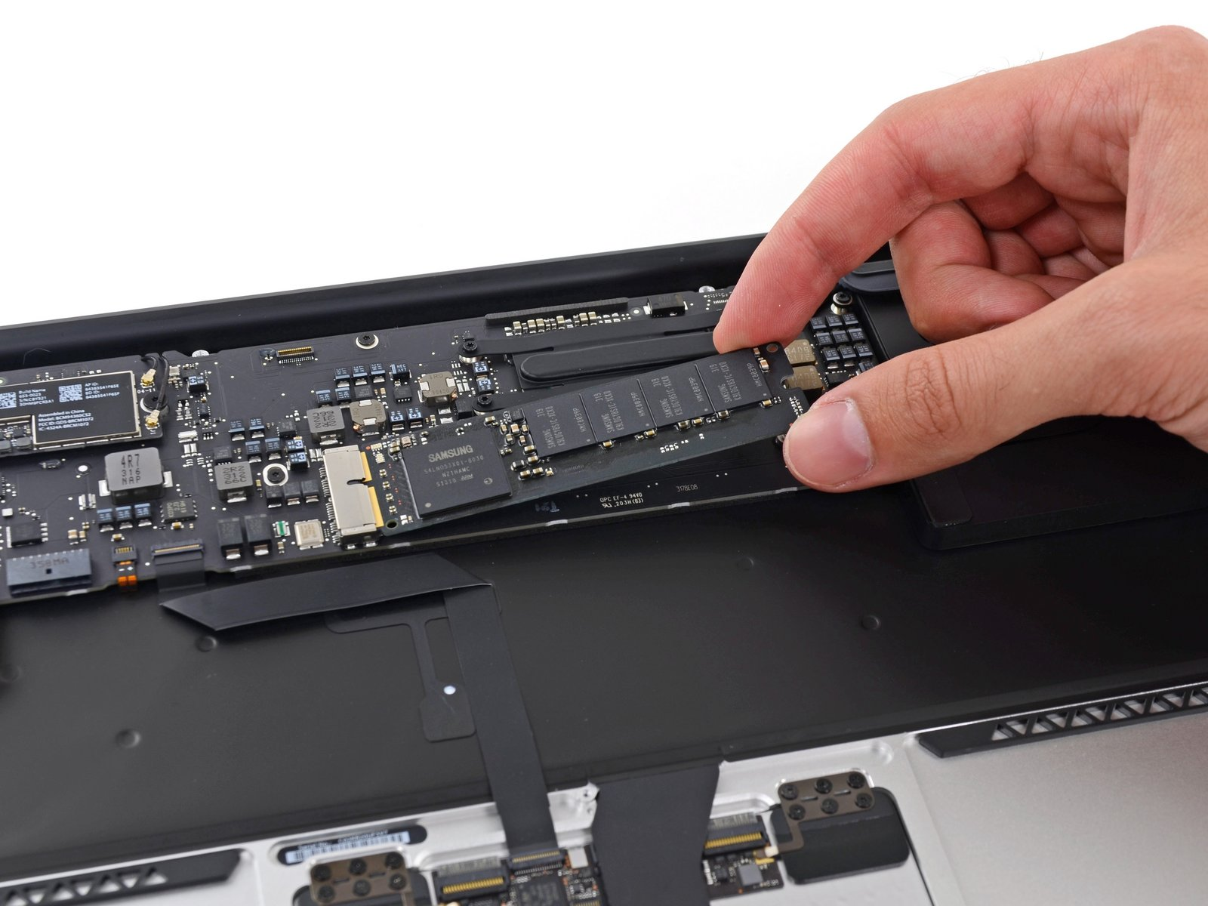
Non-volatile long-term storage: SSD
The SSD is a module that connects through PCIe
In modern laptops the SSD is often soldered directly onto the motherboard

Slide 8
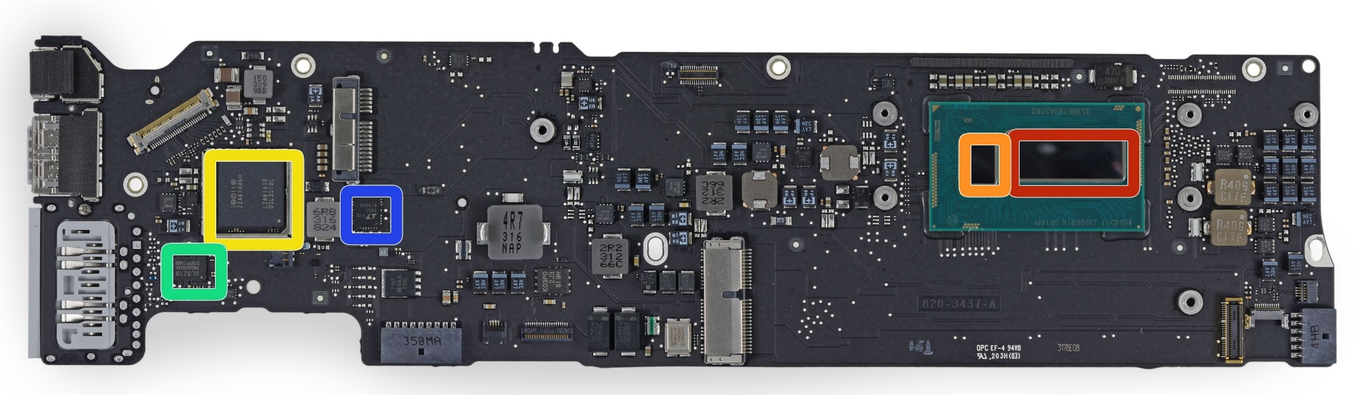
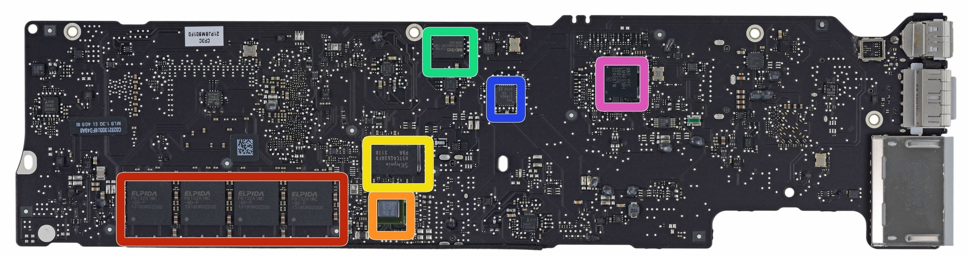
Investigating the motherboard
Red (front, right)
  Intel core i5 processor
Red (bottom, left)
  Elpida LPDDR3 RAM, 4 GB
Other stuff are mostly radios, USB/Thunderbolt controllers, and power supply
Front
Back

Slide 9
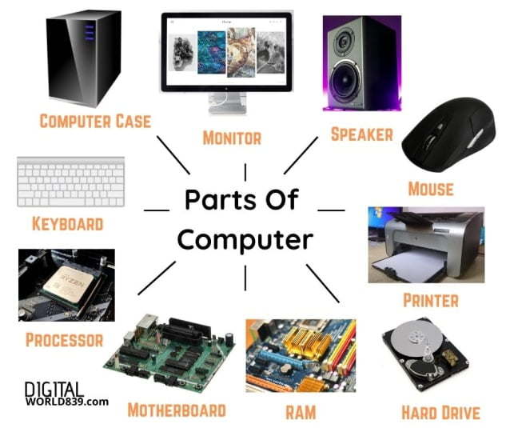
Generalizing computer design
Computers usually need
  Processor
  Memory (RAM)
  Storage (Flash/SSD)
  External communication
    USB, Thunderbolt, SATA, HDMI, WiFi
  Power management
    Maybe batteries and charging
  Something to connect it all: motherboard

Slide 10
What’s inside a Fitbit?
Fitbit flex (circa 2013)
Features
  Counts your steps
  Reports via Bluetooth Low Energy
  Lights up some LEDs based on your goals
  Vibrates when its battery is low
https://www.ifixit.com/Teardown/Fitbit+Flex+Teardown/16050
Notes:
Fitbit, Wearables, microcontrolles

Slide 11
Fitbit teardown
Notes:
Fitbit, Wearables, microcontrolles

Slide 12
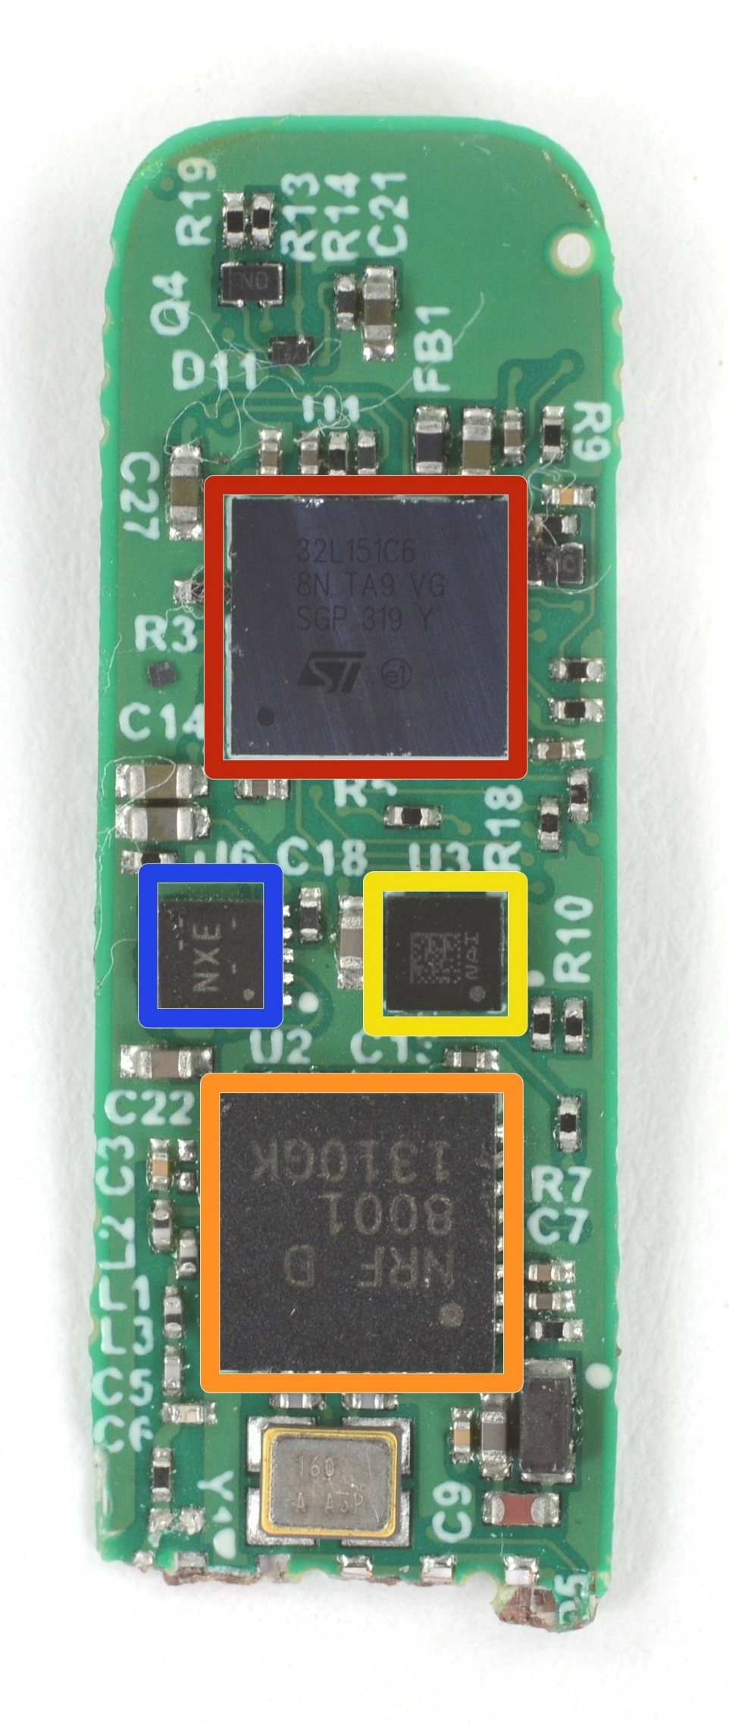
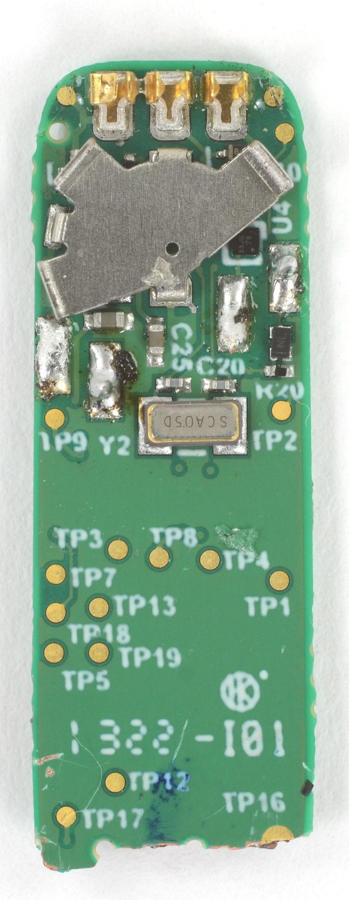
Fitbit circuit board front
The back is uninteresting
Red (top)
  STMicro 32L151C6 Microcontroller
Blue (left)
  TI BQ24040 Battery Charger
Yellow (right)
  STMicro LIS2DH Accelerometer
Orange (bottom)
  Nordic nRF8001 Bluetooth Low Energy Radio

Slide 13
Fitbit as a computer
Computers usually need
  Processor
  Memory (RAM)
  Storage (Flash/SSD)
  External communication
    USB, Thunderbolt, SATA, HDMI, WiFi
  Power management
    Maybe batteries and charging
  Something to connect it all: motherboard
  Microcontroller
  Bluetooth radio
  Vibratory motor
  Battery and power management
  Circuit board

Slide 14
Sidebar: you could make a Fitbit yourself
All those parts are commercially available, so you could make your own Fitbit if you wanted to
Make a circuit board
Buy those parts and solder them on
Write some embedded software
Make a plastic case
… build a big software backend for everything
You’ve got a Fitbit!

Slide 15
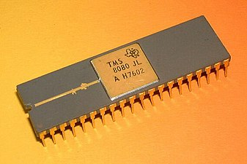
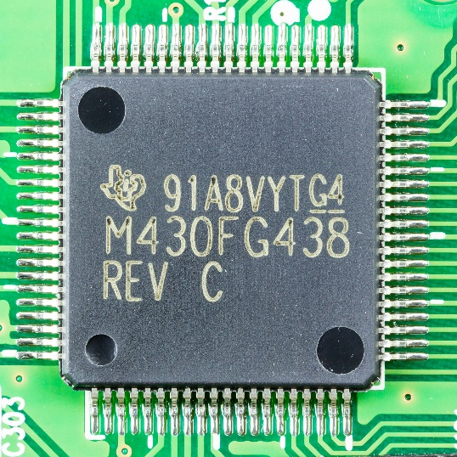
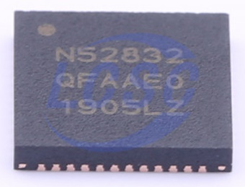
Categories of computer chips
Microprocessor (MPU or Processor)
  CPU + Bus/Pins
  No memory or peripherals
Microcontroller (MCU)
  CPU + Pins + Memory + Peripherals
  Peripherals: separate hardware units within chip
    Often I/O interfaces
System on a Chip (SoC)
  Microcontroller + Extensive Peripherals
  Example: Radios or ML Accelerators
  Essentially multiple chips combined
Evolution of increased complexity over time

Slide 16
Break + Extend your thinking
Microprocessor (MPU or Processor)
  CPU + Bus/Pins
  No memory or peripherals
Microcontroller (MCU)
  CPU + Pins + Memory + Peripherals
  Peripherals: separate hardware units within chip
    Often I/O interfaces
Why ever build a computer with a Microprocessor?

Slide 17
Break + Extend your thinking
Microprocessor (MPU or Processor)
  CPU + Bus/Pins
  No memory or peripherals
Microcontroller (MCU)
  CPU + Pins + Memory + Peripherals
  Peripherals: separate hardware units within chip
    Often I/O interfaces
Why ever build a computer with a Microprocessor?
  Microcontrollers have limited choice about memory or peripherals
  Microcontroller memory/peripherals are more basic, because they have to fit together inside one chip

Slide 18
Outline
Microcontrollers and Computers
Microcontroller Design
Microcontroller History
Microbit microcontroller

Slide 19
Generic microcontroller block diagram
Microcontroller
Processor
Peripherals
Pins
Memory

Slide 20
Processor
Microcontroller needs to execute software instructions
Emphasis: simple and reliable
  i.e. not x86 CISC
Often simple, in-order, short-pipeline RISC architectures
  Literally a three-stage pipeline you may have learned in CS361
Many different ISAs are possible
  Custom ISAs and ARM (ARMv7E-M) are both common

Slide 21
Background: Instruction Set Architecture
ISA includes the actual instructions as well as the model for how the computer interacts with memory
  Registers, reading/writing, etc.
Does the ISA for a microcontroller matter if you’re not programming in assembly? (and I promise we won’t)

Slide 22
Background: Instruction Set Architecture
ISA includes the actual instructions as well as the model for how the computer interacts with memory
  Registers, reading/writing, etc.
Does the ISA for a microcontroller matter if you’re not programming in assembly? (and I promise we won’t)
  Yes
  Differences in instruction efficiency and amount are important
  Differences in compiler support are VERY important

Slide 23
Processor design choices for embedded
How many bits is the architecture?
  8-bit and 16-bit not uncommon
  64-bit is very rare (who has that much memory?)
What instructions are supported?
  Normal stuff yes
  What about single-cycle multiply?
  What about floating-point operations?
  Vector instructions?
How fast does it run?
  1-100 MHz is common on modern systems (faster is more energy cost)
  Occasionally MUCH slower (think 32 kHz)

Slide 24
Generic microcontroller block diagram
Microcontroller
Processor
Peripherals
Pins
Memory

Slide 25
Memory
Embedded memory hierarchy
What’s missing? Why?
Registers
RAM
ROM

Slide 26
Memory
Embedded memory hierarchy
What’s missing? Why?
  Cache
  Makes timing unreliable
Registers
RAM
ROM
More modern microcontrollers often have optional instruction caches
Can be enabled by software

Slide 27
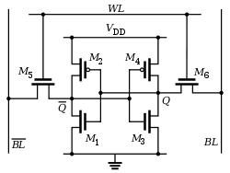
Volatile memory: SRAM
Same design as registers in traditional computer systems
  No need to refresh it -> lower energy costs
Embedded systems use SRAM for
all of their memory (no DRAM)
Tradeoffs:
  Way less energy cost
  Faster to access
  More expensive
  Physically larger

Slide 28
Non-Volatile memory: Flash (usually)
Same design as SSDs and Flash drives
Memory is stored with no energy costs
  Reading is lowish energy and quick
  Writing is high energy and very slow
    Writing also has to occur in blocks (e.g. 512 bytes)
Concern: Flash has a limited lifetime ~10,000 writes
  Only writing to Flash when you load code? Essentially forever
  Recording data to Flash every second? 2.8 hours

Slide 29
SRAM (RAM) versus Flash (ROM) memory
Size and time difference between non-volatile and volatile memory is significantly reduced from traditional computing
  Non-volatile store 2-10x larger than volatile
  Single-cycle RAM. Maybe two-cycles to Flash (to read)
Major difference: energy and writability
  SRAM is low-energy to read and write (no refresh needed)
  Flash is lowish-energy to read, but very high energy to write
Hierarchical structure is not enforced
  Same address space for RAM and Flash (very different from traditional)
  Run instructions right inside of Flash
  Keep variables in RAM (or const variables in Flash)

Slide 30
Memory design choices
How much memory can we fit without making it too high cost or too high power?
  The answer has slowly increased over time
  15 years ago: 2 KB RAM – 32 KB Flash
  Today: 256 KB RAM – 1 MB Flash
How to provide memory safety?
  Usually no virtual memory (all addresses are real addresses)
  Nothing stops arbitrary memory overwriting
  Modern systems: Memory Protection Unit
    Specify a small number of ranges and permissions

Slide 31
Generic microcontroller block diagram
Microcontroller
Processor
Peripherals
Pins
Memory

Slide 32
Peripherals
Hardware modules that perform some action
Common examples
  Control digital input and output pins
  Read analog inputs
  Send messages over various simple wire protocols (UART, SPI, I2C)
  Set and check timers
Less common examples
  Cryptography accelerators
  Complicated wire protocols (USB, CAN)
  Wireless radios (BLE, 802.15.4, WiFi)
We’ll spend most of class learning various peripherals

Slide 33
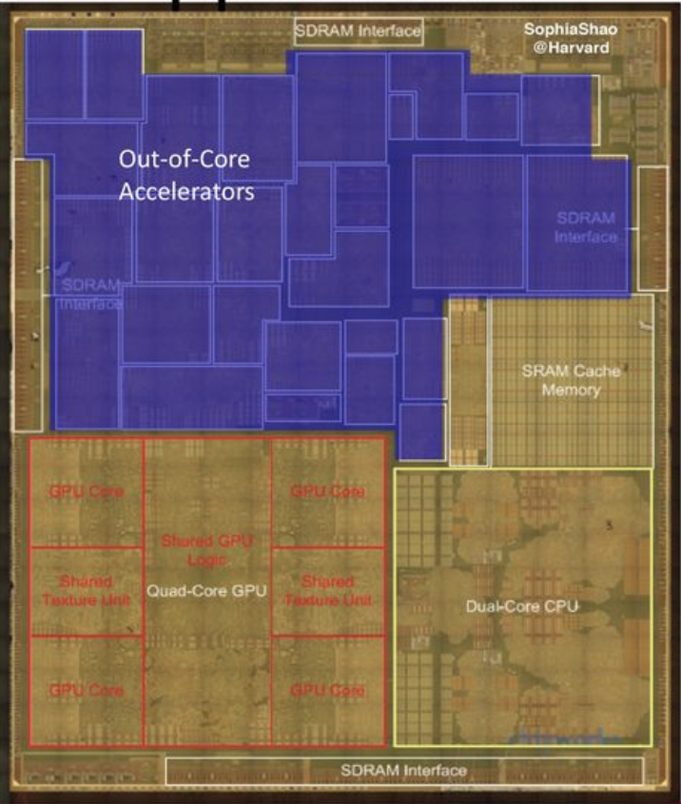
Peripheral design choices
More peripherals mean more use cases
  But also means more cost for the chip
  Peripherals occupy silicon
  Most peripherals will go unused for a given application…
Flexibility tradeoffs within a given peripheral
  One capability is easier to use
  Many capabilities are more useful
Apple A8 SoC

Slide 34
Generic microcontroller block diagram
Microcontroller
Processor
Peripherals
Pins
Memory

Slide 35
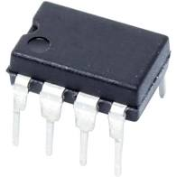
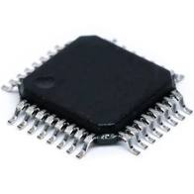
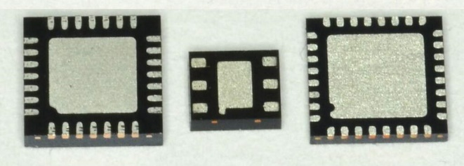
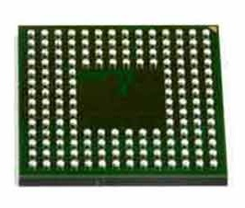
Pins
Peripherals need to electrically connect to outside world
  Attach to pins on the exterior of the chip
More pins allow for more connections
  At increased cost and size
Pin layouts can add more pins for cheaper
  But make soldering and debugging difficult

Slide 36
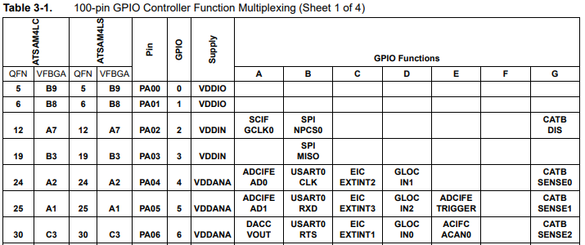
Internal connections to pins
Peripherals need to connect to external pins
  Can any peripheral connect to any pin, or are there limited mappings?
  Modern microcontrollers allow any-to-any connections
Older MCUs
had mapping
tables and
pin selection
was more
challenging

Slide 37
What haven’t we talked about?
Microcontroller
Processor
Peripherals
Pins
Memory

Slide 38
What haven’t we talked about?
Power
Programming
Others?
  Clocks
  Antennas
Microcontroller
Processor
Peripherals
Pins
Memory

Slide 39
Powering microcontrollers
Usually require a specific voltage
  E.g. 5 volts, 3.3 volts, 1.8 volts
  Must be stable and supply enough current (or MCU “browns out”)
  Noisy power supply can be an issue
Some microcontrollers have wider ranges of acceptable voltages
  Need to pay attention to acceptable range on I/O though

Slide 40
Programming microcontrollers
JTAG (Joint Test Action Group)
  Hardware built into the microcontroller for testing purposes
  Can arbitrarily read/write memory
  Can single step process too, at runtime!
    GDB can connect to it! (sort of)
Bootloaders
  Software runs on the microcontroller at boot that waits a short time for someone to contact it and upload code
    Via I/O pins
  Convenient, but sometimes unreliable

Slide 41
Break + Open Question
How little memory (RAM and/or ROM) can a computer have and still be useful?

Slide 42
Break + Open Question
How little memory (RAM and/or ROM) can a computer have and still be useful?
  If we want to run C code, we need a stack and a global data section
  Function calls may require local variables to be placed in the stack
  To use less memory, we’d need to write applications in registers
  Most variables could probably fit in registers?
  So the limit could get very low
    Enough ROM space for some useful code + a tiny bit of RAM
  Real-world answer coming on the next slide

Slide 43
Outline
Microcontrollers and Computers
Microcontroller Design
Microcontroller History
Microbit microcontroller

Slide 44
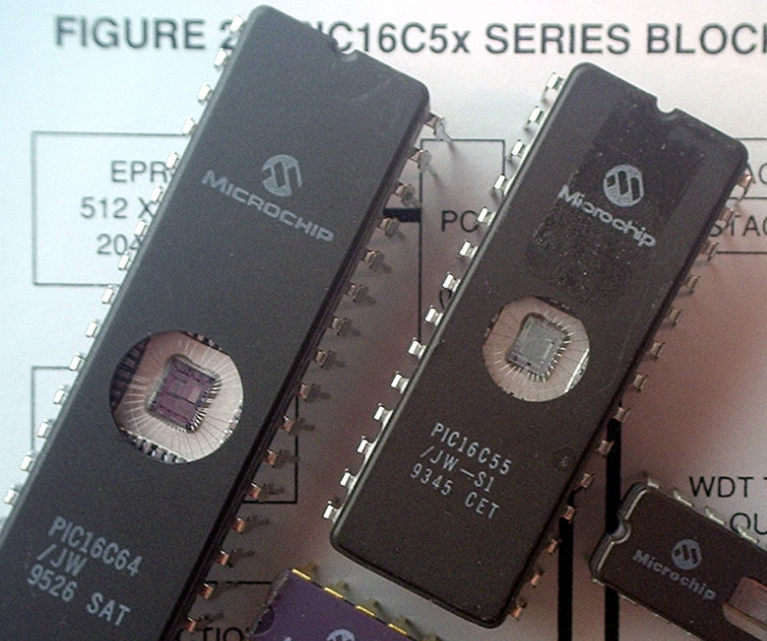
Older microcontrollers (90s-00s)
Focus: cheap, small computer systems
PIC
  8, 16, and 24-bit MIPs architecture
  PICAXE available with Basic interpreter
AVR
  8-bit custom architecture (AVR architecture)
  Used in Arduinos
  AT Tiny 4: $0.30 per unit
    4 I/O pins, 32 Bytes RAM, 512 Bytes ROM

Slide 45
More capable microcontrollers (00s-10s)
Focus: diversify into extreme low power and more capable systems
MSP430
  16-bit custom architecture (MSP430 architecture)
  Capable, but also extremely low power
    <1 μA sleep current
STM32, Atmel SAM series (Cortex-M0, M3, M4, M4F)
  32-bit ARM architecture (ARMv7)
    Leverage success of ARM on smartphones
  Every peripheral under the sun. Plus a variety of memory choices

Slide 46
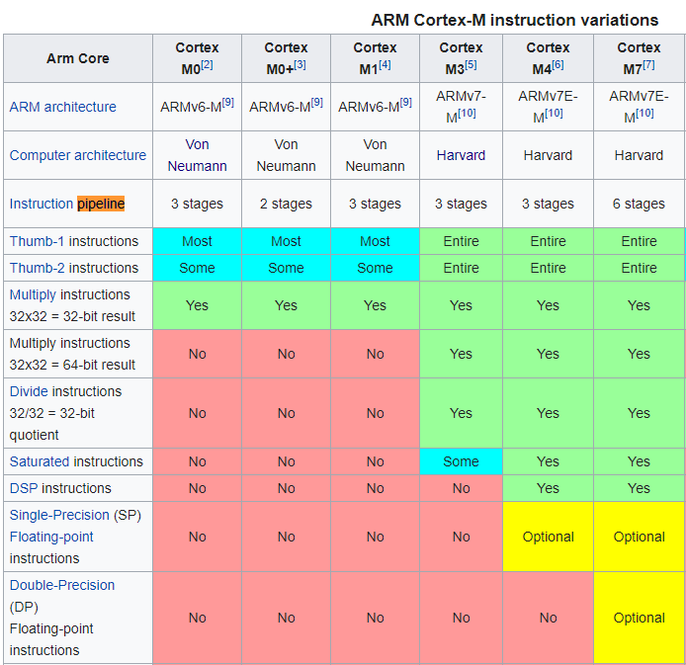
Cortex M Series
A number of options for increasing capabilities
In practice:
  Cortex-M0+ for low-end systems
  Coretx-M4 for high capability systems

Slide 47
Modern system-on-chips (10s-?)
Focus: increase memory and capability
  Include radios in the same chip
nRF51 and nRF52 series
  32-bit ARM microcontrollers (Cortex M)
  Include 2.4 GHz radio: Bluetooth Low Energy and 802.15.4/Thread
Others have followed this same path
  TI CC26XX
  Apollo3
  STM32WL

Slide 48
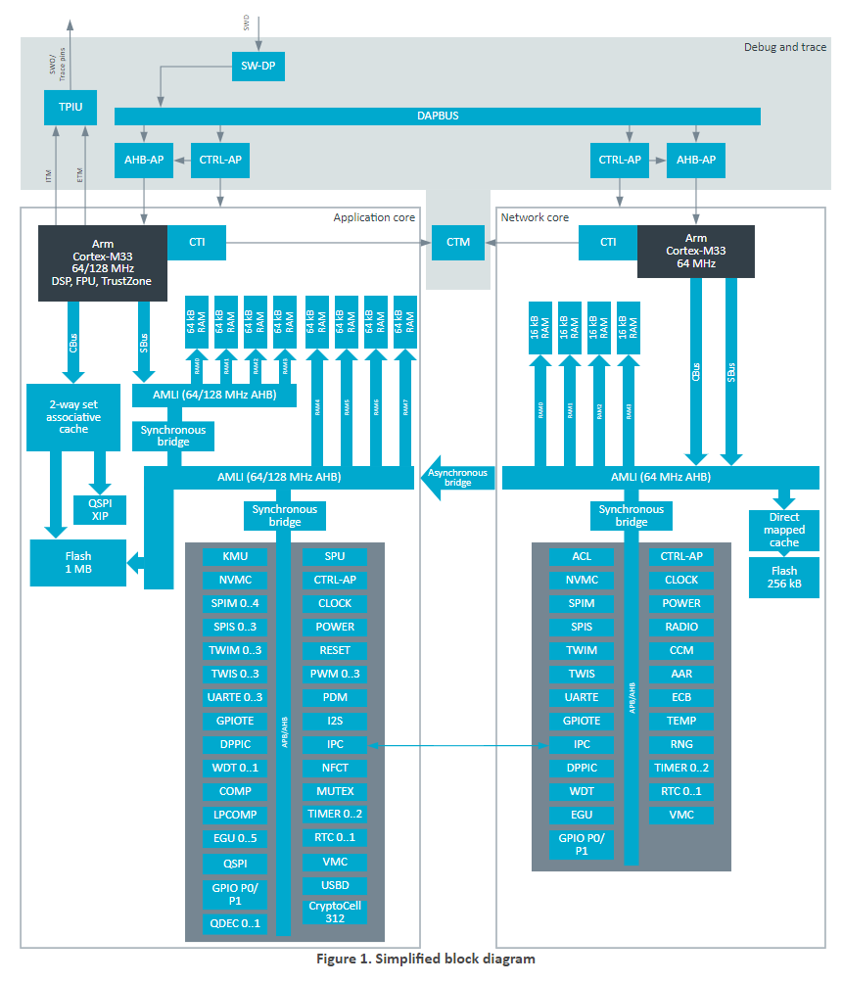
Future microcontrollers
Multi-core systems
  Not for performance, but for separation of concerns
    Run radio code on one core
    Application code goes on the other core
  Also allows BIG.little architecture
    Higher performance core when interpreting data
    Lower performance core for sampling sensors
  nRF54 series really emphasizes this
    Multiple BIG ARM processors and little RISC-V processors

Slide 49
Break + Open Question
Consider the lifecycles of computer systems
  i.e., how long are people still actively using them for?
  How long does a processor generation need to be supported?
    Think Intel Core i7-7500U or Apple M1
  How long does a microcontroller chip need to be supported?
    Think nRF52833 or MSP430

Slide 50
Break + Open Question
Consider the lifecycles of computer systems
  i.e., how long are people still actively using them for?
  How long does a processor generation need to be supported?
    Think Intel Core i7-7500U or Apple M1
    After some number of years, new products no longer use it
    Old products eventually wear out or are unsupported
  How long does a microcontroller chip need to be supported?
    Think nRF52833 or MSP430
    New products might still use them years later, because redesigning embedded systems is hard and new chips aren’t that much better

Slide 51
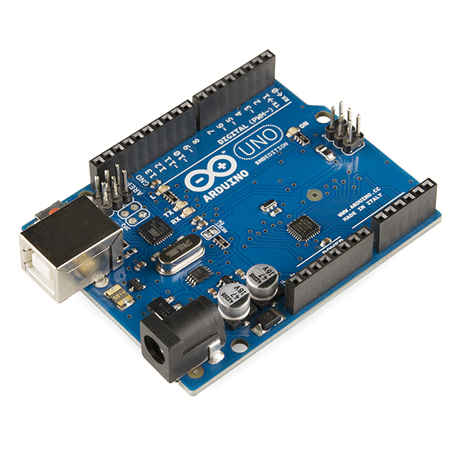
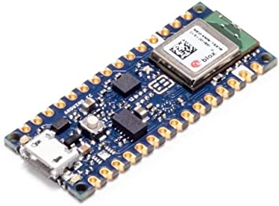
Popular components rarely die
Majority of popular older options still exist
  Designers can trade off cost, capability, and efficiency
  alongside “modern features”
Upgrading for an existing product is unlikely
  Large cost, little benefit
Example: Arduino still primarily uses AVR
  Works just fine for its needs
  Also releases new boards with nRF52s (Arduino Nano 33 BLE)

Slide 52
Fall 2024: cheapest microcontroller
ATTINY10-TSHR
  8-bit custom architecture
  32 bytes of RAM
  1 kB of Flash
  4 I/O pins
  $0.44 per microcontroller
    Still an “active” chip being manufactured

Slide 53
Outline
Microcontrollers and Computers
Microcontroller Design
Microcontroller History
Microbit microcontroller

Slide 54
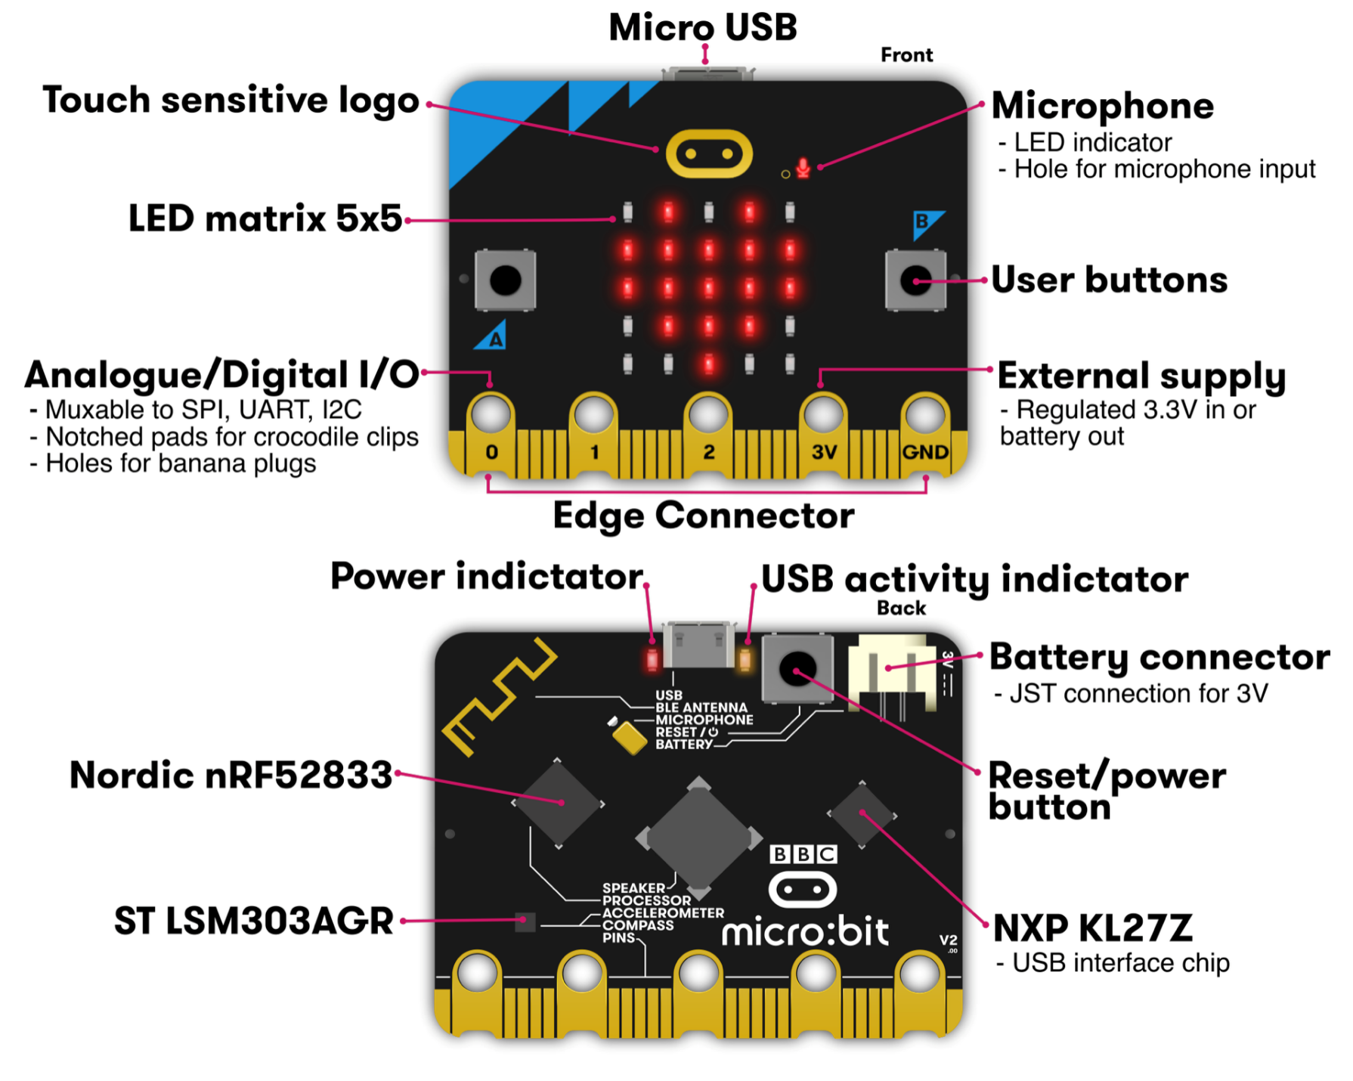
Micro:bit v2
Circuit board
  Entire thing
  a.k.a “Dev Board”
  a.k.a PCB
  (Printed Circuit Board)
Microcontroller
  The computer on it
  Microbit has two
    One as a programmer
    One for applications
Microcontrollers

Slide 55
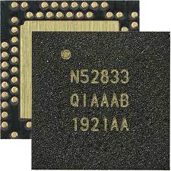
nRF52833 – Microcontroller on the Micro:bit v2
32-bit ARM Cortex-M4F microcontroller
  64 MHz core, 128 KB RAM, 512 KB Flash
  Floating point support
  2.4 GHz Radio: Bluetooth Low energy / 802.15.4
  Various peripherals
    ADC, PWM
    I2C, UART, SPI, USB
    RNG, 32-bit Timers, Watchdog, Temperature
    Up to 42 I/O pins

Slide 56
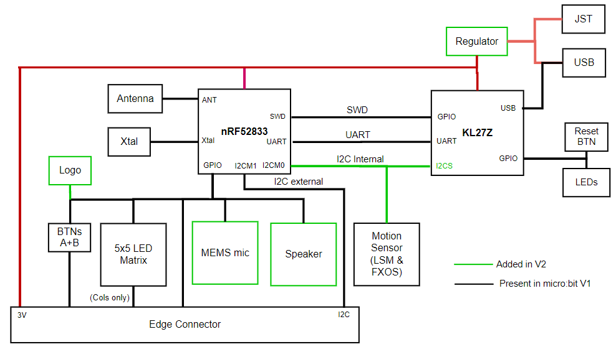
KL27Z – Programmer on the Micro:bit v2
32-bit ARM Cortex-M0+ microcontroller
  48 MHz core, 16 KB RAM, 256 KB Flash
Acts as a programming interface to nRF52833
  Connects to USB and to JTAG (SWD)

Slide 57
Microbit version 2.2
Starting in 2020 there was a global chip shortage
  Lots of demand for electronics
  Reduced supply due partly to pandemic
Microbit had to come out with a revision
  Replaced KL27Z (the programmer chip) with a WAY more capable nRF52820
This has caused some annoyances for lab that I needed to fix
  The programming interface changed a little

Slide 58
To the datasheet!
nRF52833 Product Specification
  Online: https://docs.nordicsemi.com/bundle/ps_nrf52833/page/keyfeatures_html5.html
  PDF: https://docs-be.nordicsemi.com/bundle/ps_nrf52833/attach/nRF52833_PS_v1.7.pdf

Slide 59
Outline
Microcontrollers and Computers
Microcontroller Design
Microcontroller History
Microbit microcontroller(s)

