Slide 1
Lecture 15
Nonvolatile Memory &
Energy Management
CE346 – Microprocessor System Design
Branden Ghena – Fall 2023
Some slides borrowed from:
Josiah Hester (Northwestern), Prabal Dutta (UC Berkeley)

Slide 2
Administrivia
Quiz today! Remind me at 4:30
Office Hours
  Still available for projects
  Friday 1-5 we’ll be in the Ford classroom for project help
Projects
  Get working on them! Likely can’t order new things after Thanksgiving
Hardware
  I have the rest of the hardware on hand to distribute
  Let’s do it right now so I don’t have to interrupt the quizzes later

Slide 3
Bonus Topics
We won’t have time to talk about these, but I have slides, so I included them at the end of this lecture
SD Card protocol
PPI and task/event chaining

Slide 4
Today’s Goals
Discuss uses of memory, especially nonvolatile memory, in embedded systems
Introduce internal flash peripheral
Discuss matters of energy on embedded systems
  Where to gain energy?
  How much does the Microbit use?
  How do we write software for very low energy systems?

Slide 5
Outline
Memory in Computing
nRF52 Non-Volatile Memory Controller
Energy Sources
Microbit Energy Use
Intermittent Computing

Slide 6
Memory in computing
Various different memories serve different purposes in computing
Needs
  Fast, infinite-lifetime memory to keep things like stack memory
  Nonvolatile memory that can be read from
Desires
  Fast, infinite-lifetime nonvolatile memory

Slide 7
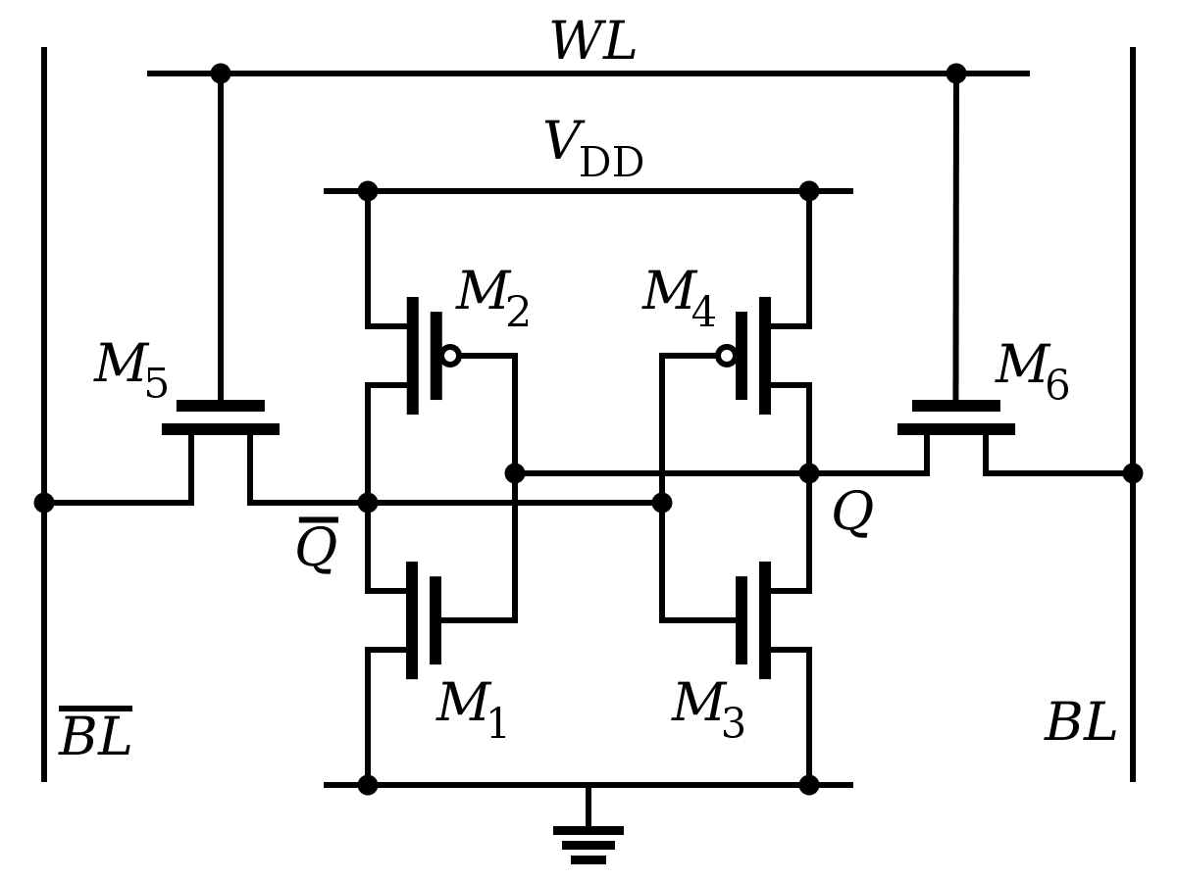
Register technology: SRAM
Static RAM (SRAM)
  Each cell stores a bit in a bi-stable circuit,
  typically a six-transistor circuit
  Static – no need for periodic refreshing;
  keeps data while powered
  Relatively insensitive to disturbances such as electrical noise
    Energetic particles (alpha particles, cosmic rays) can flip stored bits
Fastest memory on computer
  Also most expensive and takes up most space per bit
  Typically used for registers and cache memories

Slide 8
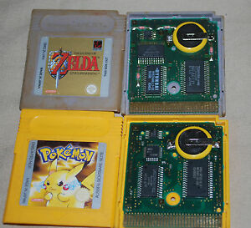
SRAM can be used a permanent memory in a pinch
Gameboy and Gameboy Color used batteries to save state
Gameboy Advanced games used batteries for an internal clock
PSA: old Gameboy games have likely lost their save files

Slide 9
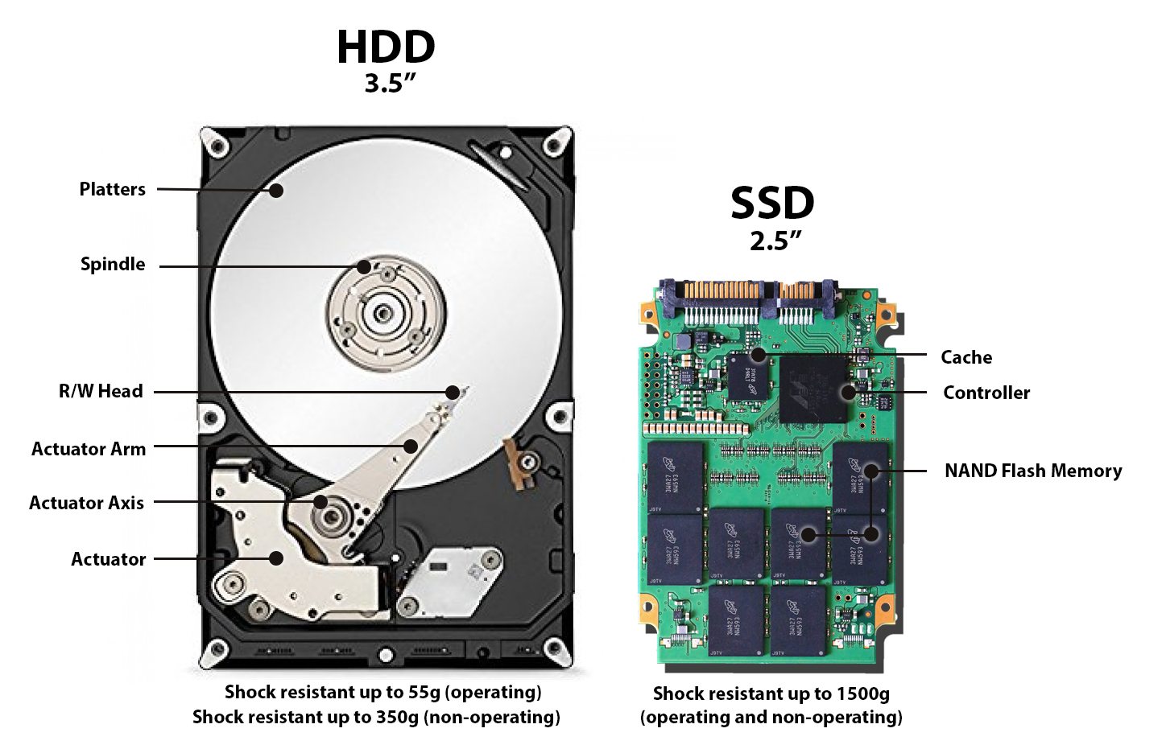
Disk drive storage

Slide 10
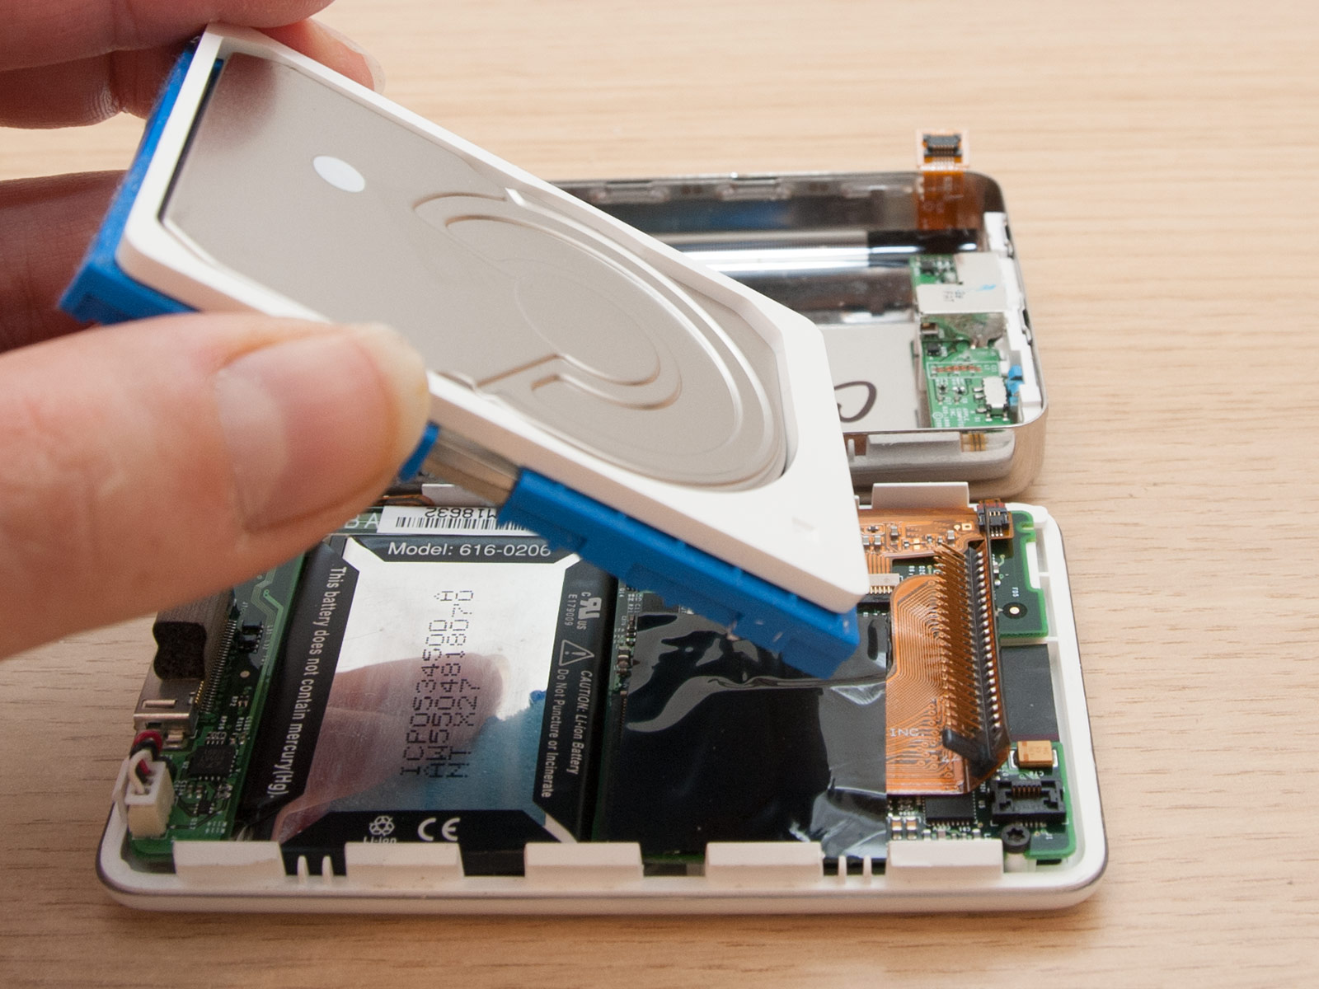
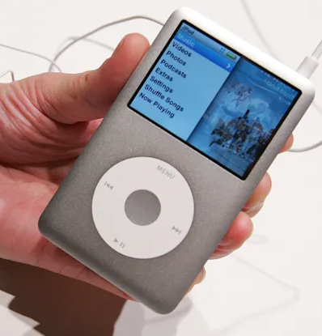
Necessity breeds creativity
Original iPod used a small disk drive

Slide 11
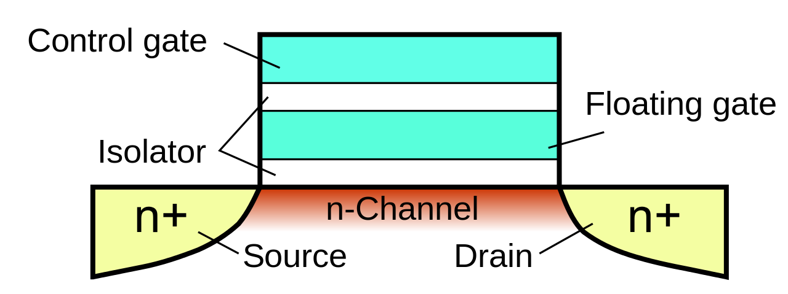
Floating-gate transistors
Concept behind transistor-based non-volatile memory
  EPROM, EEPROM, and Flash
  High voltage on control gate creates charge on floating gate
  Charge on floating gate activates/deactivates transistor
High voltage degrades
the structure, leading it
to eventually fail after
enough writes

Slide 12
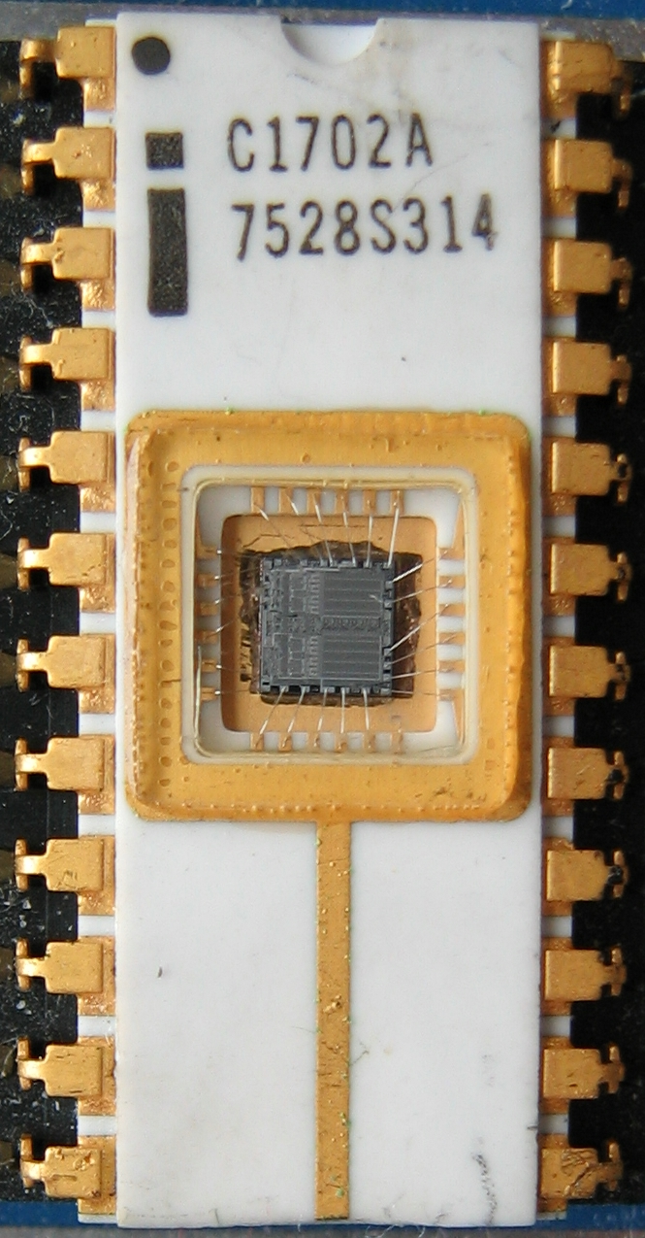
EPROM
Erasable programmable read-only memory
Erasable
  If you shine UV light directly on the IC
  Needed a window to expose the IC
Programmable
  With high voltage (25-50 volts)
Typically acted as read-only memory in
circuits

Slide 13
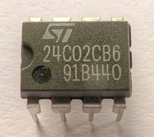
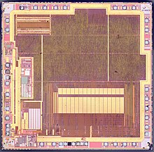
EEPROM
Electrically-erasable programable
read-only memory
Same concept as EPROM, but includes internal
circuitry to allow rewriting under normal
conditions
  Slow and high-power to write
  Has a longer lifetime compared to flash, ~100k writes
Can be built into other ICs
  Example: AT90USB162 microcontroller (512 bytes)

Slide 14
Flash
Similarly based on floating-gate transistors
  But with a different design that allows for faster erase of entire blocks
  More limited lifetime, ~1k-100k writes (10k common for embedded)
Cannot erase individual bytes, must erase in units of blocks
  Read can happen in units of bytes though
Heavily used in commercial devices
  Flash drives
  SSDs
  Smartphone storage
  Microcontroller non-volatile storage!

Slide 15
More exotic memories
FRAM and MRAM are both rising protentional Flash replacements
  Non-volatile
  Writable at the byte level
  Very high to infinite write/erase cycles
  Lower energy costs for writing and reading
They use unrelated magnetic techniques for data storage
Starting to appear in microcontrollers
  TI MSP430s have used 16 kB FRAM
  Apollo4 (ARM Cortex-M4F) has 2 MB of MRAM

Slide 16
Outline
Memory in Computing
nRF52 Non-Volatile Memory Controller
Energy Sources
Microbit Energy Use
Intermittent Computing

Slide 17
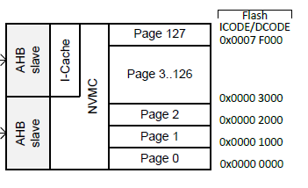
Flash memory on the nRF52833
512 kB total Flash memory
  128 pages each 4 kB in size
Non-Volatile Memory Controller (NVMC) controls access
  Enables writing to flash
  Enables erasing flash
  Manages status of flash

Slide 18
Writing to Flash
Configurable, disabled by default
  Enable with configuration register
Rules for writing to Flash
  Must write word-aligned 32-bit values
  Can only write 0 values, not ones
  Can only write 2 times before erasing (even if there are still 1 bits)
Takes 42.5 μs to write a 32-bit word
  64 MHz clock ⇨ 2720 cycles per 32-bit write

Slide 19
Erasing Flash
Lifetime: 10000 erase cycles per page
Options
  Erase a single page (4 kB): 87.5 ms
  Erase all of flash (512 kB): 173 ms
CPU is halted if executing code from Flash during the erase
  That’s 5.6 million cycles…
  Code can execute from SRAM instead
  Can also be split into a series of partial erases
    Which must add up to a complete erase time before writing

Slide 20
Factory Information Configuration Registers
Read-only memory
Chip-specific information and configuration
  Code size
  Unique device ID
  Production IDs
  Temperature conversion functions

Slide 21
User Information Configuration Registers
Additional Flash memory for non-volatile user configurations
  Writable and erasable through NVMC processes described earlier
32 words of customer information (128 bytes total)
Special configurations
  Reset pin
  NFC pin enable/disable
  Debug configuration

Slide 22
Break + Question
Could you run a system entirely within Flash?
Could you run a system entirely within RAM?

Slide 23
Break + Question
Could you run a system entirely within Flash?
  Yes, but it would go _very_ slowly
  Local variables would be pretty hard to manage
    87.5 ms of code pause every time you write to a variable…
Could you run a system entirely within RAM?
  Yes, but code would need to be loaded from somewhere else
    Need initial state that is nonvolatile
  Would run just as fast and be lower energy, actually

Slide 24
Outline
Memory in Computing
nRF52 Non-Volatile Memory Controller
Energy Sources
Microbit Energy Use
Intermittent Computing

Slide 25
Measuring energy use
Base equations
  Power = Current * Voltage (Watts)
  Energy = Power * Time (Joules)
Energy = volts * amps * seconds
  Voltage is usually constant for a system
  Time is how long you are running for / measurement period
  Current changes based on activities being done
    Often energy is presented as a current draw
    Maybe an average current draw
    With Voltage and Time implicit

Slide 26
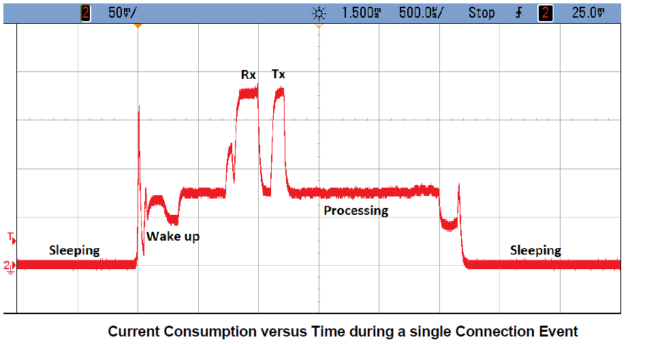
Example current trace during wireless communication

Slide 27
Wired power through USB
Provides 5v at up to 500 mA (USB 2.0) or 900 mA (USB 3.0)
  Or power delivery specifications, which can do far more power
Must be converted to different voltage to use
  Voltage regulator takes in 5v and spits out 3.3v
  Has its own maximum current!
System is limited by the minimum of USB or regulator power
  Microbit: regulator gives 3.3v at up to 600 mA
    USB 2.5 Watts, Regulator 1.98 Watts ⇨ System 1.98 Watts
    This is a max! Stay 15-30% below regulator limit

Slide 28
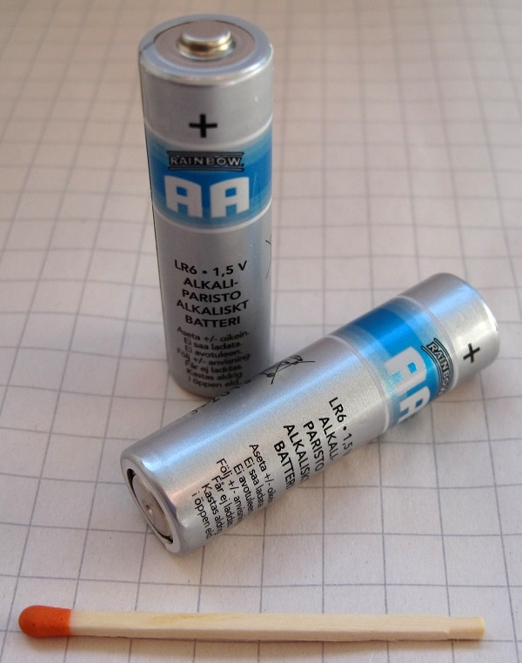
Thinking about energy
Batteries often list energy in mA*h (milliamp – hours)
  Coin cell battery: 3v at 220 mAh
  2x AA battery: 3v at 2000 mAh
  iPhone 11 battery: 3.7v at 3000 mAh
Also usually limited by regulator
  Sometimes just directly connected to system
  We can run at 3v just fine! (3.7v is no good though)
Voltage can vary with charge
  But only a little, right before battery is depleted
  Example: coin cell goes down to ~2.7 volts

Slide 29
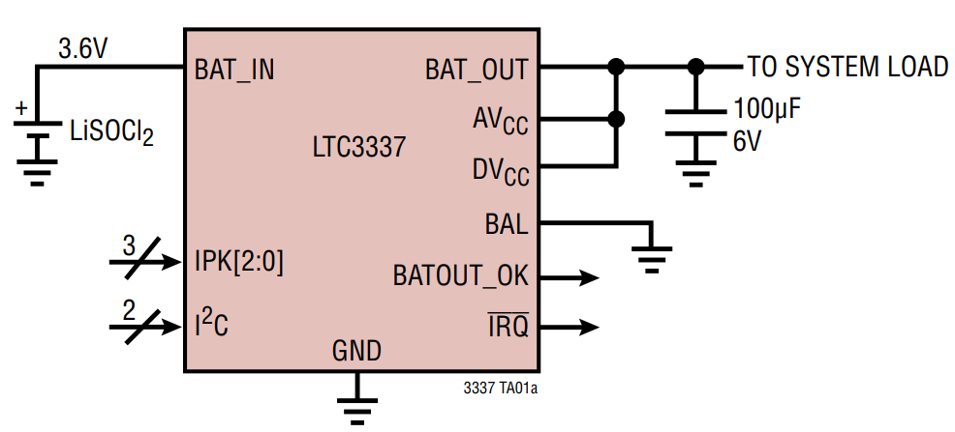
How are batteries measured?
Measuring energy remaining is a difficult problem
  Many questions to be handled
    How much did it start with?
    How much energy has been used?
    What type of battery is it?
  Energy is not as constant a quantity as one would hope
    Pulling out lots at once has an overhead penalty
Coulomb Counter (aka Battery Fuel Gauge)
  Designed for a specific battery “chemistry”
  Monitors charge flowing in each direction
  I2C interface for reading battery state
Accuracy is not exact, more of an educated guess

Slide 30
How are batteries managed?
Usually a dedicated IC for charging and managing battery packs
  Recharges battery with appropriate amount of current
  Monitors issues of battery health
    Various status monitoring
      Overcharge, undercharge
      Overcurrent
      Overtemperature, undertemperature
    Will go so far as to cut off the system to protect the battery
Takeaway: complicated problem, approach with caution!
  Best to reuse an existing design, if possible

Slide 31
Microbit only uses battery energy in a simple way
Battery input connects directly to regulator
  No protection for battery health
  No battery charging capabilities
Usually this is fine for simple, low-power systems
  It means that the input voltage can vary though
  Makes the reference voltages for the ADC/Comparator more important

Slide 32
Energy harvesting
Grab energy from the environment and use that!
  Could augment with a battery and use energy to recharge
  Could go entirely batteryless and live on harvested energy alone
Sources
  Light (outdoor or indoor. most successful)
  Airflow (outdoor or air vents)
  Motion (on human body)
  Temperature differential (difficult in practice)
  RF (very low energy source)

Slide 33
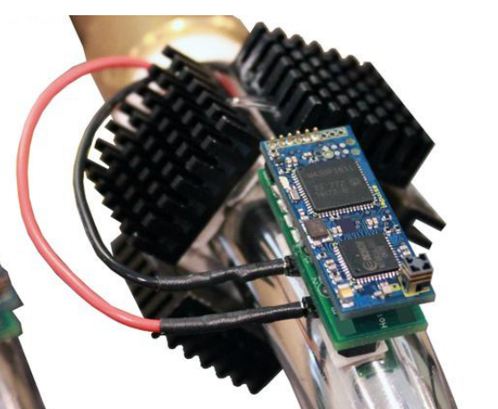
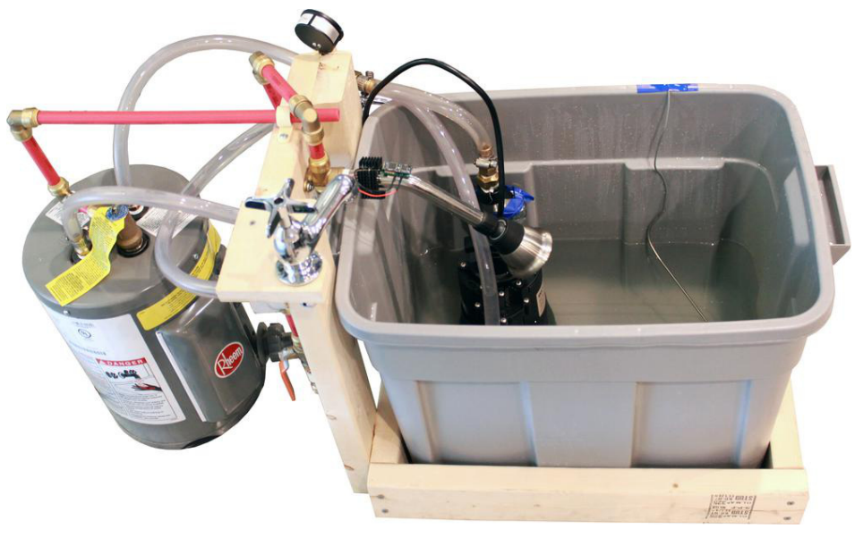
Temperature harvesting from hot pipes
Peltier junctions create a voltage from temperature differential
  Challenge: needs a large differential for more energy

Slide 34
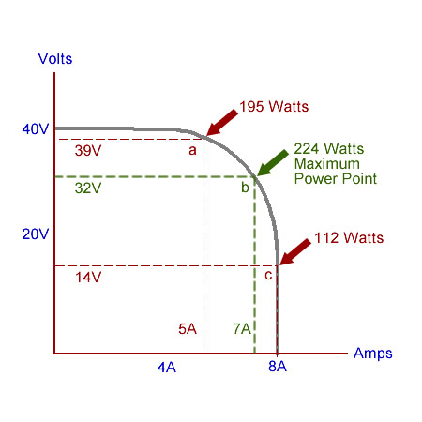
Managing harvested energy
Often uses an IC to pull in energy and provide to system
Harvested voltage/current are often very small
  Signal in millivolts is pretty common
  Need to accumulate over time to power system
    Fill up a capacitor
Need particular load for maximum power
  ICs often implement
  Maximum Power Point Tracking (MPPT)
  Varies load automatically to always
  harvest the most possible energy

Slide 35
Outline
Memory in Computing
nRF52 Non-Volatile Memory Controller
Energy Sources
Microbit Energy Use
Intermittent Computing

Slide 36
Thinking about energy
Battery energy
  Coin cell battery: 3v at 220 mAh
  2x AA battery: 3v at 2000 mAh
  iPhone 11 battery: 3.7v at 3000 mAh
nRF52833 active current: 5.6 mA (at 3v)
  Coin cell: 40 hours -> ~2 days
  2x AA: 360 hours -> ~15 days
  iPhone 11: 535 hours -> ~22 days
So how does any of this work???

Slide 37
Sleep mode power draw

Slide 38
Microcontroller sleep modes
Sleep mode
  Processor stops running but memory values are preserved
  Most peripherals are disabled
  Continues until an interrupt occurs and wakes the microcontroller
    Usually a timer or GPIO input
nRF52833 sleep mode current: 1.8 μA (GPIO port event only)
  Coin cell: 122222 hours -> ~5000 days -> ~14 years
Low-power systems shoot for less than 1% duty cycle
  Average current of ~100 μA or less
  Warning: other stuff on the board counts!!
    LEDs are 1-10 mA each… Power is not a concern of the Microbit

Slide 39
Microbit current draw (microcontroller)
Active CPU
  5.6 mA (executing from Flash)
  1.8 μA (sleep mode with RAM retention)
Transmitting RF packet
  15.5 mA (+8 dBm)
Other peripherals
  SAADC: 1.37 mA
  Timer: 729 μA (for any Timer peripheral)
  I2C: 6.6 mA (pull-down resistors when transmitting 0 bit)
  Everything else is handfuls of μA

Slide 40
Microbit current draw (non-microcontroller)
KL27 (JTAG interface microcontroller)
  2 μA sleep, 8 mA active
Speaker
  0-27.5 mA (changes with input signal)
Microphone
  0-120 μA (activated with GPIO pin)
Accelerometer/Magnetometer
  2-212 μA (depends on sensing rates, 200 is magnetometer)
LEDs
  0-230 mA (can be activated individually)
Everything else
  0-1 mA (mostly due to pull-up resistors)

Slide 41
Max and min current for Microbit
Maximum current: 280 mA at 3.3 volts (~1 W)
  With everything active
  Well within limits of regulator
Minimum current
  ~15 mA (always-on power LED)
  If you removed the power LED:
  <100 μA (with everything off)

Slide 42

nRF52 sleep mode
Triggered with assembly instruction
  WFI (Wait For Interrupt) or WFE (Wait For Event)
Stops processor until woken by interrupt, exception, or event
On nRF52 automatically disables high frequency clock if unneeded

Slide 43
Outline
Memory in Computing
nRF52 Non-Volatile Memory Controller
Energy Sources
Microbit Energy Use
Intermittent Computing

Slide 44
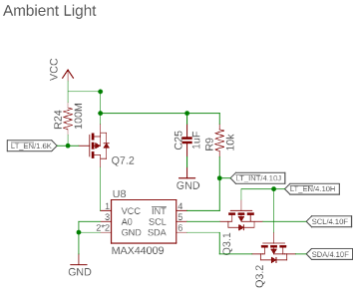
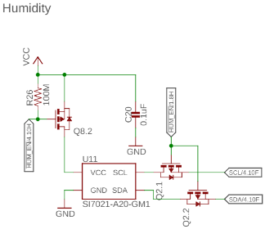
Reducing energy consumption even further
If sleep isn’t enough, you can power things off completely
  Transistor can be used to turn off the sensor

Slide 45
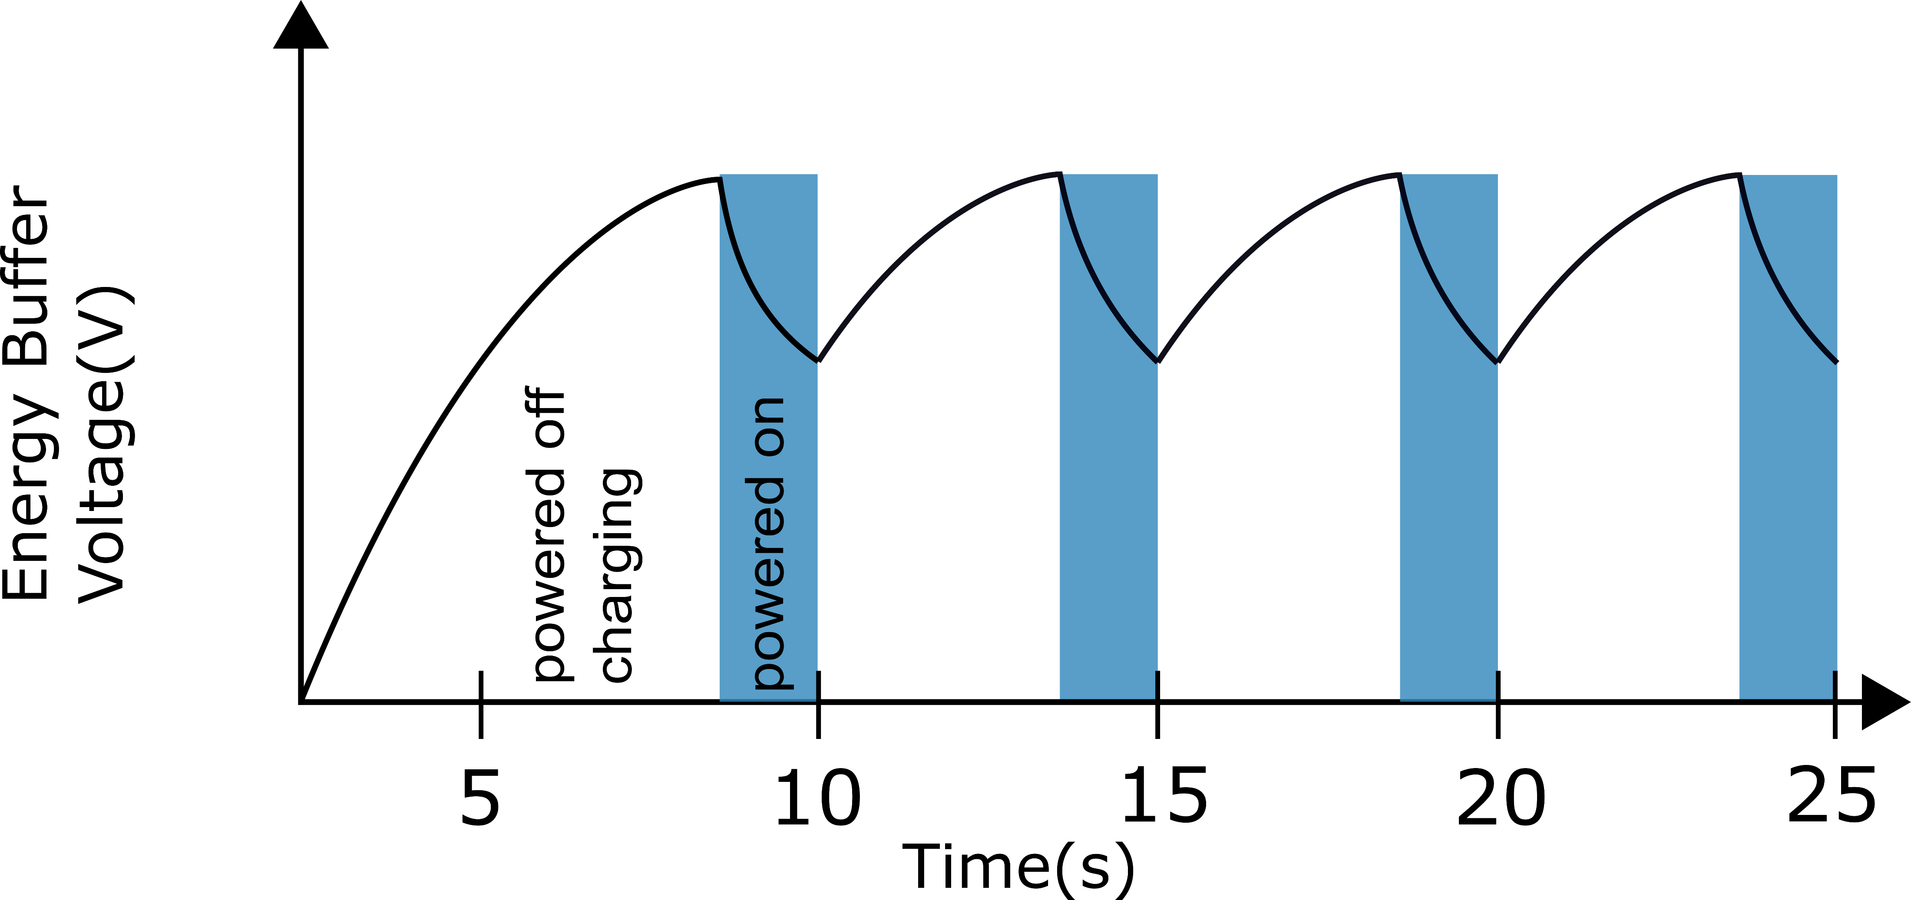

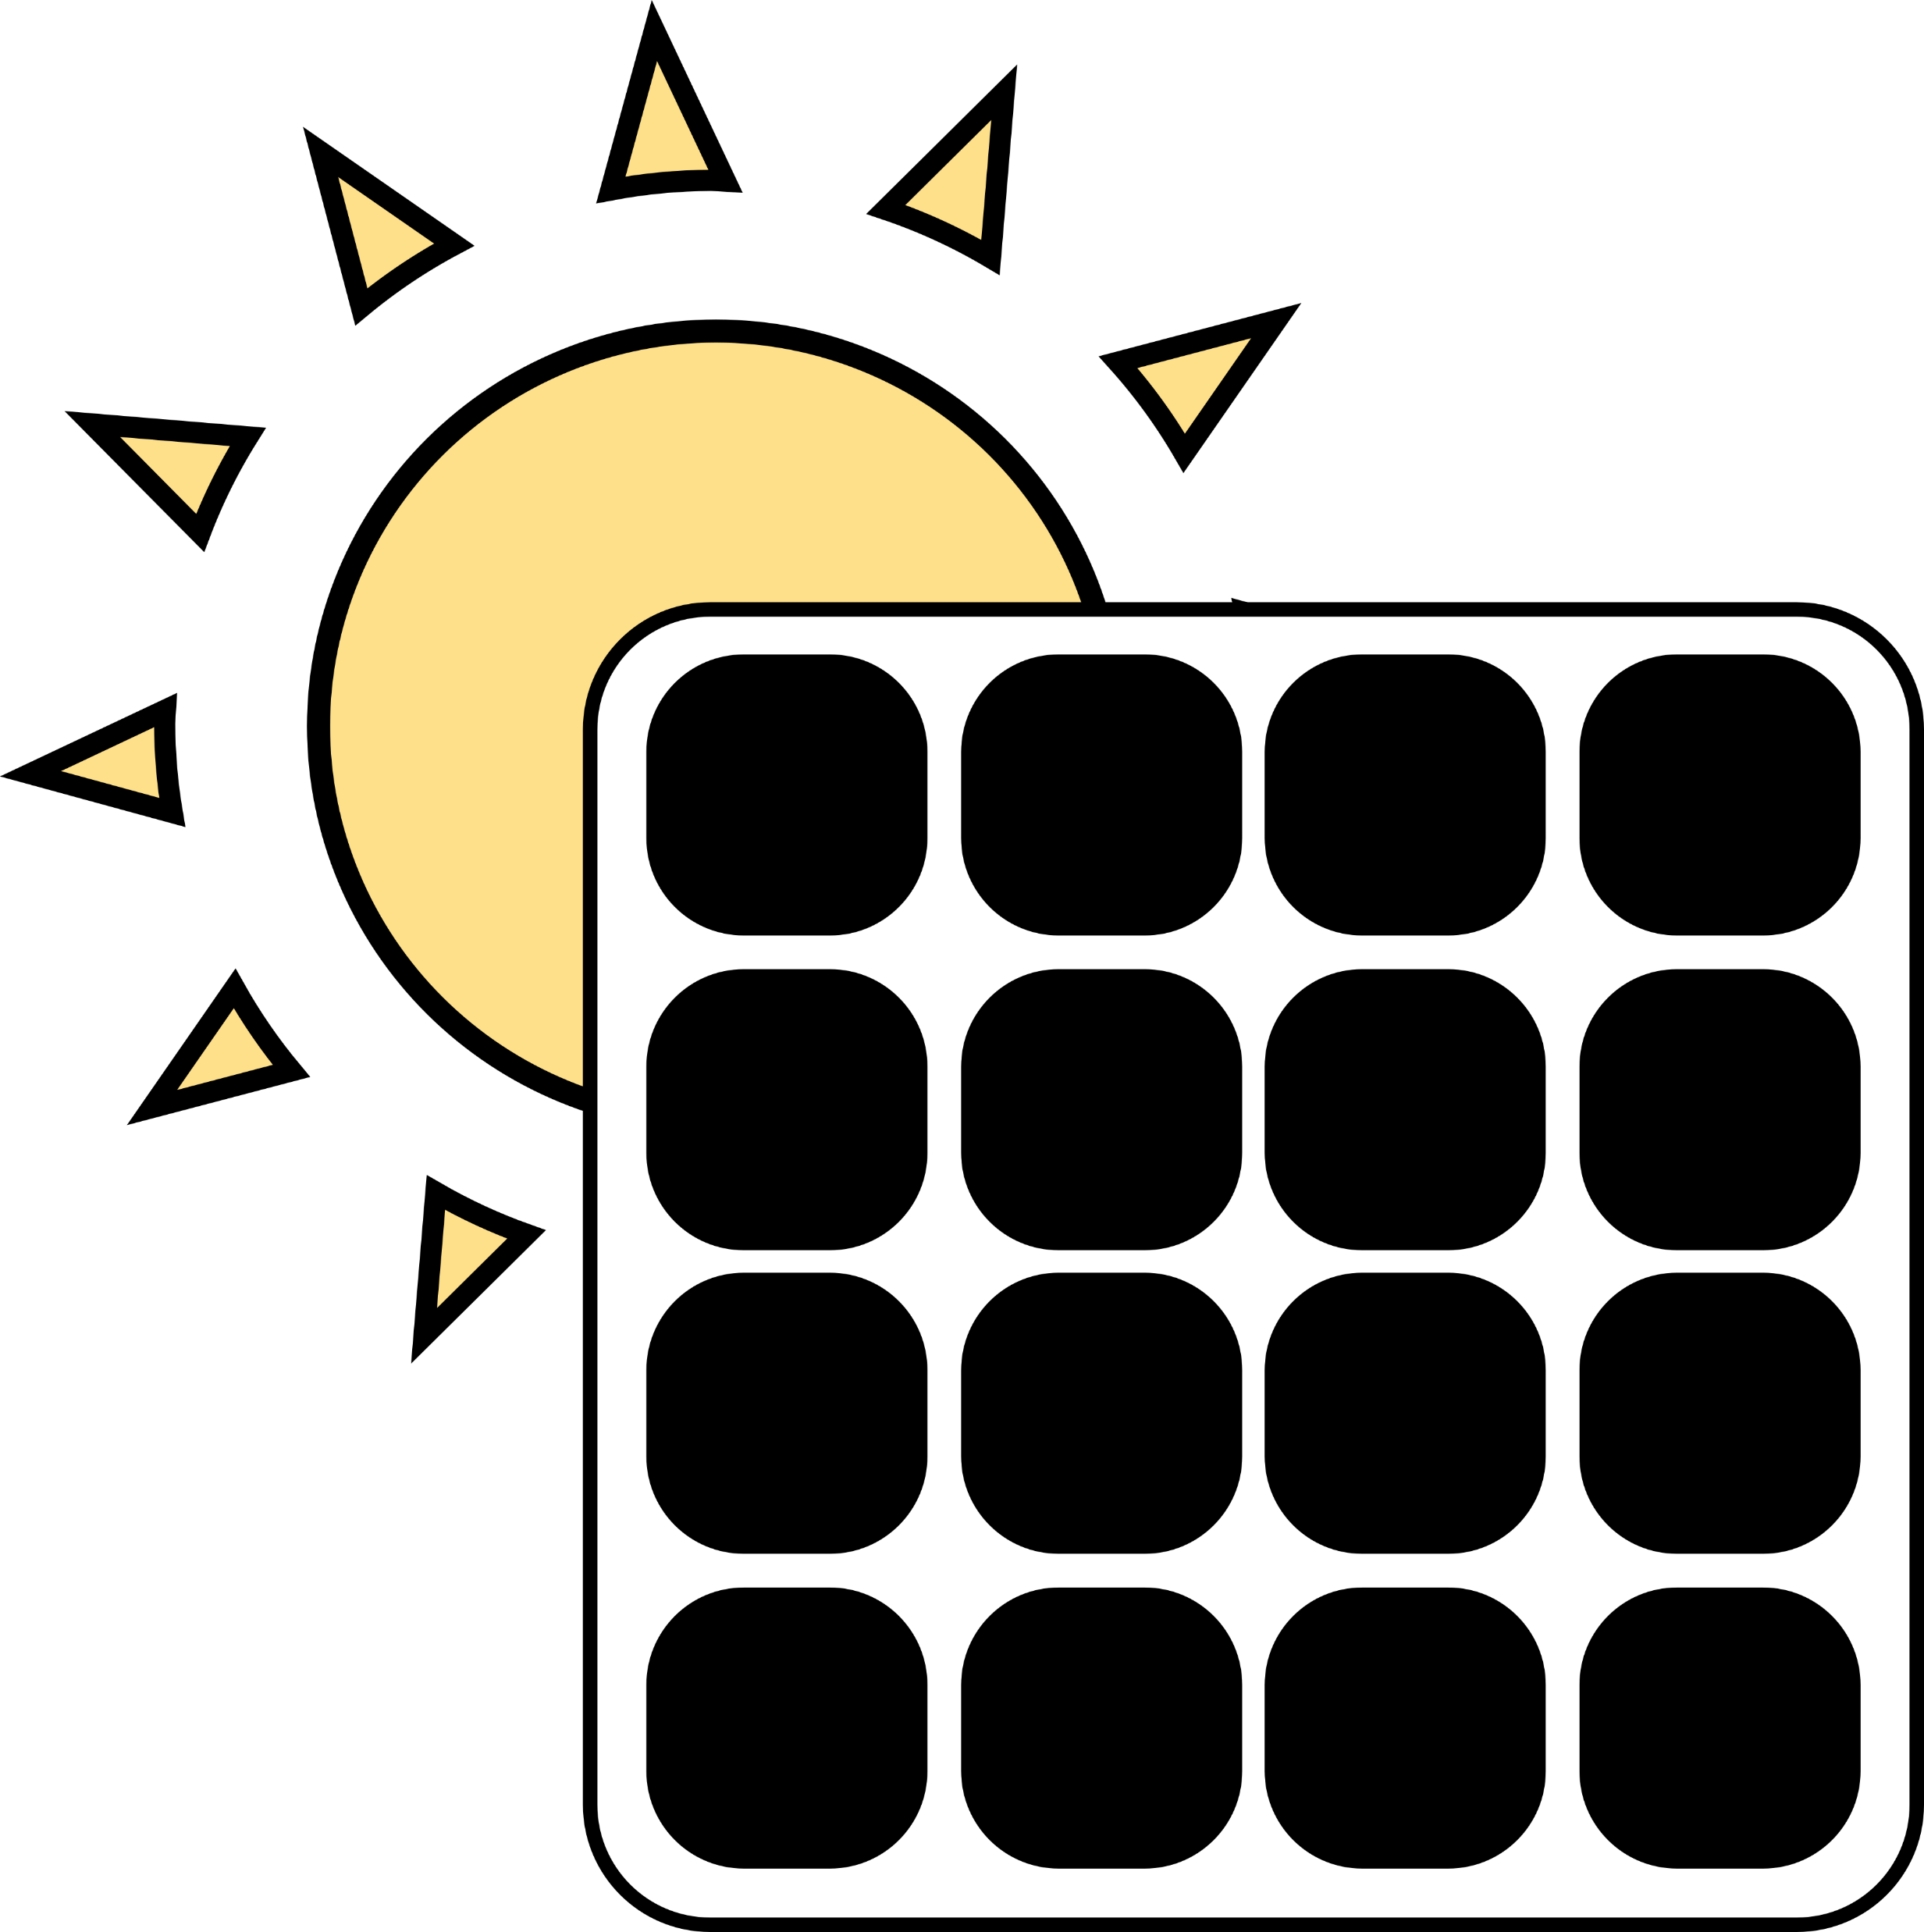

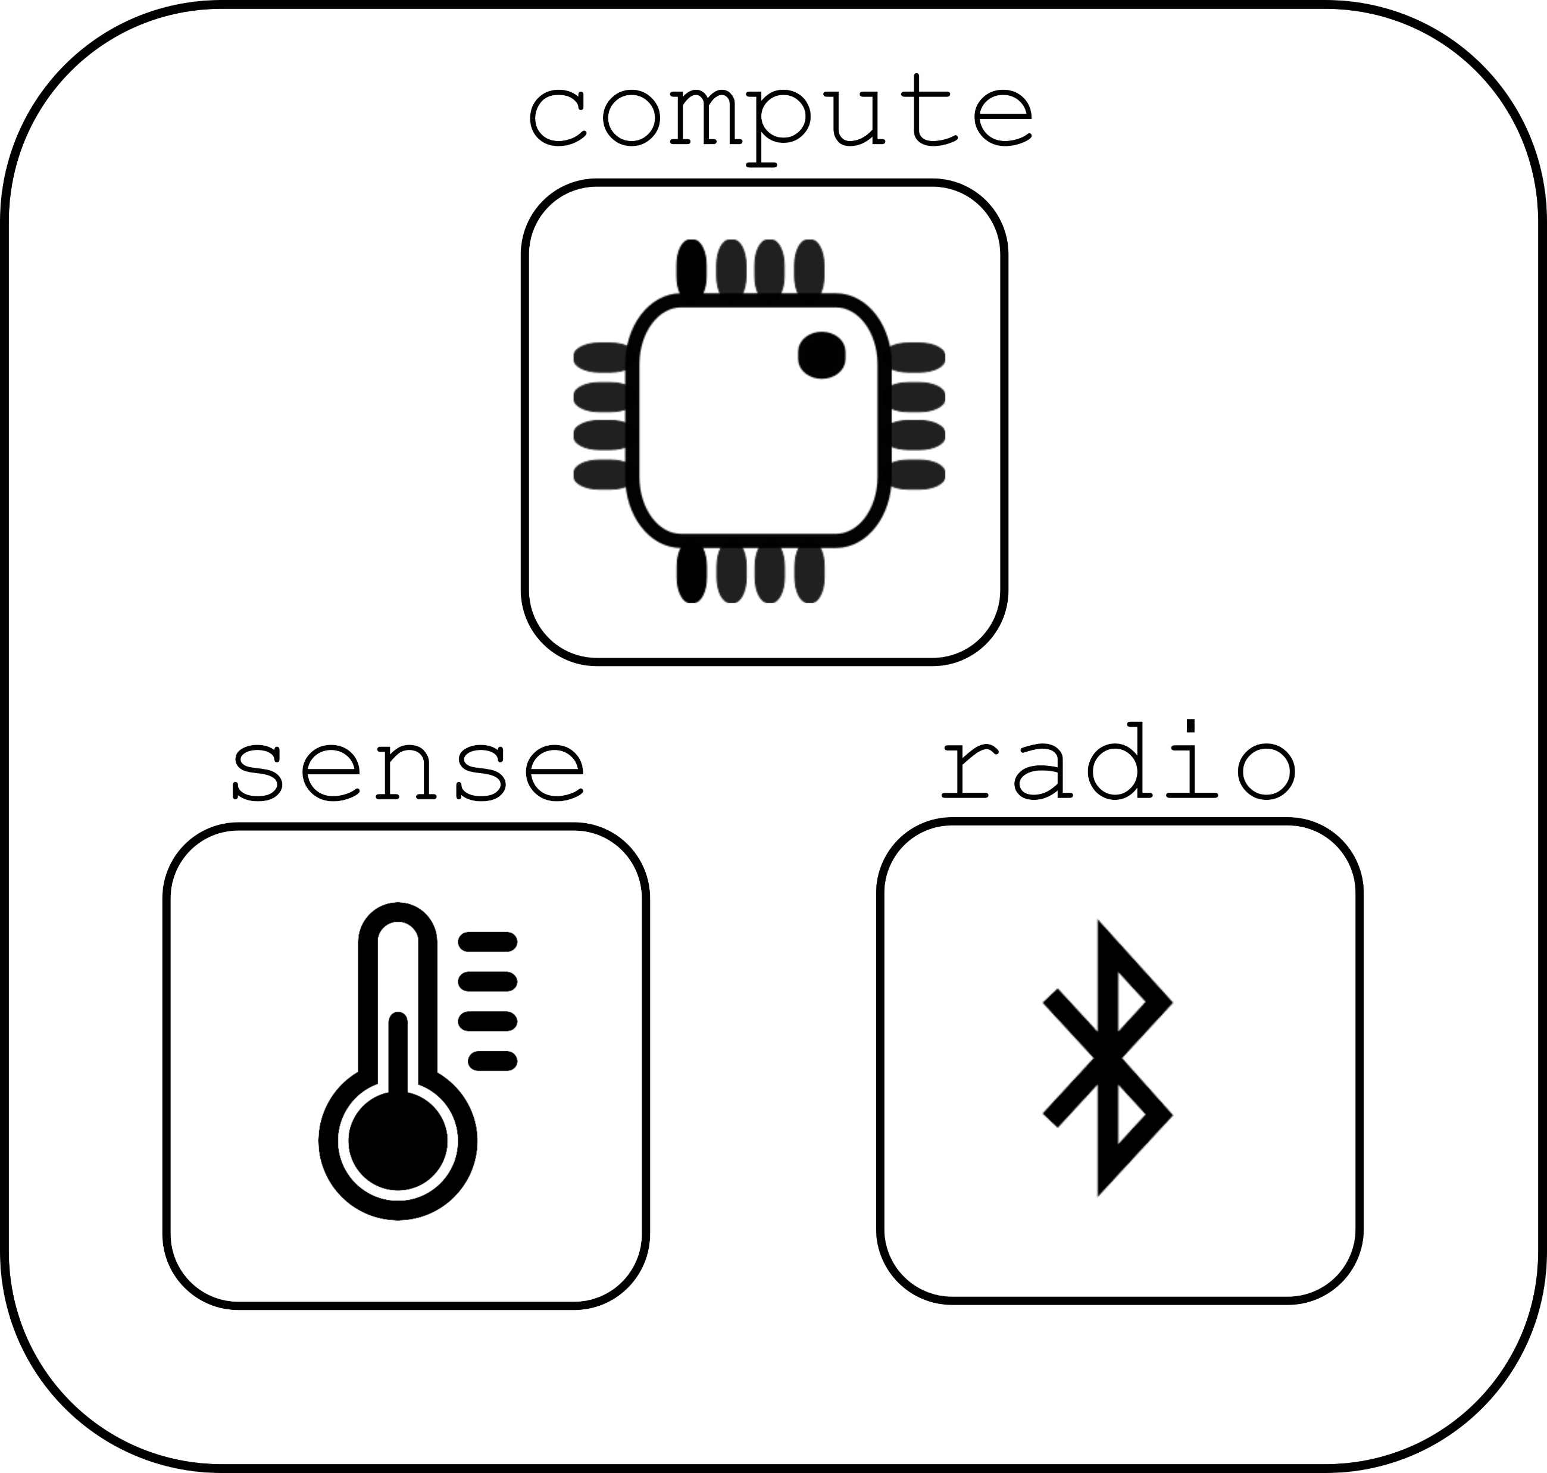

Energy harvesting can lead to intermittent computing

Slide 46
Disabling the microcontroller
Even 2 μA sleep current might be too much for energy harvesting
  Can turn off microcontroller periodically
  Enable it again once VCC returns
Problem: how do you write software to deal with intermittency?
  Run-to-completion with relatively quick code
    Initialize, sample sensor, send packet, turn off again
  Code checkpointing
    Save state from code and restore when power resumes
    Might be as little as which state the system is in, plus some samples
    Might be as much as saving entire stack state
    Needs low-energy, nonvolatile storage (FRAM or MRAM help!)

Slide 47
Programs may not finish
int process() {
count++;
buf[count] = accel();
avg = sum(buf)/count;
transmit(avg);
}
count++
buf[count] = accel()
Power fail
Execution Time
Notes:
More detailed explanation WHY volatile/non-volatile etc. Perhaps split to two slides
Add callout saying we need latch, etc.
Make capy bigger

Slide 48
Programs may not finish
int process() {
count++;
buf[count] = accel();
avg = sum(buf)/count;
transmit(avg);
}
count++
buf[count] = accel()
Power fail
Execution Time
count++;
buf[count] = accel()
Power fail
.
.
.
Notes:
More detailed explanation WHY volatile/non-volatile etc. Perhaps split to two slides
Add callout saying we need latch, etc.

Slide 49
Programs may not finish
int process() {
count++;
buf[count] = accel();
avg = sum(buf)/count;
transmit(avg);
}
count++
buf[count] = accel()
Power fail
Execution Time
count++;
buf[count] = accel()
Power fail
.
.
.
Need to latch execution state periodically!
Notes:
More detailed explanation WHY volatile/non-volatile etc. Perhaps split to two slides
Add callout saying we need latch, etc.

Slide 50
Checkpointing enables progress
int process() {
count++;
buf[count] = accel();
avg = sum(buf)/count;
transmit(avg);
}
Execute with checkpoints
count++
buf[count] = accel()
count++
buf[count] = accel()
Checkpoint
Power fail
Power fail
Execution Time
count++;
buf[count] = accel()
Power fail
.
.
.
Need to latch execution state periodically!
Notes:
More detailed explanation WHY volatile/non-volatile etc. Perhaps split to two slides
Add callout saying we need latch, etc.

Slide 51
Checkpointing enables progress
int process() {
count++;
buf[count] = accel();
avg = sum(buf)/count;
transmit(avg);
}
Execute with checkpoints
count++
buf[count] = accel()
count++
buf[count] = accel()
Checkpoint
Power fail
Power fail
Execution Time
count++;
buf[count] = accel()
buf[count] = accel()
avg = sum(buf)/count
transmit-
Power fail
Checkpoint
Power fail
.
.
.
Need to latch execution state periodically!
Notes:
More detailed explanation WHY volatile/non-volatile etc. Perhaps split to two slides
Add callout saying we need latch, etc.

Slide 52
Checkpointing enables progress
int process() {
count++;
buf[count] = accel();
avg = sum(buf)/count;
transmit(avg);
}
Execute with checkpoints
count++
buf[count] = accel()
count++
buf[count] = accel()
Checkpoint
Power fail
Power fail
Execution Time
count++;
buf[count] = accel()
buf[count] = accel()
avg = sum(buf)/count
transmit-
Power fail
Checkpoint
Power fail
.
.
.
Need to latch execution state periodically!
transmit(avg)
Notes:
More detailed explanation WHY volatile/non-volatile etc. Perhaps split to two slides
Add callout saying we need latch, etc.

Slide 53
Checkpointing goals
Have the compiler automatically insert checkpoints as needed
  Human doesn’t have to think about them when programming
Limit checkpointing overhead while maximizing forward progress
  Checkpointing will take time to perform, so want to do it rarely
  Rarer checkpoints mean more progress is lost in average outage
  Need to compromise on the two based on available energy

Slide 54
Outline
Memory in Computing
nRF52 Non-Volatile Memory Controller
Energy Sources
Microbit Energy Use
Intermittent Computing

Slide 55
Outline
Bonus: SD Cards

Slide 56
SD card references
ChaN
  Embedded systems engineer in Japan (and is amazing)
  http://elm-chan.org/docs/mmc/mmc_e.html
  http://elm-chan.org/fsw/ff/00index_e.html
Various others
  http://users.ece.utexas.edu/~gerstl/ee445m_s15/lectures/Lec08.pdf
  http://alumni.cs.ucr.edu/~amitra/sdcard/Additional/sdcard_appnote_foust.pdf
  https://luckyresistor.me/cat-protector/software/sdcard-2/
  http://users.ece.utexas.edu/~valvano/EE345M/SD_Physical_Layer_Spec.pdf
  https://github.com/tock/tock/blob/master/capsules/src/sdcard.rs

Slide 57
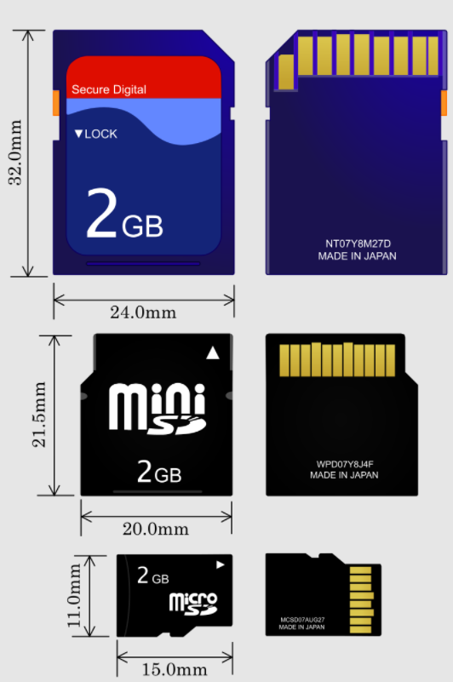
SD cards
“Secure Digital” Card
  Includes various formfactors
  Flash memory
  Capacities from 8 MB to 128 TB
    512 byte blocks
Supports 1-bit SPI interface
  As well as 4-bit SD bus protocol
Easy to support in embedded systems
  Cheap but high power

Slide 58
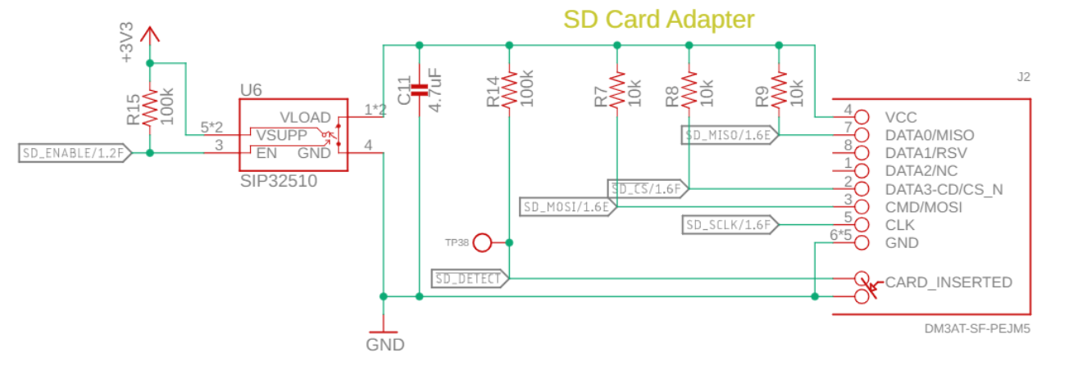
Electrical connections for an SD card
SD Card connections
  SPI SDI, SDO, CS, SCLK
  Plus a switch to enable/disable the SD card and a detect signal

Slide 59
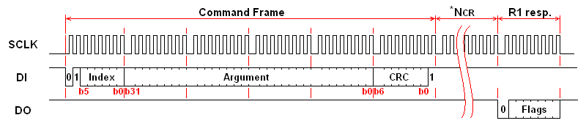
Controlling the SD card
Index: 6-bit value of command being sent
Argument: 32-bit value that may be arguments to commands
CRC: checks for bit errors
Response (after delay)

Slide 60
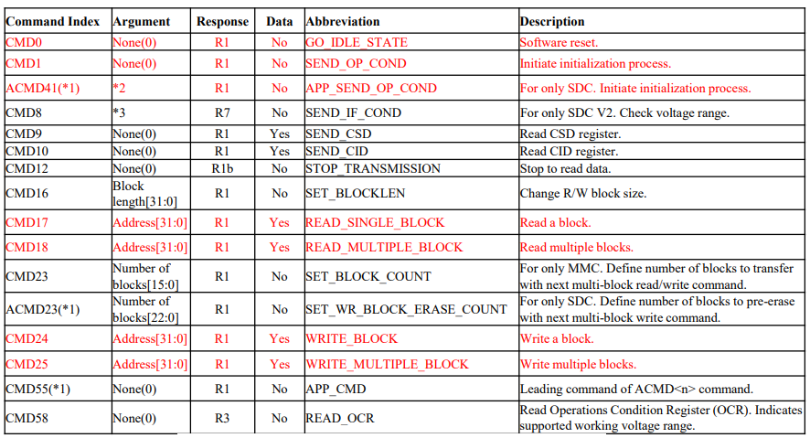
SD card SPI commands

Slide 61
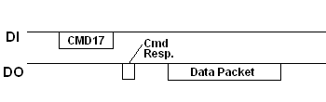
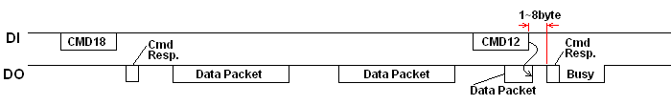
Reading from the SD card
Single block read
Multiple block read (CMD12 – Stop Transmission)

Slide 62
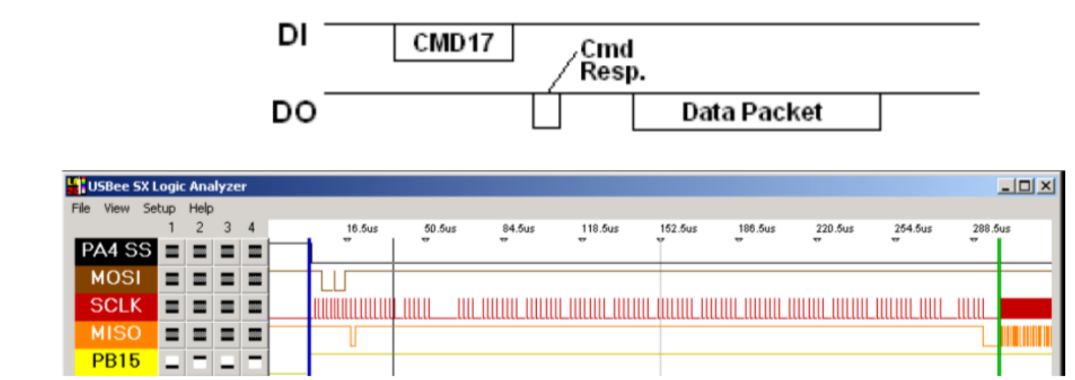
SD card delays can be significant
Performing a single byte read
  Almost 300 μs before the SD card starts sending data
  ~200 μs additional time to send the 512 bytes (20 Mbps data, 8 Mbps total)

Slide 63
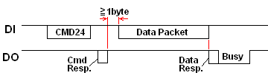
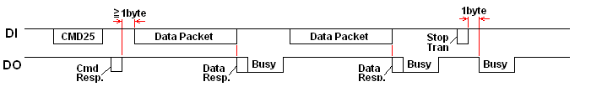
Writing to the SD card
Single block write
Multiple block write

Slide 64
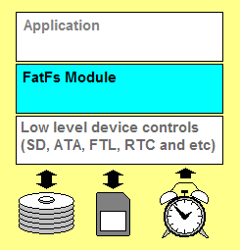
Layering a filesystem on top of an SD card
FatFs library implements the filesystem agnostic of application and storage medium
Enables the use of file system calls:
  Open, Close, Read, Seek
Connects to generic interface for low-level implementation
  disk_status, disk_init, disk_read, disk_write

Slide 65
Outline
Bonus: Task/Event Chaining with PPI

Slide 66
Software stops when the processor does, but peripherals continue
Problem: when the processor is off, no code is running
Solutions
  Peripherals can wake it up again
    Can probably go for milliseconds to minutes without any actions
    Timer interrupt can wake processor to do things
  Have hardware handle some parts in the background without the processor’s involvement
    DMA
    PPI

Slide 67
Controlling peripherals while processor sleeps
DMA (Direct Memory Access)
  Set up a pointer to memory and a length
  Peripheral can load/store memory without processor’s involvement
  Usually use completion interrupt to wake processor
PPI (Programmable Peripheral Interconnect)
  Any Event can be tied to any Task within the nRF52
  Allows for complicated actions to be chained together

Slide 68
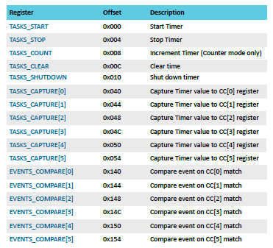
nRF52 Tasks and Events
Example: Timer peripheral
Tasks are used to perform some operation
  Often written to by software
Events change value when some change in status occurs
  Often used to trigger interrupts
PPI peripheral can connect any TASK to any EVENT

Slide 69
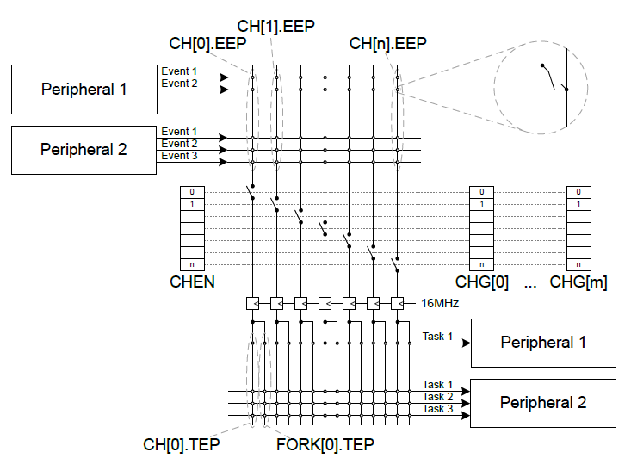
nRF52 PPI peripheral
Connects Events to Tasks via hardware
Each channel gets one Event pointer and up to two Task pointers
  Must point to Event/Task registers

Slide 70
Example PPI use case
Automatic high-speed ADC sampling
Software configures and sleeps
  ADC (buffer and enable)
  Timer (prescaler, compare value, short from compare to clear, and start)
PPI: When Timer fires (EVENTS_COMPARE[0]),
  Sample ADC (TASKS_SAMPLE)
PPI: When ADC buffer full (EVENTS_END),
  Stop Timer (TASKS_STOP)
  Fork: wake processor (via software interrupt from EGU)

