Slide 1
Lecture 16
Wrapup + Microprocessors
CE346 – Microprocessor System Design
Branden Ghena – Fall 2022
Some slides borrowed from:
Josiah Hester (Northwestern), Prabal Dutta (UC Berkeley)

Slide 2
Administrivia
Bonus office hours on Friday
  Friday 10-12 and 1-3pm in CG50
Tuesday and Thursday after Thanksgiving will be office hours too
  Likely in my office: Mudd 3305

Slide 3
Today’s Goals
Discuss remaining parts of the Microbit and nRF52833
  Realize that we’ve covered almost everything on the system!!
Explore sensing systems research

Slide 4
Outline
What haven’t we talked about?
  Microbit
  nRF52833
Other hardware systems
  Other microcontrollers
  Microprocessors
  FPGAs

Slide 5
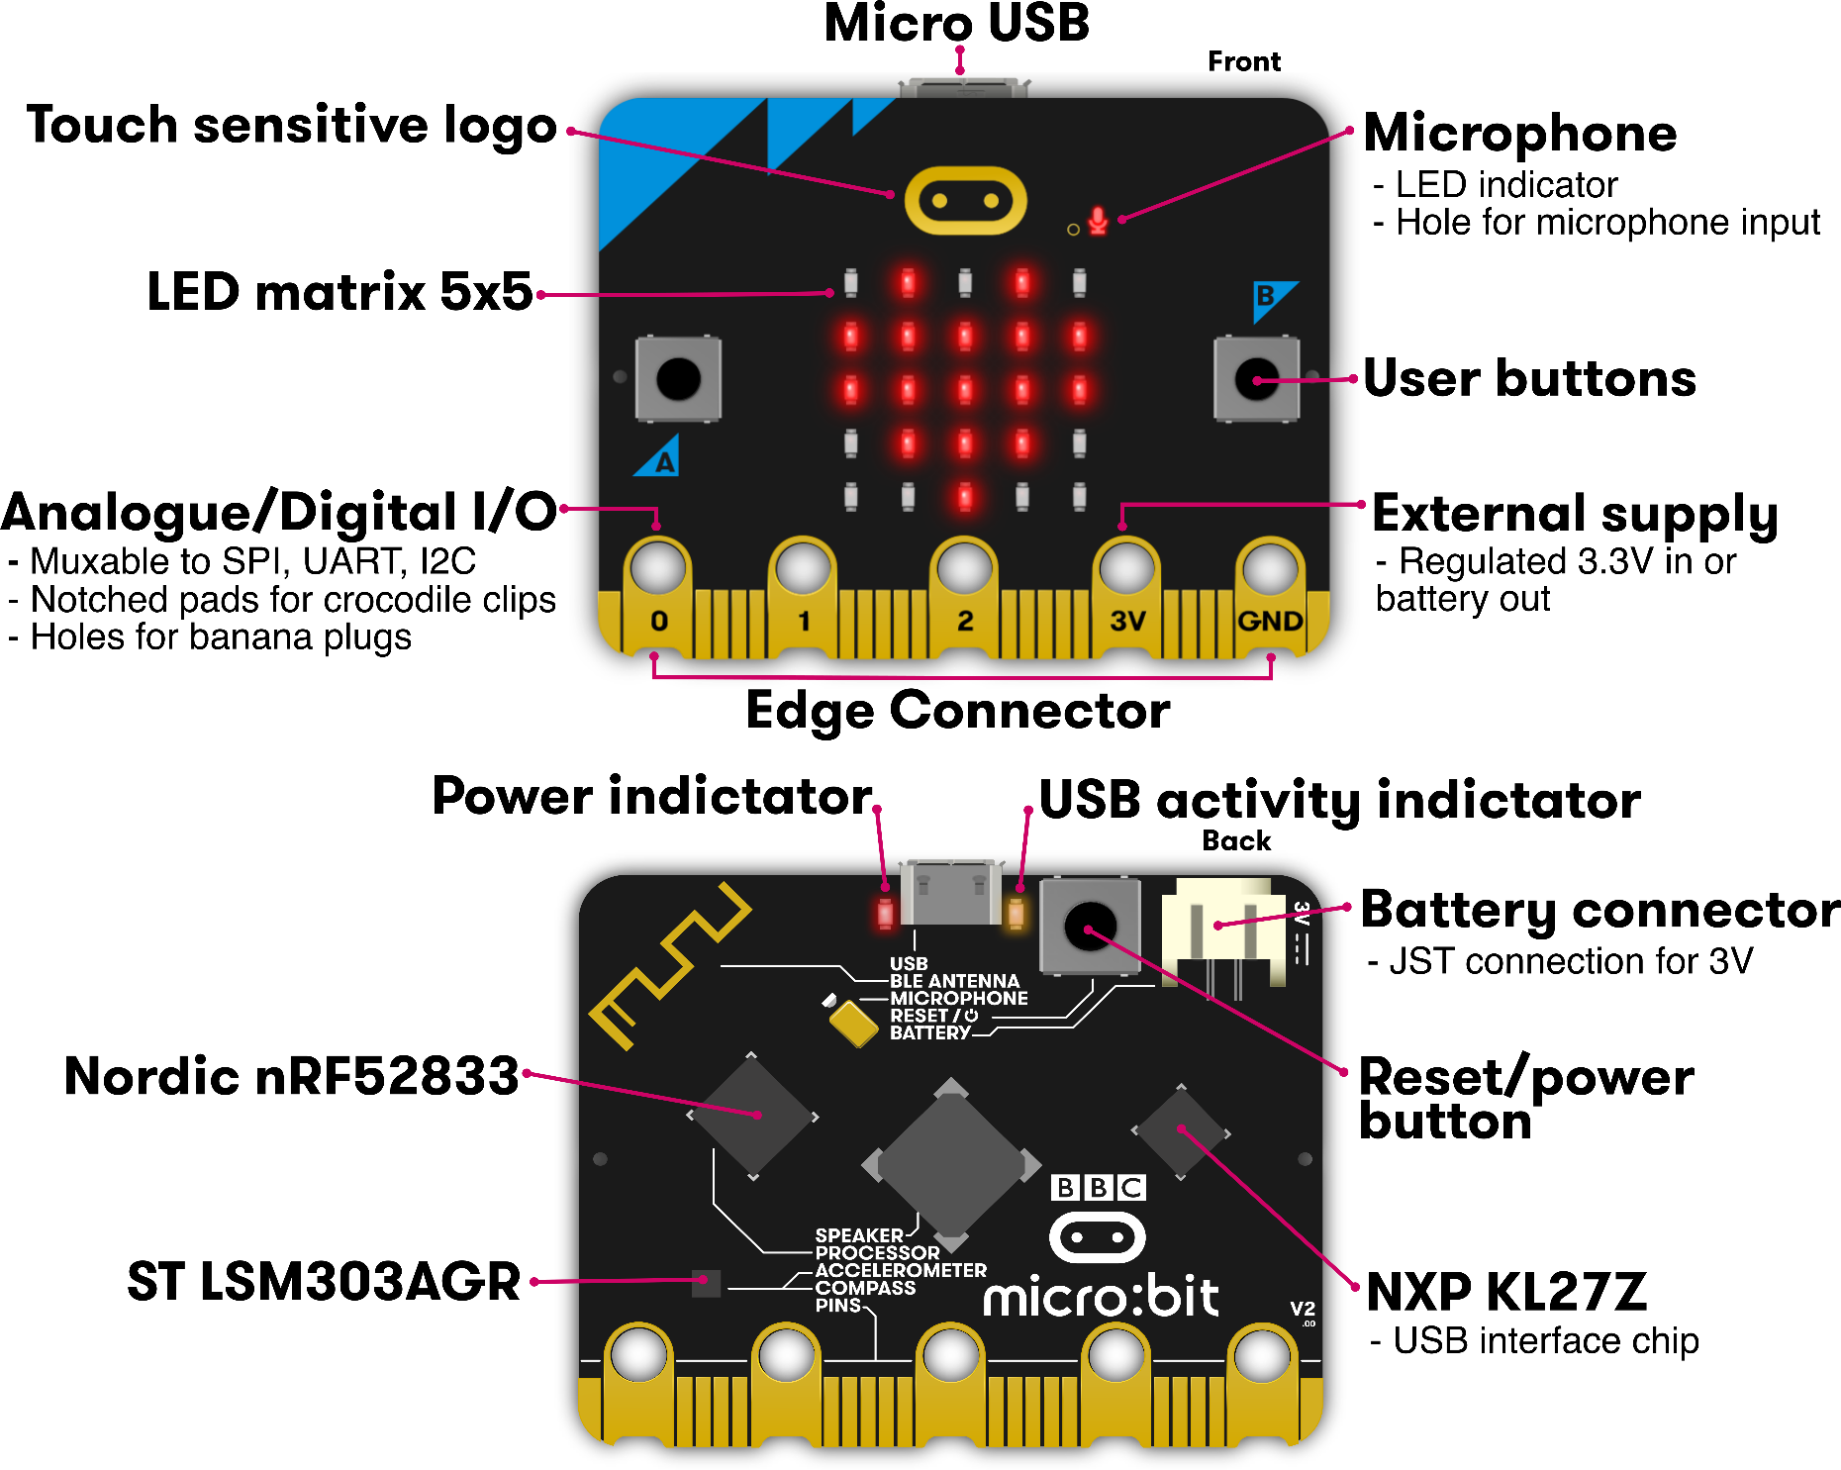
Microbit
Used almost all of this!
Remaining:
  Batteries
  Wireless
  KL27Z I2C

Slide 6
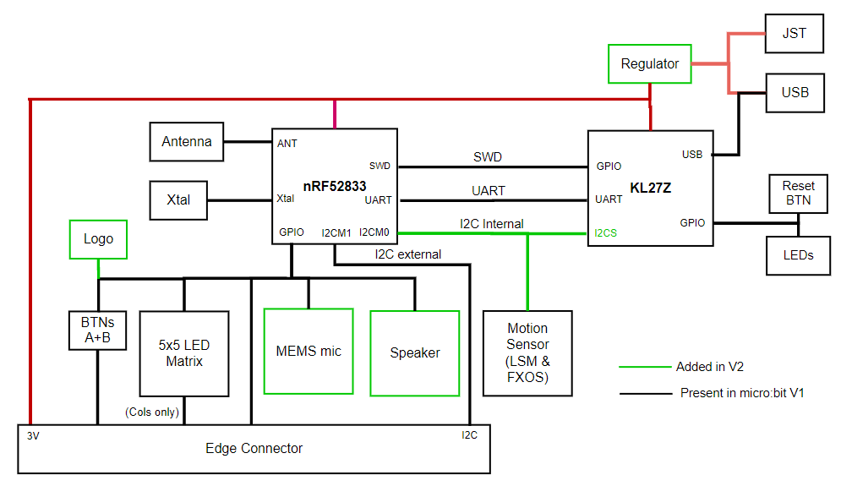
Internal Microbit connections

Slide 7
KL27 I2C Interface
Device information
  Version of board and JTAG firmware
  Power state of board
    USB, Battery, both
    Voltage values for battery and VIN
  USB connection state
  Disable the power LED!!
Flash Storage
  128 kB of the KL27’s Flash is readable/writable over I2C

Slide 8
Outline
What haven’t we talked about?
  Microbit
  nRF52833
Other hardware systems
  Other microcontrollers
  Microprocessors
  FPGAs

Slide 9
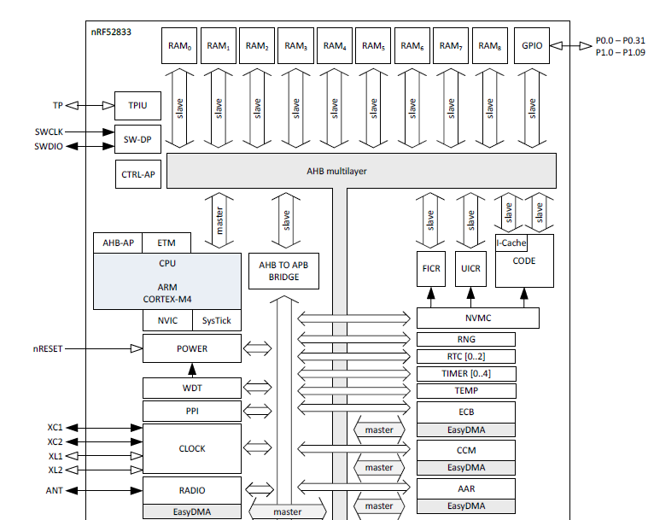
nRF52833 Peripherals
Tour of the nRF52833 peripherals
With some details on the ones we haven’t talked about
  Wireless
  Crypto
  Audio

Slide 10
nRF52833 Peripherals
Cortex-M4F processor
32-bit ARM core
Floating point
Includes Interrupt control and SysTick (an extra timer)

Slide 11
nRF52833 Peripherals
Memory buses

Slide 12
nRF52833 Peripherals
JTAG and Debugging
Allows code updates
Allows GDB to step through code

Slide 13
nRF52833 Peripherals
Volatile memory
SRAM, 128 kB

Slide 14
nRF52833 Peripherals
Nonvolatile memory
Flash, 512 kB
Non-Volatile Memory Controller

Slide 15
nRF52833 Peripherals
Power and Clock management

Slide 16
nRF52833 Peripherals
GPIO pins

Slide 17
nRF52833 Peripherals
Various timers
Watchdog Timer
Real-Time Counter
Timer peripheral

Slide 18
nRF52833 Peripherals
Programmable Peripheral Interconnect
Random Number Generator
Temperature sensor

Slide 19
nRF52833 Peripherals
Wireless radio
  Bluetooth Low Energy
  802.15.4
  (Zigbee or Thread)
Cryptography
  ECB (AES mode)
  CCM (AES mode)
  AAR (Accelerated Address Resolver)
    For BLE random addresses

Slide 20
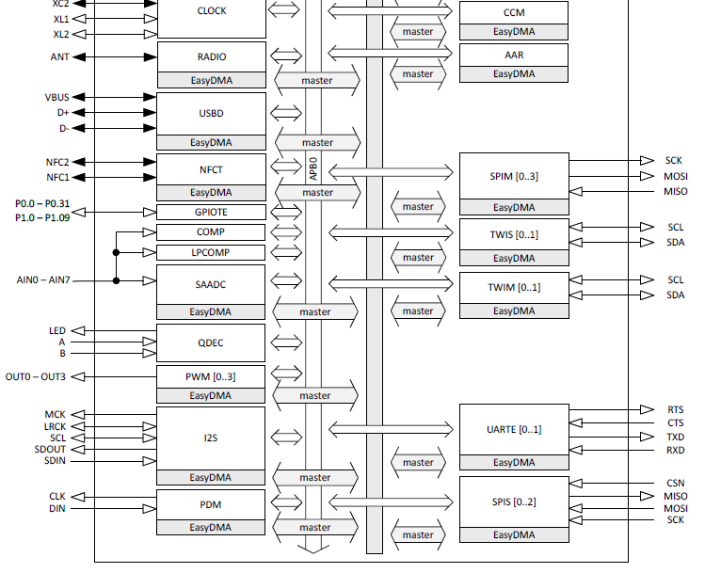
nRF52833 Peripherals
Wired communication protocols
USB Device
SPI
  Controller/Peripheral
TWI (I2C)
  Controller/Peripheral
UART

Slide 21
nRF52833 Peripherals
Inter-IC Sound (I2S)
  Wired communication bus explicitly for audio data
  Unrelated to I2C
Like a synchronous UART
  Clock, data in, data out
Additional signals
  MCK – synchronization
  LRCK – left/right channel select

Slide 22
nRF52833 Peripherals
NFC
  Near-Field Communication
Close-range wireless communication protocol
“Tap-to-pay” systems

Slide 23
nRF52833 Peripherals
GPIOTE
  GPIO interrupts

Slide 24
nRF52833 Peripherals
Analog inputs
Comparator
Low-Power Comparator
Successive Approximation Analog-to-Digital Converter

Slide 25
nRF52833 Peripherals
Quadrature Decoder peripheral
Detects rotation speeds and direction
  Usually for motors

Slide 26
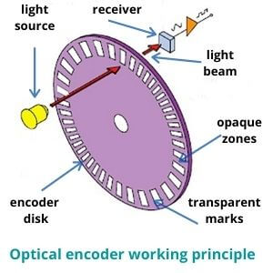
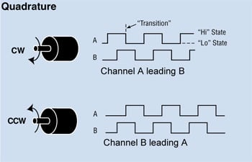
Quadrature Encoding

Slide 27
nRF52833 Peripherals
Pulse Width Modulation
Pulse Density Modulation
  Similar idea to PWM
  Input-only peripheral
  Targets microphones

Slide 28
nRF52833 is complete
That’s just about everything!
First 550 out of 600 pages of nRF52833 datasheet
  Remaining 50 are hardware details
    Pinout for different packages
    Recommended circuit layout
    Soldering details

Slide 29
Break + Open Question
What doesn’t the nRF52833 have a peripheral for?
(i.e., what could you imagine a peripheral for that it doesn’t have)

Slide 30
Outline
What haven’t we talked about?
  Microbit
  nRF52833
Other hardware systems
  Other microcontrollers
  Microprocessors
  FPGAs

Slide 31
Microcontroller knowledge is transferrable
Your knowledge of microcontrollers applies to almost all of them
  They have similar peripherals that work in similar ways
The exact names and configurations will definitely be different
  But the fundamentals stay the same
Let’s prove this with a quick view of two microcontrollers
  Atmel SAM4L
  Texas Instruments MSP430

Slide 32
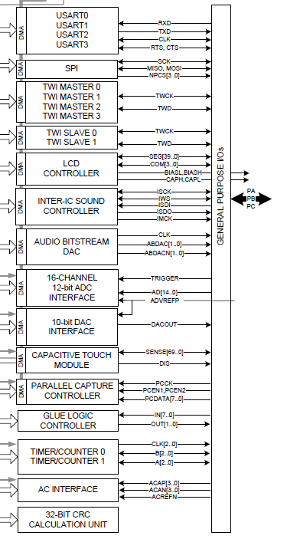
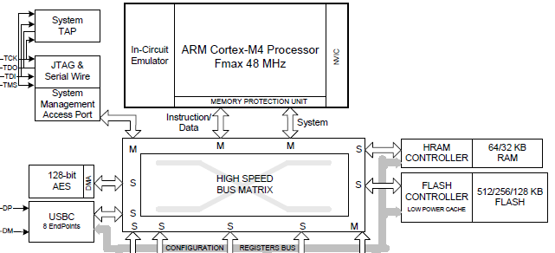
Atmel SAM4L Microcontroller
ARM Cortex M4F (same processor!)
Lots of very configurable peripherals
  USART, SPI, TWI, I2S, DAC, ADC, Timer, …
  Kind of a “do-everything” microcontroller

Slide 33
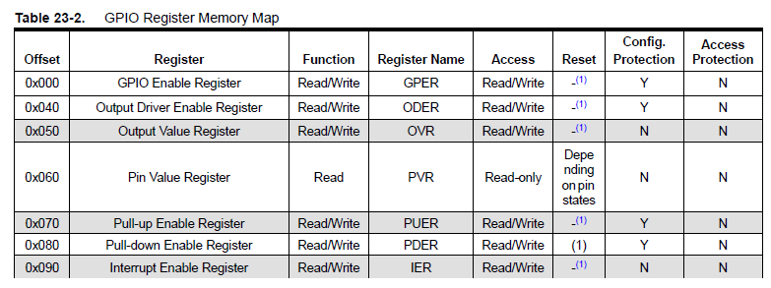
SAM4L GPIO
GPIO register map (heavily abbreviated)

Slide 34
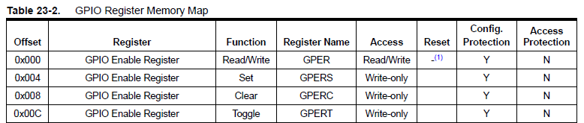
Setting or clearing individual bits
Actually, each register appears four times in a row
  Read/write version
  Set version
  Clear version
  Toggle version

Slide 35
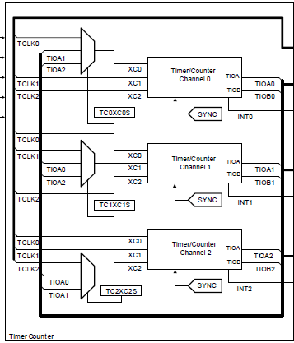

SAM4L Timers
Three 16-bit timers
  Each of which can have multiple inputs clock signals with prescaler values
  Timers can be chained together to make up to a 48-bit timer
One register for reading counter
Three registers for “compare interrupts”

Slide 36
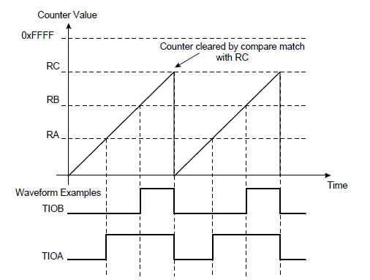
SAM4L PWM
PWM peripheral is essentially built into Timer peripheral
Timer peripheral also supports a “Waveform” mode where it generates an output GPIO signal
One comparison point is low-to-high transition, another is high-to-low transition

Slide 37
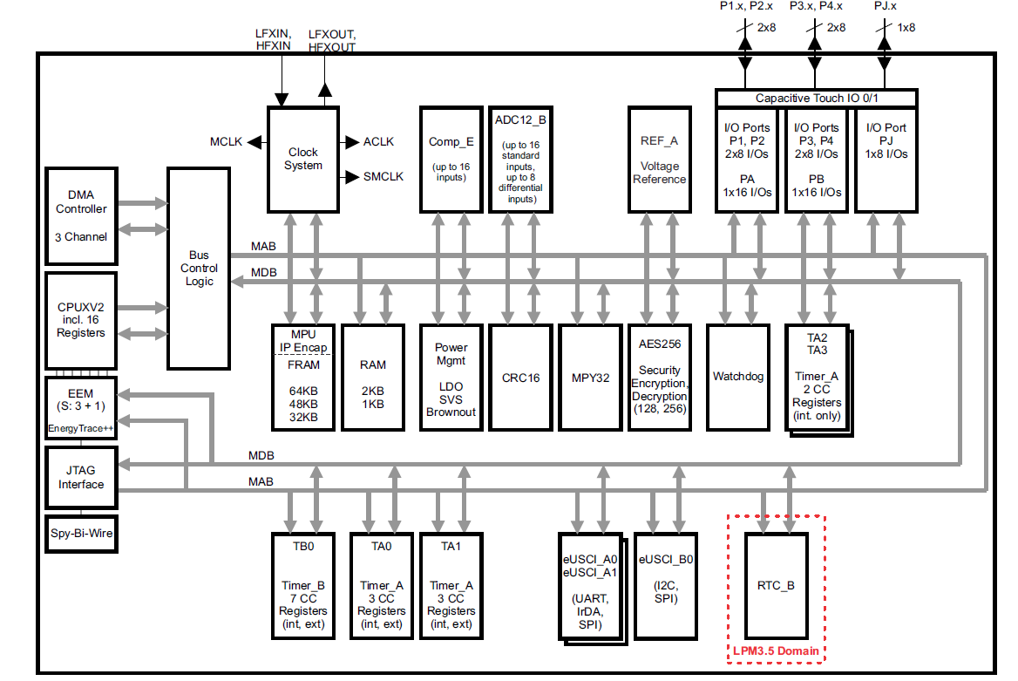
Texas Instruments MSP430 (MSP430FR59xx)
Example of a
very different
microcontroller
16-bit custom
architecture
processor
2 kB RAM
64 kB FRAM

Slide 38
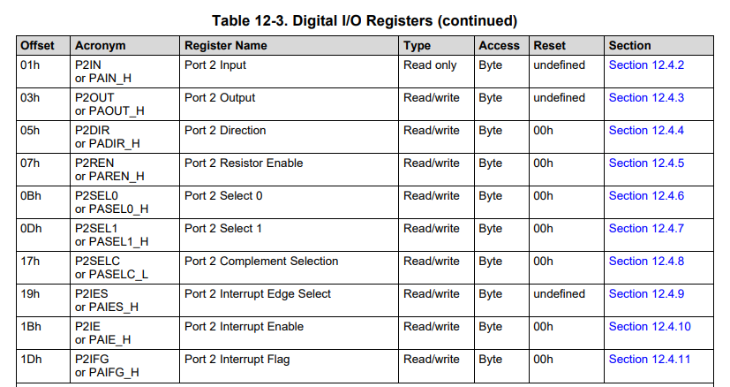
MSP430 GPIO register map
Registers are a single byte in size
Oddly, some have an “undefined” reset state

Slide 39
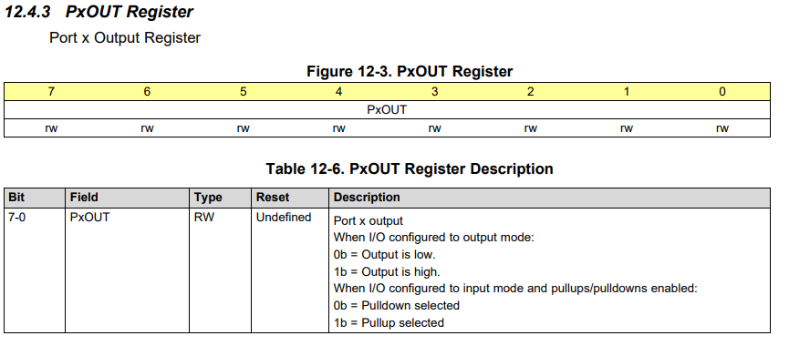
Example MSP430 GPIO register: OUT
Example 8-bit register. Controls 8 pins in a GPIO “port”

Slide 40
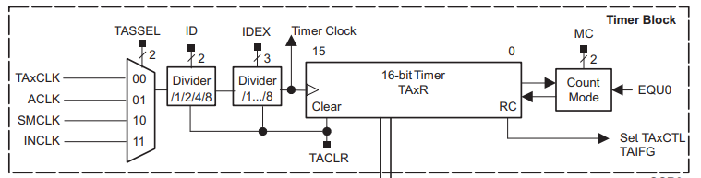
MSP430 Timer peripheral
A choice of input clocks goes through dividers to run a 16-bit timer
  Five total timers available on the system
  Some can trigger external output pins, some are only internal

Slide 41
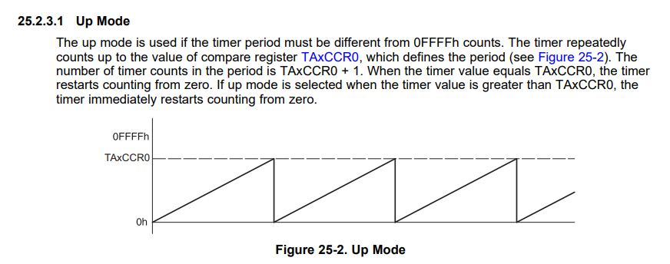
MSP430 PWM
The MSP430 Timer peripheral handles PWM as well!

Slide 42
Outline
What haven’t we talked about?
  Microbit
  nRF52833
Other hardware systems
  Other microcontrollers
  Microprocessors
  FPGAs

Slide 43
Microprocessor system design
What about microprocessors?
  Similar idea, but a LOT more stuff
Various peripherals, which might not be focused on sensor I/O
  Less ADCs and I2C more Ethernet and Graphics
External memory busses
  Microprocessors expect external memory to exist on the system
  Which means that they need pins for an external memory bus

Slide 44
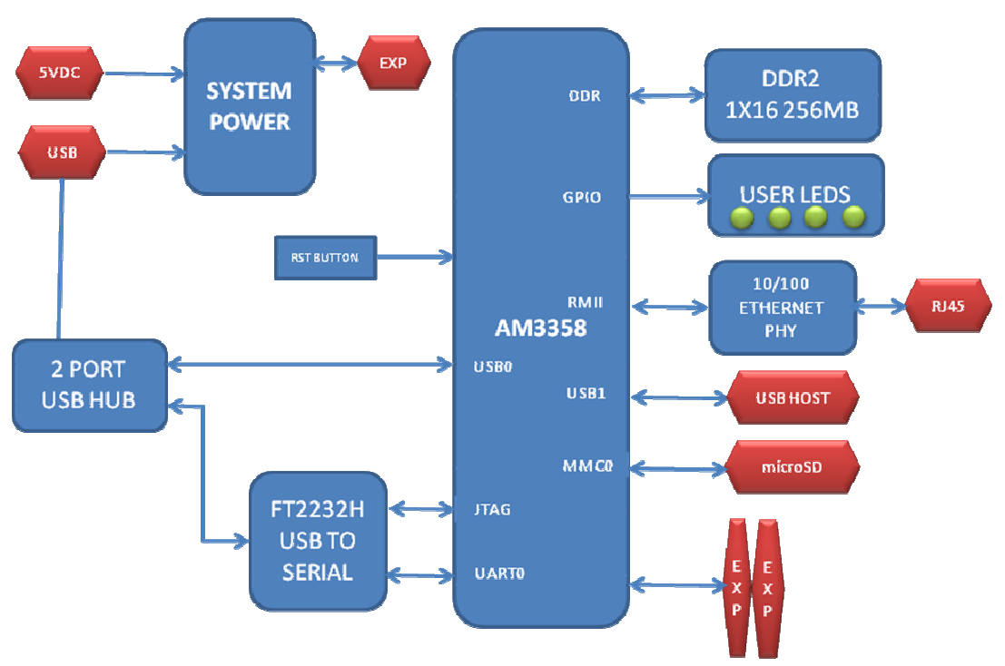
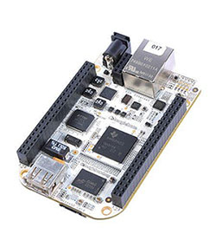
Beaglebone
Cheap, single board
computer
  Like Raspbery Pi

Slide 45
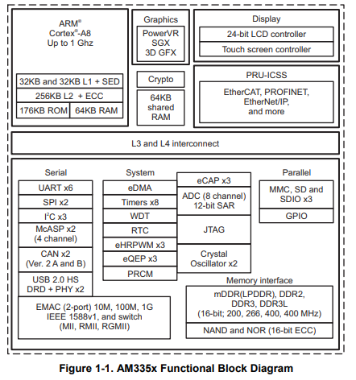
AM3358 processor
ARM Cortex A8
  32-bit processor
  1 GHz clock
  300 pins!!
Internal memory
  176 kB ROM
  64 kB RAM
External memory
  DDR2/3, 400 MHz RAM
  NAND or NOR Flash

Slide 46
AM3358 peripherals
Advanced peripherals
  Graphics
  Ethernet
  USB, CAN
Regular peripherals
  GPIO, Timers
  ADC
  UART, SPI, I2C

Slide 47
How much bigger is a microprocessor?
nRF52833 datasheet:
  600 pages total
AM3358 datasheet:
  250 pages of electrical information
  5000 pages of peripheral information
  And it’s not that the basic peripherals are much larger
    UART: 60 pages
    I2C: 20 pages
    Four different timers at ~30 pages each

Slide 48
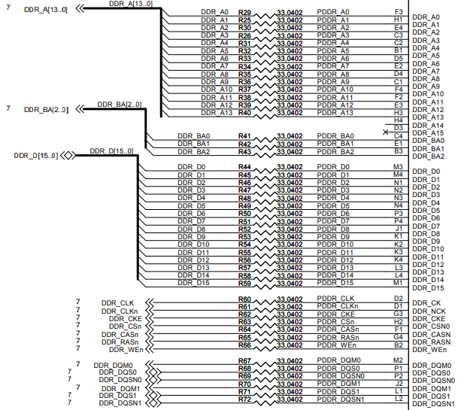
Memory interface - DDR
Pinout on the Beaglebone
Double Data Rate (DDR)
Address bits
  17 pins (3 bank, 14 address)
  Bank + Address selects a 2 kB chunk out of 2 GB
Data bits
  16 pins
Clocks, Chip select
Various sequencing signals

Slide 49
Break + Question
Wires (traces) for high-speed busses like memory
must be match, to ensure that all are exactly the same length.
Why?

Slide 50
Break + Question
Wires (traces) for high-speed busses like memory
must be match, to ensure that all are exactly the same length.
Why?
Speed of electricity in the wires matters
If one wire is a foot longer than the others, its signal arrives 1 ns late
  Even fractions of nanoseconds could matter for high-speed communication

Slide 51
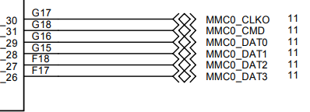
Flash interface - MMC
Multi-media Card interface
  Used to communicate with SD Cards
  Also for eMMC Flash chips (which act like SD Cards, but soldered in place)
For SD cards SPI can usually be used
For eMMC 4-bit version of interface
  Clock
  Command
  Data 0, 1, 2, 3
Pinout on the Beaglebone

Slide 52
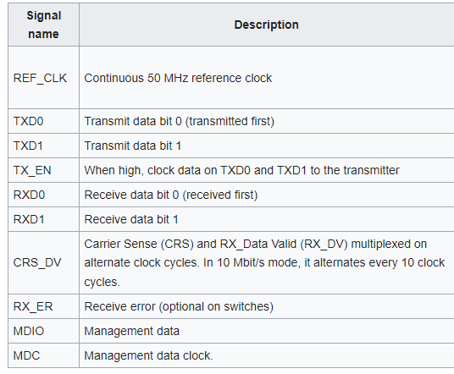
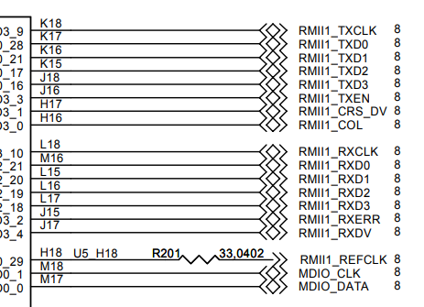
Ethernet interface - RMII
Reduced Media-Independent Interface (RMII)
Pinout on the Beaglebone

Slide 53
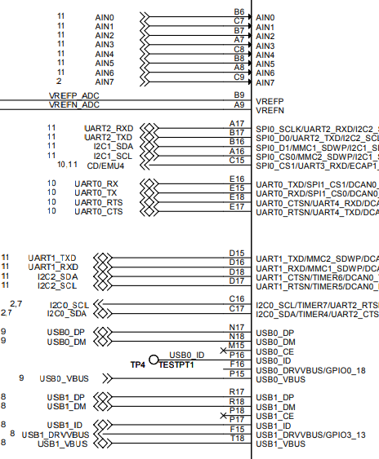
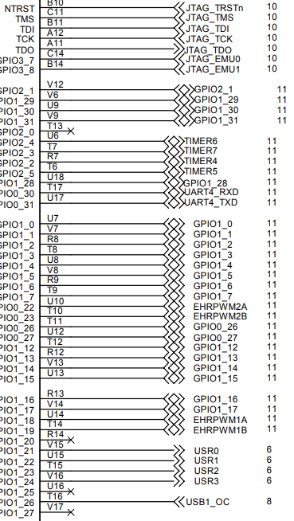
Other processor pinouts on the Beaglebone
Lots of acronyms that we recognize!
Analog inputs
UARTs
I2C
GPIOs
Timers

Slide 54
Resources on the Beaglebone and its microprocessor
https://beagleboard.org/bone-original
https://beagleboard.org/static/beaglebone/BEAGLEBONE_SCHEM_A3.pdf
https://transistor-man.com/files/emu/beaglebone_hardware/BONE_SRM.pdf
https://www.ti.com/product/AM3358

Slide 55
Outline
What haven’t we talked about?
  Microbit
  nRF52833
Other hardware systems
  Other microcontrollers
  Microprocessors
  FPGAs

Slide 56
FPGA systems
When else might you run into large busses like memory?
On an FPGA!
  Field-Programmable Gate Array (FPGA)
  Configurable hardware
    Engineers write a description of the hardware (Verilog or VHDL)
    FPGA implements that hardware
  Much faster than software, but still slower than a custom chip

Slide 57
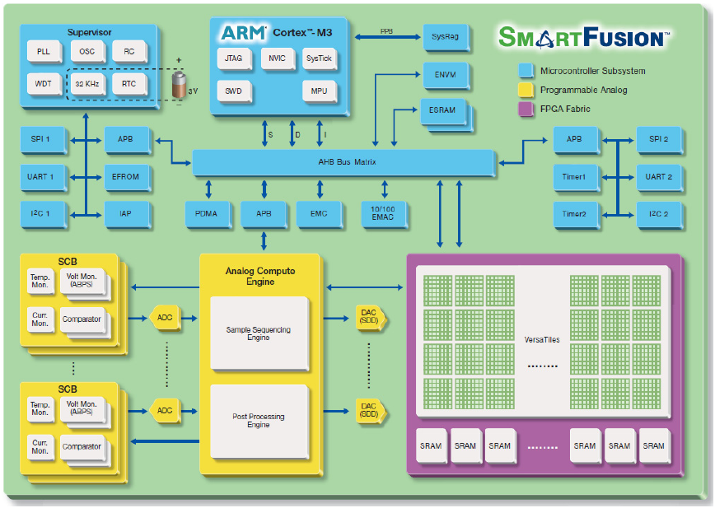
Combined
FPGA + Microcontroller

Slide 58
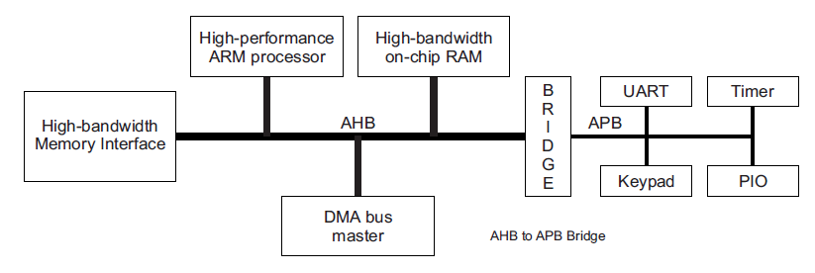
Busses: AHB vs APB
Advanced Peripheral Bus (APB)
  Simpler interface
  Lower power
  Used for most peripheral communication
Advanced High-performance Bus (AHB)
  Multiple bus controllers
  Pipelined operation
  Burst transfers of data
  Used for high-speed memory operations

Slide 59
APB usage
Bus has three states
  IDLE
    Nothing is happening
    Default
  SETUP
    A transfer of data is about to happen
    Address and configuration signals are set
  ACCESS
    Data is actually transferred over the bus

Slide 60
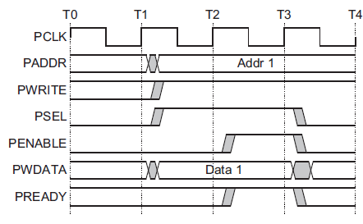
Example APB write operation
Setup phase begins
with this rising edge
Setup
Phase
Access
Phase

Slide 61
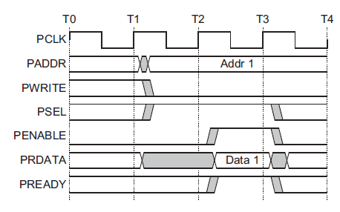
Example APB read operation
Setup phase begins
with this rising edge
Setup
Phase
Access
Phase

Slide 62
With an FPGA you can create your own peripherals
Busses can be exposed to the FPGA for it to use
Example use case
  Custom camera with selectable pixel lines and an ADC
  Don’t want to manually control it with software (too slow)
  Create a hardware peripheral on the FPGA that takes software commands like “grab a frame” and implements them

Slide 63
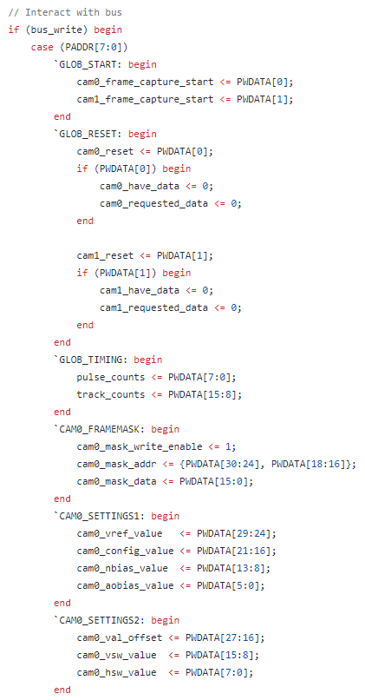
Example register map
Verilog HDL that describes a register map
Reads in the address from the bus to determine which register is written to
Modifies internal registers based on the bits of the data

Slide 64
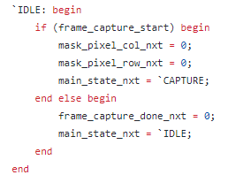
Performing peripheral operations
On every clock edge, check status registers
If they are active, iterate through a state machine
  Possibly many states to make the actual operation occur

Slide 65
Outline
What haven’t we talked about?
  Microbit
  nRF52833
Other hardware systems
  Other microcontrollers
  Microprocessors
  FPGAs

