Slide 1
Lecture 11
Wired Communication:
UART
CE346 – Microprocessor System Design
Branden Ghena – Fall 2022
Some slides borrowed from:
Josiah Hester (Northwestern), Prabal Dutta (UC Berkeley), Alanson Sample (Michigan)

Slide 2
Today’s Goals
Explore tradeoffs in wired communication
  Signals, Speed, Timing, Topology
Describe wired serial communication protocol: UART
Discuss nRF52 implementation of UART

Slide 3
Outline
Wired Communication
UART
nRF52 UARTE

Slide 4
Purpose of communication
Goal: convey digital information between two devices
Simple solution
  Digital I/O pin – 1-bit of information
Complex solution
  Send multiple bits (arbitrarily many)
  While also minimizing
    Time, Energy, Pins, Errors, etc.

Slide 5
Wired versus wireless communication
Wired
  Send digital signals across one or more wires
  Advantages: Reliable, Low energy, Often simpler topology
  Disadvantages: Physically limiting
Wireless
  Send digital signals across another medium (usually RF)
  Advantages: Physically flexible,
  Disadvantages: Unreliable, High energy, Usually broadcast

Slide 6
Wired versus wireless communication
Wired
  Send digital signals across one or more wires
  Advantages: Reliable, Low energy, Often simpler topology
  Disadvantages: Physically limiting
  This week + next two lectures: UART, I2C, SPI, USB
Wireless
  Send digital signals across another medium (usually RF)
  Advantages: Physically flexible,
  Disadvantages: Unreliable, High energy, Usually broadcast
  Next week: Wireless Communication

Slide 7
Tradeoffs in Wired Communication
Number of signals
Communication speed
Controlling timing
Network topology
Let’s talk about each of these in the coming slides

Slide 8
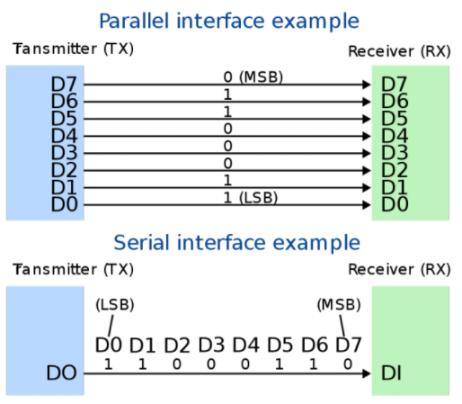
Tradeoff: number of signals
Serial interface
  Single wire
  Transmit data as a “series” of bits separated by time
Parallel interface
  Multiple wires
    How many depends on the system
  Transmit data across multiple “parallel” wires simultaneously
  Still separate by time for more data than wires
Transmitter
Transmitter

Slide 9
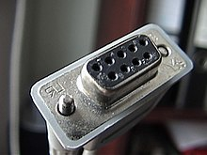
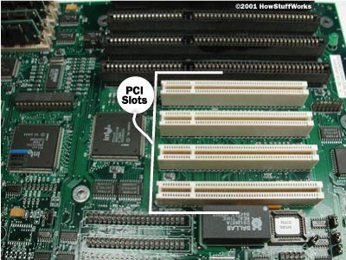
Serial versus parallel
Serial
  Cheaper to use less wires
  Slower to transmit data
  Examples
    RS-232, UART, I2C, USB (2.0)
Parallel
  More expensive for more pins and wires
  Faster to transmit data
  Examples
    Internal buses, PCI, USB (3.0)

Slide 10
Tradeoffs in Wired Communication
Number of signals
  Parallel versus Serial
Communication speed
Controlling timing
Network topology

Slide 11
Tradeoff: communication speed
Inherently limited by the speed of light
  Speed of electricity 50-99% of that
  29 cm (11.4 in) = 1 nanosecond
    Totally relevant for Gbps speeds within computers
Also limited by interference
  Faster signals are harder to distinguish
  More susceptible to interference (matters less for wired comms)
Limited by whether other device can keep up
  Might need some flow-control signaling to slow down when not ready

Slide 12
Example communication speed
Note: Speeds are always measured in bit per second
Internal, low-energy communication
  UART, 1-1000 kbps
  I2C, 100-400 kbps
  SPI, 1-100 Mbps
External (mostly serial) communication
  USB, 1-10000 Mbps
  Ethernet, 1-1000 Mbps
  HDMI, 4-48 Gbps
Internal parallel communication
  PCI, 8-32 Gbps
  RAM, 12-25 Gbps

Slide 13
Tradeoffs in Wired Communication
Number of signals
  Parallel versus Serial
Communication speed
  1000 bps to 10000000000 bps
Controlling timing
Network topology

Slide 14
Tradeoff: controlling timing
Synchronous communication
  Clock signal sent along with data
  Data is captured at edge of clock signal (rising or falling)
  Advantage: send signals very fast
  Disadvantage: extra pin and wire
Asynchronous communication
  Agree upon timing in advance and read data at that rate
  Advantage: no need for clock signal
  Disadvantage: clock synchronization
Transmitter
Receiver
b0
b1
b2
b3
b4
b5
b6
b7
DATA
CLK
Transmitter
Receiver
b0
b0
b0
b0
b0
b0
D0
b1
D1
b2
D2
b3
D3
b4
D4
b5
D5
b6
D6
b7
D7
CLK

Slide 15
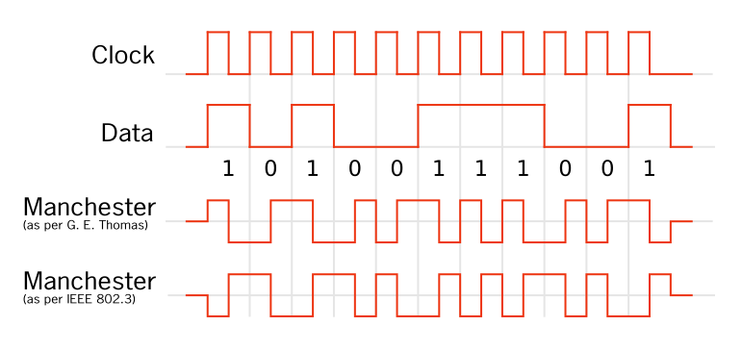
Compromise: combining signals and clocks
There is a method of recovering the clock from the signal
  Either the clock is directly encoded in the signal
  Or the signal will have mandatory high/low changes to synchronize
https://en.wikipedia.org/wiki/Clock_recovery
https://en.wikipedia.org/wiki/Self-clocking_signal

Slide 16
Tradeoffs in Wired Communication
Number of signals
  Parallel versus Serial
Communication speed
  1000 bps to 10000000000 bps
Controlling timing
  Synchronous versus Asynchronous
Network topology

Slide 17

How to connect: point-to-point networks
How do we connect computers in a network?
  This is a question of “network topology”
  Simple option: just connect them directly
Problem: what if I find a third computer?

Slide 18
How to connect: bus networks
Connect everything to one wire in parallel
  Actually a “multidrop bus”
  Scales pretty well to many computers
Problem: which computer gets to transmit when?
  Simultaneous transmissions conflict
  Need a scheme for “arbitration”, deciding who transmits when

Slide 19
How to connect: ring networks
Connect everything with point-to-point connections
  Connect the last computer back to the first computer
  Also known as Daisy-Chain (without the last connection back to the start)
Problem: what if a computer stops sending?

Slide 20

How to connect: star networks
Connect to a hub with point-to-point connections
  Hub connects all computers
  Hub is a simple computer with one job: transfer communications between computers
    Hopefully more reliable than any of the computers

Slide 21
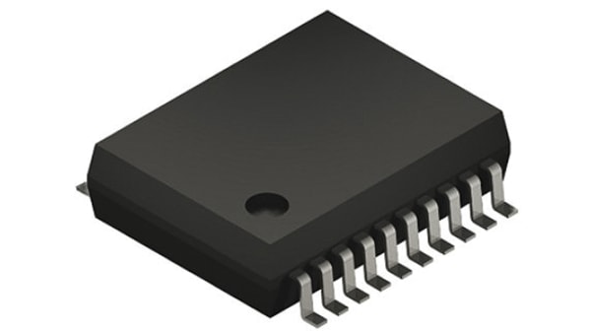
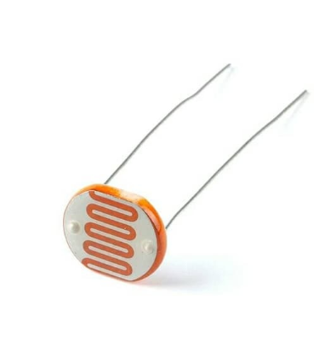
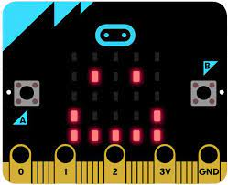
Microcontrollers are often hubs of star networks
Connect to multiple different sensors
Sometimes a few sensors are connected on a bus

Slide 22
Tradeoffs in Wired Communication
Number of signals
  Parallel versus Serial
Communication speed
  1000 bps to 10000000000 bps
Controlling timing
  Synchronous versus Asynchronous
Network topology
  Point-to-Point, Bus, Ring, Star

Slide 23
Break + Administriva
Place parts orders ASAP
  I’ll do the next bunch of purchasing tomorrow
  The sooner you get your stuff, the sooner you can get started
  I should be able to bring the first batch of stuff on Thursday
After Lab 6 is completed, I’ll provide each group with a Microbit that they can hang onto for the rest of class
  Work in lab or at home, or wherever
Quiz today!

Slide 24
Outline
Wired Communication
UART
nRF52 UARTE

Slide 25
UART Overview
Universal Asynchronous Receiver Transmitter
  Serial communication between two devices
  Two wires: transmit and receive
  Simple to implement and very common on microcontrollers
Tradeoff choices: Serial, Low speed, Asynchronous, Point-to-Point
Most frequently used to send text data between devices
  Microcontroller printf() output
  GPS to microcontroller
  Radio AT commands to/from microcontroller

Slide 26
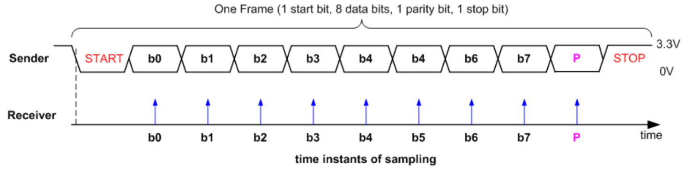
UART data frame
Signal is high by default
Goes low to trigger Start
Send each data bit (high=1, low=0), plus optionally parity bit
Goes high to trigger Stop

Slide 27
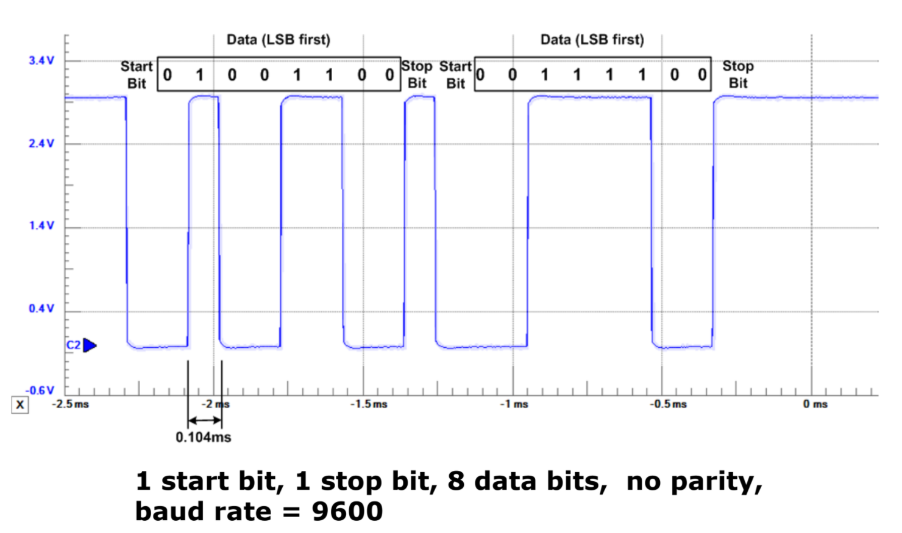
UART example, transmitting 0x32 and 0x3C

Slide 28
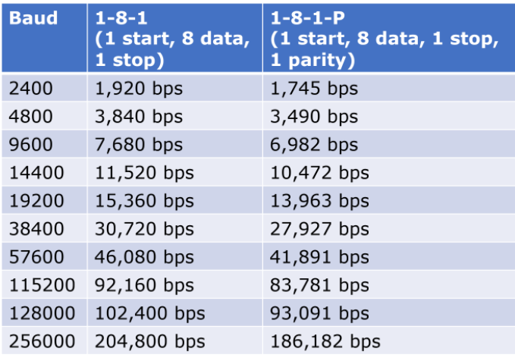
UART baud rates
Baud rate is a measure of “symbols per second”
  Typically 1 bit per symbol, but not always
  UART is 1 bit per symbol,
  but 8 data bits per 10/11 symbols
Any baud rate is possible
  But there are a handful of normal configurations
  115200 and 9600 are most common
  We use 38400

Slide 29
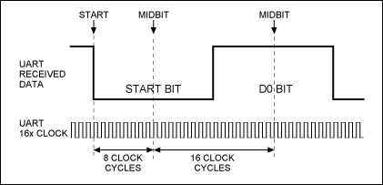
UART sampling rate
How do we make asynchronous communication work?
  Both sides must agree on the baud rate
  Listen for start bit
  Conceptually:
    Only need to sample 9-10 more times at baud rate spacing
    Short enough that clocks should not diverge too much
  Realistically:
    Sample 8 or 16 times per bit
    Determine boundaries between bits
    Select most common value
    between boundaries

Slide 30
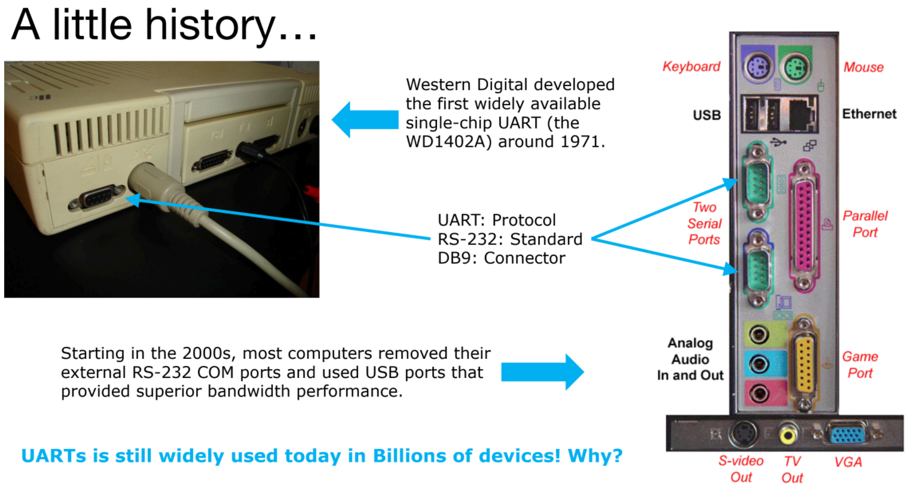

Slide 31
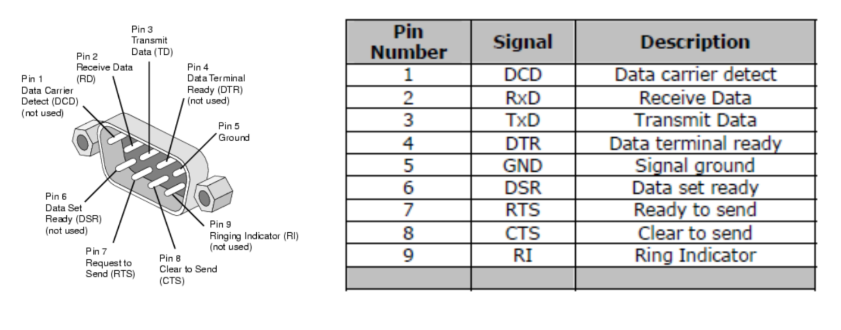
Serial communication - DB9 connector
Common pattern in cables
  Ground (must be common), often VCC, Tx, RX
  Plus extra wires for signaling metadata
Signal voltage not compatible with modern microcontrollers!
  Up to +/- 15 volts

Slide 32
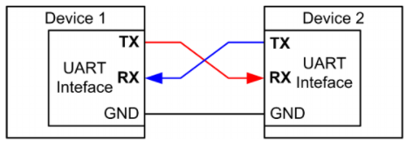
UART: chip-to-chip communication
Usually implemented as a two-wire interface
  TXD: Transmits data
  RXD: Receives data
  Optionally two additional pins for flow control
  No clock signal! Asynchronous
Note: TX connects to RX
(you’ll always get this
wrong on the first try)

Slide 33
Detecting errors with parity
Choose one configuration for all UART messages
  Even parity: total number of “1” bits in data is even
  Odd parity: total number of “1” bits in data is odd
Parity bit: set to 1 or 0 to guarantee the parity configuration
  If message doesn’t match parity configuration at receiver,
  there was a bit error (single error detecting)
Example: Data = 10101011 (five “1” bits)
  Odd parity: set parity bit to zero
  Even parity: set parity bit to one

Slide 34
UART error conditions
Parity failure
  Bit error when receiving data
Overrun
  New data arrived and overwrote buffer in peripheral before it was read
Framing
  Did not see Stop Bit when expected (should be guaranteed “1”)
Break condition
  Signal is low for entire message (Zero data plus Framing Error)
  Often used as a signal between devices

Slide 35
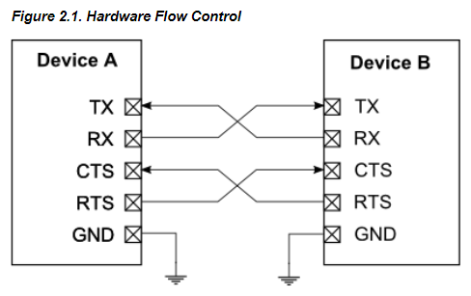
UART flow control
How do we ensure that the other device is ready for the message?
  Add two pins for “hardware flow control”
  Ready To Send (RTS) output, signals that you want to send data
  Clear to Send (CTS) input, signals that other device is ready to receive
Software flow control is possible
too
  Send special byte that means pause
  or resume transmissions
  Only works with ASCII though
  (otherwise, byte might be valid data)

Slide 36
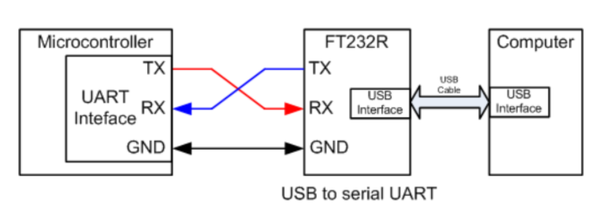
UART to USB bridge
FTDI makes the most common chip to do this (FT232)
Microbit uses a microcontroller to do this!
  KL27Z connects to USB
  Also connects to nRF52833 via UART and JTAG
  ttyACM0 is a “virtual serial device” on top of USB, miniterm is a serial console

Slide 37
UART Pros and Cons
Pros
  Only uses two wires
  No clock signal is necessary
  Can do error detection with parity bit
Cons
  Data frame is limited to 8 bits out of 10 bits (20% signaling overhead)
  Doesn’t support multiple device interactions (point-to-point only)
  Relatively slow to ensure proper reception

Slide 38
Break + Longer Decoding Example
How many bytes are transmitted here?

Slide 39
Break + Longer Decoding Example
START
STOP
START
START
STOP
STOP
How many bytes are transmitted here? 3 bytes

Slide 40
Break + Longer Decoding Example
START
STOP
START
START
STOP
STOP
How many bytes are transmitted here? 3 bytes
What is the data for the first byte?
  Remember: least significant bit is first

Slide 41
Break + Longer Decoding Example
 |  |  | 0 | 0 | 0 | 1 | 0 | 0 | 1 | 0
START
STOP
START
START
STOP
STOP
How many bytes are transmitted here? 3 bytes
What is the data for the first byte? 0b01001000 -> 0x48
  Remember: least significant bit is first

Slide 42
Break + Longer Decoding Example
 |  |  | 0 | 0 | 0 | 1 | 0 | 0 | 1 | 0
START
STOP
START
START
STOP
STOP
How many bytes are transmitted here? 3 bytes
What is the data for the first byte? 0b01001000 -> 0x48
  Remember: least significant bit is first
What message is sent here?

Slide 43
Break + Longer Decoding Example
 |  |  | 0 | 0 | 0 | 1 | 0 | 0 | 1 | 0 |  |  | 1 | 0 | 0 | 1 | 0 | 0 | 1 | 0 |  |  | 1 | 0 | 0 | 0 | 0 | 1 | 0 | 0
START
STOP
START
START
STOP
STOP
How many bytes are transmitted here? 3 bytes
What is the data for the first byte? 0b01001000 -> 0x48
  Remember: least significant bit is first
What message is sent here? 0x48, 0x49, 0x21
  In ASCII: HI!

Slide 44
Real-world signals don’t have the guide
Assume the smallest step you ever see is the bit length
  Check that the start/stop bits are where you expect
  Calculate the values
Or use a logic analyzer that can decode it for you

Slide 45
Outline
Wired Communication
UART
nRF52 UARTE

Slide 46
Which UART peripheral?
Two peripherals in the nRF52 documentation
UART peripheral
  Standard UART without DMA
  Deprecated (as in, they suggest not using it)
UARTE peripheral
  Standard UART with DMA
Their registers overlap
  They are two different ways of using the same hardware
  Only one at a time can be “active”

Slide 47
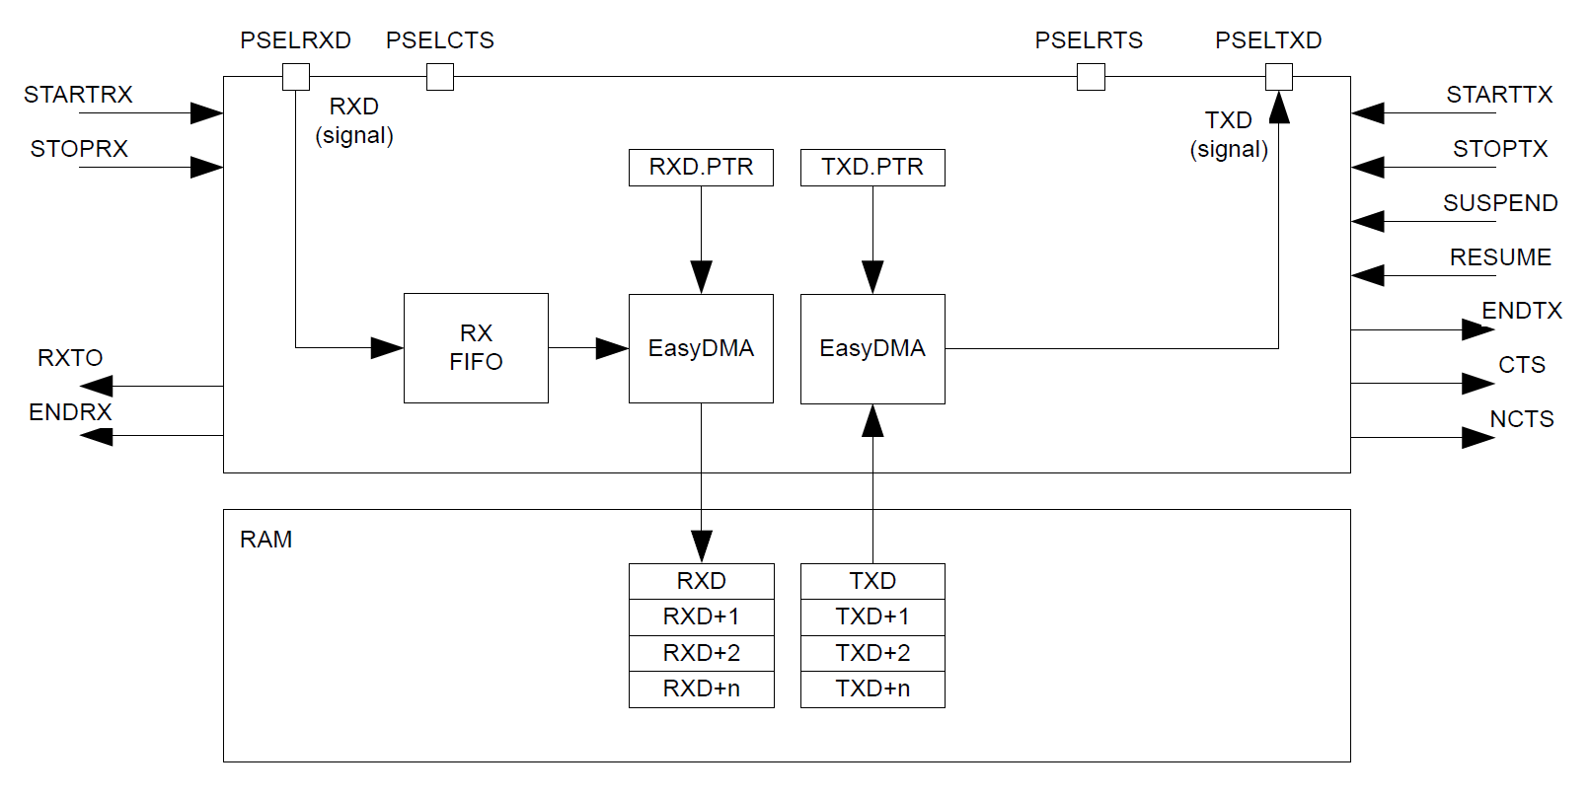
UARTE peripheral

Slide 48
UARTE peripheral
Pins: RX, TX, (optional) CTS and RTS

Slide 49
UARTE peripheral
Receive connects directly to buffer in RAM

Slide 50
UARTE peripheral
Transmit connects directly from buffer in RAM (not flash!)

Slide 51
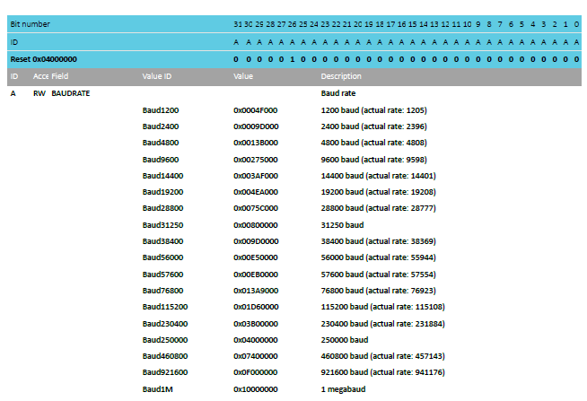
UARTE baudrates
Choose from standard, preconfigured buad rates
That values are 32-bit numbers implies other baudrates are possible

Slide 52
Typical UART configurations
Baud rate 115200
No parity
No flow control
Probably covers ~70% of UART communication
  Baud rate 9600, No parity, No flow control covers another 15%

Slide 53
UARTE driver code
Pretty straightforward to implement driver for this
  Definitely could have been a lab
DMA is exactly what you want
  Pointer to buffer of data (in RAM)
  Length
  Go!
More interesting: how does printf() use the UART?

Slide 54
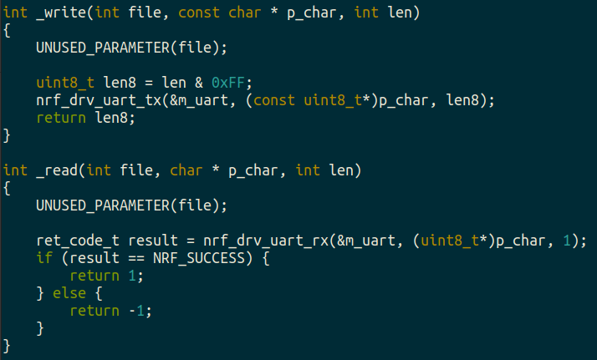
boards/microbit_v2/microbit_retarget.c
printf() eventually calls _write()with formatted data
Converts stdio calls into UART TX and RX
Library just sets DMA and starts Tx

Slide 55
Outline
Wired Communication
UART
nRF52 UARTE

