Slide 1
Lecture 04
Input and Output
CE346 – Microprocessor System Design
Branden Ghena – Fall 2022
Some slides borrowed from:
Josiah Hester (Northwestern), Prabal Dutta (UC Berkeley)

Slide 2
Administrivia
Lab tomorrow!
  Tech CG50
  https://www.mccormick.northwestern.edu/contact/tech-room-finder-map.php?id=CG50&room-floor=0&room-id=259&room-ingress=
Weekly office hours will be posted today or tomorrow

Slide 3
Quiz coming soon
First quiz is next week Tuesday! (09/27)
  15-minute quiz, taken in-class on paper
  Last fifteen minutes of class
  Bring a pencil
  Closed notes, no calculator
Covers material from the last two weeks, including today

Slide 4
General Lab access
We’ll double-check on Friday, but your ID cards should get you into CG50 at any time
  You are welcome to go in there to work on stuff 24/7
  If your card doesn’t work on Friday, post a campuswire message so I know

Slide 5
Today’s Goals
How does a microcontroller interact with peripherals to perform input and output operations?
  Memory-Mapped I/O
  Interrupts
  DMA
Explore reliable use of MMIO
Discuss interaction patterns for Interrupts and DMA
Understand General Purpose I/O (GPIO) peripherals
  And what kind of configurations they have

Slide 6
Outline
I/O Motivation
Memory-Mapped I/O
Interrupts
Controlling digital signals
  GPIO
  GPIOTE

Slide 7
Devices are the point of computers
Traditional systems need to
receive input from users and
output responses
  Keyboard/mouse
  Disk
  Network
  Graphics
  Audio
  Various USB devices
Embedded systems have the same requirement, just more types of IO
Computer
Processor
Memory
Devices
Control
Input
Datapath
Output

Slide 8
Devices are core to useful general-purpose computing
Input
Output
Mouse
Monitor
Computer
Keyboard
Headphones
Ethernet
Ethernet
Bluetooth
Bluetooth

Slide 9
Devices are essential to cyber-physical systems too
Input
Output
Lidar
Throttle Control
Computer
Inertial Measurement Unit
Brake Control
Camera
Wheel Rotation
CAN
CAN

Slide 10
Device access rates vary by many orders of magnitude
Rates in bit/sec
System must be able to handle each of these
  Sometimes needs low overhead
  Sometimes needs to not wait around
Device | Behavior | Partner | Data Rate (Kb/s)
Keyboard | Input | Human | 0.2
Mouse | Input | Human | 0.4
Microphone | Output | Human | 700.0
Bluetooth | Input or Output | Machine | 20,000.0
Hard disk drive | Storage | Machine | 100,000.0
Wireless network | Input or Output | Machine | 300,000.0
Solid state drive | Storage | Machine | 500,000.0
Wired LAN network | Input or Output | Machine | 1,000,000.0
Graphics display | Output | Human | 3,000,000.0

Slide 11
Outline
I/O Motivation
Memory-Mapped I/O
Interrupts
Controlling digital signals
  GPIO
  GPIOTE

Slide 12
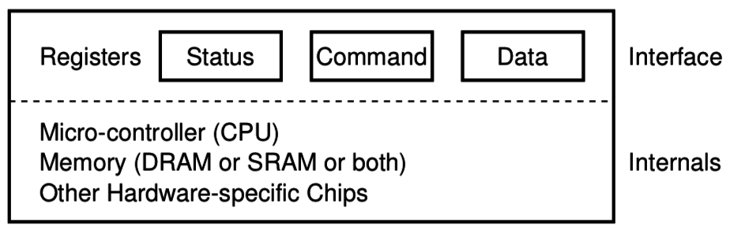
How does a computer talk with peripherals?
A peripheral is a hardware unit within a microcontroller
  Sort of a “computer-within-the-computer”
  Performs some kind of action given input, generates output
We interact with a peripheral’s interface
  Called registers (actually are from EE perspective, but you can’t use them)
  Read/Write like they’re data
How do we read/write them?
  Options:
    Special assembly instructions
    Treat like normal memory

Slide 13

Memory-mapped I/O (MMIO): treat devices like normal memory
Certain physical addresses do not actually go to memory
Instead they correspond to peripherals
  And any instruction that accesses memory can access them too!
Every microcontroller I’ve
ever seen uses MMIO
Address
0xFFFFFFFF
0xFFFF0000
control reg.
data reg.
0x00000000

Slide 14
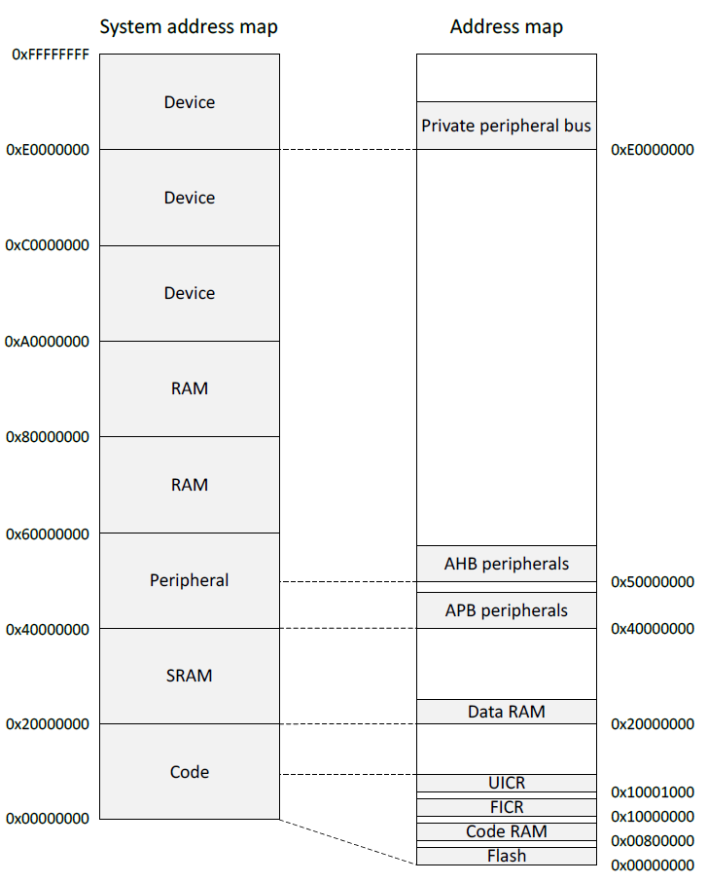
Memory map on nRF52833
Flash 0x00000000
SRAM 0x20000000
APB peripherals 0x40000000
  Everything but GPIO
AHB peripherals 0x50000000
  Just GPIO
UICR – User Information Config
FICR – Factory Information Config

Slide 15
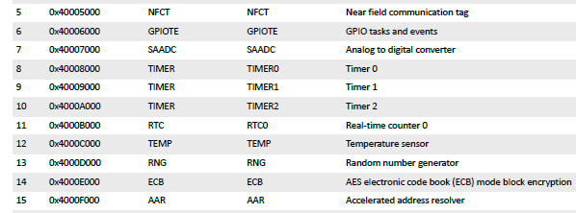
Example nRF52 peripheral placement
0x1000 is plenty of space for each peripheral
  1024 registers, each 32 bits
  No reason to pack them tighter than that

Slide 16
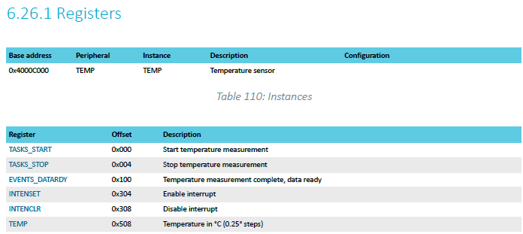
TEMP on nRF52833 example
Internal temperature sensor
  0.25° C resolution
  Range equivalent to microcontroller IC (-40° to 105° C)
  Various configurations for the temperature conversion (ignoring)

Slide 17
MMIO addresses for TEMP
What addresses do we need? (ignore interrupts for now)
  0x4000C000 – TASKS_START
  0x4000C100 – EVENTS_DATARDY
  0x4000C508 - TEMP

Slide 18
Accessing addresses in C
What does this C code do?
*(uint32_t*)(0x4000C000) = 1;

Slide 19
Accessing addresses in C
What does this C code do?
*(uint32_t*)(0x4000C000) = 1;
  0x4000C000 is cast to a uint32_t*
  Then dereferenced
  And we write 1 to it
  “There are 32-bits of memory at 0x4000C000. Write a 1 there.”

Slide 20
Example code
To the terminal!
Let’s write it from scratch

Slide 21
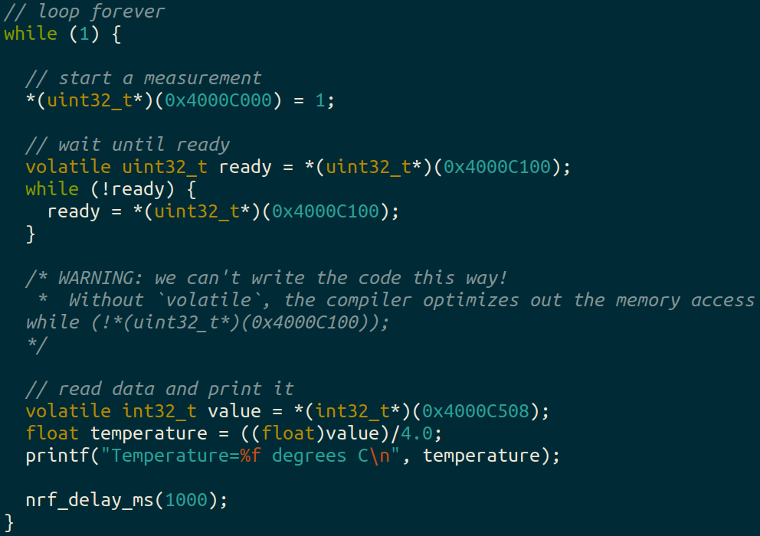
Example code

Slide 22
Using structs to manage MMIO access
Writing simple C code and access peripherals is great!
Problems:
  Need to remember all these long addresses
  Need to make sure compiler doesn’t stop us!
Solution:
  Wrap entire access in a struct!
  Compilers turn it into the same thing in the end anyways

Slide 23
C structs
Collection of variables placed together in memory
  typedef struct {
  uint32_t variable_one;
  uint32_t variable_two;
  uint32_t array[2];
  } example_struct_t;
Placement rules - Variables are placed adjacent to each other in memory except:
  Variables are always placed at a multiple of their size
  Padding added to the end to make the total size a multiple of the biggest member
  Microcontrollers can usually ignore these: all registers are the same size!

Slide 24
Temperature peripheral MMIO struct
  typedef struct {
  } temp_regs_t;

Slide 25
Temperature peripheral MMIO struct
typedef struct {
uint32_t TASKS_START;
uint32_t TASKS_STOP;
uint32_t _unused_A[62];
uint32_t EVENTS_DATARDY;
uint32_t _unused_B[0x204/4 - 1];
uint32_t INTENSET;
uint32_t INTENCLR;
uint32_t _unused_C[0x200/4 – 1];
uint32_t TEMP;
} temp_regs_t;
volatile temp_regs_t* TEMP_REGS = (temp_regs_t*)(0x4000C000);

Slide 26
Temperature peripheral MMIO struct
typedef struct {
uint32_t TASKS_START;
uint32_t TASKS_STOP;
uint32_t _unused_A[62];
uint32_t EVENTS_DATARDY;
uint32_t _unused_B[0x204/4 - 1];
uint32_t INTENSET;
uint32_t INTENCLR;
uint32_t _unused_C[0x200/4 – 1];
uint32_t TEMP;
} temp_regs_t;
volatile temp_regs_t* TEMP_REGS = (temp_regs_t*)(0x4000C000);
// code to access
TEMP_REGS->TASKS_START = 1;
while (TEMP_REGS->EVENTS_DATARDY == 0);
float temperature = ((float)TEMP_REGS->TEMP)/4.0;

Slide 27
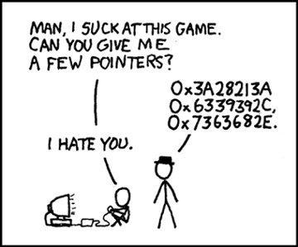
Break + relevant xkcd
https://xkcd.com/138/

Slide 28
Outline
I/O Motivation
Memory-Mapped I/O
Interrupts
Controlling digital signals
  GPIO
  GPIOTE

Slide 29
What do interactions with devices look like?
    while STATUS==BUSY; Wait
      (Need to make sure device is ready for a command)
    Write value(s) to DATA
    Write command(s) to COMMAND
    while STATUS==BUSY; Wait
      (Need to make sure device has completed the request)
    Read value(s) from Data
This is the “polling” model of I/O.
“Poll” the peripheral in software repeatedly to see if it’s ready yet.

Slide 30
Waiting can be a waste of CPU time
    while STATUS==BUSY; Wait
      (Need to make sure device is ready for a command)
    Write value(s) to DATA
    Write command(s) to COMMAND
    while STATUS==BUSY; Wait
      (Need to make sure device has completed the request)
    Read value(s) from Data
Imagine a keyboard device
  CPU could be waiting for minutes before data arrives
  Need a way to notify CPU when an event occurs
    Interrupts!

Slide 31
Interrupts
What is an interrupt?
  Some event which causes the processor to stop normal execution
  The processor instead jumps to a handler for that event
What causes interrupts?
  Hardware exceptions
    Divide by zero, Undefined Instruction, Memory bus error
  Software
    Syscall, Software Interrupt (SWI)
  External hardware
    Input pin, Timer, various “Data Ready”

Slide 32
Interrupts, visually
Some code
that’s executing

Slide 33
Interrupts, visually
Some code
that’s executing
Interrupt triggers!
Interrupt handler
code

Slide 34
Interrupts, visually
Some code
that’s executing
Interrupt triggers!
Interrupt handler
code
Continue
original code

Slide 35
ARM Nested Vectored Interrupt Controller (NVIC)
Handles interrupt entry and exit
Stacking
Unstacking
Priorities
Interrupts can preempt other interrupts!
Jump directly to the interrupt handler
Manages interrupt requests (IRQ)
  Stores all callee saved registers on the stack
    So the handler code doesn’t overwrite them
  Moves the PC to the proper handler, a.k.a. Interrupt Service Routine (ISR)
  Restores registers after handler returns and moves PC back

Slide 36
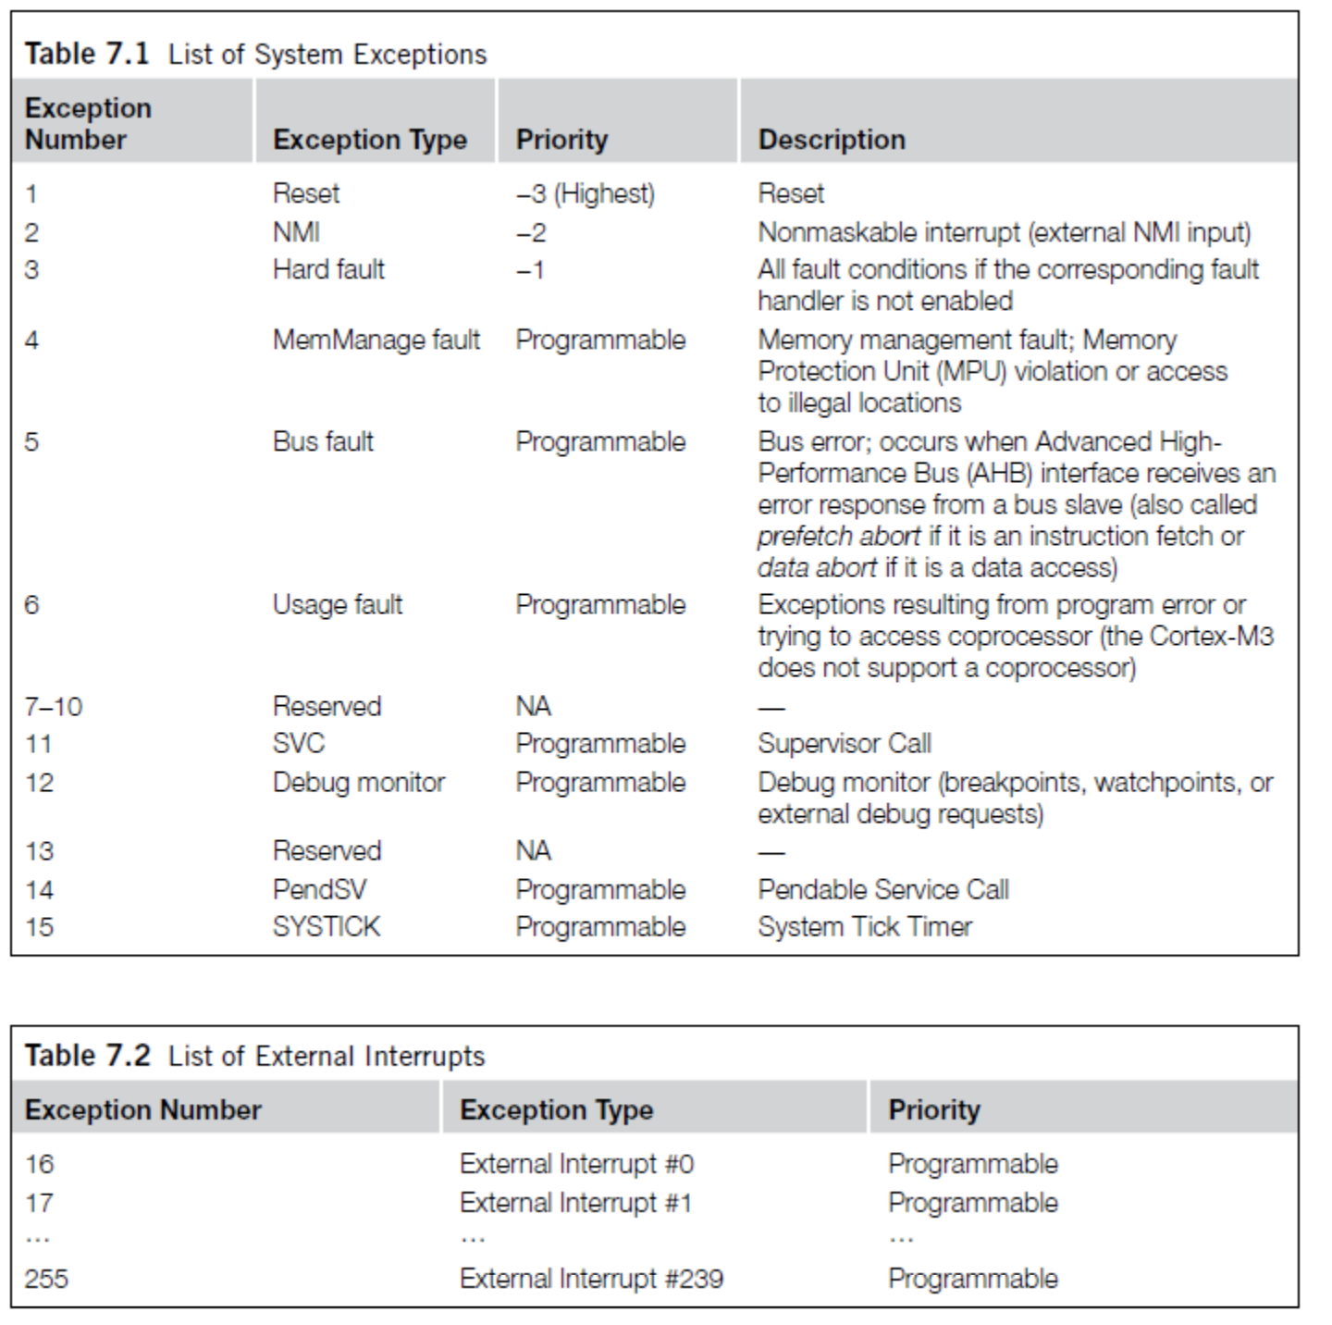
ARM Vector table
List of function pointers to handler for each interrupt/exception
First 15 are architecture-specific exceptions
After that are microcontroller interrupt signals

Slide 37
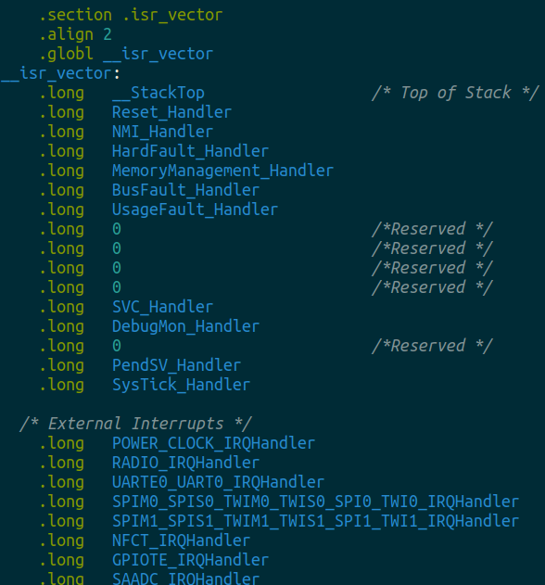
Vector table in software
Placed in its own section
  LD file puts it first in Flash
Reset_Handler determines where software starts executing
After that are all exception and interrupt handlers
  All function pointers to some C code somewhere

Slide 38
NVIC functionality
NVIC functions
  NVIC_EnableIRQ(number)
  NVIC_DisableIRQ(number)
  NVIC_SetPriority(number, priority)
    Technically 256 priorities
    Only 8 are implemented
Must enable interrupts in two places!
  Enabling interrupt in the peripheral will generate the signal
  Enabling interrupt in the NVIC will cause signal to jump to handler
Priority determines which interrupt goes first
  And determines how interrupts are nested

Slide 39
Nested interrupts, visually
Some code
that’s executing
Interrupt triggers!
Interrupt handler
Higher priority
Interrupt triggers!
Interrupt handler
continues
Continue
original code

Slide 40
Break + Open Question
When should a system use polling versus interrupts?

Slide 41
Break + Open Question
When should a system use polling versus interrupts?
Polling
  Great if the device is going to respond immediately (like 1 cycle)
  Important if we need to respond very quick (less than a microsecond)
Interrupts
  Great if we’ll need to wait a long time for status to change
  Still responds pretty quickly, but not immediately
    Needs to context switch from running code to interrupt handler

Slide 42
Outline
I/O Motivation
Memory-Mapped I/O
Interrupts
Controlling digital signals
  GPIO
  GPIOTE

Slide 43
Digital signals
Simplest form of I/O
Exist in two states:
  High (a.k.a. Set, a.k.a. 1)
  Low (a.k.a. Clear, a.k.a. 0)
Simpler to interact with
  Constrained to two voltages
  With quick transitions between the two
  No math for voltage level
    Either high or low

Slide 44
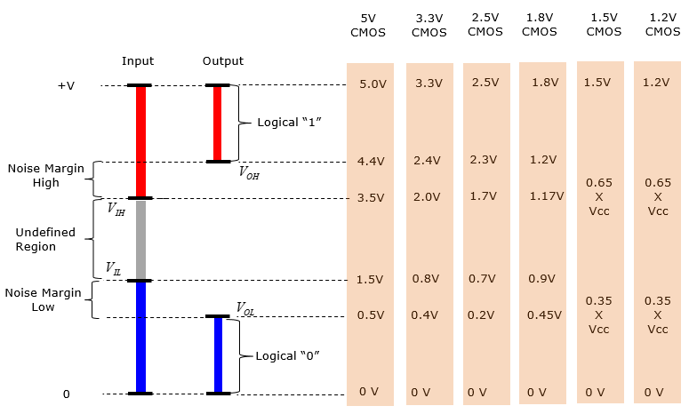
Digital signals map to voltage ranges
Upper range is high signal
  ~0.7*VDD
Bottom range is low signal
  ~0.3*VDD
Middle is undefined
  Only exists during transitions
http://www.sharetechnote.com/html/Electronics_CMOS.html

Slide 45
General Purpose Input/Output (GPIO)
Read/write from/to external pins on the microcontroller
  Two possible values: high (1) or low (0)
Basic unit of operation for microcontrollers
  Allows them to interact with buttons and LEDs
  Every microcontroller has GPIO

Slide 46
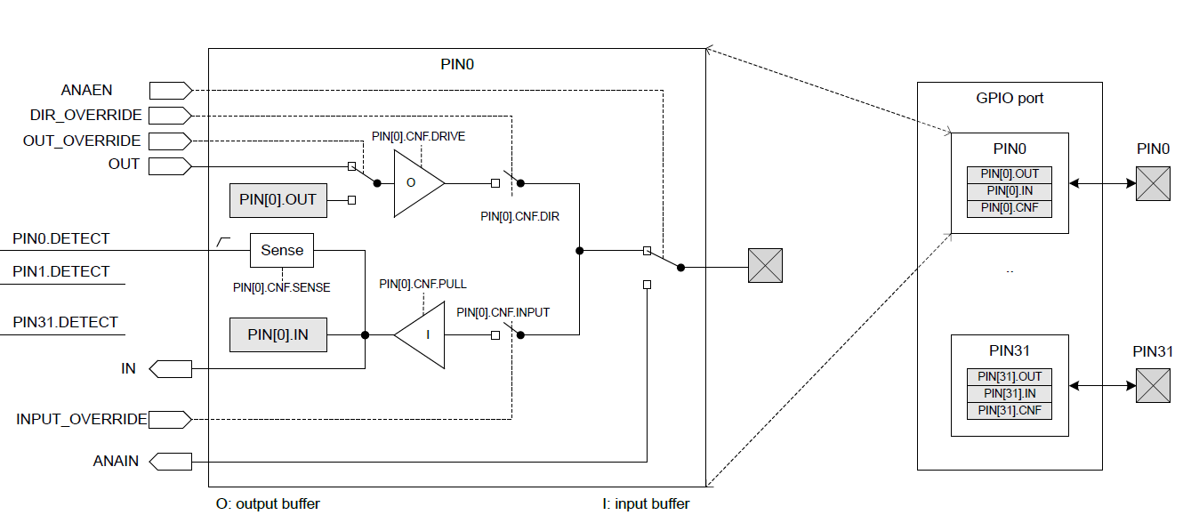
GPIO on nRF52833

Slide 47
GPIO on nRF52833
Abstract model of the pin.
This isn’t really how the hardware is implemented. But it’s a reasonable model for users.

Slide 48
GPIO on nRF52833
Inputs and outputs to/from the peripheral.
GPIO could be controlled by other peripherals. Controlling a pin in use by other peripherals is bad.

Slide 49
GPIO on nRF52833
Registers within the GPIO peripheral.
Configure various things about setup.

Slide 50
GPIO on nRF52833
Peripheral contents are duplicated for each output pin.
Each pin has its own registers (or portions thereof).

Slide 51
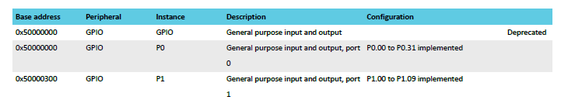
Multiple ports
nRF52833 has up to 42 I/O pins
  But only 32 can fit in a single word
  Splits them into two “ports”
Pins are named based on port
  P0.14 – Button A, P0.23 – Button B
  P1.04 – LED column 4

Slide 52
GPIO on nRF52833
External pin on the microcontroller

Slide 53
GPIO on nRF52833
Output chain. Signal comes from OUT register, through output buffer, to external pin.

Slide 54
GPIO Output
Outputs a high or low signal
Output configurations
  High drive output (either for high, low, or both)
    Sources or sinks additional current
      For powering external devices
    Normal drive: ~2 mA
    High drive: ~10 mA
  Disconnect (a.k.a. High Impedance or High-Z)
    Wired-OR or Wired-AND scenarios

Slide 55
GPIO on nRF52833
Input chain. Signal goes from pin, through input buffer, to IN register.

Slide 56
GPIO Input
Reads in a signal as either high or low
Input Configurations
  Input buffer connect/disconnect
    Allows the pin to be disabled if not being read from
  Pull
    Disabled, Pulldown, Pullup
    Connects an internal pull up/down resistor (~13 kΩ)
    Sets default value of input

Slide 57
Electrical specifications
High voltage range: 0.7*VDD to VDD (~2.3 volts)
Low voltage range: Ground to 0.3*VDD (~1 volt)
GPIO are extremely fast
  Transition time is <25 ns
  Connected directly to memory bus for faster interactions
  This allows complicated signal patterns to be replicated in software
    If they aren’t implemented as a hardware peripheral
    Known as “bit-banging”

Slide 58
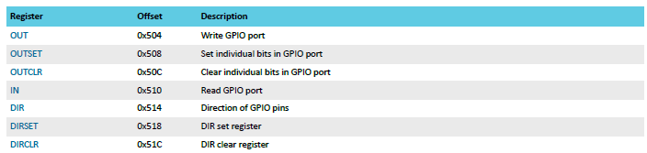
Set/Clear registers
OUT works traditionally: write a 1 for high, 0 for low
OUTSET write a 1 to set that pin (high) zero has no effect
OUTCLR write a 1 to clear that pin (low) zero has no effect
  Lets you modify a pin without modifying the others (or reading first)

Slide 59
Outline
I/O Motivation
Memory-Mapped I/O
Interrupts
Controlling digital signals
  GPIO
  GPIOTE

Slide 60
Handling interrupts from GPIO
Separate peripheral, GPIOTE (GPIO Task/Event)
  Manages up to 8 individual pins
    Can read inputs and trigger interrupts
    Can also connect outputs from events on other peripherals (PPI)
  Can trigger interrupts for a “Port event” as well
    Software checks which pin(s) caused the event to occur
    Very low power operation (works with system clocks off)
Unclear why this is a separate peripheral
  Presumably too complicated/expensive to have 42 of them

Slide 61
Configuring individual input interrupts
Pick an available GPIOTE channel (0-7)
Configure it
  Port and Pin number
  Task (output), Event (input), or Disabled
  Polarity for input events
    Low-to-high
    High-to-low
    Toggle (both directions)
Enable interrupts for channel in GPIOTE (and in NVIC!)
Clear event in interrupt handler
  Doesn’t happen automatically

Slide 62
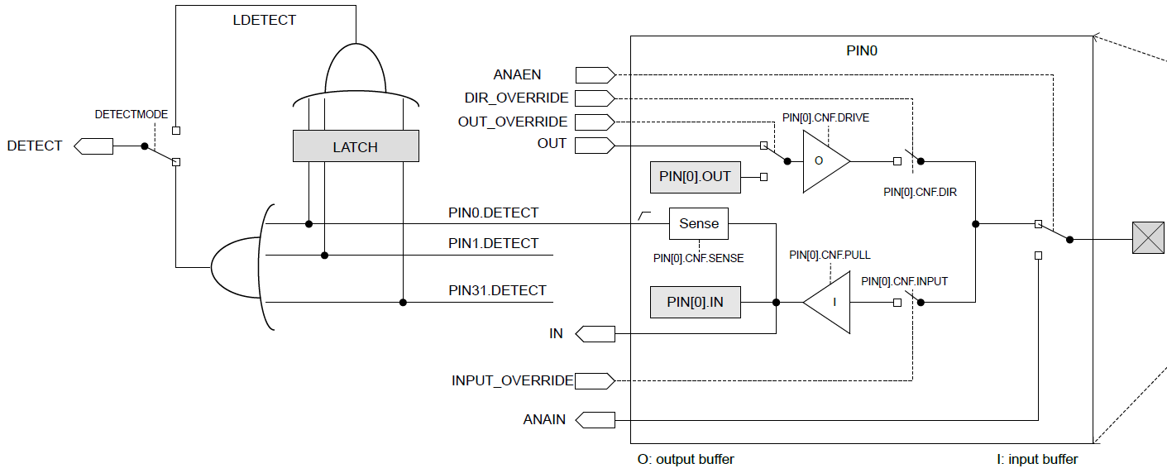
Sensing port events
Uses the “Detect” signal. Generated from pin Sense configuration

Slide 63
Configuring port input interrupts
Configure the Sense for each pin
  High or Low
  Allows different pins to have different “active” states
Select detect mode
  Direct connection to pins
  Latched version (saved even if pin later changes back)
Enable interrupts for port in GPIOTE (and in NVIC!)
Clear event in interrupt handler and value in Latch register
  Doesn’t happen automatically

Slide 64
Outline
I/O Motivation
Memory-Mapped I/O
Interrupts
Controlling digital signals
  GPIO
  GPIOTE

