Slide 1
Lecture 02 Microcontrollers
CE346 – Microprocessor System Design
Branden Ghena – Fall 2022
Some slides borrowed from: Josiah Hester (Northwestern), Prabal Dutta (UC Berkeley)

Slide 2
Class Updates
Reminder: no lab this Friday
I won’t be there. Don’t show up.
My office hours are by request right now
Will be posting an office hours schedule as soon as possible
Guide on personal lab setups posted on Campuswire
Totally optional
Also posted on the Canvas homepage

Slide 3
Today’s Goals
Explore microcontrollers
How do they compare to computers?
Purpose, capabilities, tradeoffs
Describe history and state-of-the-art for microcontrollers
Explore the microcontroller(s) on the Microbit

Slide 4
Outline
Microcontrollers and Computers
Microcontroller Design
Microcontroller History
Microbit microcontroller

Slide 5
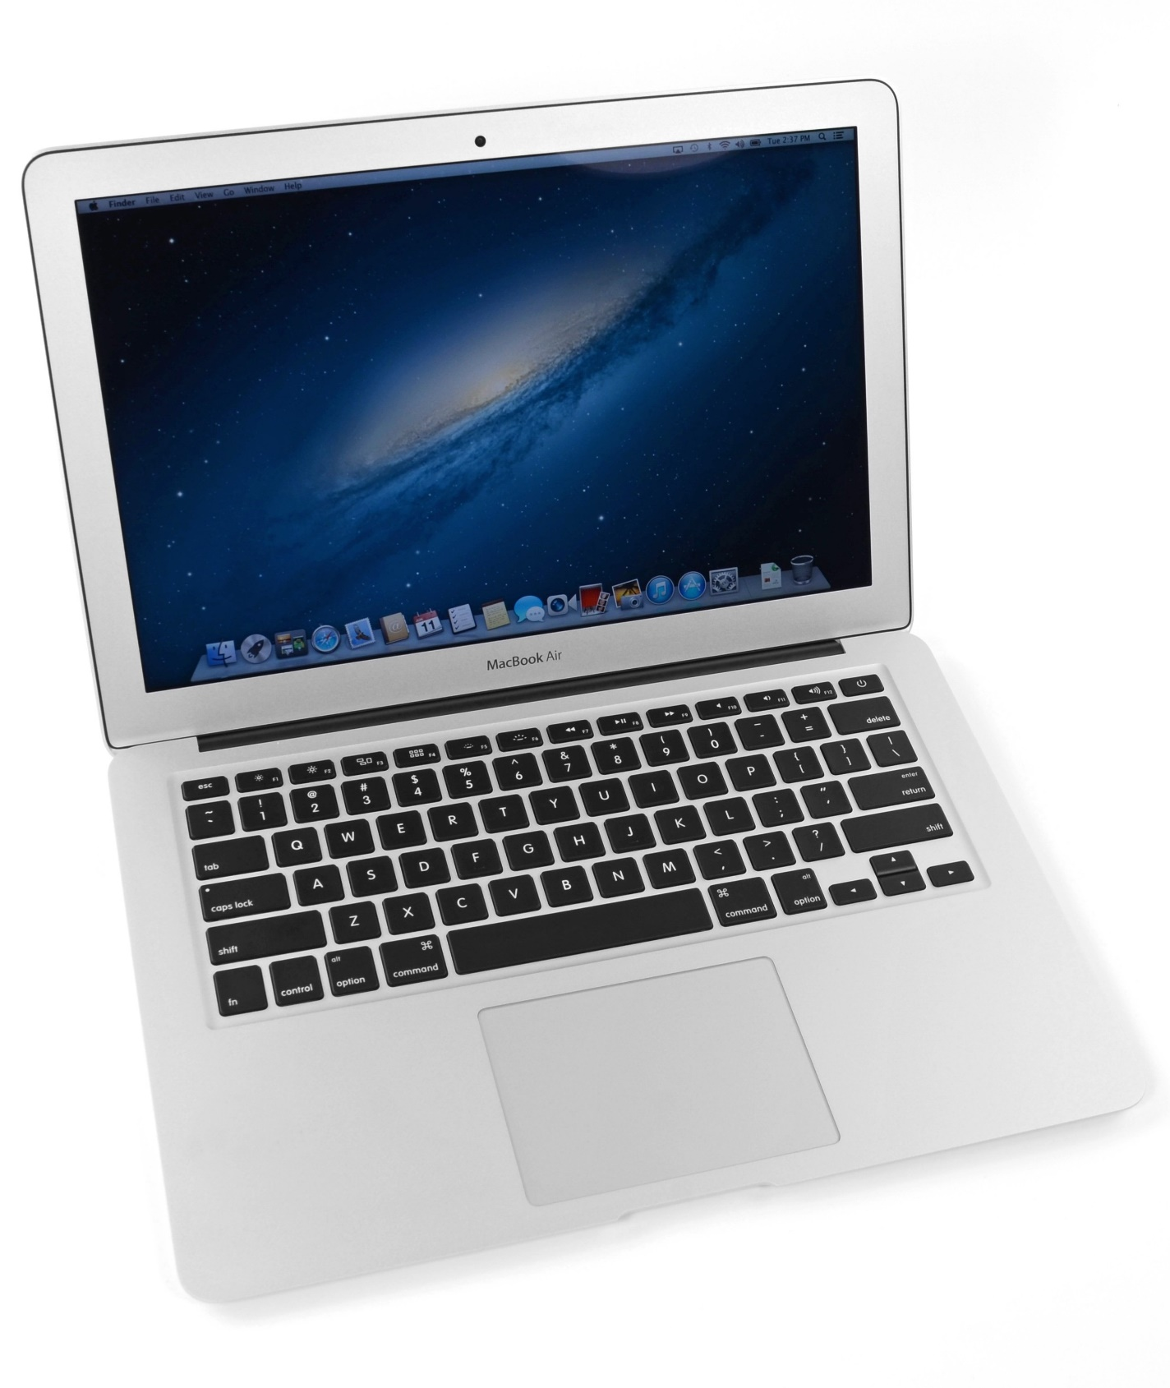
What’s inside a computer?
Macbook Air (circa 2013, 2nd gen)
Modern computers are mostly similar
Intel Core i5 processor
128 GB Flash storage
4 GB DDR3 RAM
1440x900 pixel display
Picked because there is a teardown I like of an embedded device from the same year
https://www.ifixit.com/Teardown/MacBook+Air+13-Inch+Mid+2013+Teardown/15042

Slide 6
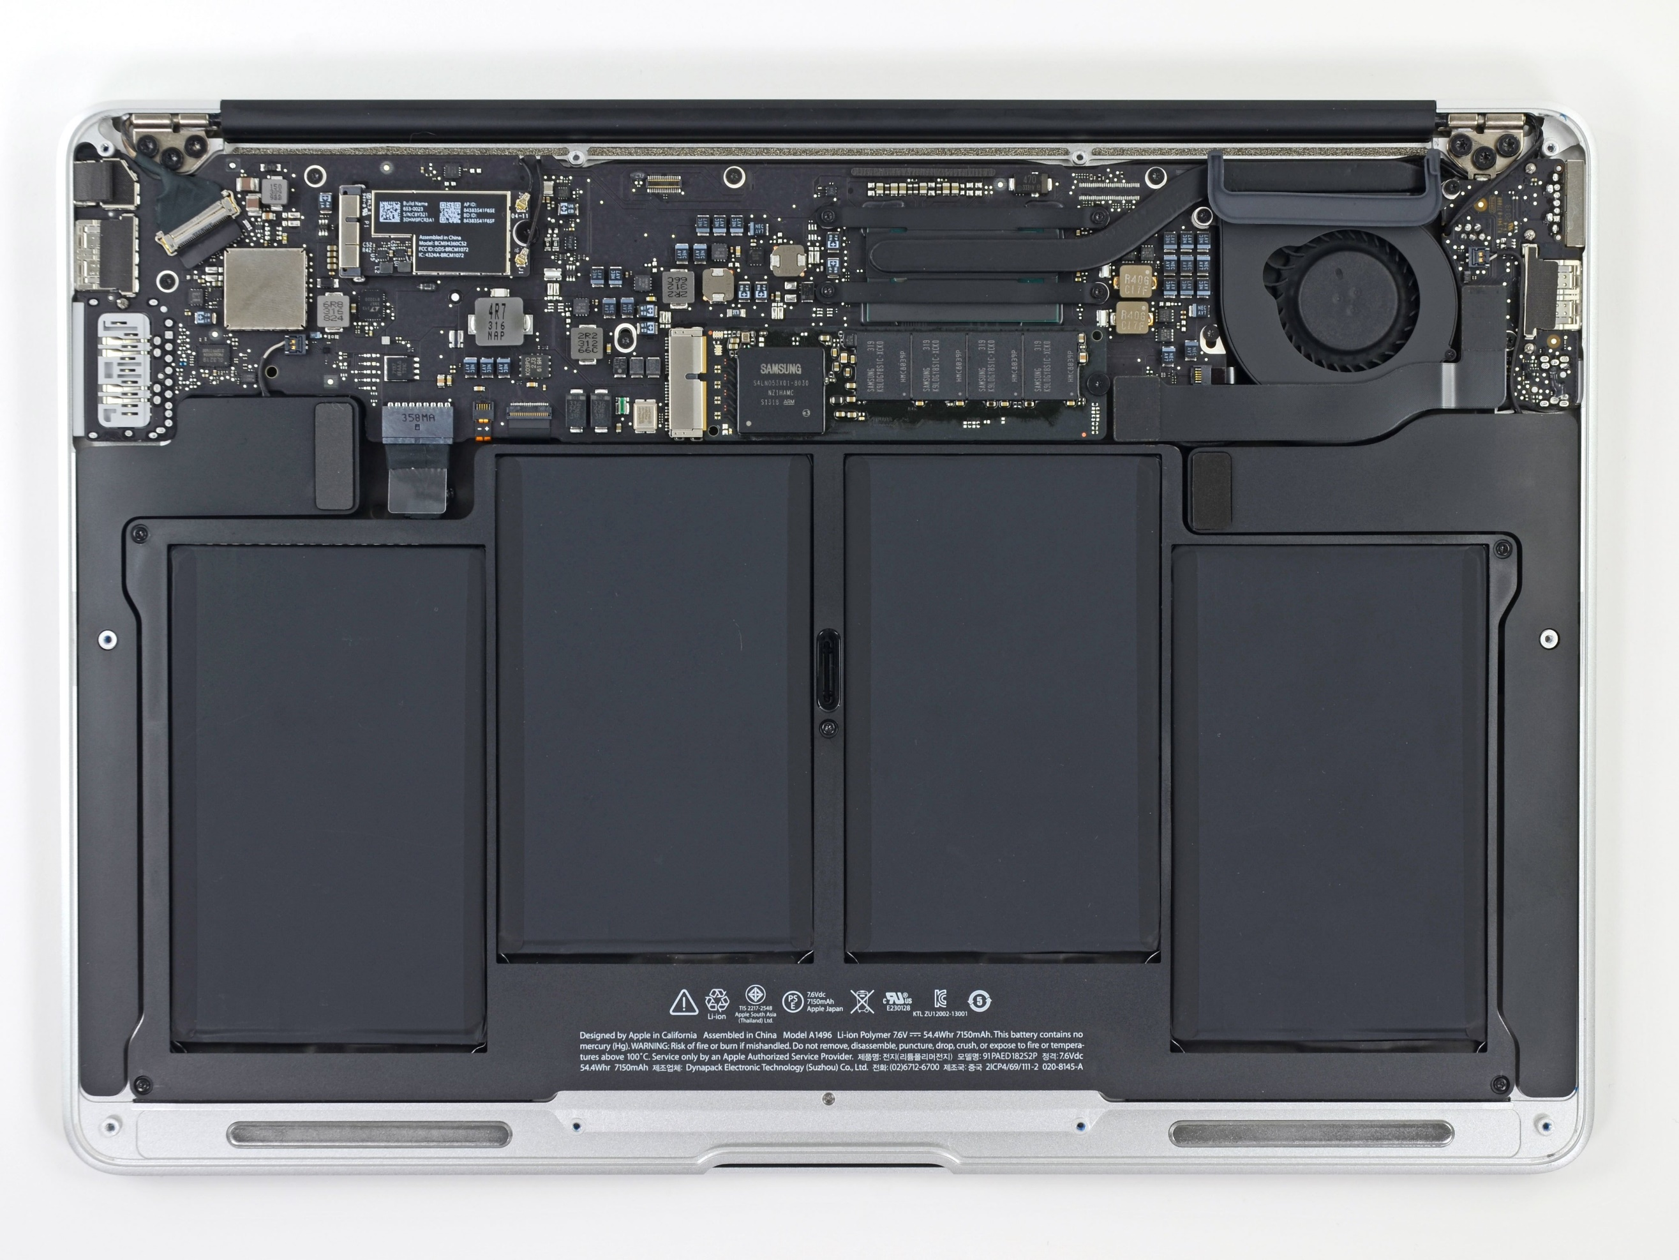
Unscrewing the bottom cover
Top half is the motherboard
Holds and connects all the parts of the computer
Bottom half are battery packs

Slide 7
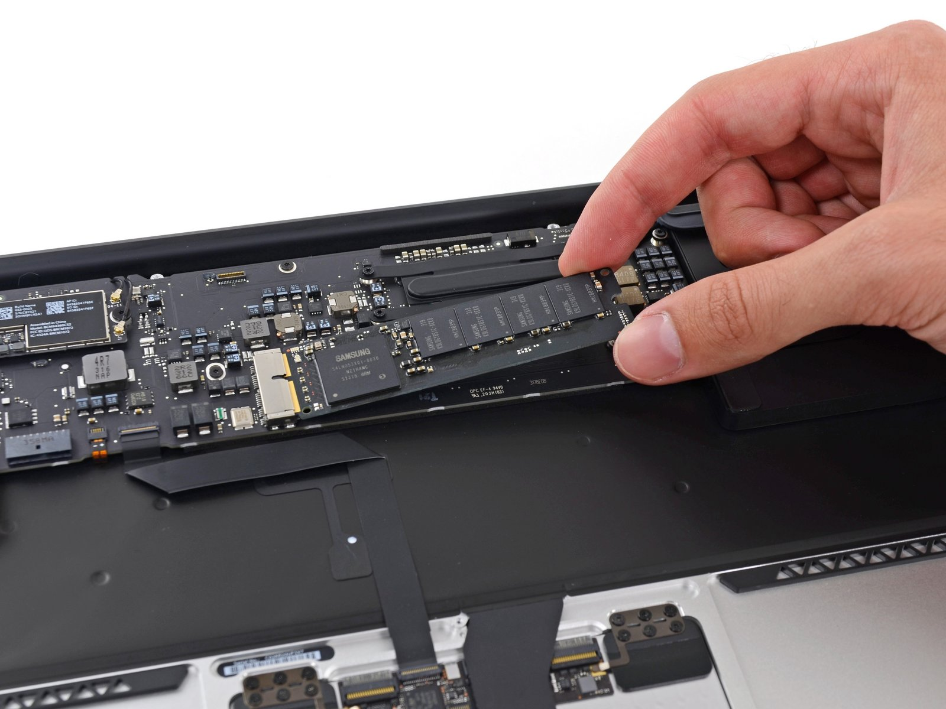
Non-volatile long-term storage: SSD
The SSD is a module that connects through PCIe
In modern laptops the SSD is often soldered directly onto the motherboard

Slide 8
Investigating the motherboard
Red (front, right)
Intel core i5 processor
Red (bottom, left)
Elpida LPDDR3 RAM, 4 GB
Other stuff are mostly radios, USB/Thunderbolt controllers, and power supply
Front
Back

Slide 9
Generalizing computer design
Computers usually need
Processor
Memory (RAM)
Storage (Flash/SSD)
External communication
USB, Thunderbolt, SATA, HDMI, WiFi
Power management
Maybe batteries and charging
Something to connect it all: motherboard

Slide 10
What’s inside a Fitbit?
Fitbit flex (circa 2013)
Features
Counts your steps
Reports via Bluetooth Low Energy
Lights up some LEDs based on your goals
Vibrates when its battery is low
https://www.ifixit.com/Teardown/Fitbit+Flex+Teardown/16050
Notes:
Fitbit, Wearables, microcontrolles

Slide 11
Fitbit teardown
Notes:
Fitbit, Wearables, microcontrolles

Slide 12
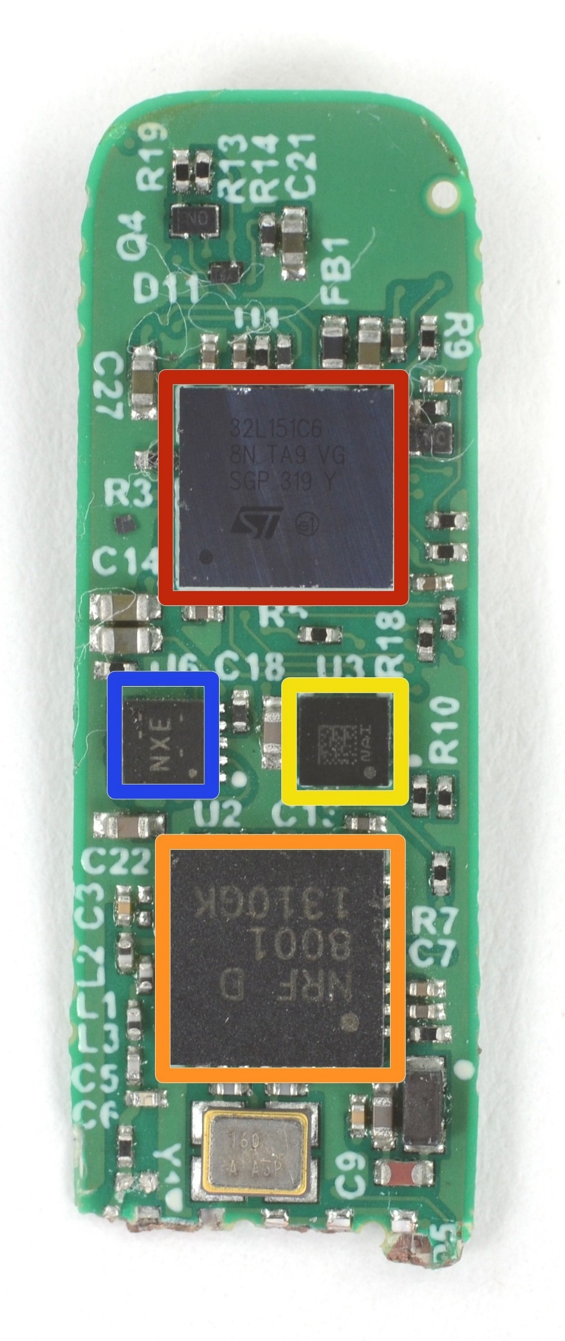
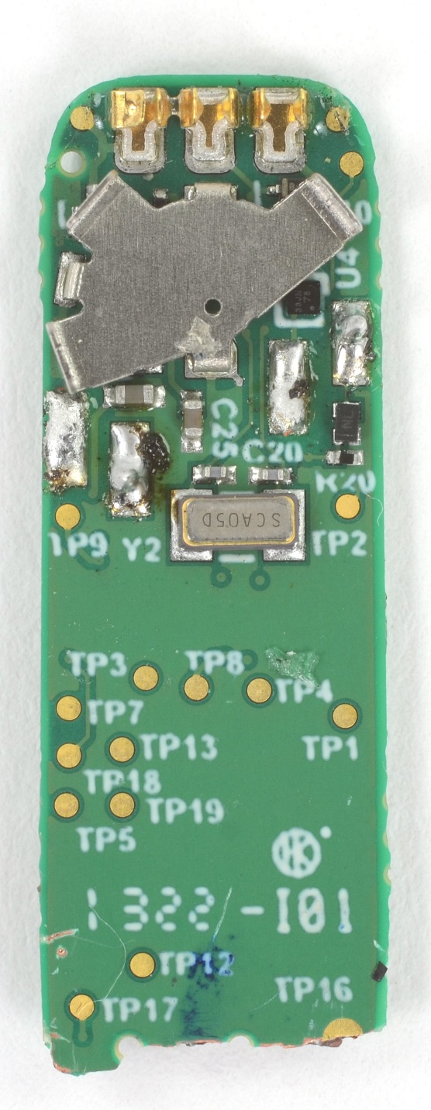
Fitbit circuit board front
The back is uninteresting
Red (top)
STMicro 32L151C6 Microcontroller
Blue (left)
TI BQ24040 Battery Charger
Yellow (right)
STMicro LIS2DH Accelerometer
Orange (bottom)
Nordic nRF8001 Bluetooth Low Energy Radio

Slide 13
Fitbit as a computer
Computers usually need
Processor
Memory (RAM)
Storage (Flash/SSD)
External communication
USB, Thunderbolt, SATA, HDMI, WiFi
Power management
Maybe batteries and charging
Something to connect it all: motherboard
Microcontroller
Bluetooth radio
Vibratory motor
Battery and power management
Circuit board

Slide 14
Sidebar: you could make a Fitbit yourself
All those parts are commercially available, so you could make your own Fitbit if you wanted to
Make a circuit board
Buy those parts and solder them on
Write some software
Make a plastic case
You’ve got a Fitbit!

Slide 15
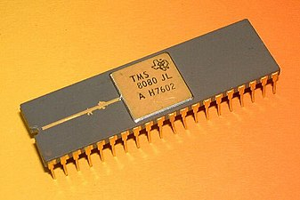
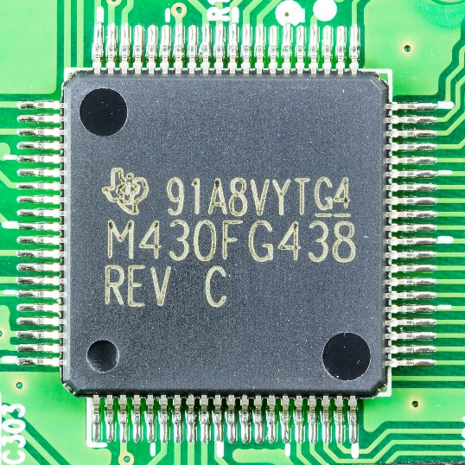
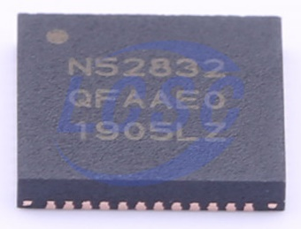
Categories of computer chips
Microprocessor (MPU or Processor)
CPU + Bus/Pins
No memory or peripherals
Microcontroller (MCU)
CPU + Pins + Memory + Peripherals
Peripherals: separate hardware units within chip
Often I/O interfaces
System on a Chip (SoC)
Microcontroller + Extensive Peripherals
Example: Radios or ML Accelerators
Essentially multiple chips combined
Evolution of increased complexity over time

Slide 16
Break + Extend your thinking
Microprocessor (MPU or Processor)
CPU + Bus/Pins
No memory or peripherals
Microcontroller (MCU)
CPU + Pins + Memory + Peripherals
Peripherals: separate hardware units within chip
Often I/O interfaces
What are some downsides to using a microcontroller?

Slide 17
Break + Extend your thinking
Microprocessor (MPU or Processor)
CPU + Bus/Pins
No memory or peripherals
Microcontroller (MCU)
CPU + Pins + Memory + Peripherals
Peripherals: separate hardware units within chip
Often I/O interfaces
What are some downsides to using a microcontroller?
No choice about memory or peripherals
Less complicated designs, because they all have to fit in one chip

Slide 18
Outline
Microcontrollers and Computers
Microcontroller Design
Microcontroller History
Microbit microcontroller

Slide 19
Generic microcontroller block diagram
Microcontroller
Processor
Peripherals
Pins
Memory

Slide 20
Processor
Microcontroller needs to execute software instructions
Emphasis: simple and reliable
i.e. not x86 CISC
Often simple, in-order, short-pipeline RISC architectures
Literally a three-stage pipeline you may have learned in CS361
Many different ISAs are possible
Custom ISAs and ARM (ARMv7E-M) are both common

Slide 21
Background: Instruction Set Architecture
ISA includes the actual instructions as well as the model for how the computer interacts with memory
Does the ISA for a microcontroller matter if you’re not programming in assembly? (and I promise we won’t)

Slide 22
Background: Instruction Set Architecture
ISA includes the actual instructions as well as the model for how the computer interacts with memory
Does the ISA for a microcontroller matter if you’re not programming in assembly? (and I promise we won’t)
Yes
Differences in instruction efficiency and amount are important
Differences in compiler support are VERY important

Slide 23
Processor design choices for embedded
How many bits is the architecture?
8-bit and 16-bit not uncommon
64-bit is very rare (who has that much memory?)
What instructions are supported?
Normal stuff yes
What about single-cycle multiply?
What about floating-point operations?
Vector instructions?
How fast does it run?
1-100 MHz is common on modern systems (faster is more energy cost)
Occasionally MUCH slower (think 32 kHz)

Slide 24
Memory
Embedded memory hierarchy
What’s missing? Why?
Registers
RAM
ROM

Slide 25
Memory
Embedded memory hierarchy
What’s missing? Why?
Cache
Makes timing unreliable
Registers
RAM
ROM
More modern microcontrollers often have optional instruction caches
Can be enabled by software

Slide 26
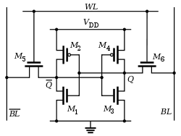
Volatile memory: SRAM
Same design as registers in traditional computer systems
No need to refresh it -> lower energy costs
Embedded systems use SRAM for all of their memory (no DRAM)
Tradeoffs:
Way less energy cost
Faster to access
More expensive
Physically larger

Slide 27
Non-Volatile memory: Flash (usually)
Same design as SSDs and Flash drives
Memory is stored with no energy costs
Reading is lowish energy and quick
Writing is high energy and very slow
Writing also has to occur in blocks (e.g. 512 bytes)
Concern: Flash has a limited lifetime ~10,000 writes
Only writing to Flash when you load code? Essentially forever
Recording data to Flash every second? 2.8 hours

Slide 28
SRAM (RAM) versus Flash (ROM) memory
Size and time difference between non-volatile and volatile memory is significantly reduced from traditional computing
Non-volatile store 2-10x larger than volatile
Single-cycle RAM. Maybe two-cycles to Flash (to read)
Major difference: energy and writability
SRAM is low-energy to read and write (no refresh needed)
Flash is lowish-energy to read, but very high energy to write
Hierarchical structure is not enforced
Same address space for RAM and Flash (very different from traditional)
Run instructions right inside of Flash
Keep variables in RAM (or const variables in Flash)

Slide 29
Memory design choices
How much memory can we fit without making it too high cost or too high power?
The answer has slowly increased over time
15 years ago: 2 KB RAM – 32 KB Flash
Today: 256 KB RAM – 1 MB Flash
How to provide memory safety?
Usually no virtual memory (all addresses are real addresses)
Nothing stops arbitrary memory overwriting
Modern systems: Memory Protection Unit
Specify a small number of ranges and permissions

Slide 30
Peripherals
Hardware modules that perform some action
Common examples
Control digital input and output pins
Read analog inputs
Send messages over various simple wire protocols (UART, SPI, I2C)
Set and check timers
Less common examples
Cryptography accelerators
Complicated wire protocols (USB, CAN)
Wireless radios (BLE, 802.15.4, WiFi)
We’ll spend most of class learning various peripherals

Slide 31
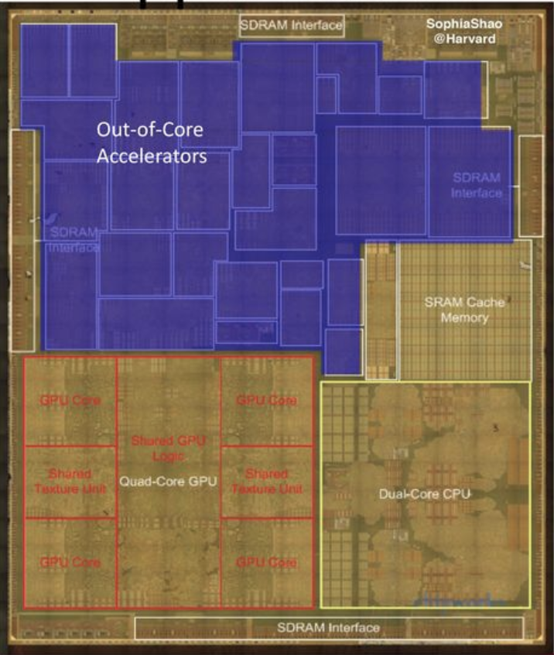
Peripheral design choices
More peripherals mean more use cases
But also means more cost for the chip
Peripherals occupy silicon
Most peripherals will go unused for a given application…
Flexibility tradeoffs within a given peripheral
One capability is easier to use
Many capabilities are more useful
Apple A8 SoC

Slide 32
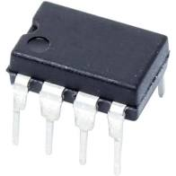
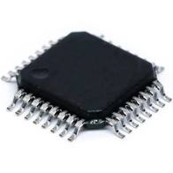
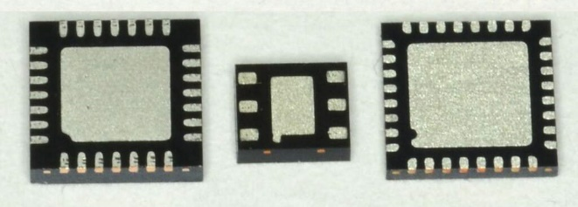
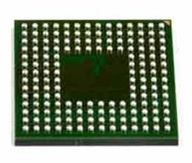
Pins
Peripherals need to electrically connect to outside world
Attach to pins on the exterior of the chip
More pins allow for more connections
At increased cost and size
Pin layouts can add more pins for cheaper
But make soldering and debugging difficult

Slide 33
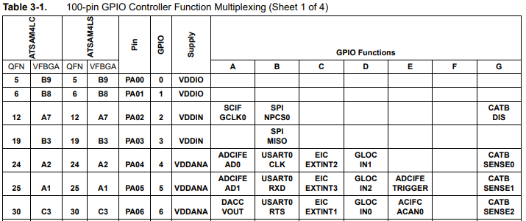
Internal connections to pins
Peripherals need to connect to external pins
Can any peripheral connect to any pin, or are there limited mappings?
Modern microcontrollers allow any-to-any connections
Older MCUs had mapping tables and pin selection was more challenging

Slide 34
What haven’t we talked about?
Microcontroller
Processor
Peripherals
Pins
Memory

Slide 35
What haven’t we talked about?
Power
Programming
Others?
Clocks
Antennas
Microcontroller
Processor
Peripherals
Pins
Memory

Slide 36
Powering microcontrollers
Usually require a specific voltage
E.g. 5 volts, 3.3 volts, 1.8 volts
Must be stable and supply enough current (or MCU “browns out”)
Noisy power supply can be an issue
Some microcontrollers have wider ranges of acceptable voltages
Need to pay attention to acceptable range on I/O though

Slide 37
Programming microcontrollers
JTAG (Joint Test Action Group)
Hardware built into the microcontroller for testing purposes
Can arbitrarily read/write memory
Can single step process too, at runtime!
GDB can connect to it! (sort of)
Bootloaders
Software runs on the microcontroller at boot that waits a short time for someone to contact it and upload code
Via I/O pins
Convenient, but sometimes unreliable

Slide 38
Break + Open Question
How little memory (RAM and/or ROM) can a computer have and still be useful?

Slide 39
Break + Open Question
How little memory (RAM and/or ROM) can a computer have and still be useful?
If we want to run C code, we need a stack and a global data section
Function calls may require local variables to be placed in the stack
To use less memory, we’d need to write applications in registers
Most variables could probably fit in registers?
So the limit could get very low
Enough ROM space for some useful code + a tiny bit of RAM
Real-world answer coming on the next slide

Slide 40
Outline
Microcontrollers and Computers
Microcontroller Design
Microcontroller History
Microbit microcontroller

Slide 41
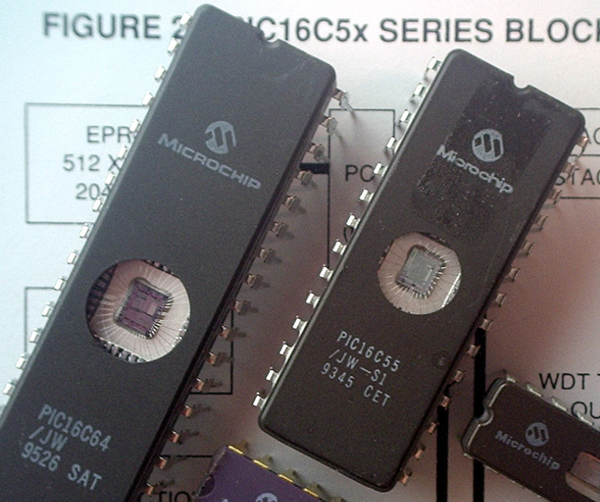
Older microcontrollers (90s-00s)
Focus: cheap, small computer systems
PIC
8, 16, and 24-bit MIPs architecture
PICAXE available with Basic interpreter
AVR
8-bit custom architecture (AVR architecture)
Used in Arduinos
AT Tiny 4: $0.30 per unit
4 I/O pins, 32 Bytes RAM, 512 Bytes ROM

Slide 42
More capable microcontrollers (00s-10s)
Focus: diversify into extreme low power and more capable systems
MSP430
16-bit custom architecture (MSP430 architecture)
Capable, but also extremely low power
<1 μA sleep current
STM32, Atmel SAM series (Cortex-M0, M3, M4, M4F)
32-bit ARM architecture (ARMv7)
Leverage success of ARM on smartphones
Every peripheral under the sun. Plus a variety of memory choices

Slide 43
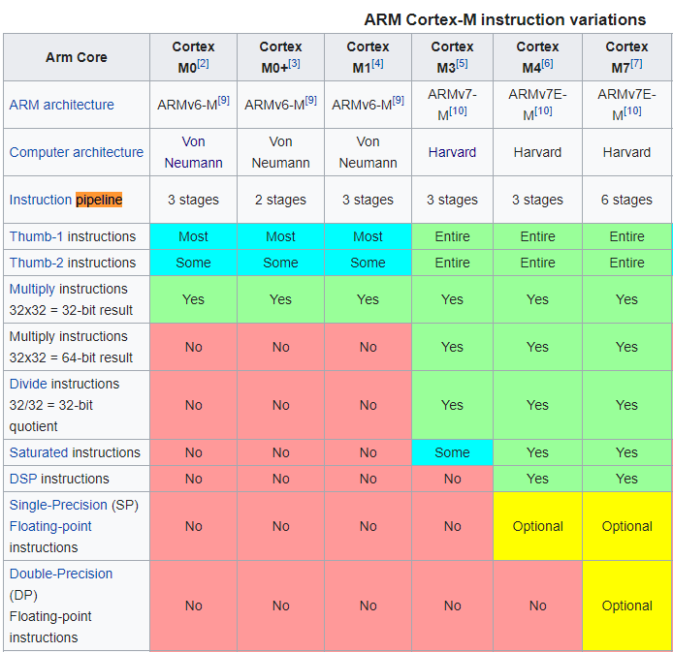
Cortex M Series
A number of options for increasing capabilities
In practice:
Cortex-M0+ for low-end systems
Coretx-M4 for high capability systems

Slide 44
Modern system-on-chips (10s-?)
Focus: increase memory and capability
Include radios in the same chip
nRF51 and nRF52 series
32-bit ARM microcontrollers (Cortex M)
Include 2.4 GHz radio: Bluetooth Low Energy and 802.15.4/Thread
Others have followed this same path
TI CC26XX
Apollo3
STM32WL

Slide 45
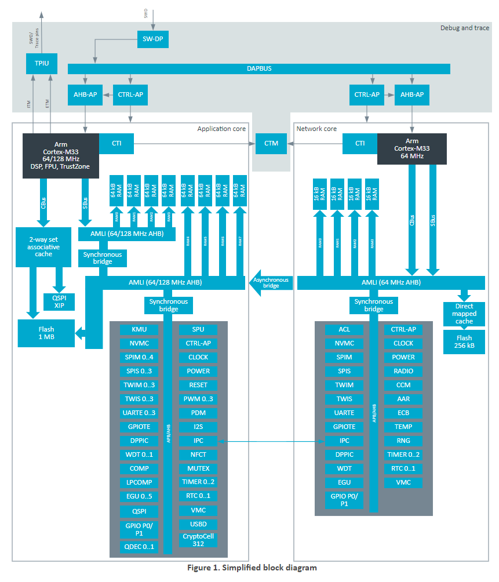
Future microcontrollers
Multi-core systems
Not for performance, but for separation of concerns
Run radio code on one core
Application code goes on the other core
Also allows BIG.little architecture
Higher performance core when interpreting data
Lower performance core for sampling sensors
nRF53 series is already doing this
But support is still fairly nascent

Slide 46
Break + Open Question
Consider the lifecycles of computer systems
i.e., how long are people still actively using them for?
How long does a processor generation need to be supported?
Think Intel Core i7-7500U or Apple M1
How long does a microcontroller chip need to be supported?
Think nRF52833 or MSP430

Slide 47
Break + Open Question
Consider the lifecycles of computer systems
i.e., how long are people still actively using them for?
How long does a processor generation need to be supported?
Think Intel Core i7-7500U or Apple M1
After some number of years, new products no longer use it
Old products eventually wear out or are unsupported
How long does a microcontroller chip need to be supported?
Think nRF52833 or MSP430
New products might still use them years later, because redesigning embedded systems is hard and new chips aren’t that much better

Slide 48
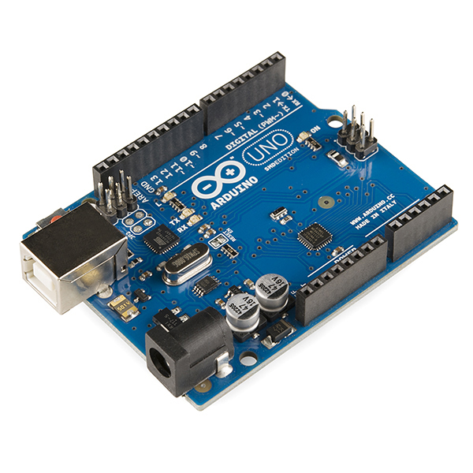
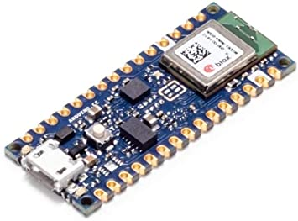
Popular components rarely die
Majority of popular older options still exist
Designers can trade off cost, capability, and efficiency alongside “modern features”
Upgrading for an existing product is unlikely
Large cost, little benefit
Example: Arduino still primarily uses AVR
Works just fine for its needs
Also releases new boards with nRF52s (Arduino Nano 33 BLE)

Slide 49
Outline
Microcontrollers and Computers
Microcontroller Design
Microcontroller History
Microbit microcontroller

Slide 50
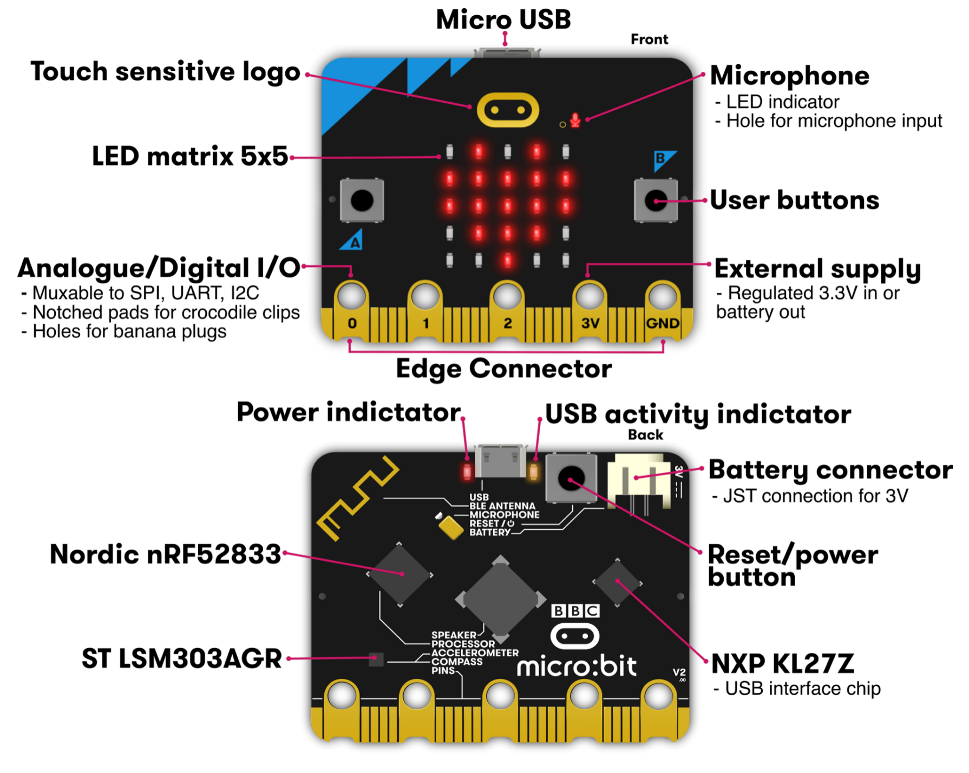
Micro:bit v2
Circuit board
Entire thing
a.k.a “Dev Board”
a.k.a PCB (Printed Circuit Board)
Microcontroller
The computer on it
Microbit has two
One as a programmer
One for applications
Microcontrollers

Slide 51
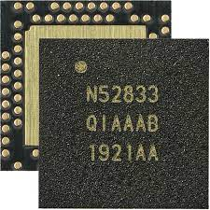
nRF52833 – Microcontroller on the Micro:bit v2
32-bit ARM Cortex-M4F microcontroller
64 MHz core, 128 KB RAM, 512 KB Flash
Floating point support
2.4 GHz Radio: Bluetooth Low energy / 802.15.4
Various peripherals
ADC, PWM
I2C, UART, SPI, USB
RNG, 32-bit Timers, Watchdog, Temperature
Up to 42 I/O pins

Slide 52
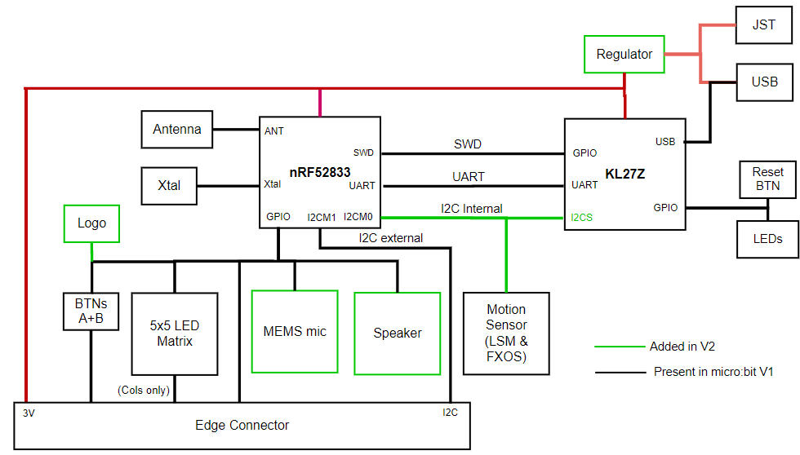
KL27Z – Programmer on the Micro:bit v2
32-bit ARM Cortex-M0+ microcontroller
48 MHz core, 16 KB RAM, 256 KB Flash
Acts as a programming interface to nRF52833
Connects to USB and to JTAG (SWD)

Slide 53
Microbit version 2.2
Circa 2020-??? there has been a global chip shortage
Lots of demand for electronics
Reduced supply due partly to pandemic
Microbit had to come out with a revision
Replaced KL27Z (the programmer chip) with a WAY more capable nRF52820
This has caused some annoyances for lab that I need to fix
The programming interface changed a little

Slide 54
To the datasheet!
nRF52833 Product Specification
Online: https://infocenter.nordicsemi.com/index.jsp?topic=%2Fps_nrf52833%2Fkeyfeatures_html5.html
PDF: https://infocenter.nordicsemi.com/pdf/nRF52833_PS_v1.5.pdf

Slide 55
Outline
Microcontrollers and Computers
Microcontroller Design
Microcontroller History
Microbit microcontroller(s)

