Slide 1
Lecture 01
Introduction
CE346 – Microprocessor System Design
Branden Ghena – Fall 2022
Some slides borrowed from:
Josiah Hester (Northwestern), Prabal Dutta (UC Berkeley)

Slide 2
Welcome to CE346!
Focus on hardware/software systems and their design
  Hardware/Software co-design
    How do you write software that interacts with hardware?
    How do you choose hardware to support software needs?
  Sensors and Sensing
    What can sensors do and how do they work?
    How do you write applications that sense the world?

Slide 3
Asking questions, four ways
You can always ask questions during lecture!
  I’ll let you know if I need to move on for now and answer you after class
We’ll take breaks during lecture
  I’ll pause after each break to see if any questions came up
I will hang out after class for questions
  Plenty of time to answer everyone
You can always ask questions on Campuswire too
  The class message board app

Slide 4
Today’s Goals
What are the goals of this course?
Why do I think embedded systems are so important?
How is the course going to operate?

Slide 5
Outline
Who and Why
Embedded Systems
Course Overview

Slide 6
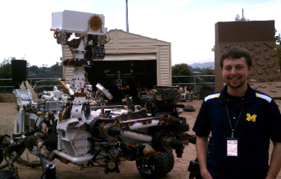
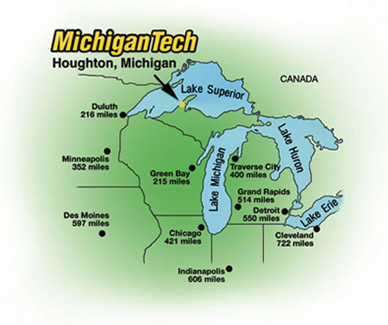
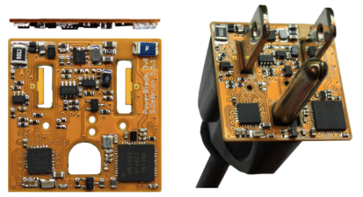
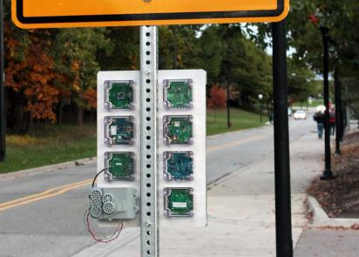





Branden Ghena (he/him)
Assistant Faculty of Instruction
Education
  Undergrad: Michigan Tech
  Master’s: University of Michigan
  PhD: University of California, Berkeley
Research
  Resource-constrained sensing systems
  Low-energy wireless networks
  Embedded operating systems
Teaching
  Computer Systems
    CS211: Fundamentals of Programming II
    CS213: Intro to Computer Systems
    CS343: Operating Systems
    CE346: Microprocessor System Design
    CS397: Wireless Protocols for the IoT
Things I love

Slide 7

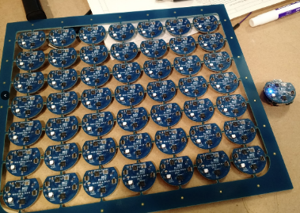
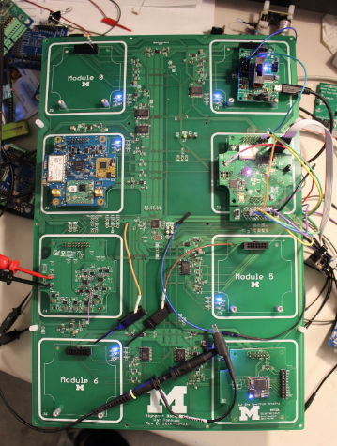
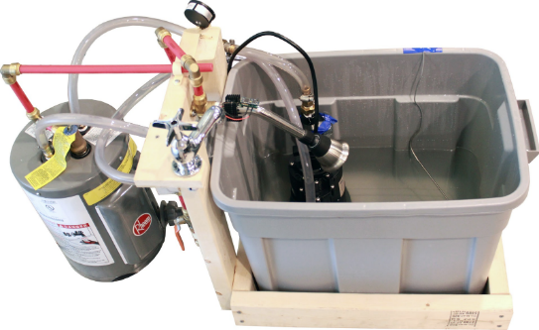
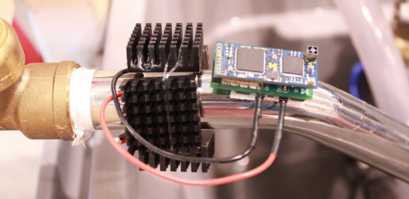
Research area: resource-constrained embedded systems
Most interesting to me: the interfaces
  Hardware and software
  Applications and OS
  Communication

Slide 8
Faculty: now I can choose what to teach!
Goal: provide classes that teach more advanced embedded systems topics
  Hopefully, generally useful to other nearby domains of CS and ECE too!
Result: this course!
  Course goal: introduce students to hardware-software interactions
    Practical hands-on experience with microcontrollers and sensors
    Open-ended project where students can choose their specific focus

Slide 9
Outline
Who and Why
Embedded Systems
Course Overview

Slide 10
What is an embedded system?
A computer built into a device
such that the device is interacted with, not the computer
  Not a desktop, laptop, server, smartphone, smartwatch
  (although many of those deal with overlapping hardware/software issues)
Many domains
  Robotics
  Industrial processes
  Smart home
  Smart city
  Wearables and health sensing
  Generally: Internet of Things

Slide 11
Discussion: identify some embedded systems
What devices that you might not usually consider as computers actually have embedded computers in them?
  Talk with the others around you
  Goal: come up some unique ideas
  We’ll share ideas with the class afterwards

Slide 12
Trend: embedded computers instead of custom hardware
Some embedded devices could be a state machine in custom hardware instead
However, computers are increasingly common in those cases
  Embedded computers are increasingly cheap
  More software developers than hardware developers

Slide 13
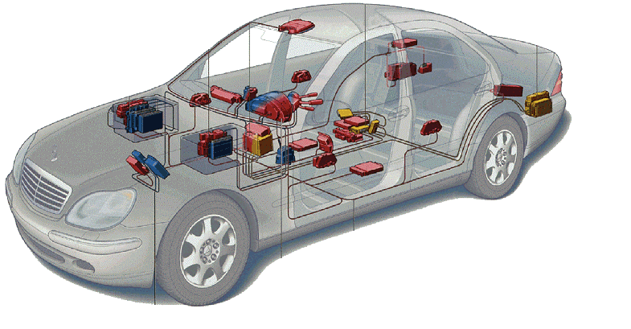
Related area: Cyber-Physical Systems
Systems that are part computational and part real-world
  Example: autonomous vehicles
Combines multiple fields to handle this problem
  Embedded Systems
  Electronics
  Controls
  Software Engineering
  Computer Theory
Automotive

Slide 14
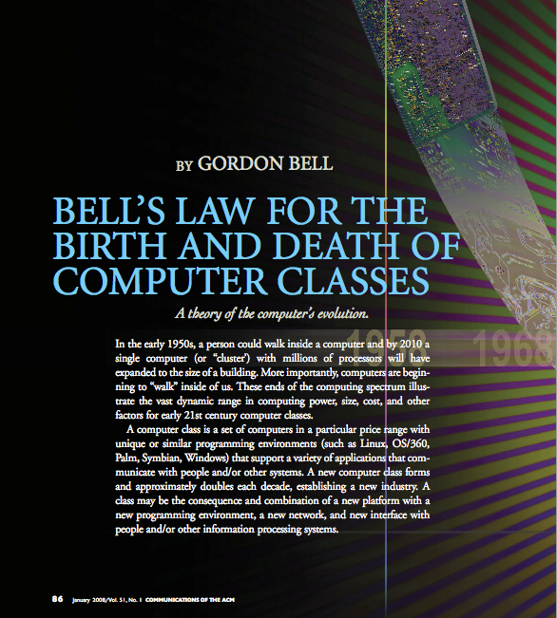
Bell’s Law: A new computer class every decade
“Roughly every decade a new, lower priced computer class forms based on a new programming platform, network, and interface resulting in new usage and the establishment of a new industry.”
- Gordon Bell [1972,2008]

Slide 15
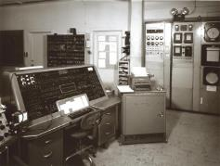
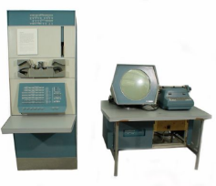
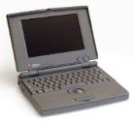
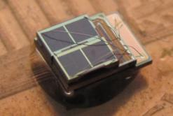

Number of computers per person grows over time
Mainframe
1 per Enterprise
[Bell et al. Computer, 1972, ACM, 2008]
Workstation
1 per Engineer
Laptop
1 per Professional
log (people per computer)
Smart Sensors
Mini Computer
Ubiquitous
1 per Company
Personal Computer
100 – 1000’s per person
1 per Family
1 per person
Smartphone

Slide 16
Computer volume shrinks by 100x every decade
Mainframe
1 per Enterprise
100x smaller every decade
Workstation
1 per Engineer
[Nakagawa08]
Laptop
1 per Professional
Smart Sensors
Mini Computer
Ubiquitous
1 per Company
Personal Computer
100 – 1000’s per person
1 per Family
1 per person
Smartphone

Slide 17

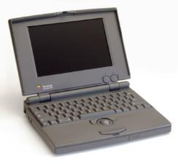


Price falls dramatically, enabling new applications
Mainframe
Workstation
Number Crunching
Data Storage
Laptop
productivity
interactive
Mini Computer
streaming
information
to/from the
physical
world
Smart Sensors
Personal Computer
Smartphone

Slide 18
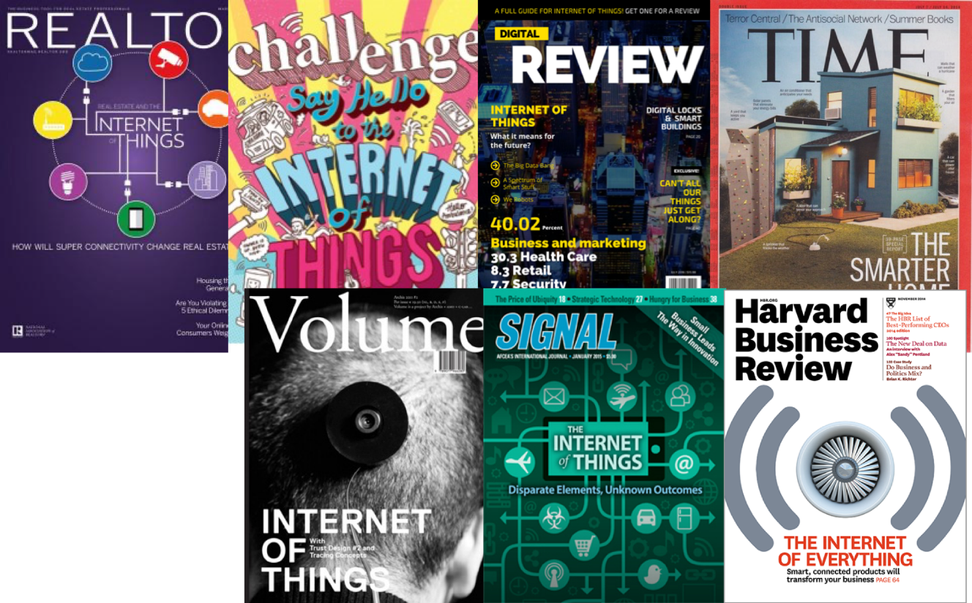

The Internet of Things (IoT)

Slide 19
Discussion: what is the Internet of Things?
Name a few Internet of Things devices
What are the qualities that designate those devices at “IoT”?

Slide 20
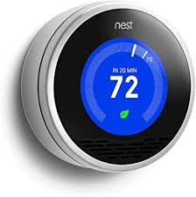
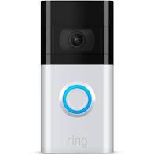
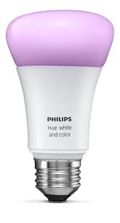

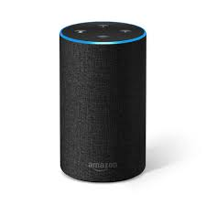
Discussion: what is the Internet of Things?
Name a few Internet of Things devices
What are the qualities that designate those devices at “IoT”?

Slide 21
Thought experiment on capabilities
What if the Nest thermostat was powered by an entire desktop?
  8-core x86-64 processor, 32 GB RAM, 1 TB SSD
Would that still count as IoT?
Could that still be an embedded system?
Why don’t we see that in practice?

Slide 22
Thought experiment on capabilities
What if the Nest thermostat was powered by an entire desktop?
  8-core x86-64 processor, 32 GB RAM, 1 TB SSD
Would that still count as IoT?
  Doesn’t really feel right. Built in assumption of limitations.
Could that still be an embedded system?
  Yes
Why don’t we see that in practice?
  Cost

Slide 23
Branden’s take on the Internet of Things
Key features
  Computation
    Local to the device
    With some capability for arbitrary compute and storage
  Connectivity
    Almost certainly wireless
    Likely Internet, possibly local
  Interaction
    Sensing or Actuation
Secondary features
  Low energy
  (Relatively) Low cost

Slide 24
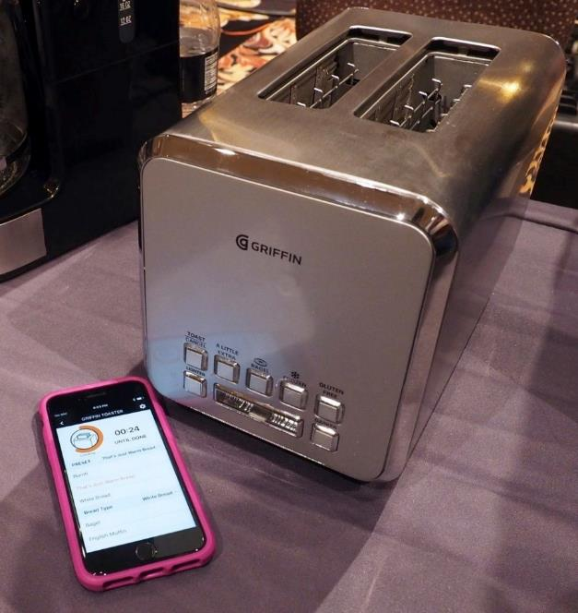
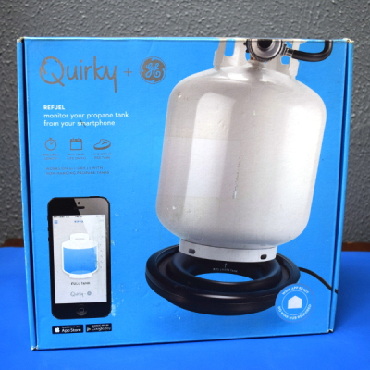
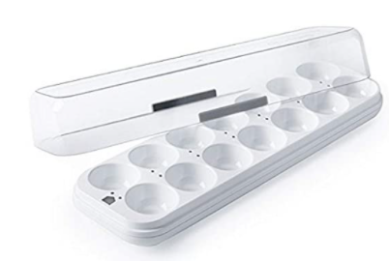
Warning: Internet of Crap

Slide 25
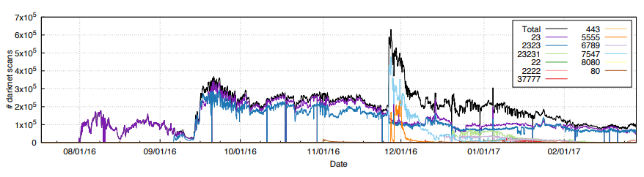
Internet of Insecure Crap
Mirai botnet (2016)
Takes control of up to 600,000 insecure connected devices
  IP-attached cameras, DVRs, routers, printers
Used to DoS websites

Slide 26
What makes resource-constrained embedded systems interesting?
Focus on the real world
  You can actually see the purpose and effects of your applications
  Easily explainable to non-engineer humans
Challenging limitations
  Limited memory and processing
  Energy concerns

Slide 27
What makes resource-constrained embedded systems frustrating?
Challenging limitations
  Limited memory and processing
  Energy concerns
Full-stack development means problems could be anywhere
  Hardware problems
  Firmware problems
  Software problems
  Example: my first grad project eye-tracking glasses
    Camera -> ADC -> FPGA -> Linux driver -> Linux app -> Network -> Visualizer app

Slide 28
Architecture of a lecture
Full
Administrivia
+ stretch break
Open
Question
Summary
+ Bonus
Attention
0
20
25
50
53
78
80
Time (minutes)

Slide 29
Outline
Who and Why
Embedded Systems
Course Overview

Slide 30
Course Staff and Office Hours
Four PMs who previously took the class
  Kevin Zhu
  Will Phillips
  Tee Amornkasemwong
  Huaxuan Chen
  They will help out during labs and also provide lab office hours
Office Hours: TBD
  We’ll post a schedule soon. PM office hours will be in the labs.
  Also by request! (especially during projects)

Slide 31
Course lectures
Lecture: Tuesdays and Thursdays 3:30-4:50pm, 555 Clark room B03
  I’m considering if I need to start a few minutes late
Provides background on everything we’ll be doing in labs
  Lectures are automatically recorded so you can review them
No textbook for this class
  Nobody seems to write a good one
  The datasheet for our microcontroller (nRF52833) will be important though!

Slide 32
Class lab sessions
Lab: Fridays 10:00-11:50am OR 1:00-2:50pm, Tech CG50
Labs start next week Friday and are weekly from there
  No lab this week!
  Six labs total
  When labs run out, I’ll use the time for project meetings with groups

Slide 33
Course grade components
42% Labs
  6 labs at 7% each
  Guided exploration of course concepts
  Staff gives checkoffs as you complete parts
20% Quizzes
  Four timed quizzes at 5% each
  Covers lecture material from last two weeks
  Probably in-class at the end of class, I’ll update you in advance
38% Final Project
  Open-ended group project (will explain in a minute)

Slide 34
Labs
MMIO and Interrupts
Virtual Timers
LED Matrix
Breadboarding
Audio Input/Output
I2C Accelerometer/Magnetometer
Labs will be partner work
  You choose, but different partner each week
Due one week from start of lab
  Complete Checkoffs plus some Post-lab Questions due online

Slide 35
Quizzes
In-class, on-paper, closed notes quizzes
  Usually about 15 minutes and held at the end of lecture
Cover the last two weeks worth of material
  So make sure you’re up-to-date on what we’re talking about
First quiz is Tuesday, October 4th (third week of classes)

Slide 36
Final projects
Opportunity for you to apply your interests to this course
  In groups of 2-3 students (maybe 4 for a really big idea)
Demonstrate course knowledge through any application
  Microbit (99% required)
  Various hardware I’ll have on hand
  Small budget for purchasing additional stuff

Slide 37
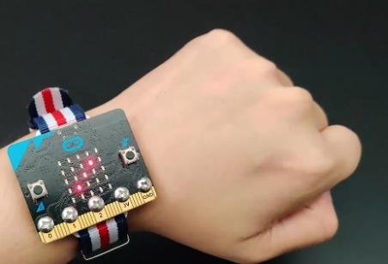
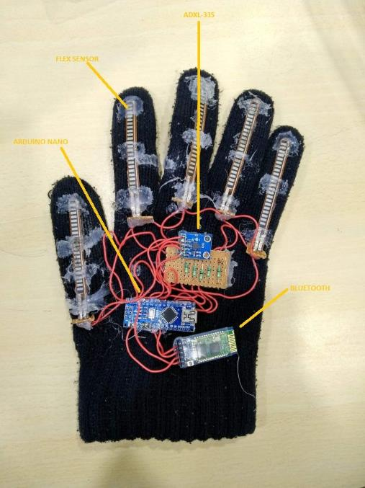
Project Ideas
Some ideas to get you thinking
  Game with interesting control mechanism
  Smart gloves
  Smartwatch
  Simple robotic systems
Projects can use
  Multiple Microbits
  A personal computer for some amount of coordination
  Lots of different sensors or actuators
    Go explore sparkfun.com

Slide 38
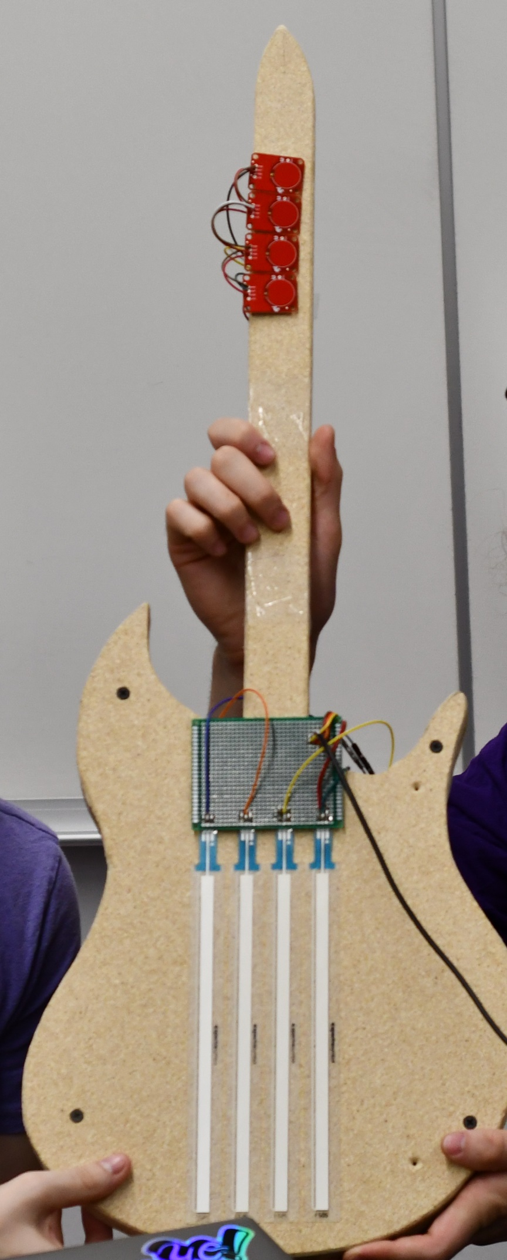
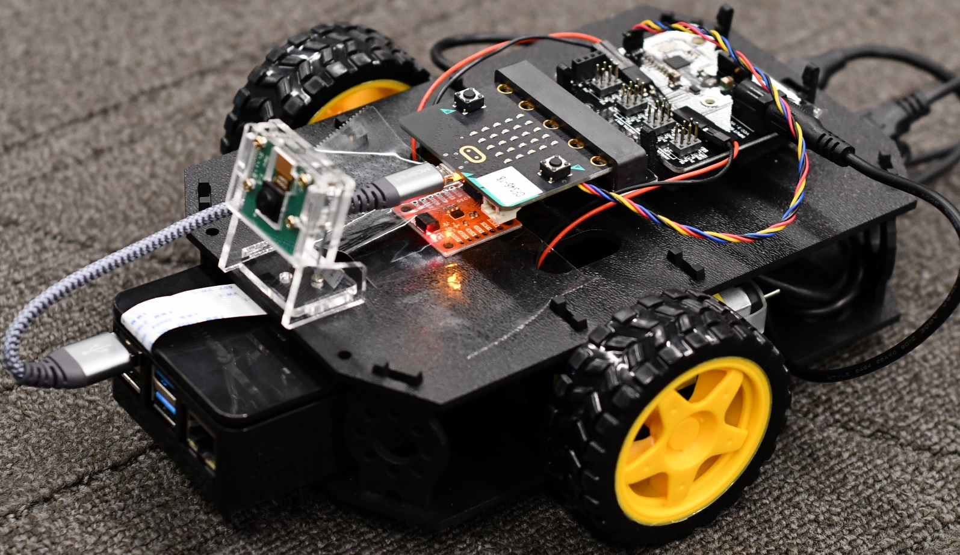
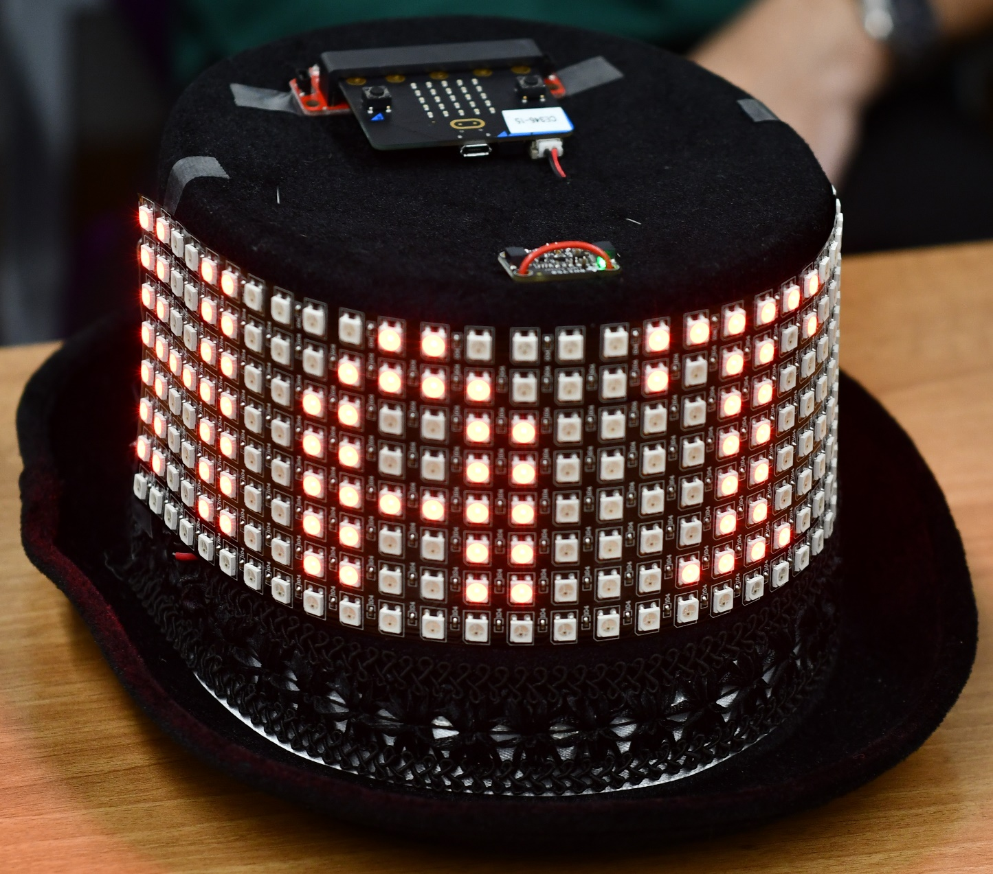
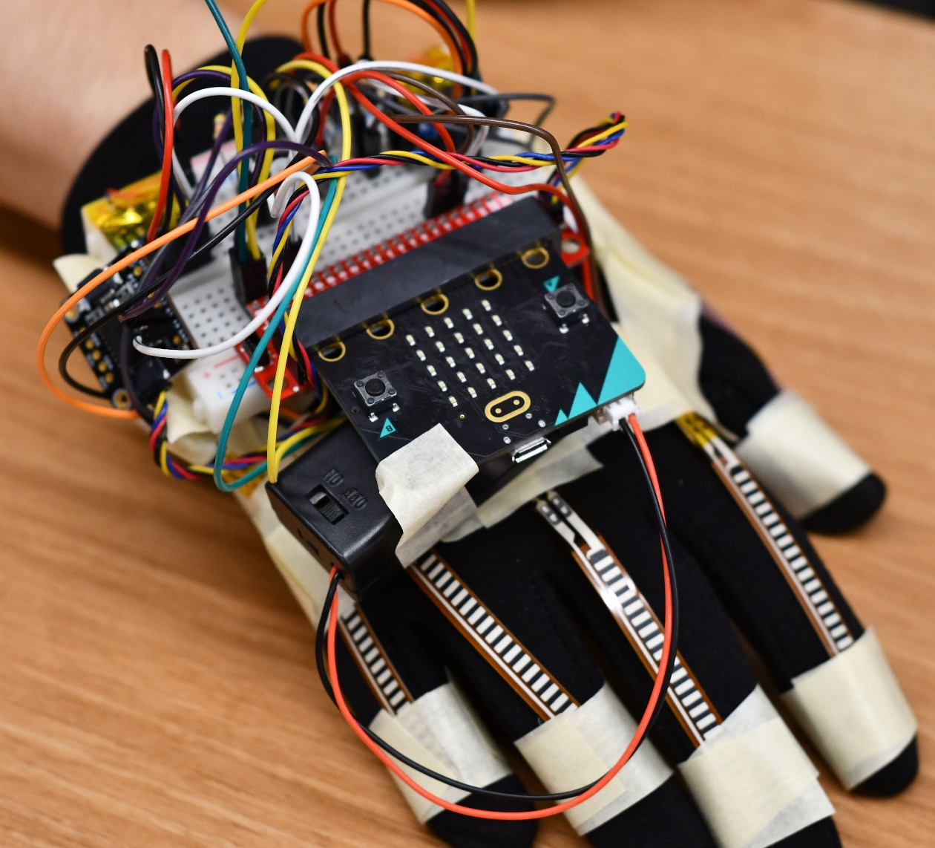
Some awesome Fall 2021 projects

Slide 39
Project Logistics
Week 4: Proposals due
  I’ll get you feedback in a week
Week 6: Project Design Presentations
  Short presentations in class about your proposed project and design
  Chance to give each other useful feedback about how to proceed
Week 8-9: Labs are done and Fridays are used for update meetings
Week 11: Live project demos!!
  Public demo session
  Almost certainly: Tuesday, December 6th (Tuesday of exam week)

Slide 40
Course Communication
Campuswire
  You should all already be registered on it
  If you aren’t, let me know! (or if you want to change emails)
All course communication goes through Campuswire, not email
  Multiple people can respond to you
  Messages are kept in one place and stay “unanswered”
  You can post directly to “Instructors & TAs” if it is private
    Use that feature to request office hour appointments if desired

Slide 41
Flexibility
Sometimes stuff just doesn’t work
  Especially when we’re working with hardware
We can be flexible about those deadlines
  If you’re having problems and tell us
  Less flexible if you don’t communicate or if you started late
Takeaway: let us know if you’re having problems
Notes:
Bonus note

Slide 42
Class lab – Tech CG50
Tech, Wing C, Ground Floor, Room 50
You should have swipe access to get into lab 24/7
  Work on labs or projects
  We’ll keep class hardware down there so you can access it
Important rules:
  No food or drink
  Clean up after yourself (tablespace, chairs, etc.)
  Class hardware does not leave the room

Slide 43
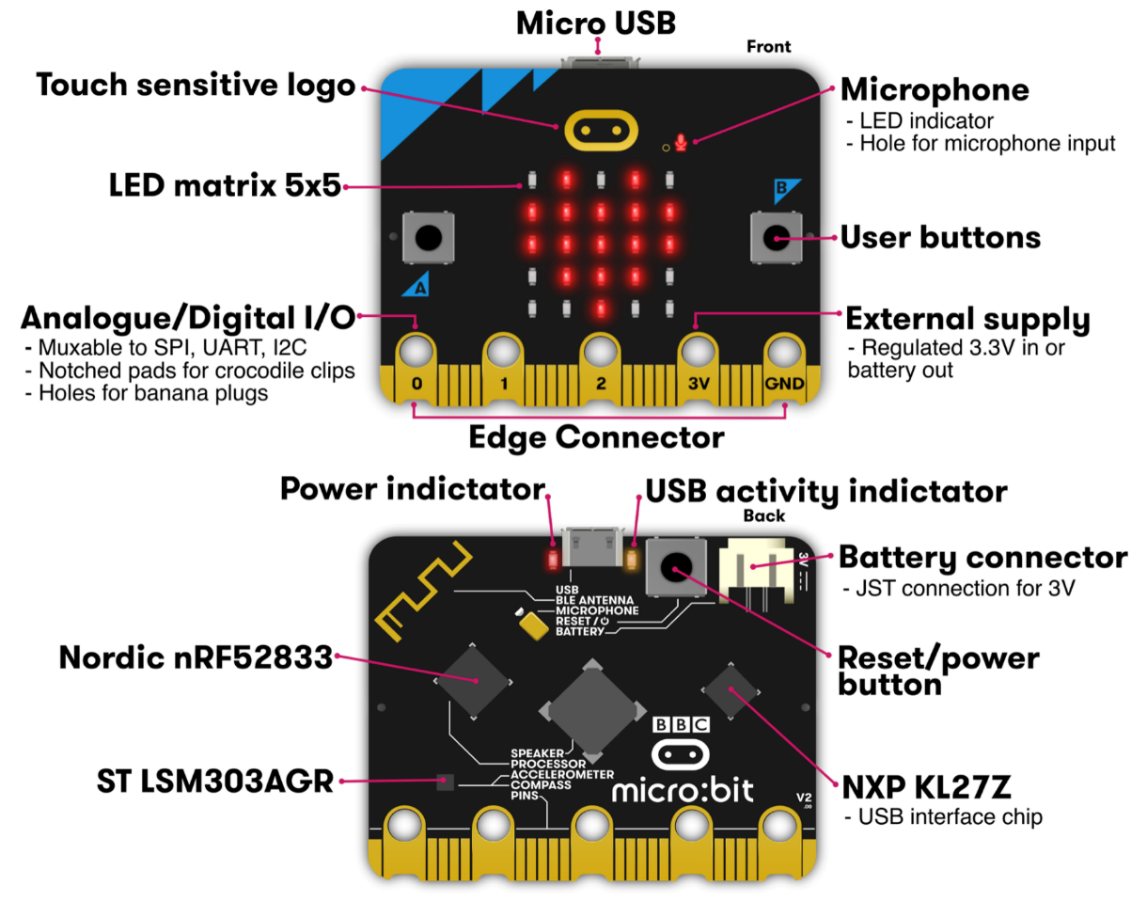
Micro:bit v2
Legacy from 1980s “BBC Computer Literacy Project”
  Reimagined today
Under $20
  Modern microcontroller AND sensors
Plan for class:
  Explore most of its functionality

Slide 44
Working on your own machine
Generally, CG50 should have plenty of availability outside of lab sessions
  Plus staff will hold office hours in there to provide checkoffs
But it might be nice to have your own personal setup too
  If you’ve already got a Linux install, you can just install the programs
  Or you can set up a virtual machine
  I’ll post instructions for this later this week
You can buy your own Micro:bit v2
  Chip shortage makes this difficult and/or expensive
  Make sure you’re buying version 2 NOT version 1 (v2.2 should be fine)

Slide 45
Outline
Who and Why
Embedded Systems
Course Overview

Slide 46
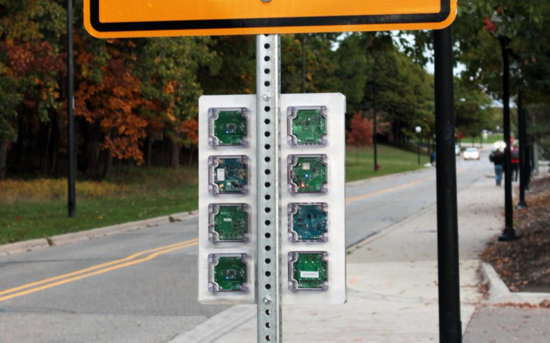
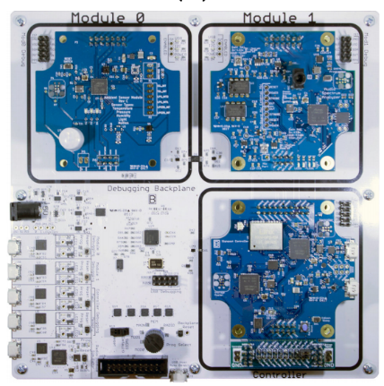
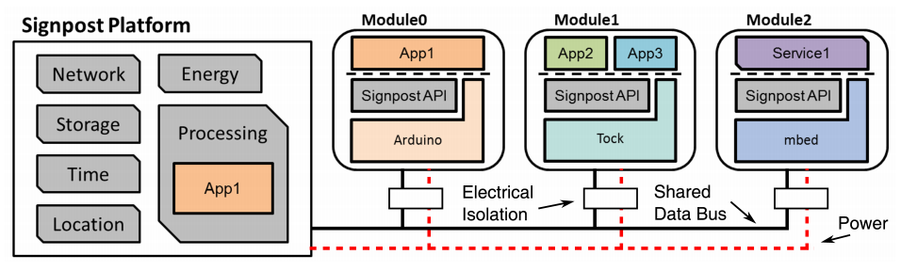
Signpost – City-Scale Sensing
How do we reduce the burden of city-scale sensing experimentation?
Platform provides resources
  Modules provide sensor and application

Slide 47
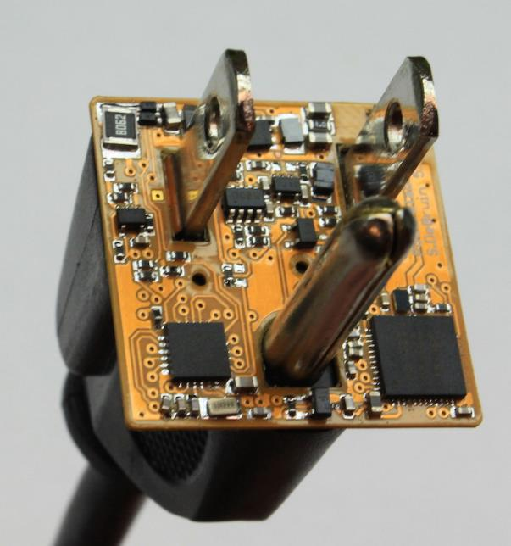
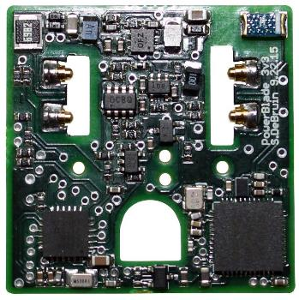
PowerBlade – Smart Home
Plug-load power meter
  How do we measure every device in a home?
Challenges
  Deployability
  Powering it
  Sensing AC current and voltage
  Reporting measurements
https://www.youtube.com/watch?v=oNUXhCDnHoE

